Slide 1
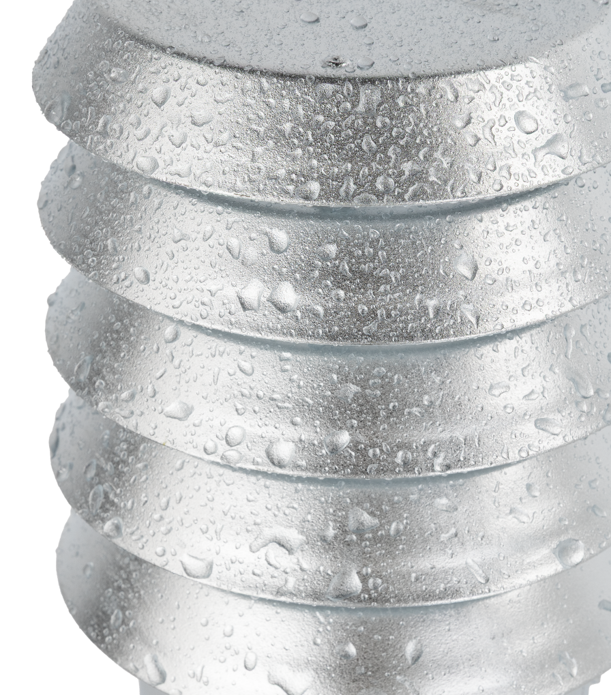
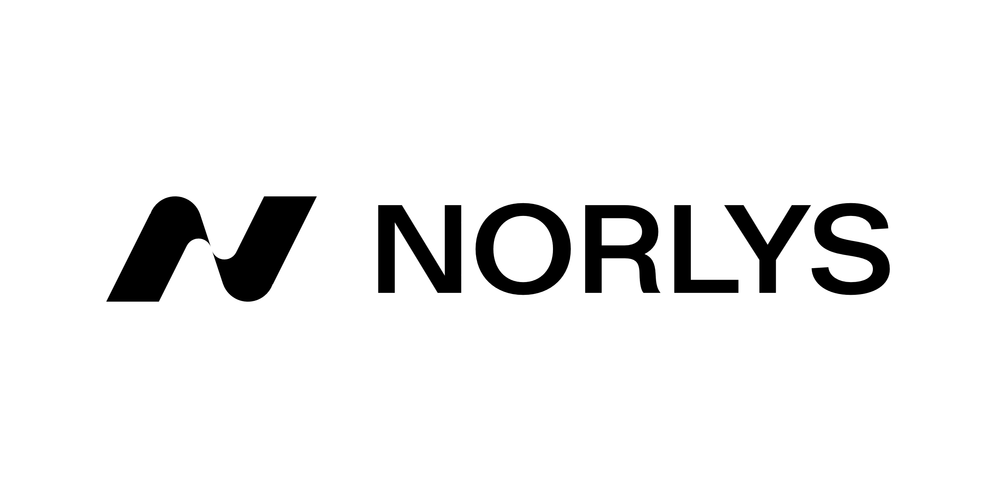
Surface protection

Slide 2
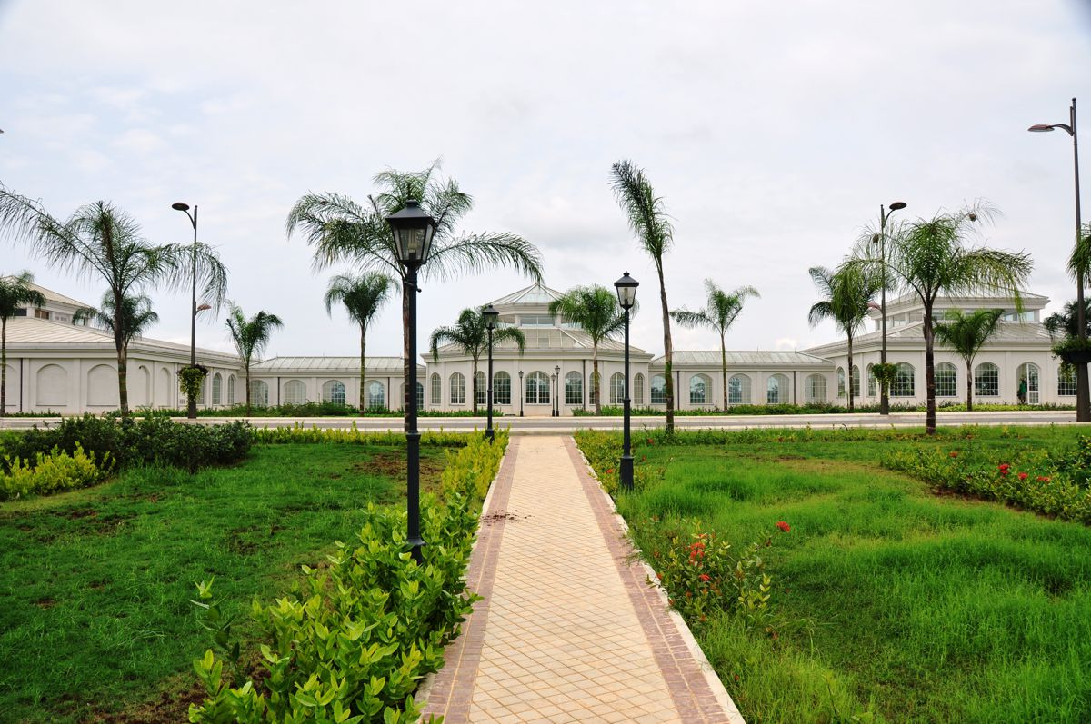
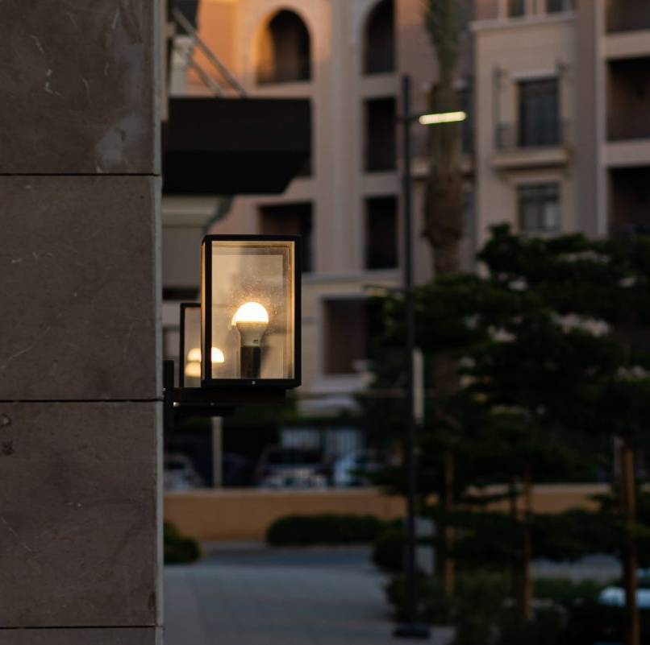
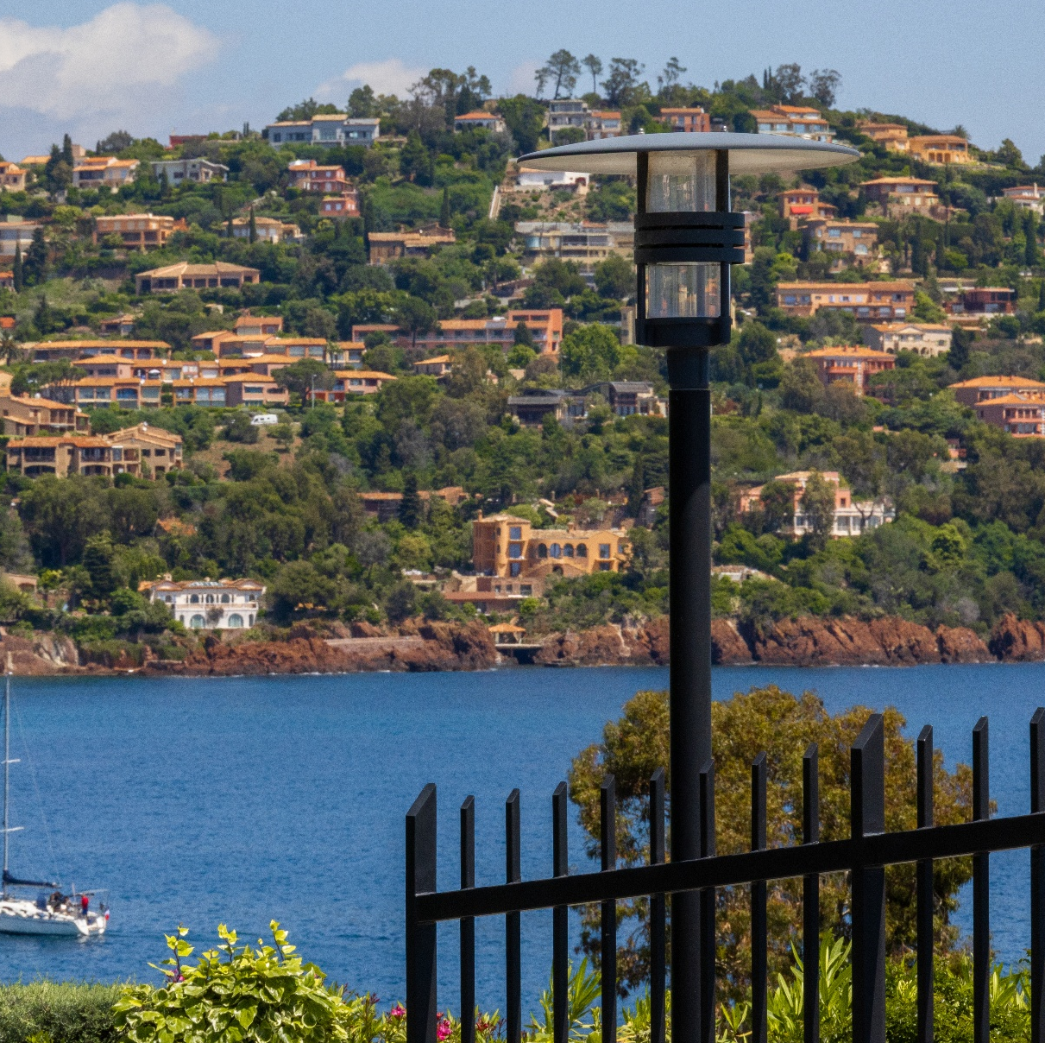
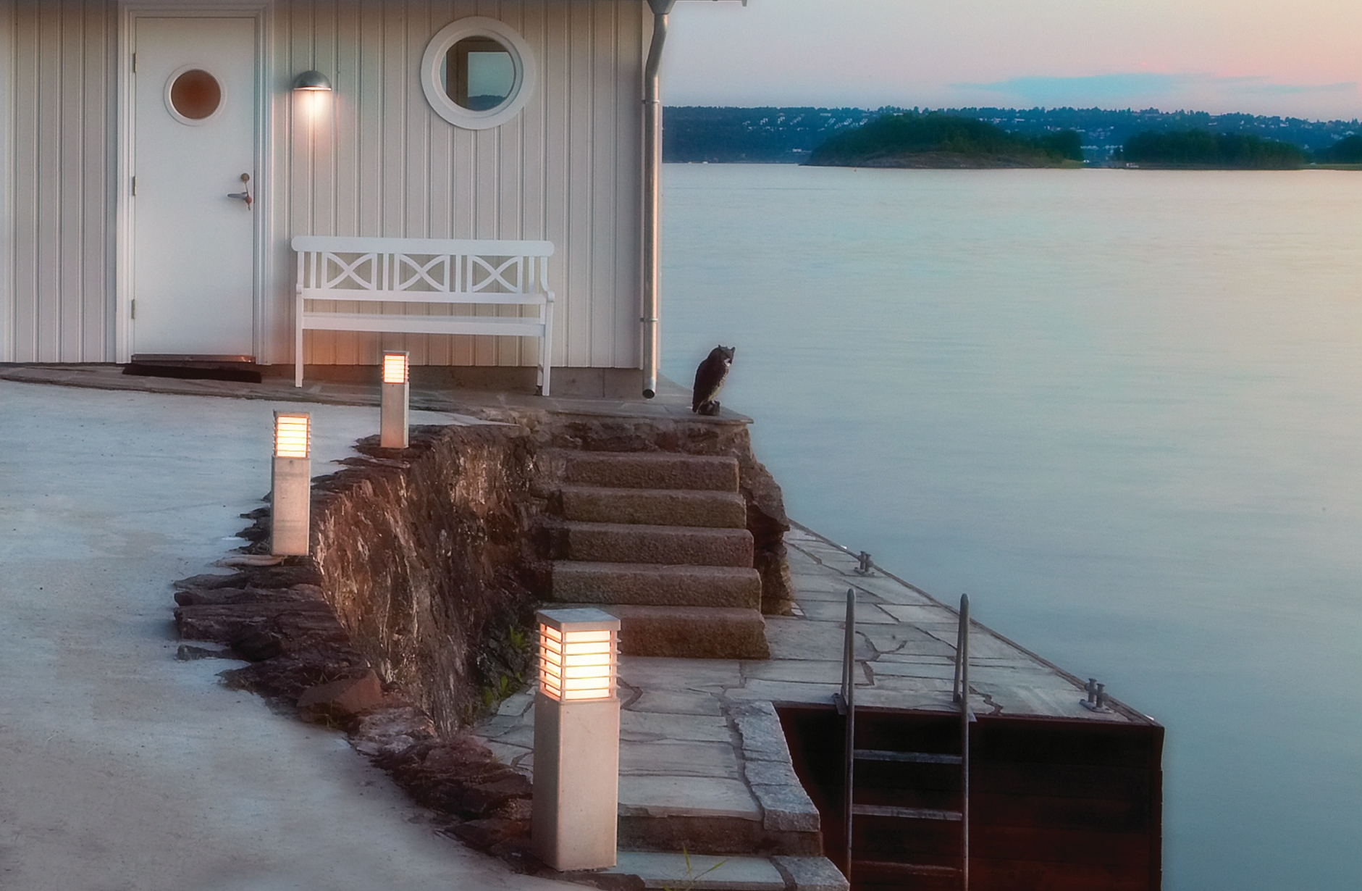

Surface protection
as a crucial process during production
Norlys possess a vast, distinctive selection of products, which are perfectly suitable for either costal zone territories (North Sea, Baltic Sea, Mediterranean Sea), or for dry and sandy environments of Middle east and Northern Africa.
From our own experience we know, that a lot of effort has to be applied for proper preparation of products in order to provide their long and seamless operation in these, very different environments. .
Apart from using best electrical components and raw materials, during over 30 years of operation Norlys has adapted and perfected state of the art. processes of aluminium and steel surface protection.

Slide 3
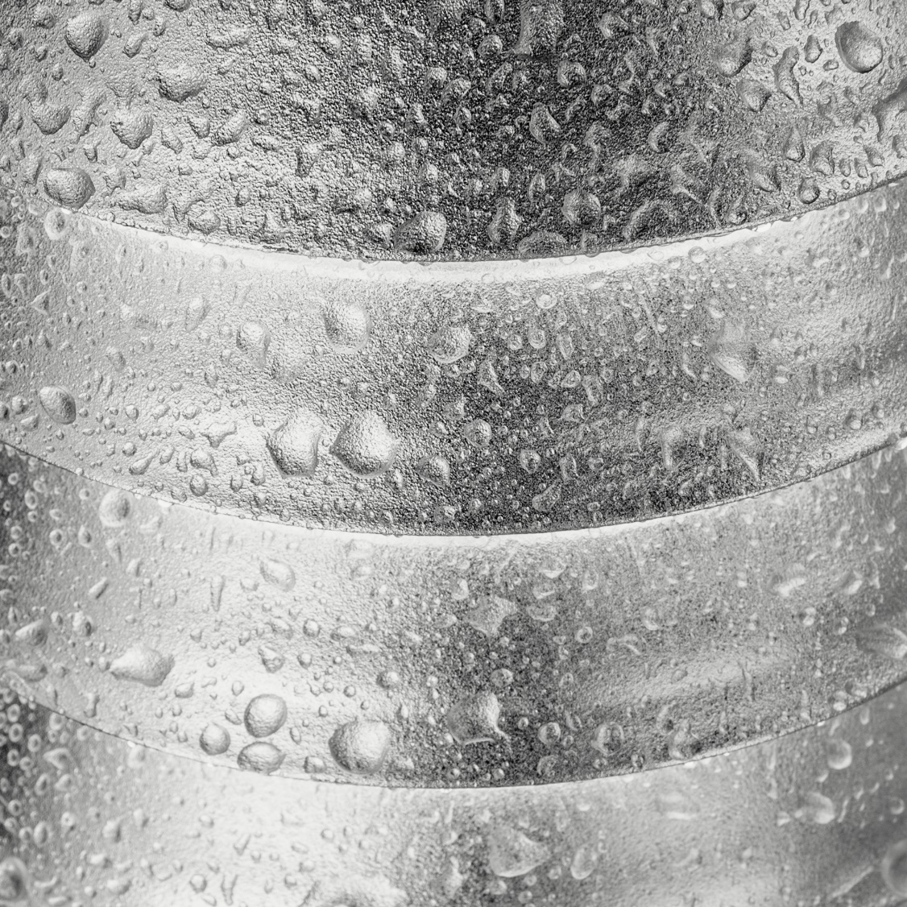
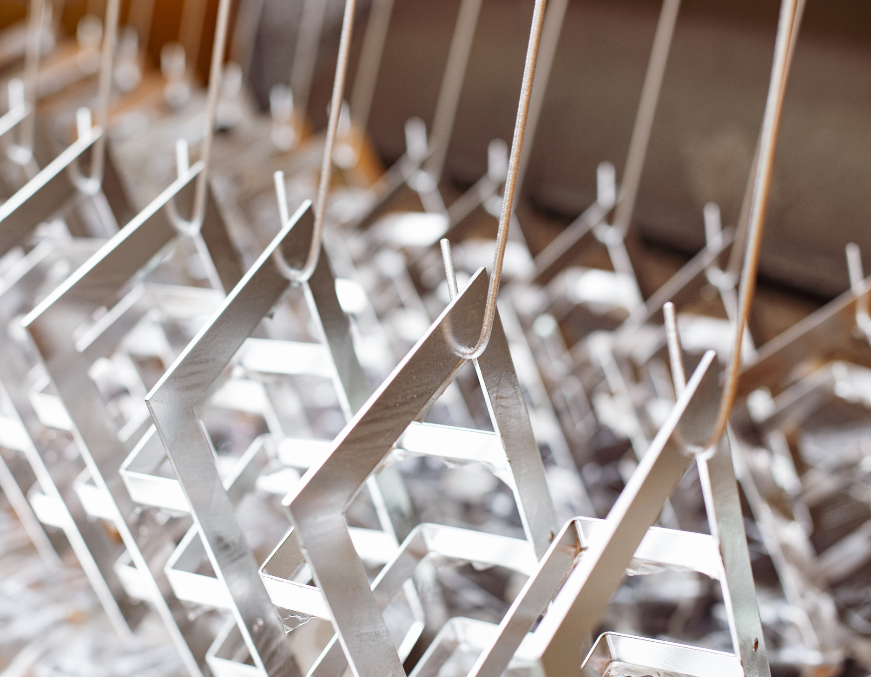

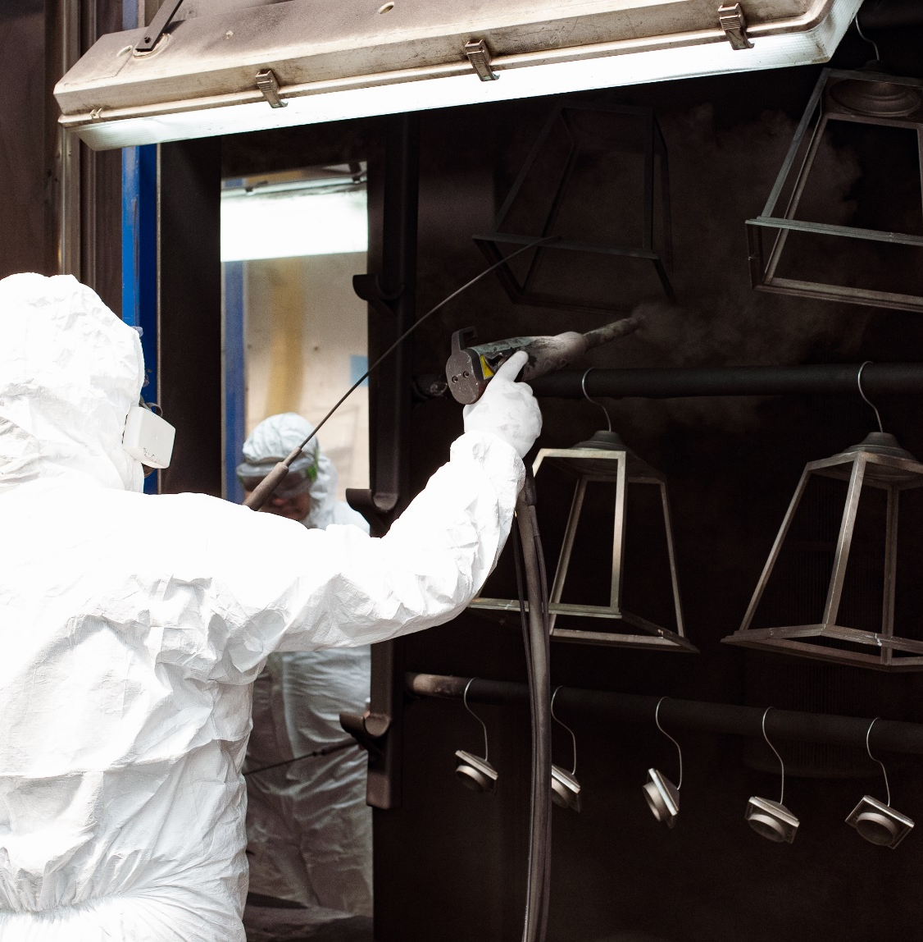
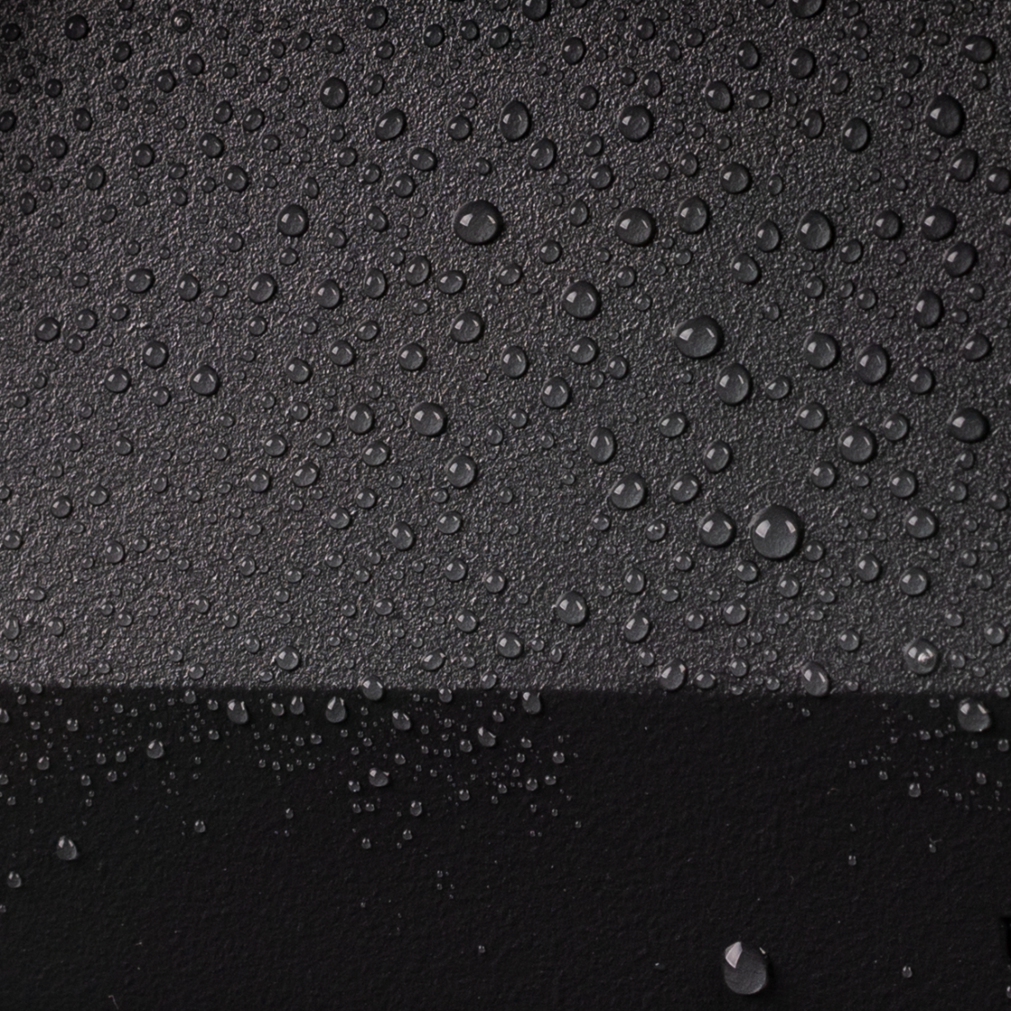

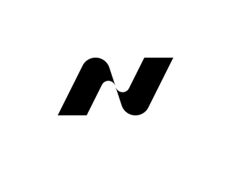

Types of surface protection.
Hot-Dip Galvanization
Provides a long-lasting anti-corrosion and kinetic force protection for steel components. It can be used either as the final surface treatment or as an intermediate stage before further powder coating.
Our process utilizes one of the smallest immersion baths with molten zinc, allowing precise control and fine-tuning of the galvanization process.
This approach, apart from excellent aesthetics, ensures the highest quality and durability of surface protection.
Powder Coating
Most steel and aluminium components are coated to ensure long-lasting anti-corrosion protection.
Before painting, elements undergo a multi-stage physico-chemical treatment, enhancing their corrosion resistance.
Our paint-shop uses TRIBO powder coating technology for precise application of powder paint.
Immediately after powder application, components undergo a polymerization process in specialized oven, ensuring a durable and flawless finish.

Slide 4
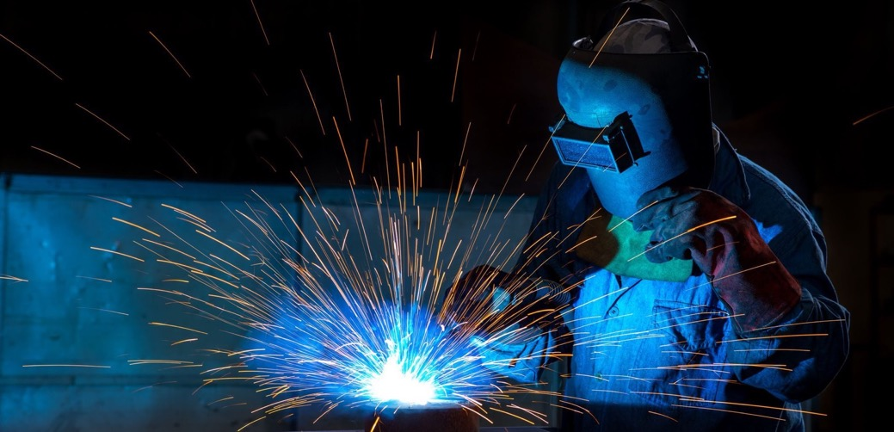
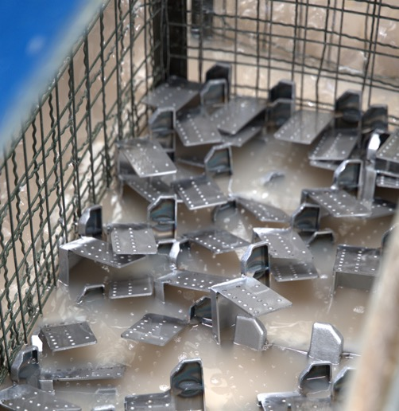
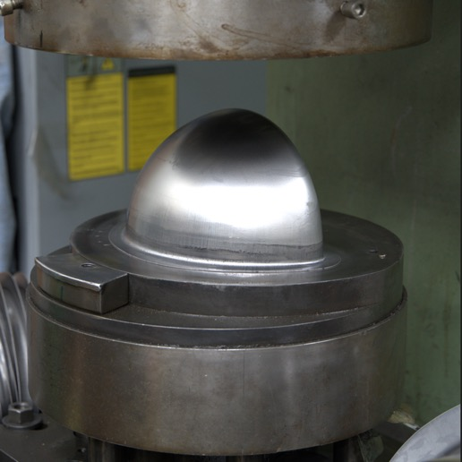
Steel – why we’ve chosen it?
A centuries - old tradition of processing steel, which is an extremely durable yet formable material. Well-known technology and methods of surface protection.
Norlys uses, European sourced, basic steel plates, pipes and profiles in its production processes.
In order to assure long lasting anti-corrosion protection, Norlys performs
a multi stage physical and chemical surface treatment process, before finally painting it into a desired finish.
.

Slide 5
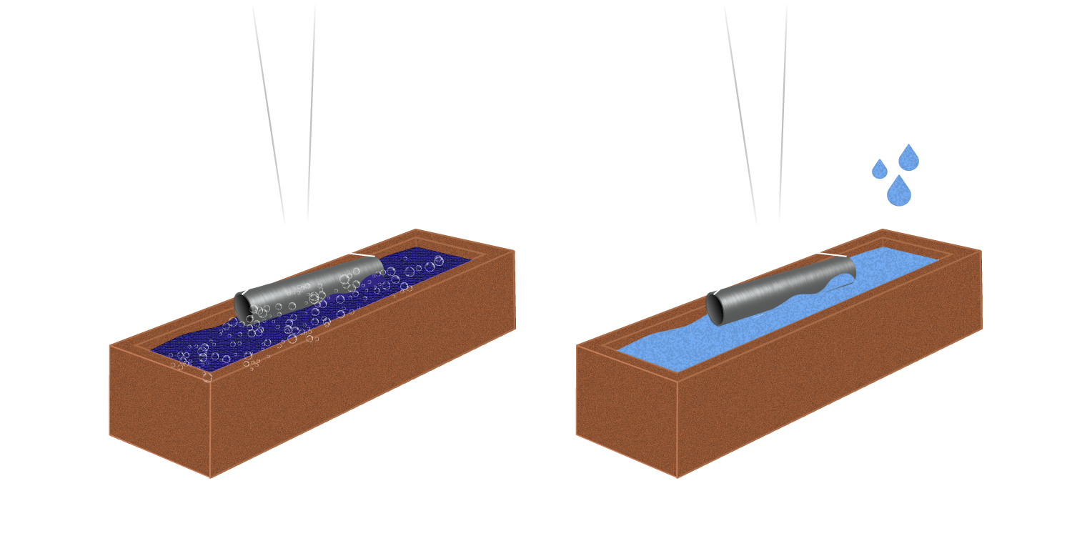
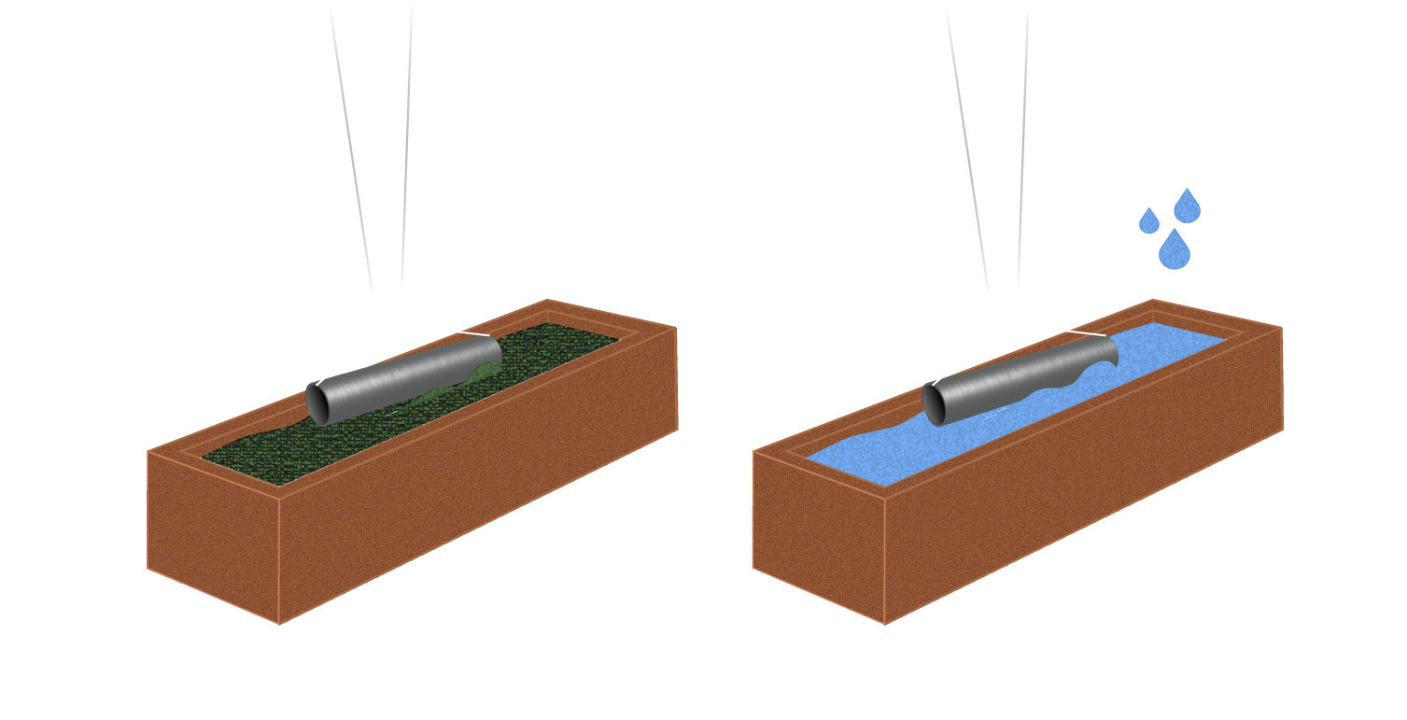
Protection of steel Surface - the process.
1.
2.
1.
Cleaning (physico-chemical, using base solution along with strong detergents) - around 10-15 minutes in temp. ~50ºC. Bath is in constant ﬂow (pumps) which ensures excellent cleaning results.
Rinsing
2.
3.
4.
3.
Chemical activation before phosphating. Around 2 minutes in a special acidic solution.
It gives better phosphorus salts penetration and further paint adhesion.
Rinsing
4.

Slide 6
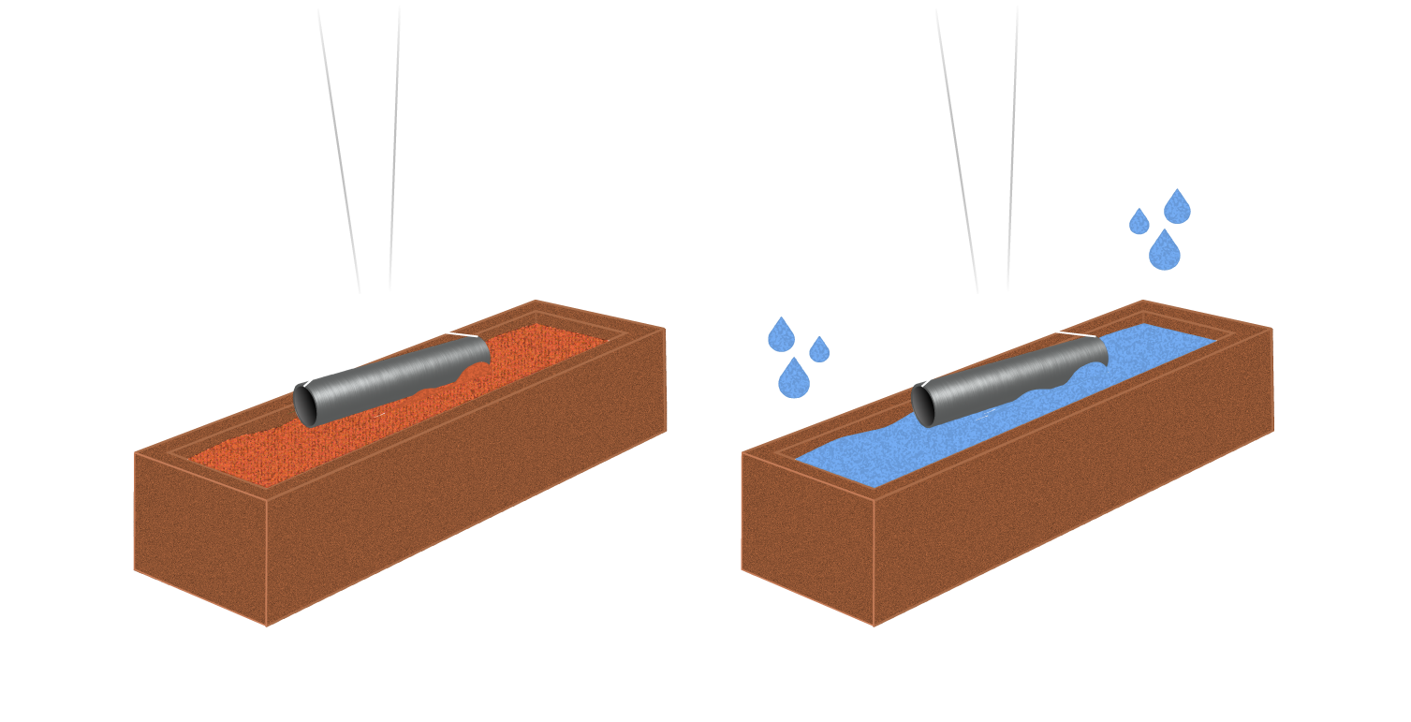
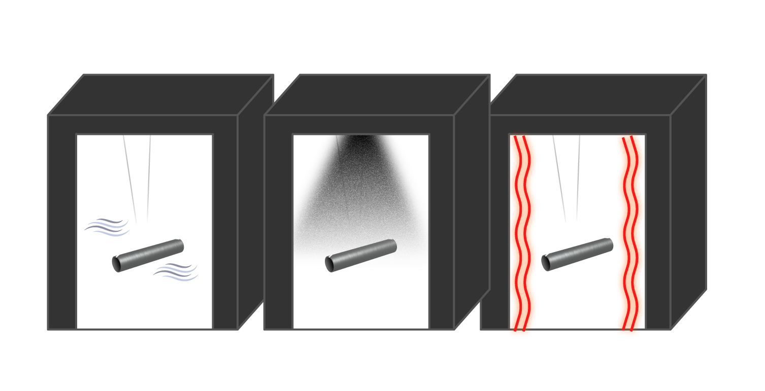
5.
6.
5.
Phosphating. It gives an excellent corrosion protection along with very good paint adhesion. This process is the set of the most complex chemical reactions used in the operation. It requires very strict control of chemical and physical parameters.
Double Rinsing
6.
7.
Dryer treatment
Powder painting (coating)
Paint polymerization in a special oven.
7.
8.
9.
8.
9.

Slide 7
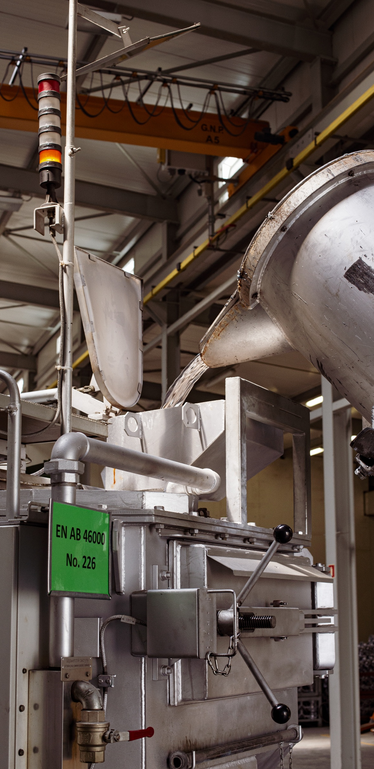
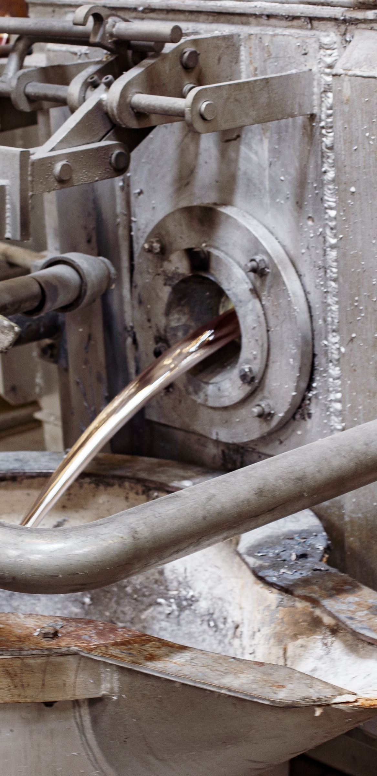
Aluminium – why we’ve chosen it?
Aluminium (alloys) are one of the most popular raw materials used for production of lantern ‚cages’. Aluminium provides an excellent heat transfers from within lantern body. Die casting processes enables producers to propose various shapes and clever technical solutions, which could be either very hard or impossible to obtain if these products are made of steel only.
As in case of steel, Norlys uses European sourced aluminium and performs a multi stage physical and chemical surface treatment preparation process, in order to assure long lasting anti-corrosion protection.

Slide 8
Protection of aluminium surface – the process.
1.
2.
1.
Cleaning Cleaning (chemical, using base solution along with strong detergents) - around 10-15 minutes
in temp. ~50ºC. Bath is in constant ﬂow (pumps) which ensures excellent cleaning results.
Rinsing
2.
3.
4.
3.
Chemical activation Chemical activation before chromating. Around 2 minutes in special acidic solution. It gives better chrome polymer penetration and further paint adhesion.
Rinsing
4.

Slide 9
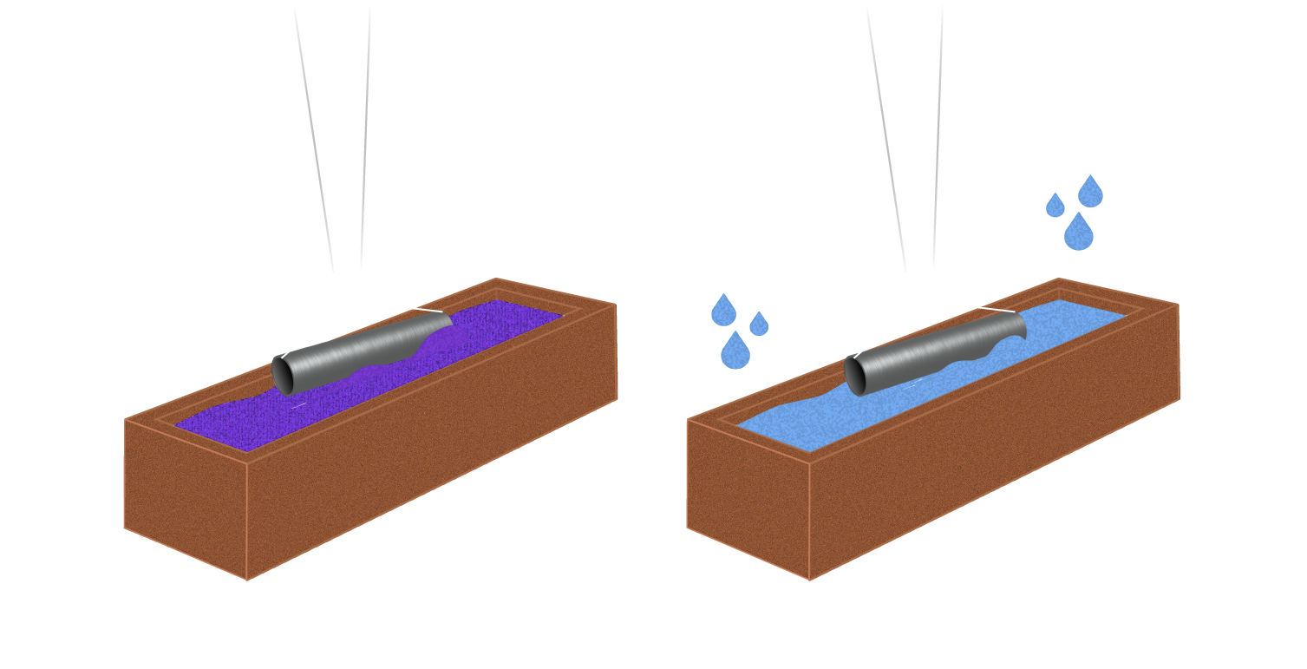
5.
6.
5.
Chromating (polymer based). It gives excellent corrosion protection. Polymer formula gives very good paint adhesion.
Double Rinsing
6.
7.
Dryer treatment
Powder painting (coating)
Paint polymerization in special oven.
7.
8.
9.
8.
9.

Slide 10
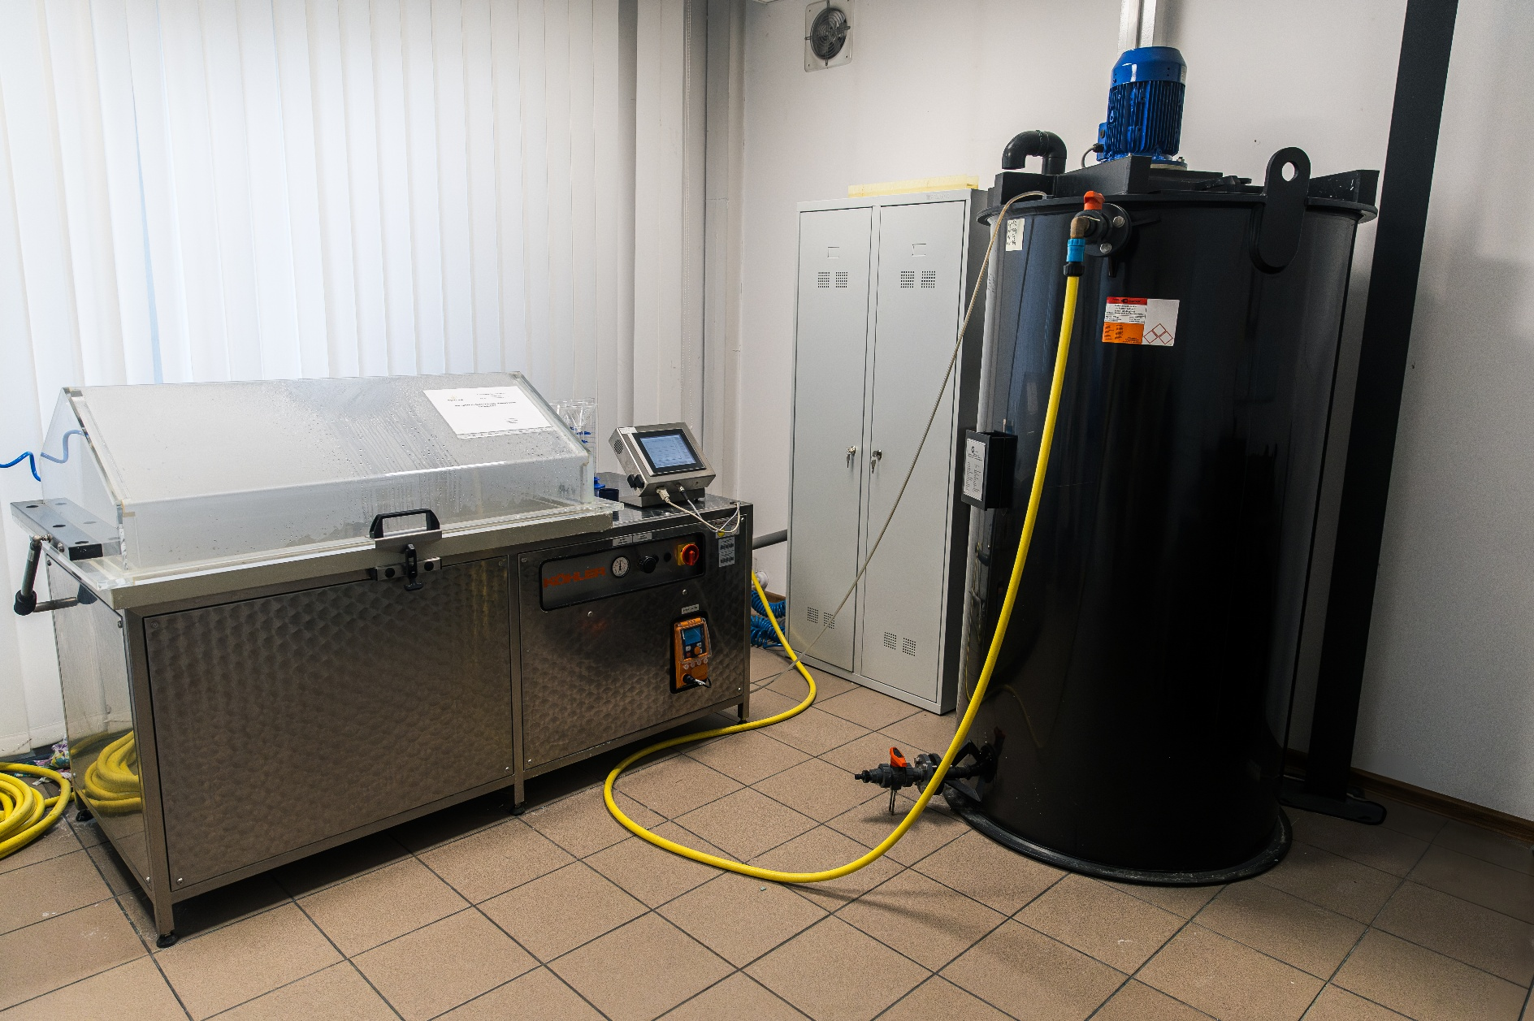
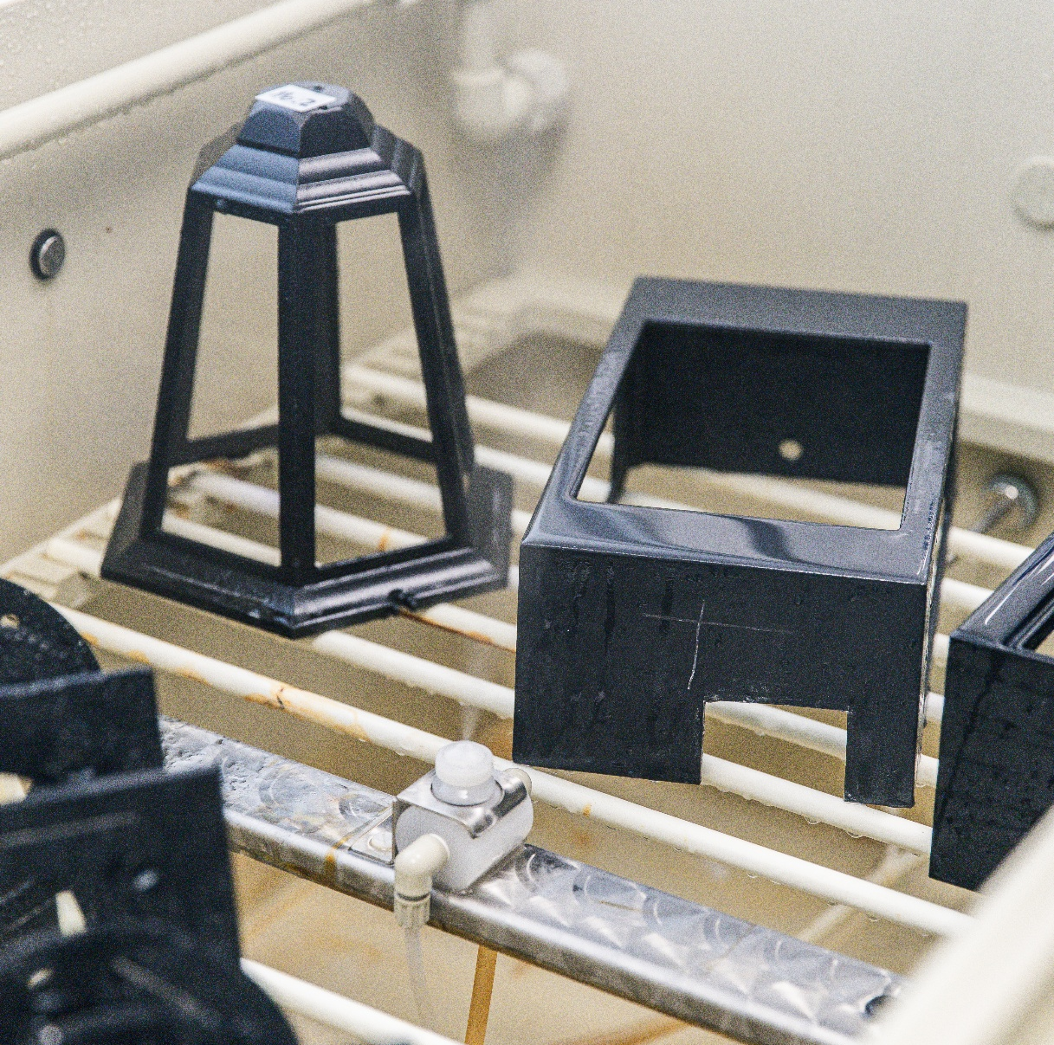
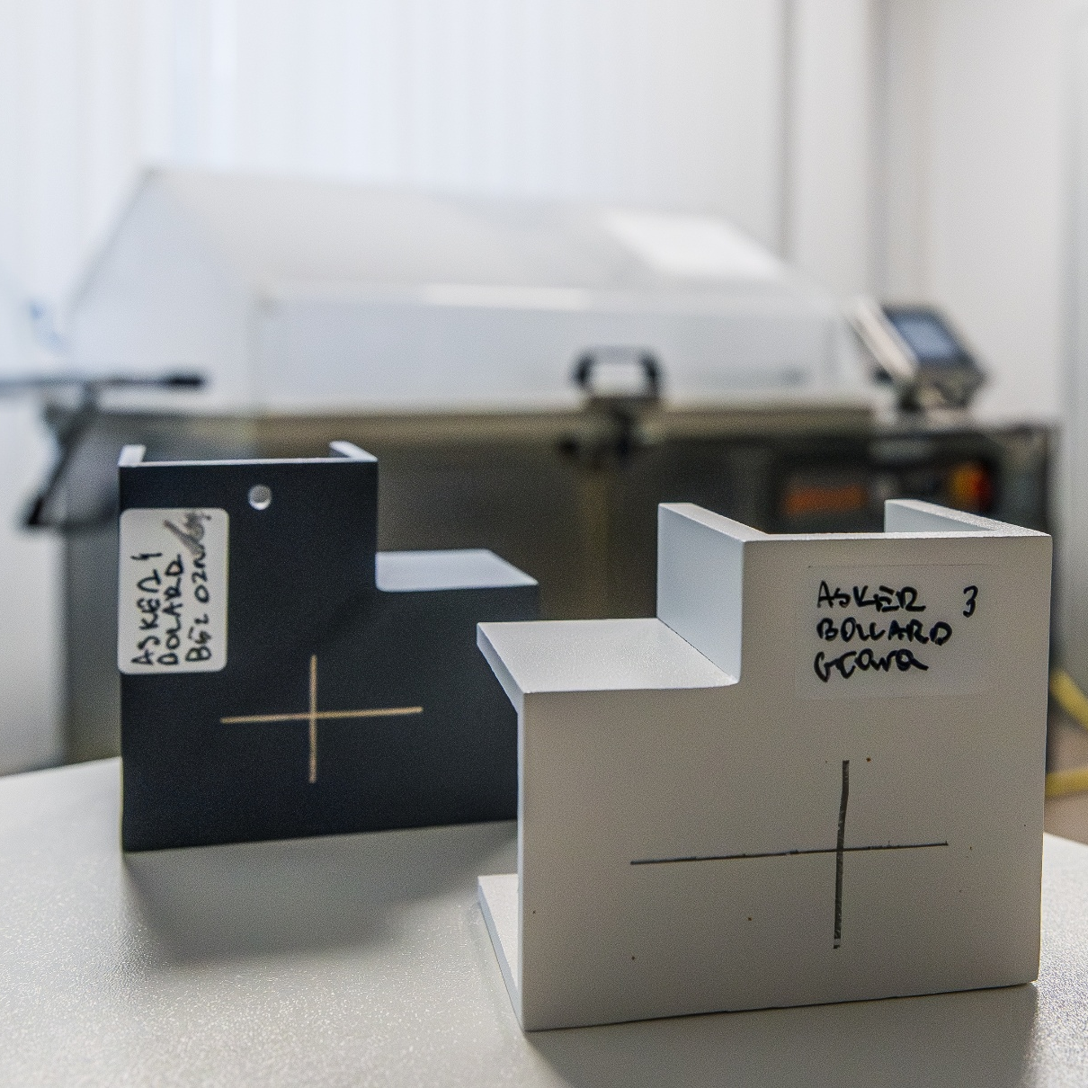
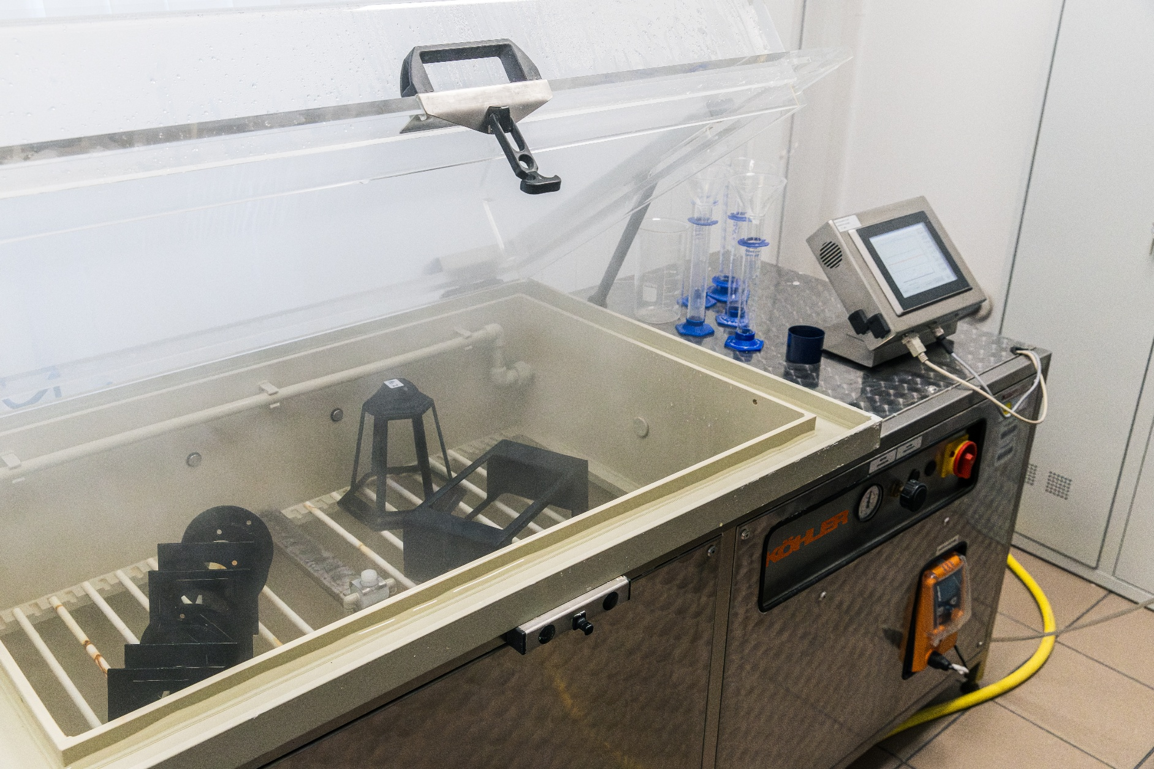
Final step - testing
All of previous actions, performed under strictly controlled conditions, would be nothing without the final validation.
Norlys constantly controls regular production samples as well as newly proposed modifications/improvements of chemical surface treatment processes in its salt chamber.
These tests, performed in accordance with ISO 9227 norm, are very good indicator of real conditions corrosion resistance performance.
.

Slide 11


Contact
Norlys AS
Hovfaret 4B, NO-0275 Oslo
P.B 1014 Hoff, NO-0218 Oslo – Norway
info@norlys.com

