Slide 2
Initial capital Norwegian 100%
Shares in company holding:
About Norlys

Slide 3
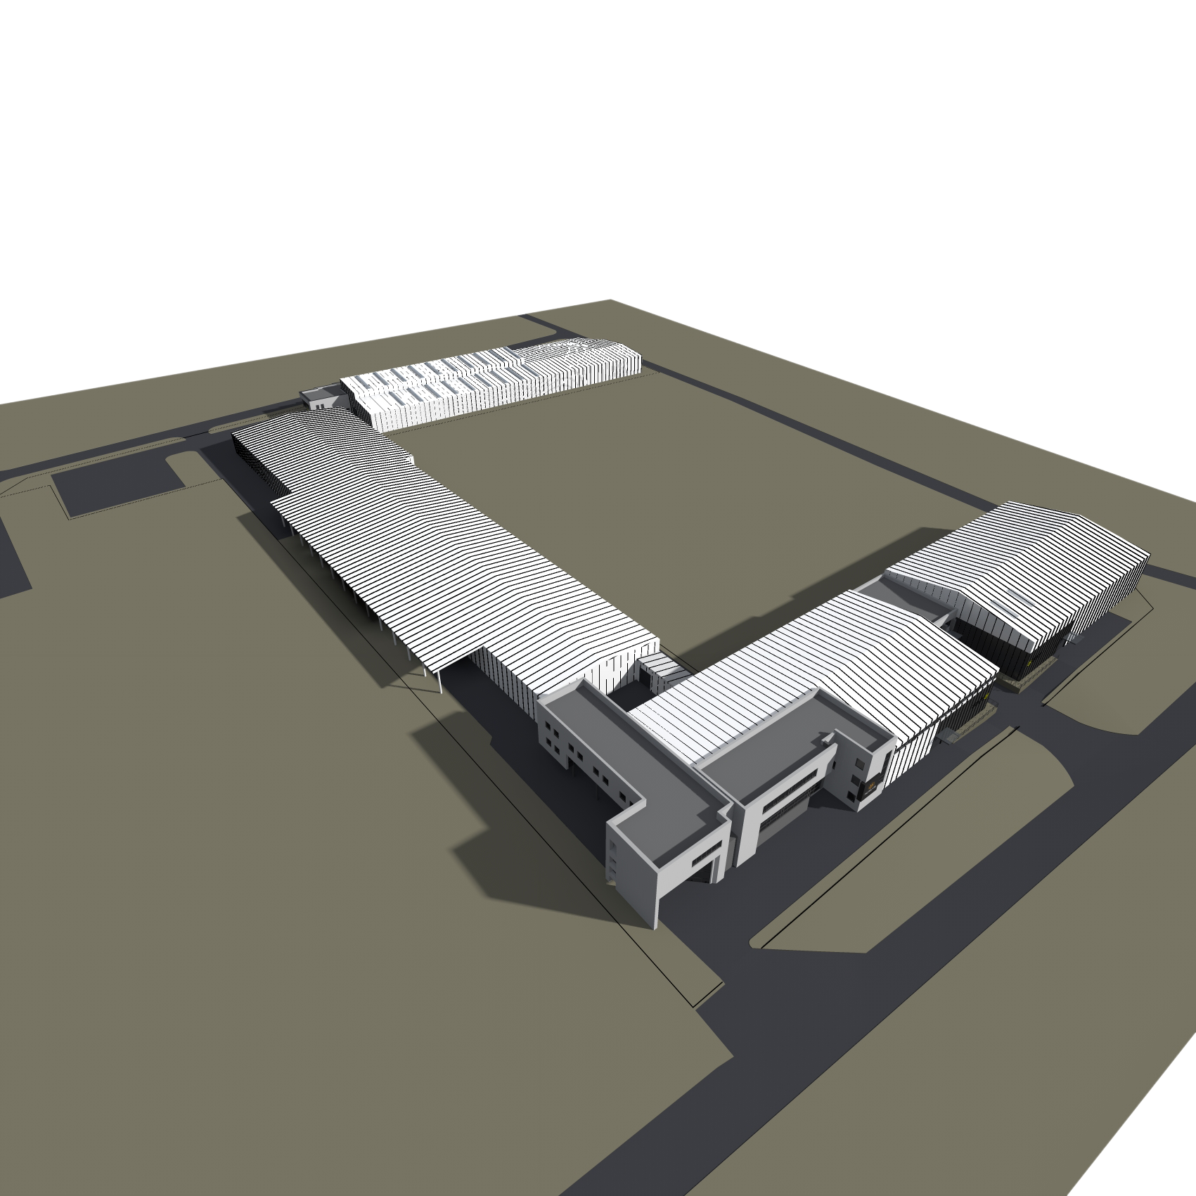
NORLYS w Polsce
13 000 m² usable area
planned 15 500 m² usable area
20 500 m² buisness area
240 employees
49 administrative stuff
21 departments
15 engineers

Slide 4
Turnover of money and investement
Investment in 2014 – 7 000 000 PLN Turnover in 2014 – about 32 987 000

Slide 5
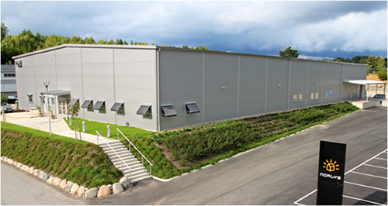
Distribution Network
Branch of NORLYS
Norway
Sweden
Poland
France
Italy
Great Britain
Exclusive distribution
Finland
Russia
Lithuania
Ukraine
Hungary
Austria
Switzerland
Belgium
Netherlands
Denmark
Spain
Greece
Portugal
Irleland
Island
Cyprus
Turkey
Selective distribution
Germany
Czech Republic
Slovakia
Romania
Bulgaria
Latvia
Estonia
Lack of representation

Slide 6
Sale of lighting fixtures in the number of units

Slide 7
Sales by country

Slide 8
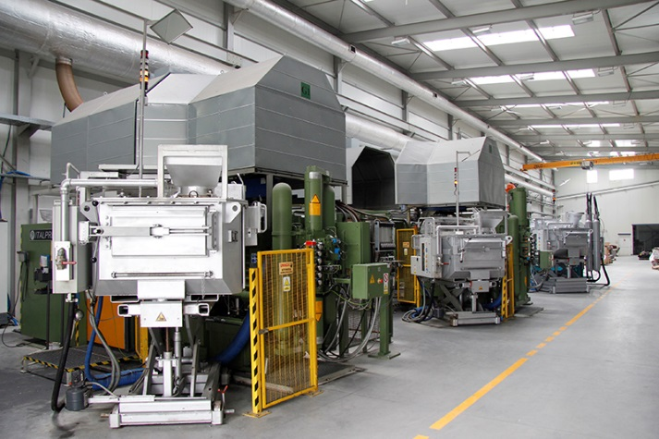
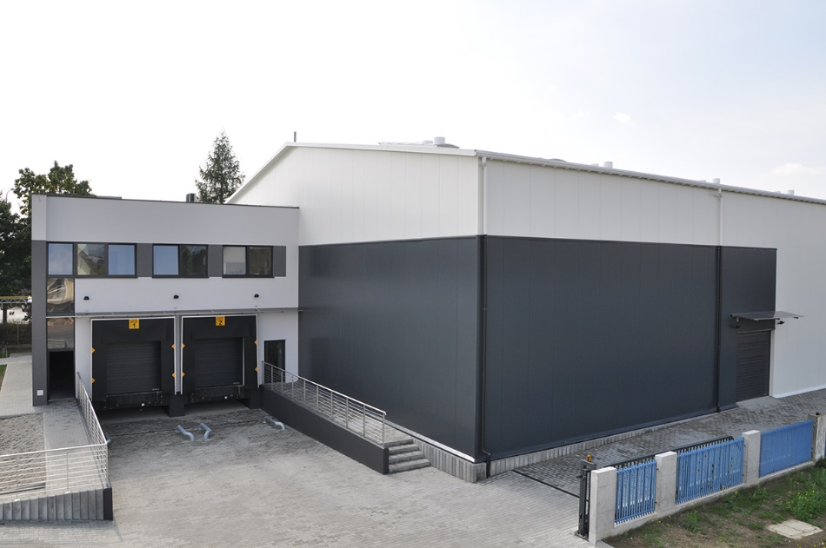
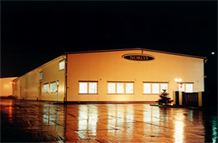
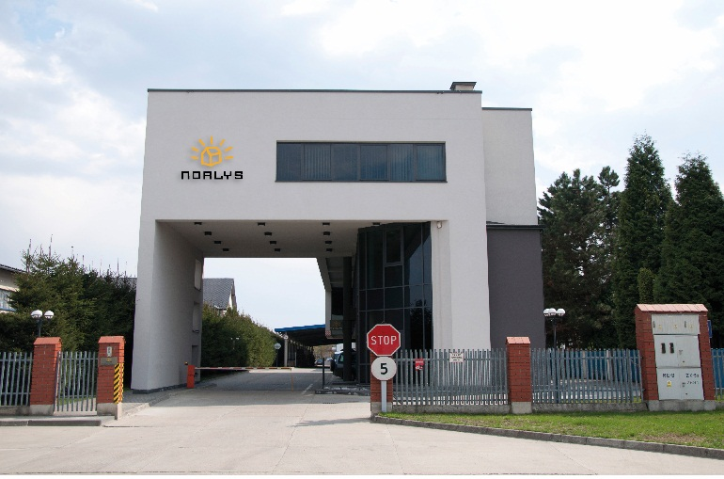
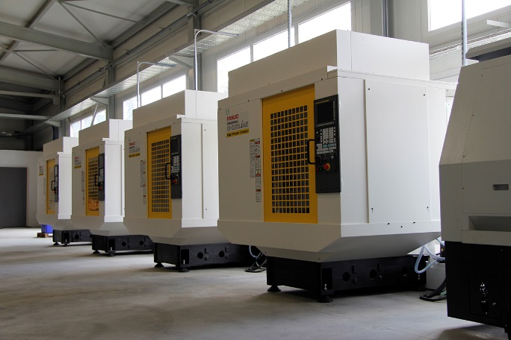
NORLYS over the years
Ocynkownia ogniowa
Galvanizing department
2004
1998
2004
1998
2002
2002
Foundry department
2011
Year Established
Year Established
1953
1953
Warehouse
Warehouse
2006
2006
Tools Department
Warehouse
2013
Year Established Polish Dep.
Year Established Polish Dep.
1993
New Office
1993
New Office
2009
2009
Powder Paint Shop
Powder Paint Shop
Production Hall
Production Hall
2014
CNC
Year established
1953
Year Established Polish Dep.
1993
2014

Slide 9
Foundry, Tool Department and Machining Department

Slide 10
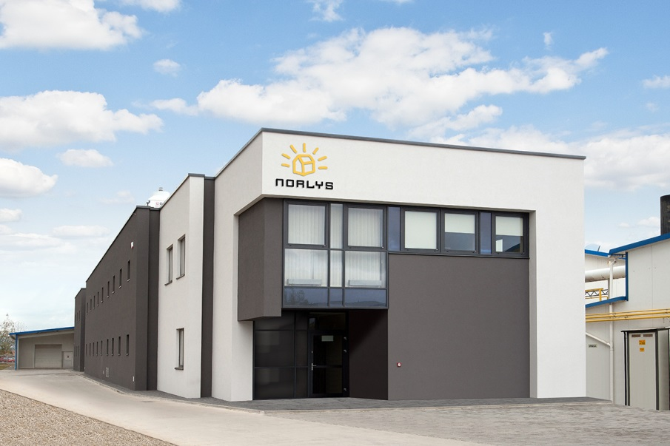

Foundry
Office
High pressure die casting machines

Slide 11
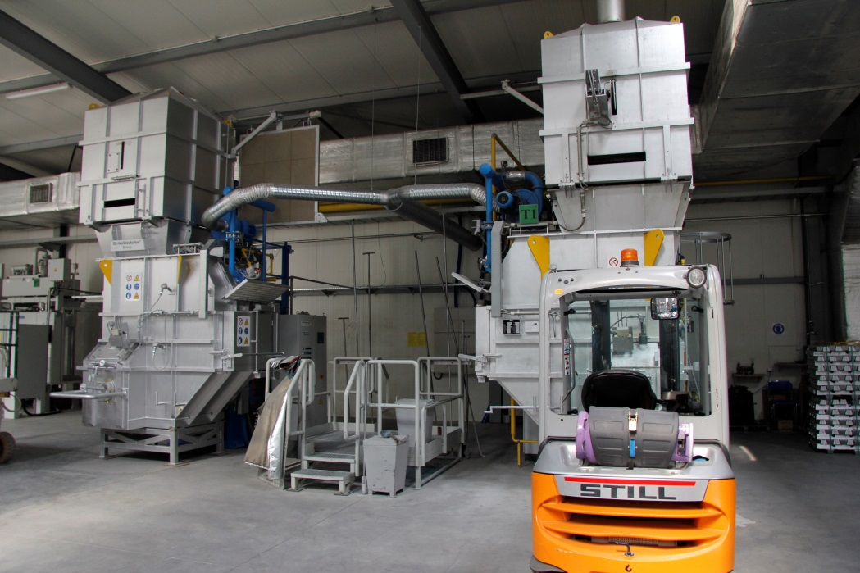
Foundry
Melting furnances

Slide 12
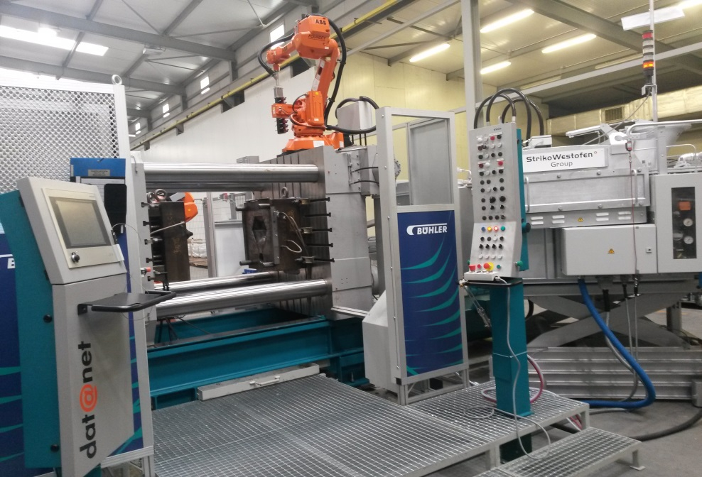
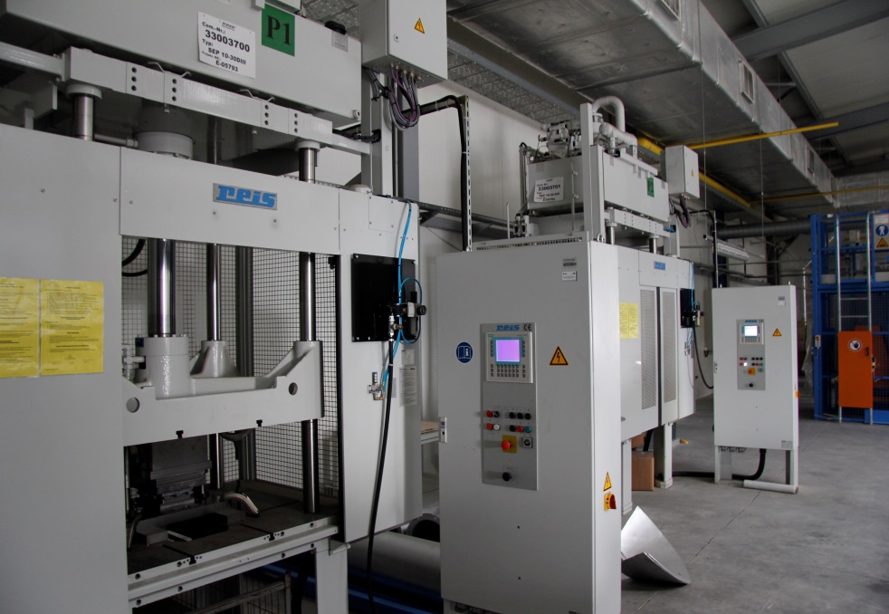
Foundry
High pressure die casting machine with robots and vacuum casting process
Trimming presses

Slide 13
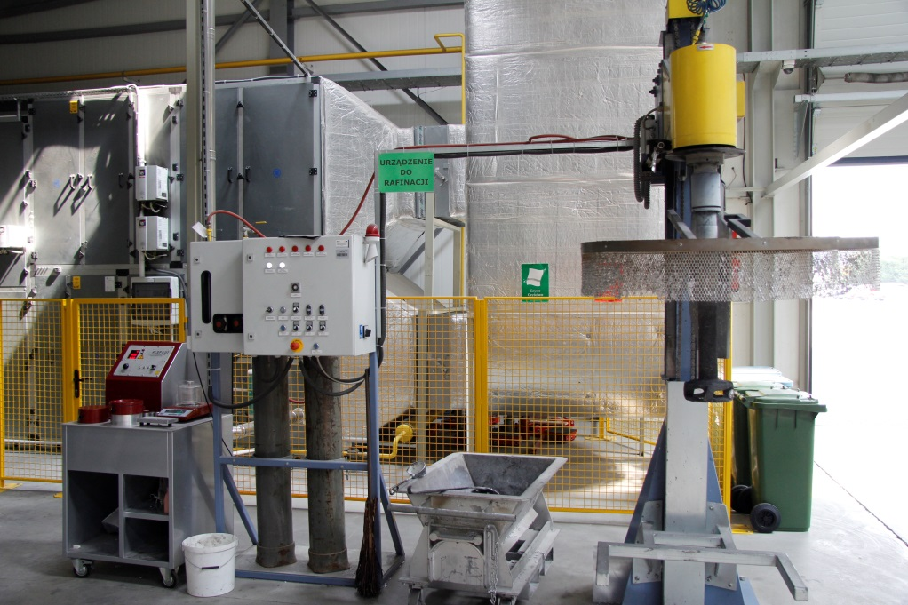
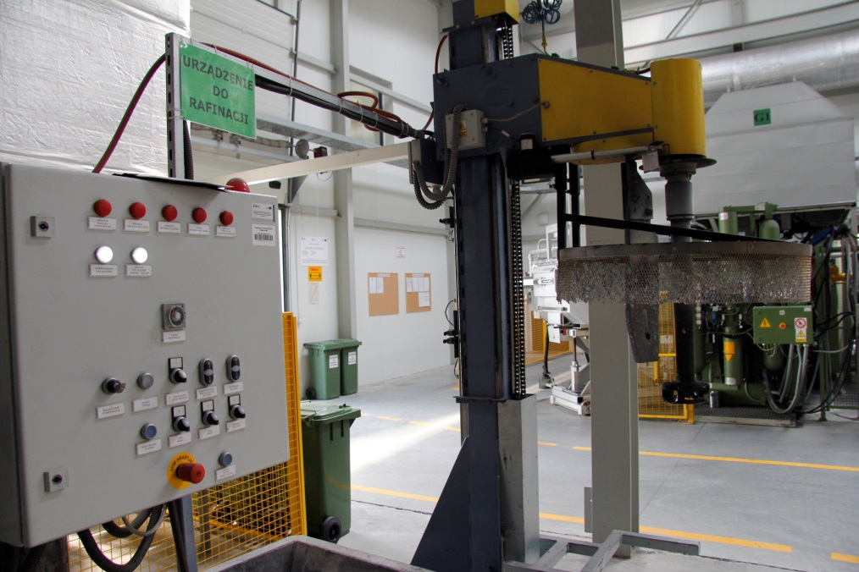
Foundry
Degassing equipment
Vacuum density testing machine

Slide 14
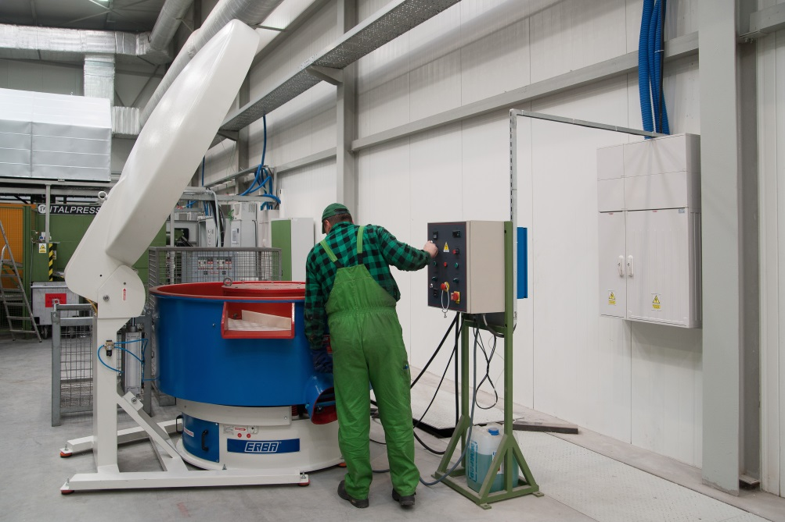
Foundry
Vibratory surface finishing machine

Slide 15
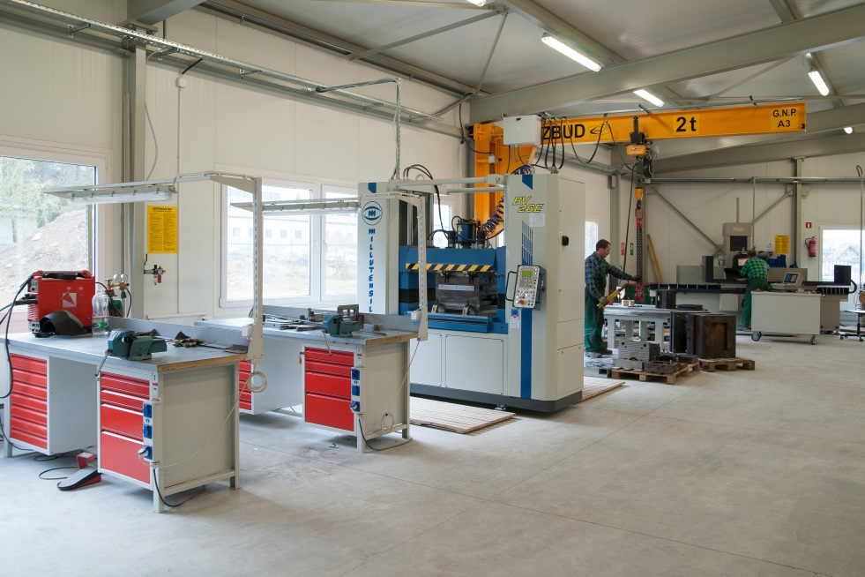
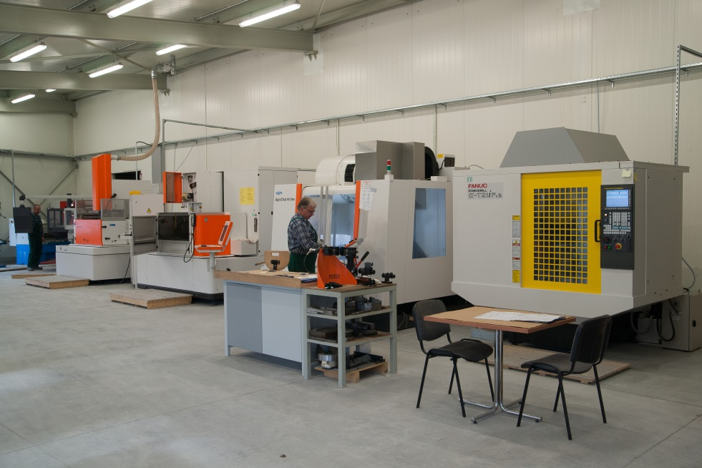
Tool Department
General overview

Slide 16
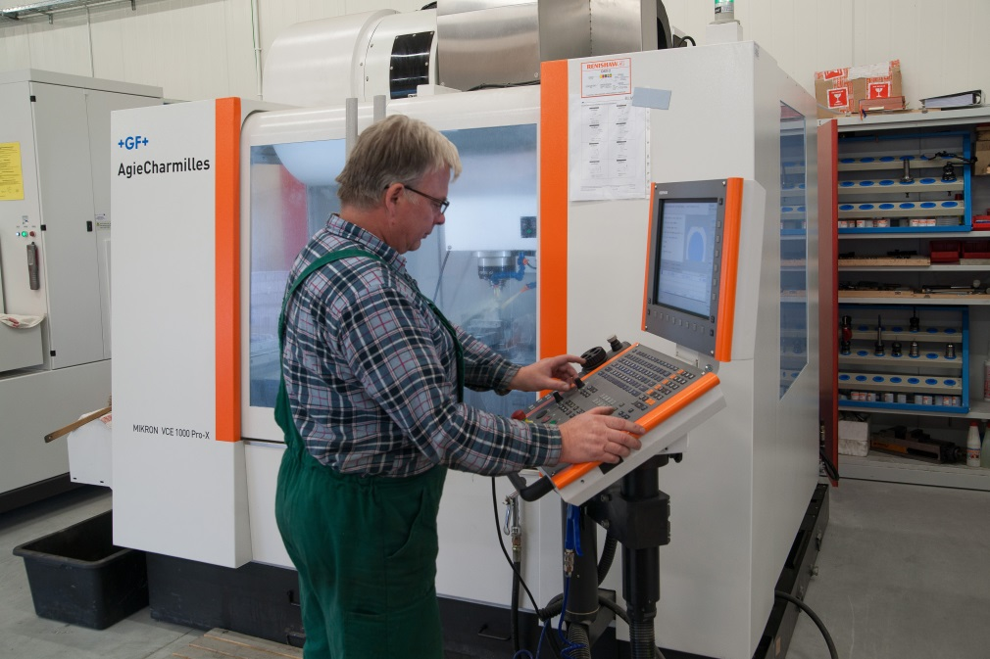
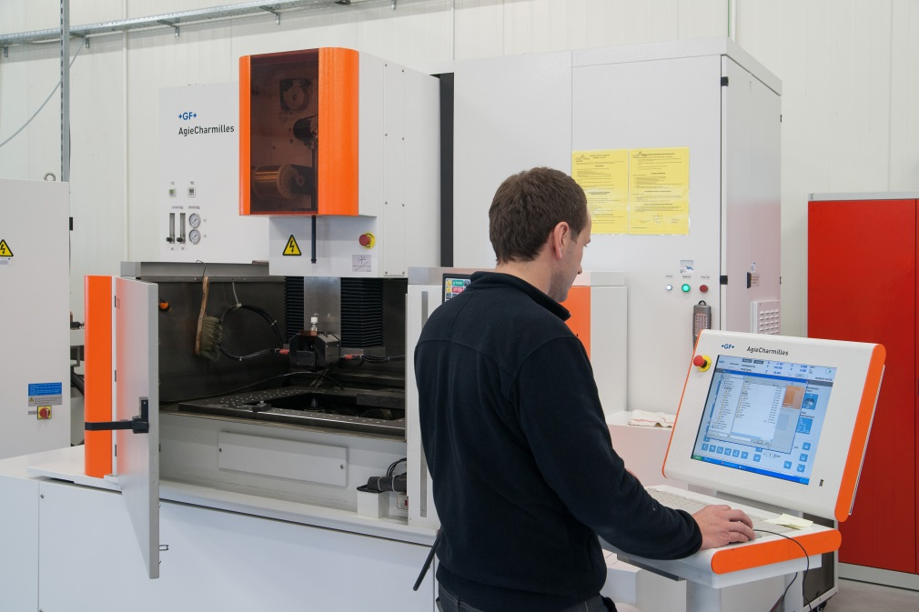
Tool Department
High-precision cutting machine (CNC)
Wire cutting machine (CNC)

Slide 17
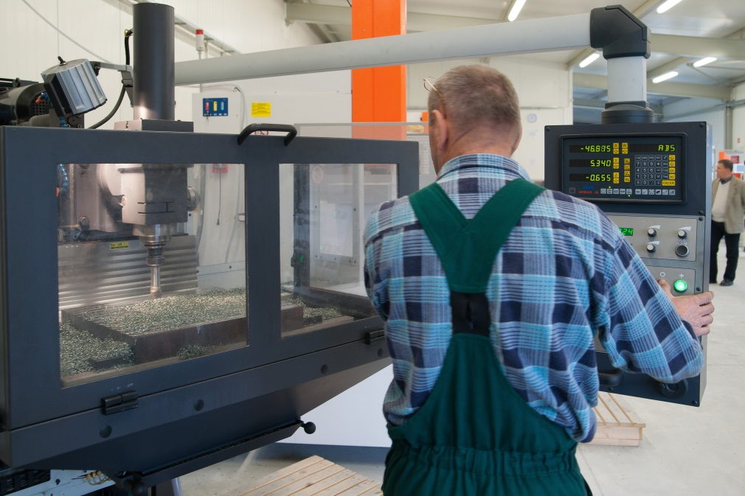
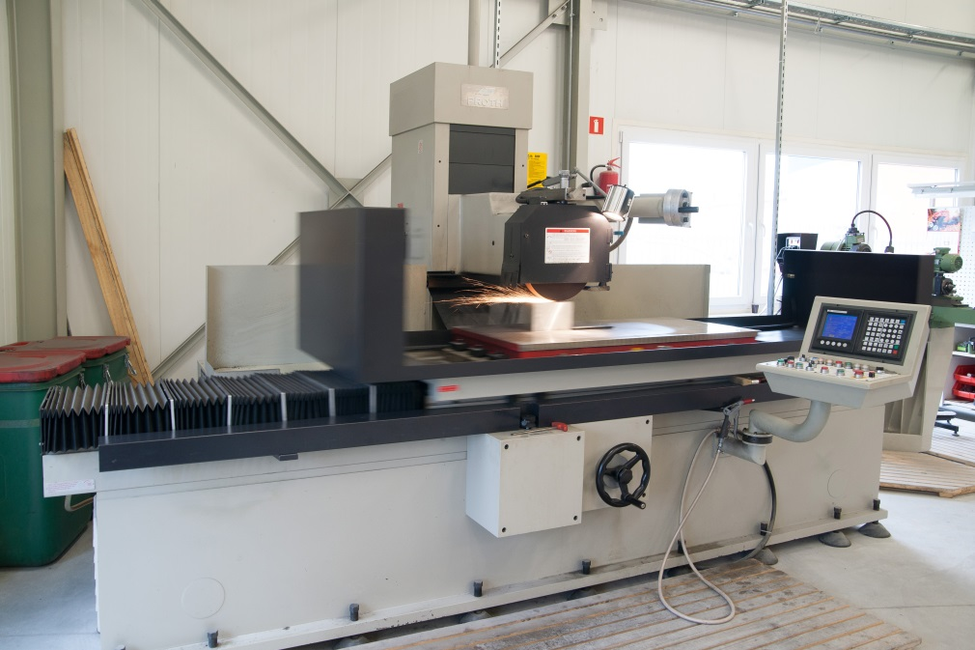
Tool Department
Cutting machine
Precision surface grinder

Slide 18
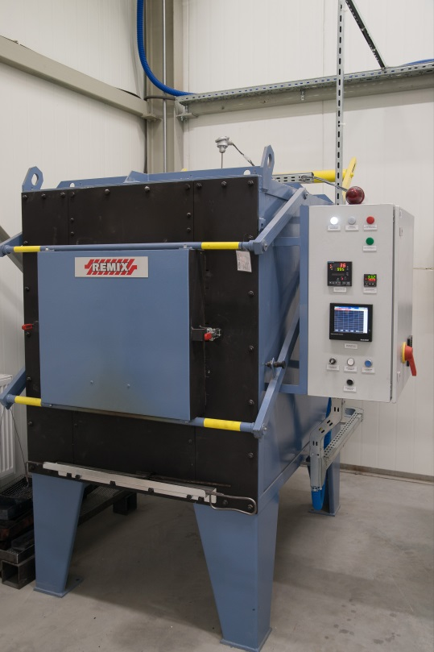
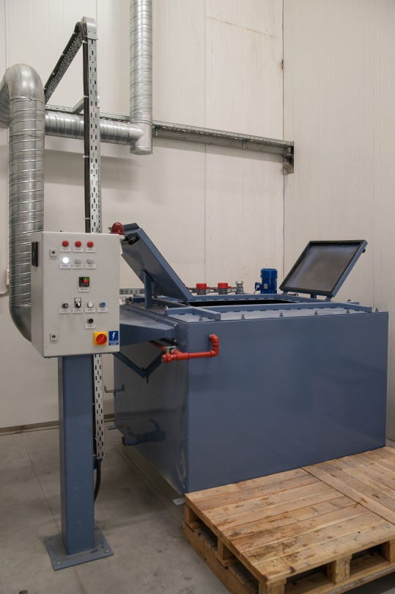
Tool Department
Equipment for heat treatment

Slide 19
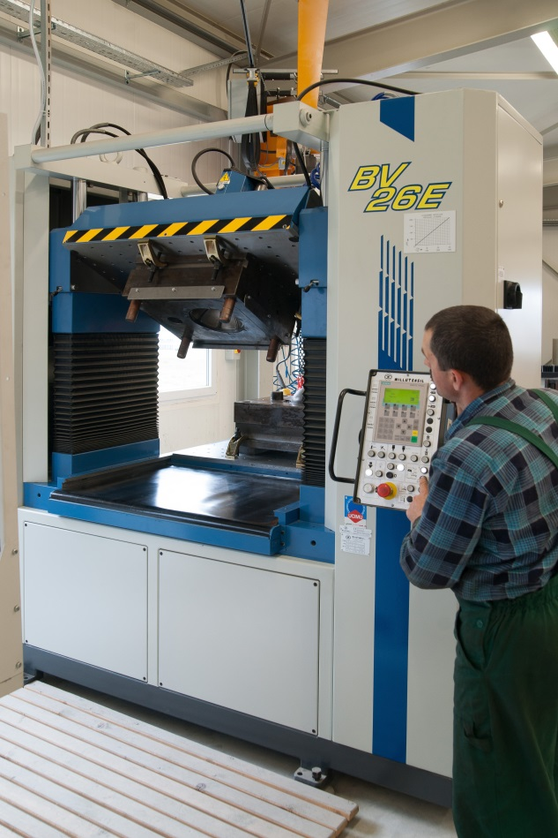
Tool Department
Spotting press

Slide 20
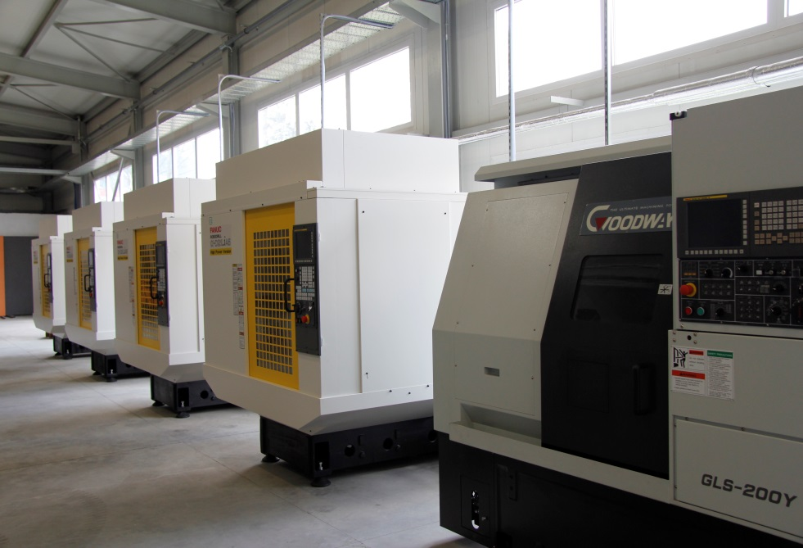
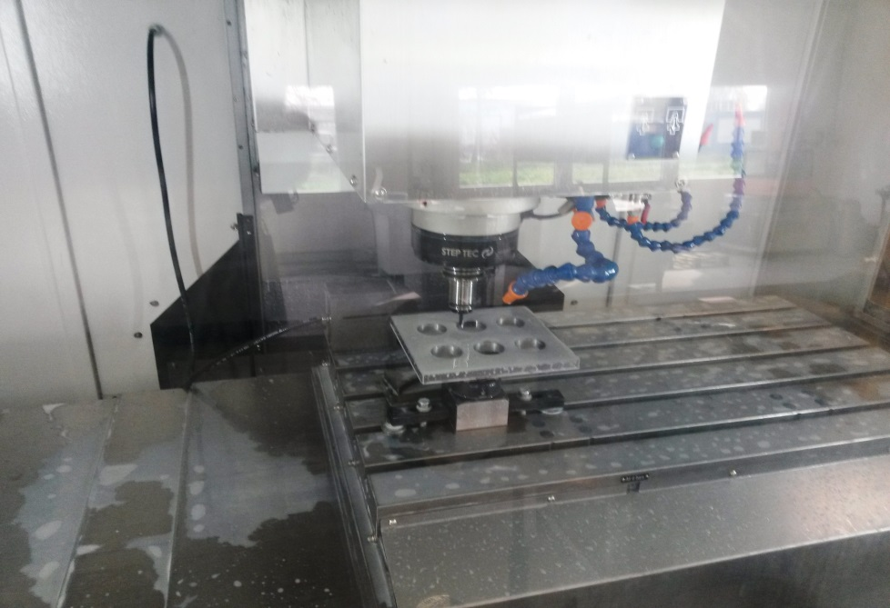
Machining Department
Lathe (CNC) and high precision cutting machines (CNC)
Machining process

Slide 21
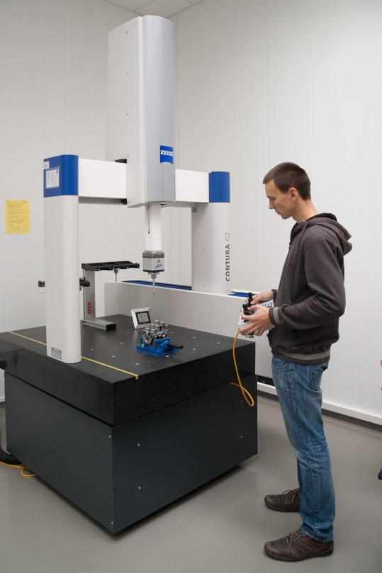
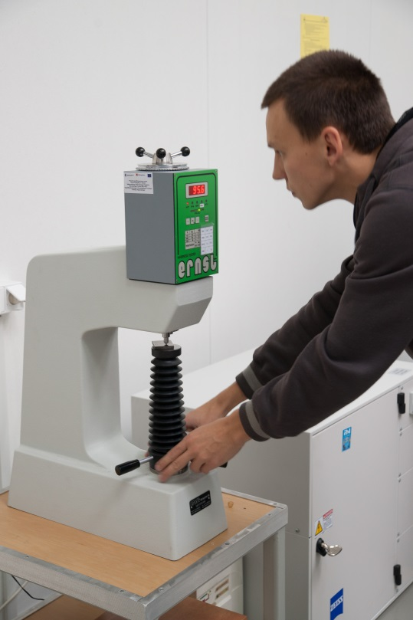
Measuring Laboratory
Coordinate measuring machine (CNC)
Hardness tester

Slide 22
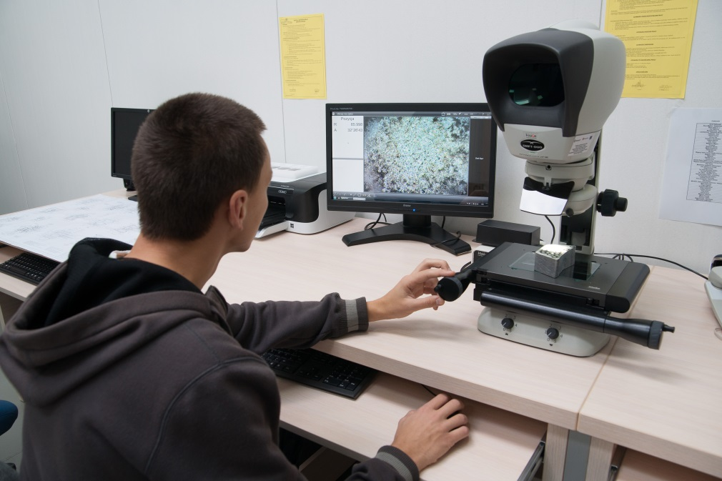
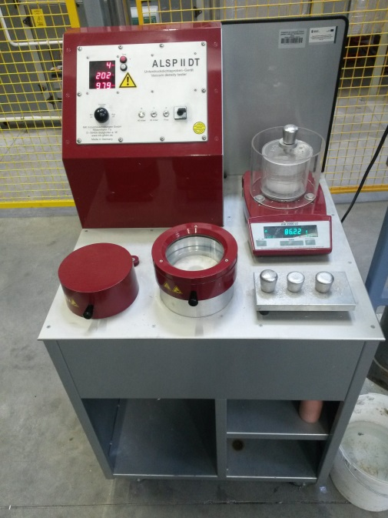
Measuring Laboratory
Measuring microscope
Vacuum
density-testing equipment

Slide 23
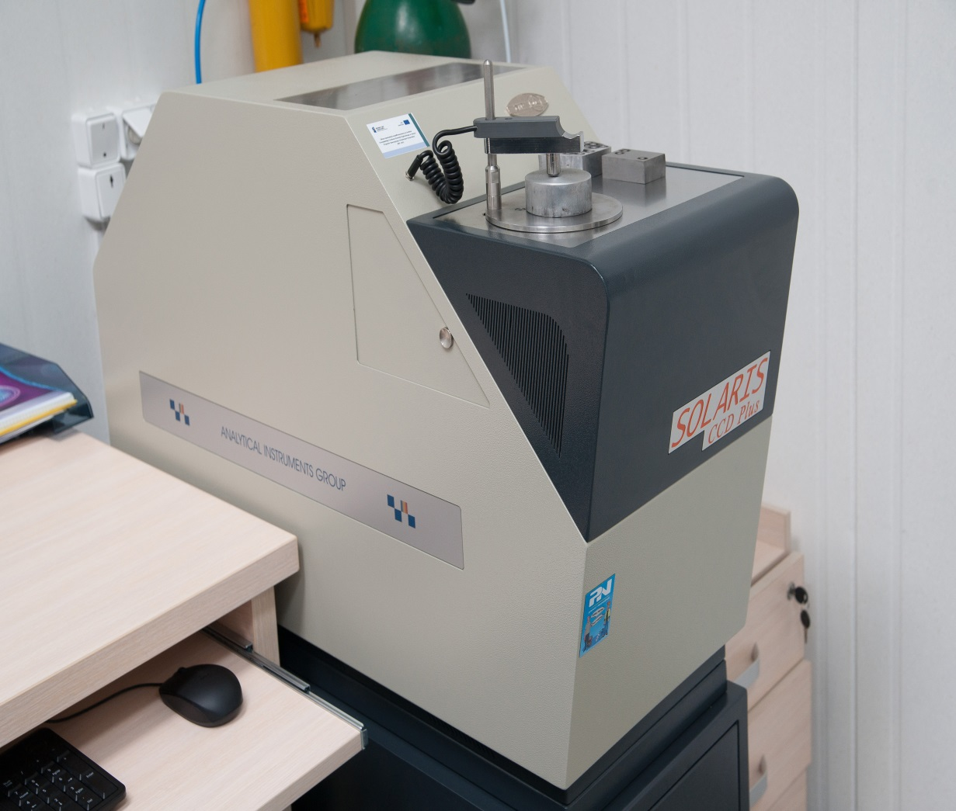
Measuring Laboratory
Spectrometer

Slide 24
Direction of development
Castings for own needs
External customers of automotive market and electromechanical market
Goals
Supply of machined castings that meet customer requirements
Production moulds, trimming dies and machining tooling
Providing high quality products according to customer requirements

Slide 25
Implementation of the objectives
Adequate production facilities
Modern machinery
Experienced personnel
Own tool department
Quality control at every stage of production
Proper organization of production
Experience in the implementation of automotive projects

Slide 26
Production capacities
Since II quarter 2014 :
- 350 t/year, including about 200 tones
machined casts
Successive increase in production capacity depending on the market demand :
- target about 1000 t/year machined casts

Slide 27
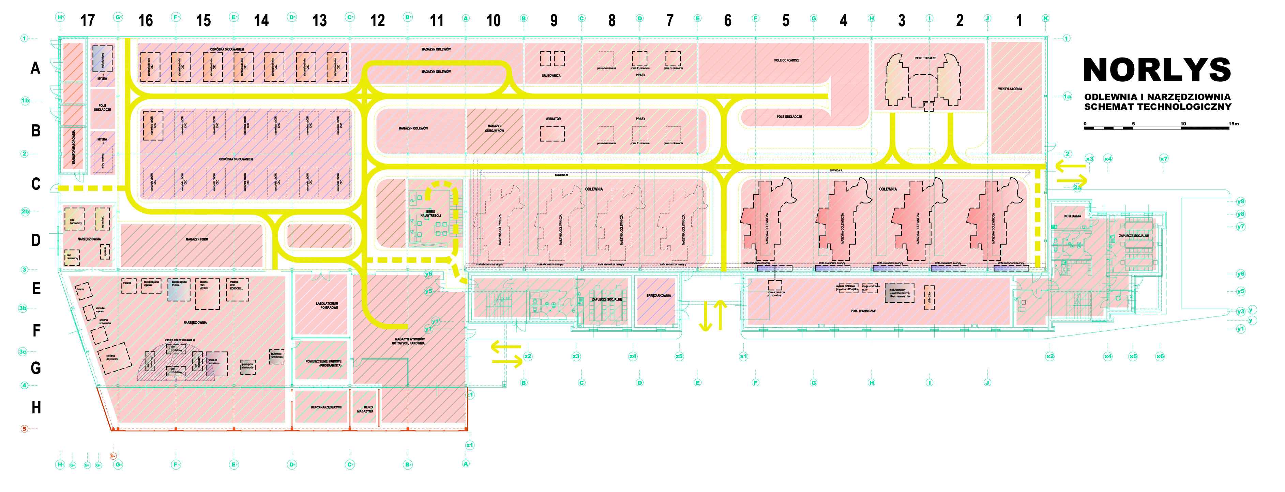
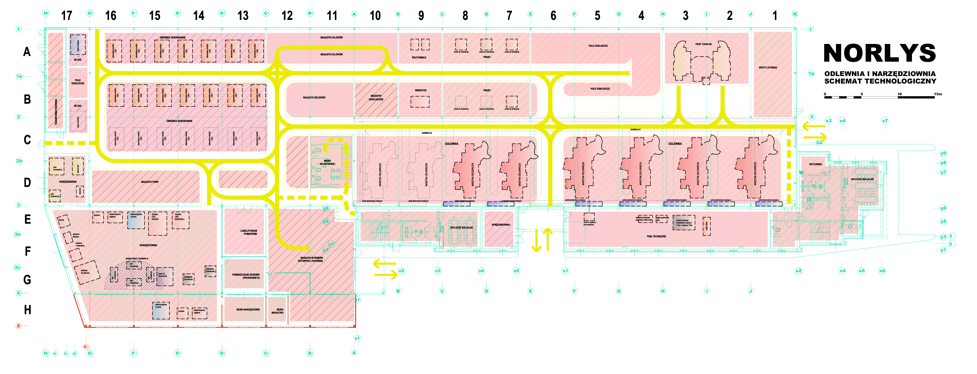
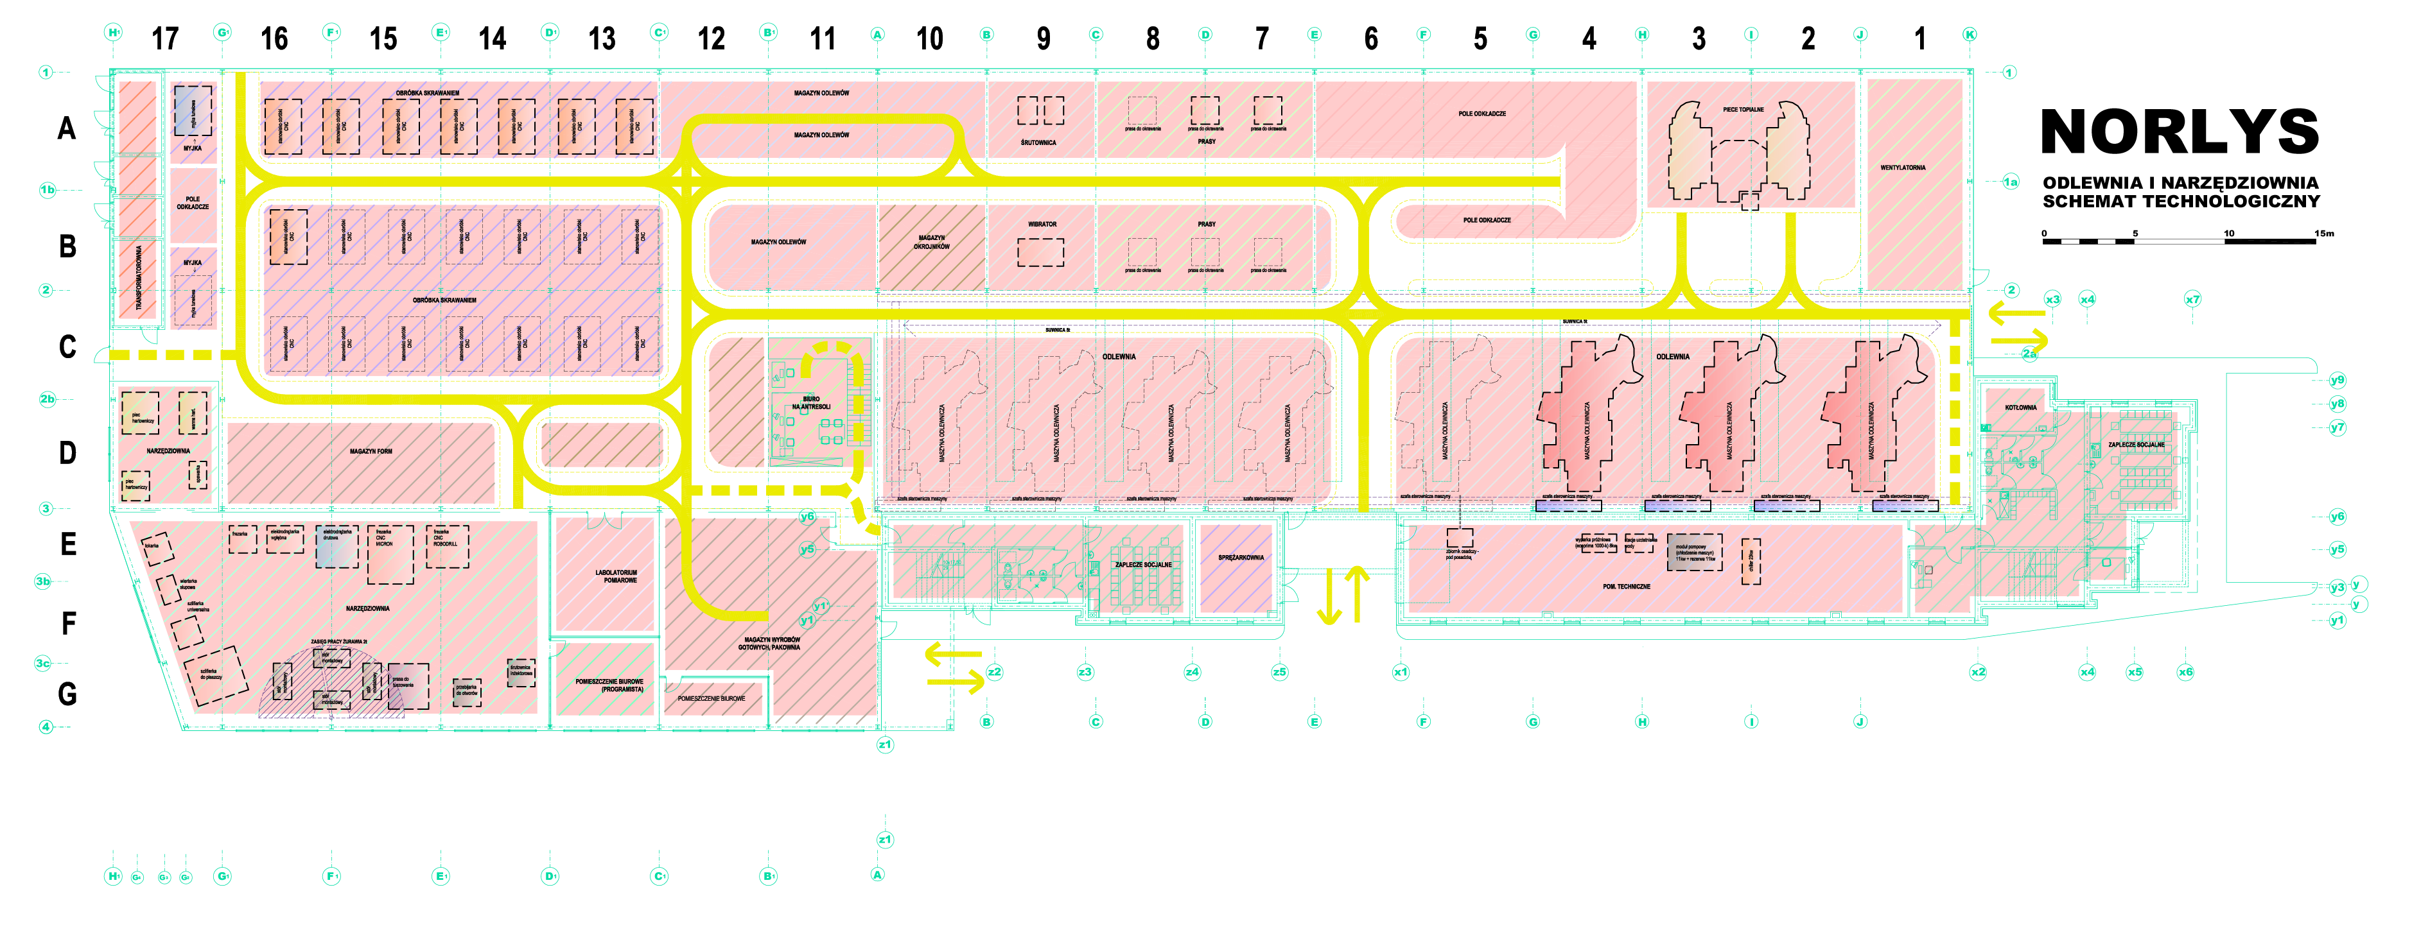
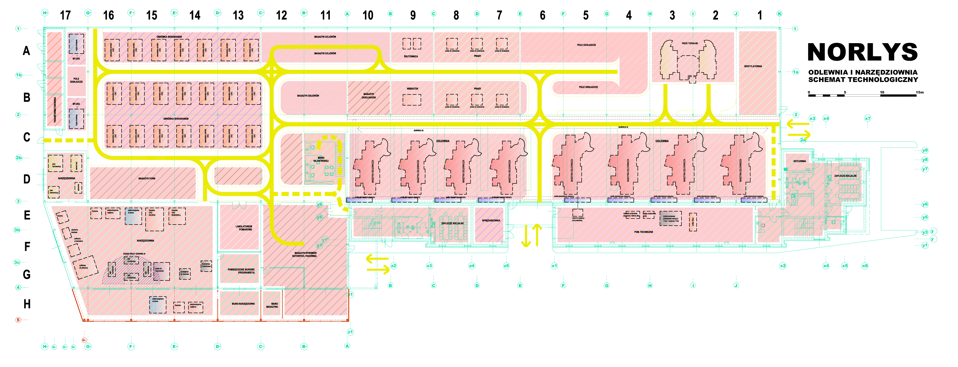
At present
June 2015
Planned
IV quarter 2015
Planned
2016
Planned
2017 - 2018
At present – June 2015
IV quarter 2015
Planned 2016
Planned 2017-2018
3 casting machines
8 CNC machine tools
1 casting machine
2 casting machines
6 CNC machine tools
2 casting machines
7 CNC machine tools

