Slide 1
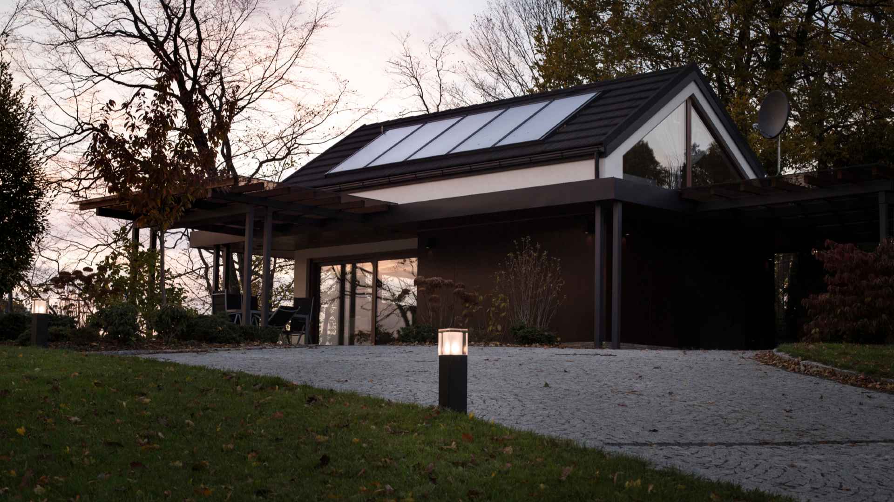



Slide 2

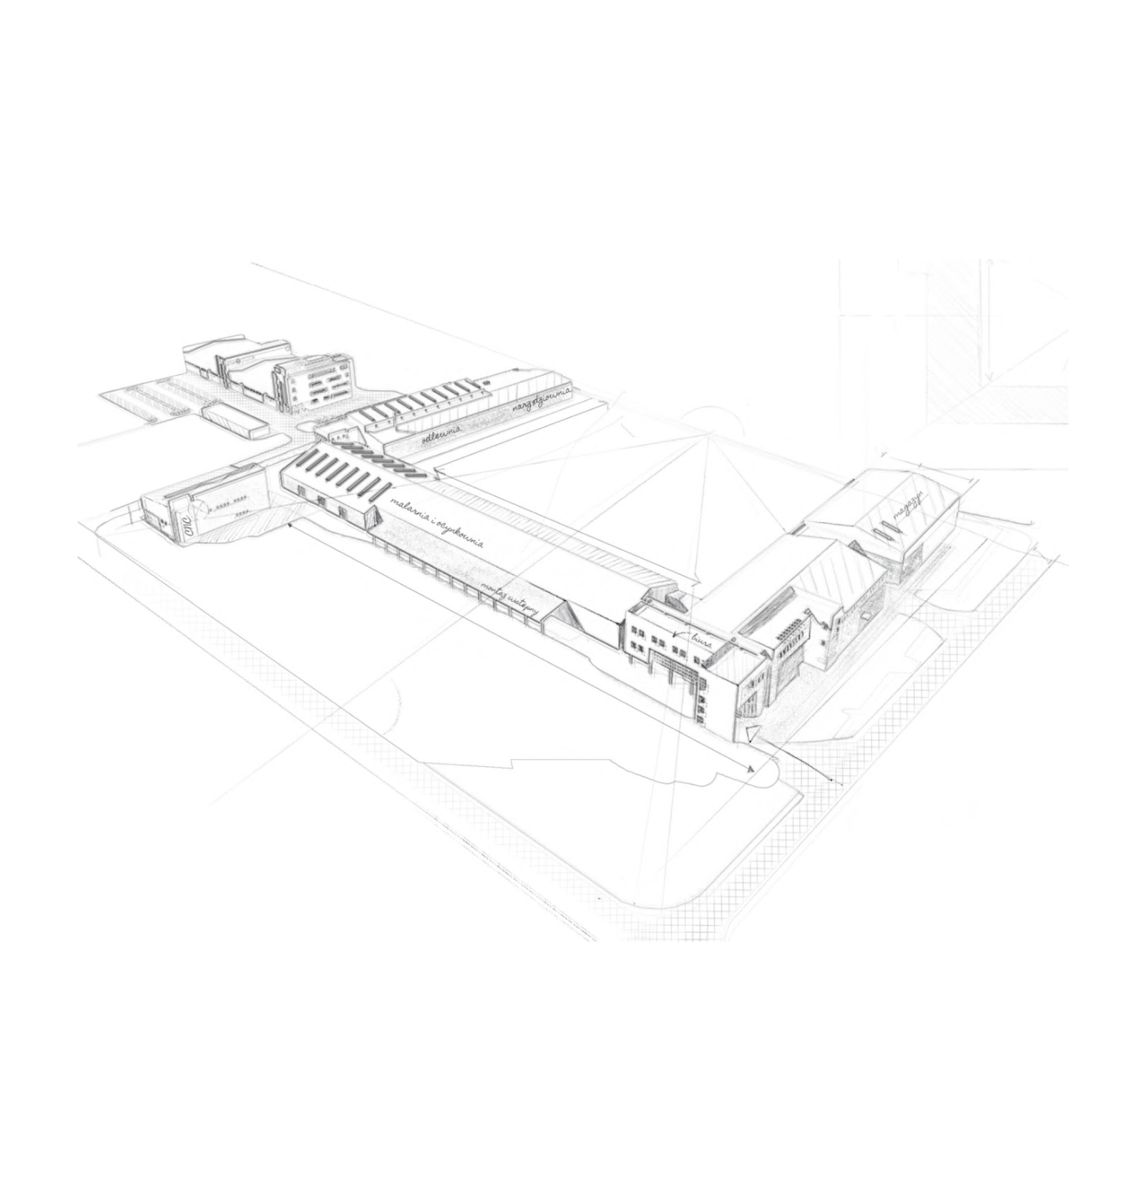

Brightening your life
with our passion for light
NORLYS is an international holding established in Norway, with 60 years of tradition in crafting exceptional outdoor lighting solutions.
By offering a diverse range of outdoor lighting products, we cater to both residential and commercial customers, including municipalities, architects, landscape designers, and homeowners. Our efficient and attractive lighting solutions contribute to the safety, ambiance, and overall aesthetic of outdoor spaces.
Our Scandinavian origin naturally obliges us to develop and provide innovative products with robust construction and weather-resistant materials. NORLYS luminaires areengineered to thrive in even the most challenging environments.

Slide 3


NORLYS in numbers
70+
300+
24
5 mln
years on the market
team members
countries
unit sold

Slide 4




For People
Passion for Light
Responsibility
Putting our customers first is at the heart
of everything we do. Our commitment
to personalized service ensures that every interaction with our customers is exceptional.
We believe in building long-term relationships based on trust and mutual success
Our customers are the center of our company, and their satisfaction is our ultimate goal.
We are driven by a deep passion for light and
its transformative power. Our team of dedicated professionals combines innovation, light architecture, and their individual passion
to create remarkable illumination experiences. We believe that through our passion for light,
we can enhance living and working spaces, creating environments that inspire and uplift.
We are dedicated to delivering products that
are of the utmost quality while minimizing
our environmental impact. By focusing
on renewable resources, implementing
energy-saving production techniques,
and continually improving our procedures,
we strive to reduce our footprint and contribute to a sustainable future.

Slide 5
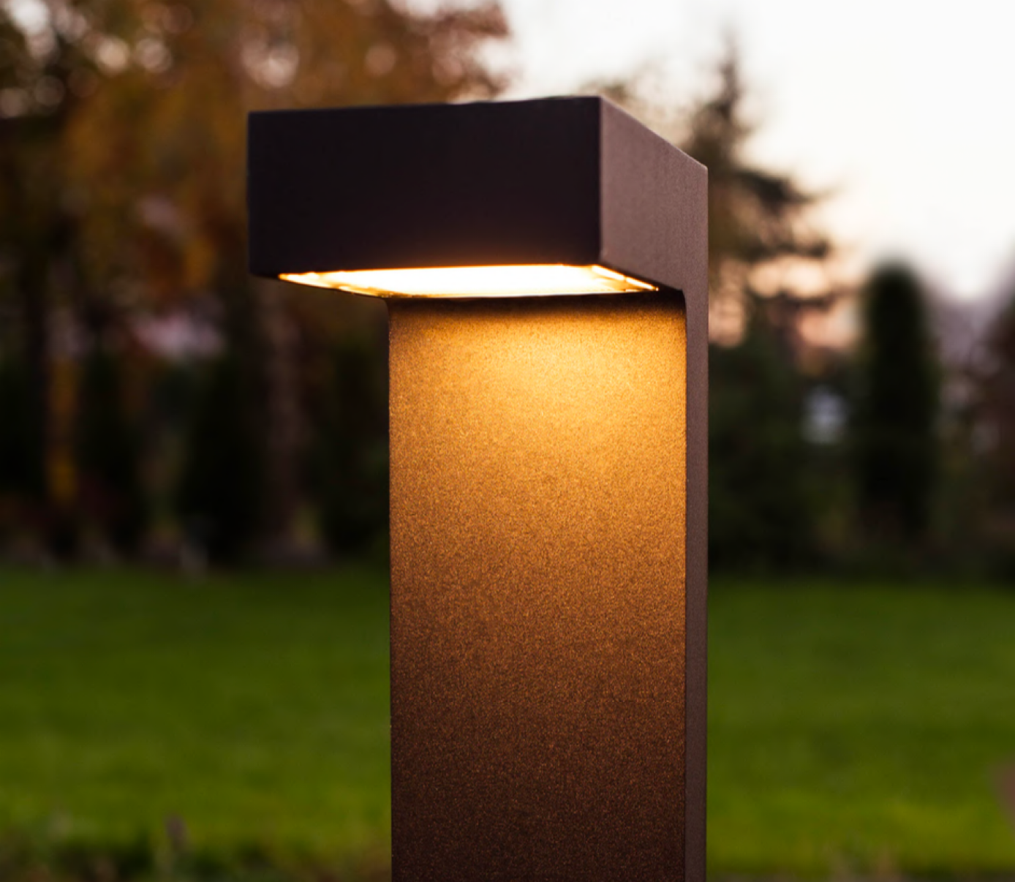
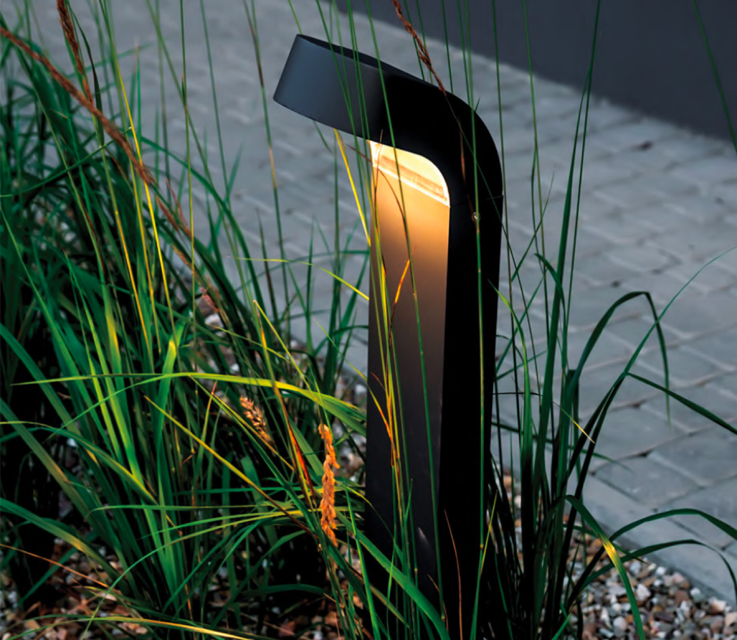
Our products
Asker
Molde

Slide 6
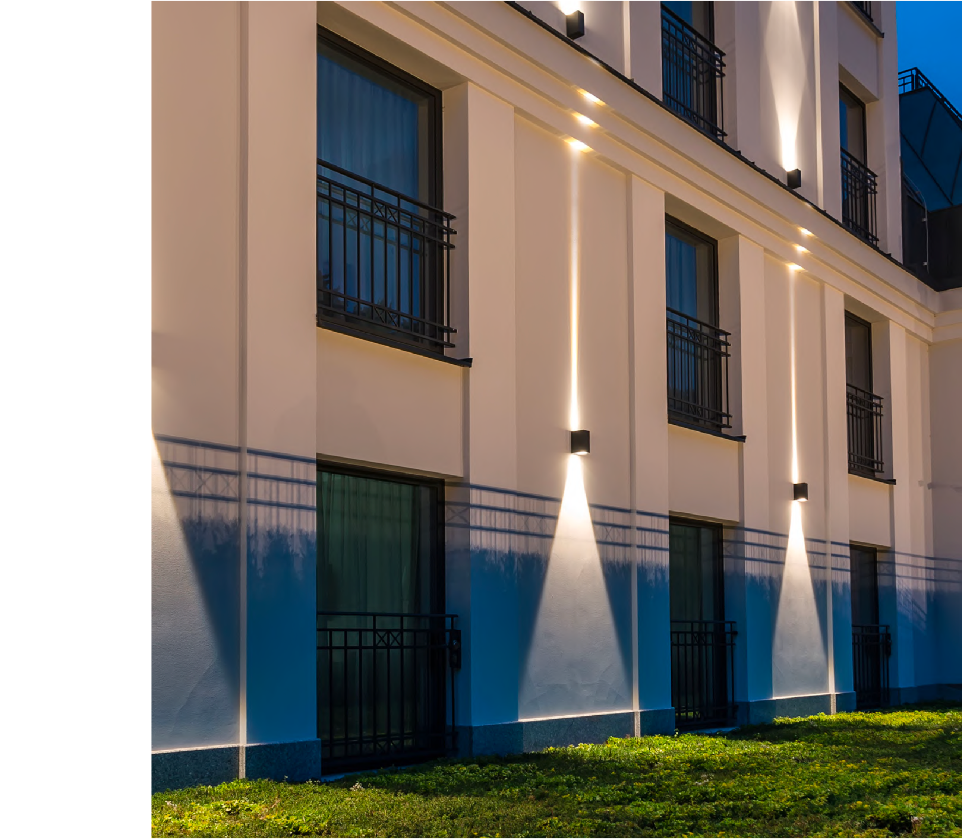
Modern luminaires
Step into the world of modern lighting with our exceptional range
of luminaires. Designed to captivate and inspire, our Asker, Glode,
Narvik, Lillehammer, Borg, and other models embody the essence
of contemporary aesthetics. With their sleek and minimalist design,
our luminaires effortlessly blend into any environment, creating
a seamless integration with a modern decor.
Illuminate surroundings with confidence as our luminaires are equipped with bright and energy-efficient LEDs. These cutting-edge light sources provide optimal illumination while minimizing energy consumption, making them a sustainable and cost-effective lighting solution.
To perfectly complement a personal style and interior design, we offer
a wide range of colors and finishes. Whether a bold and eye- catching
hue is needed or a subtle and understated tone, our selection allows
to customize lighting fixtures to create the desired ambiance.

Slide 7

Contact
Norlys sp. z o.o.
Zawiszy Czarnego 7
33-300 Nowy Sącz
P: +48 500 500 500
F: +48 200 200 200
M: norlys@norlys.pl
NIP: 1234567891
REGON: 123456789
KRS: 1234567891

