Slide 1
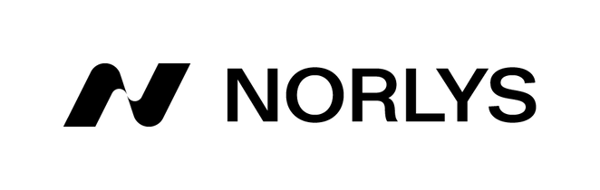

High-pressure
Foundry
Proficiency in aluminum alloy die casting,
CNC machining, surface treatment and tool making.

Slide 2
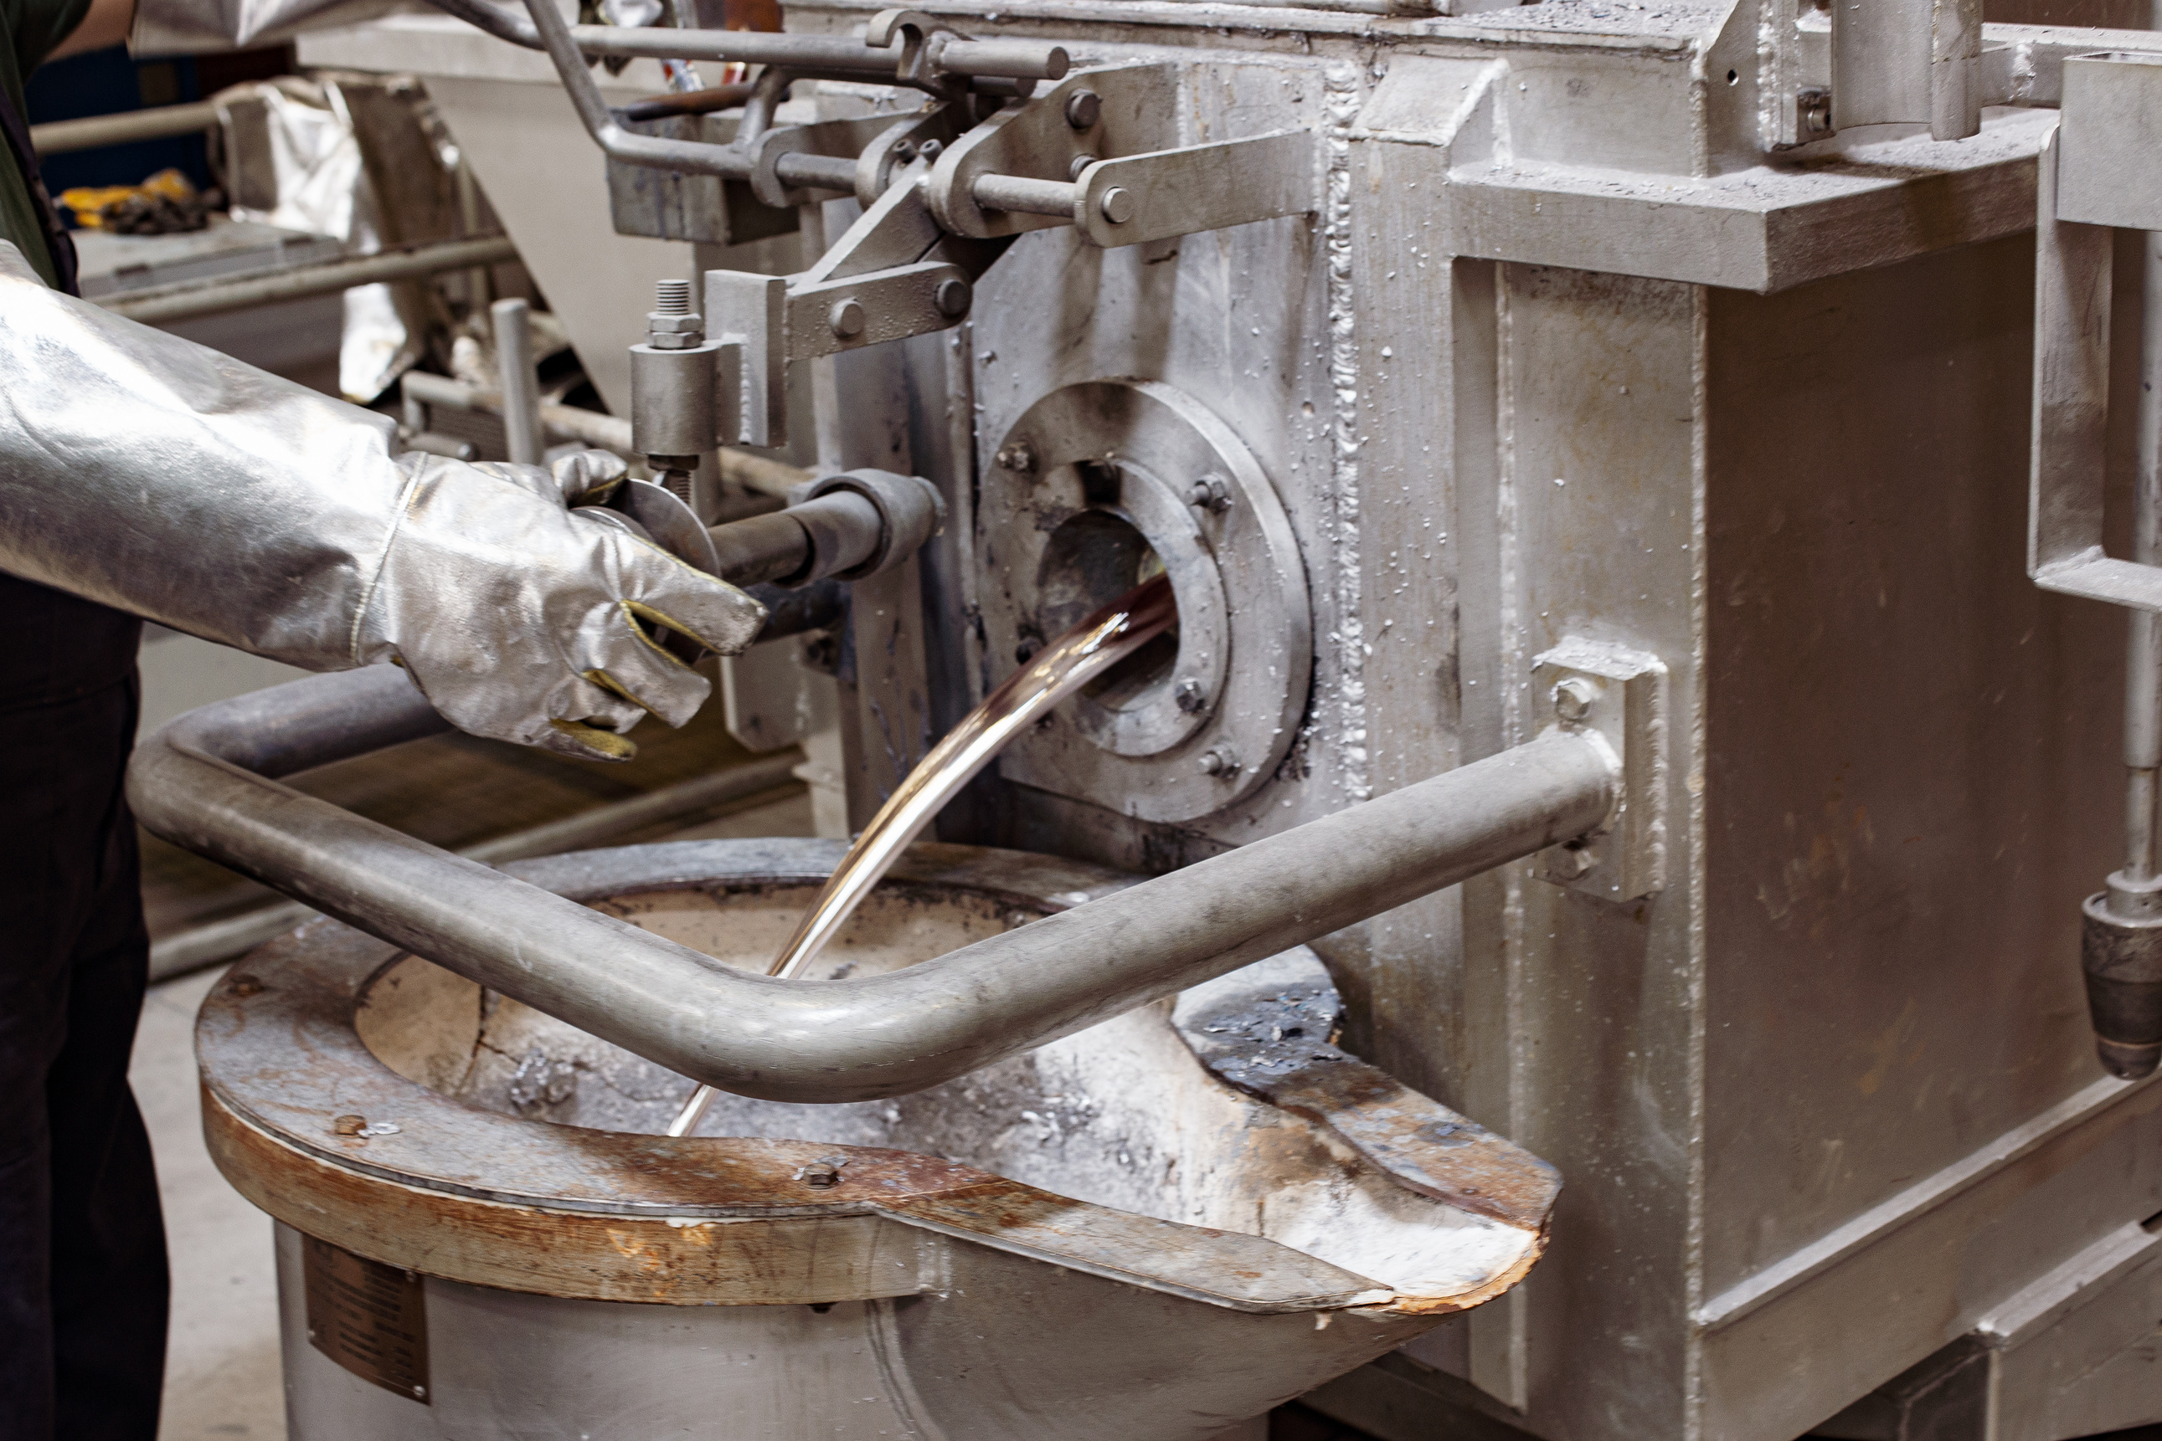

About Us
Norlys has been specializing in the production of outdoor lighting for years and its history begins in Norway. From the very beginning, durability, resistance to severe weather conditions and highest quality were the most important for us and that is why in 2012 our High- pressure Foundry was established . Today, we specialize in the production of complex castings of lighting fixtures, automotive parts but not only.

Slide 3
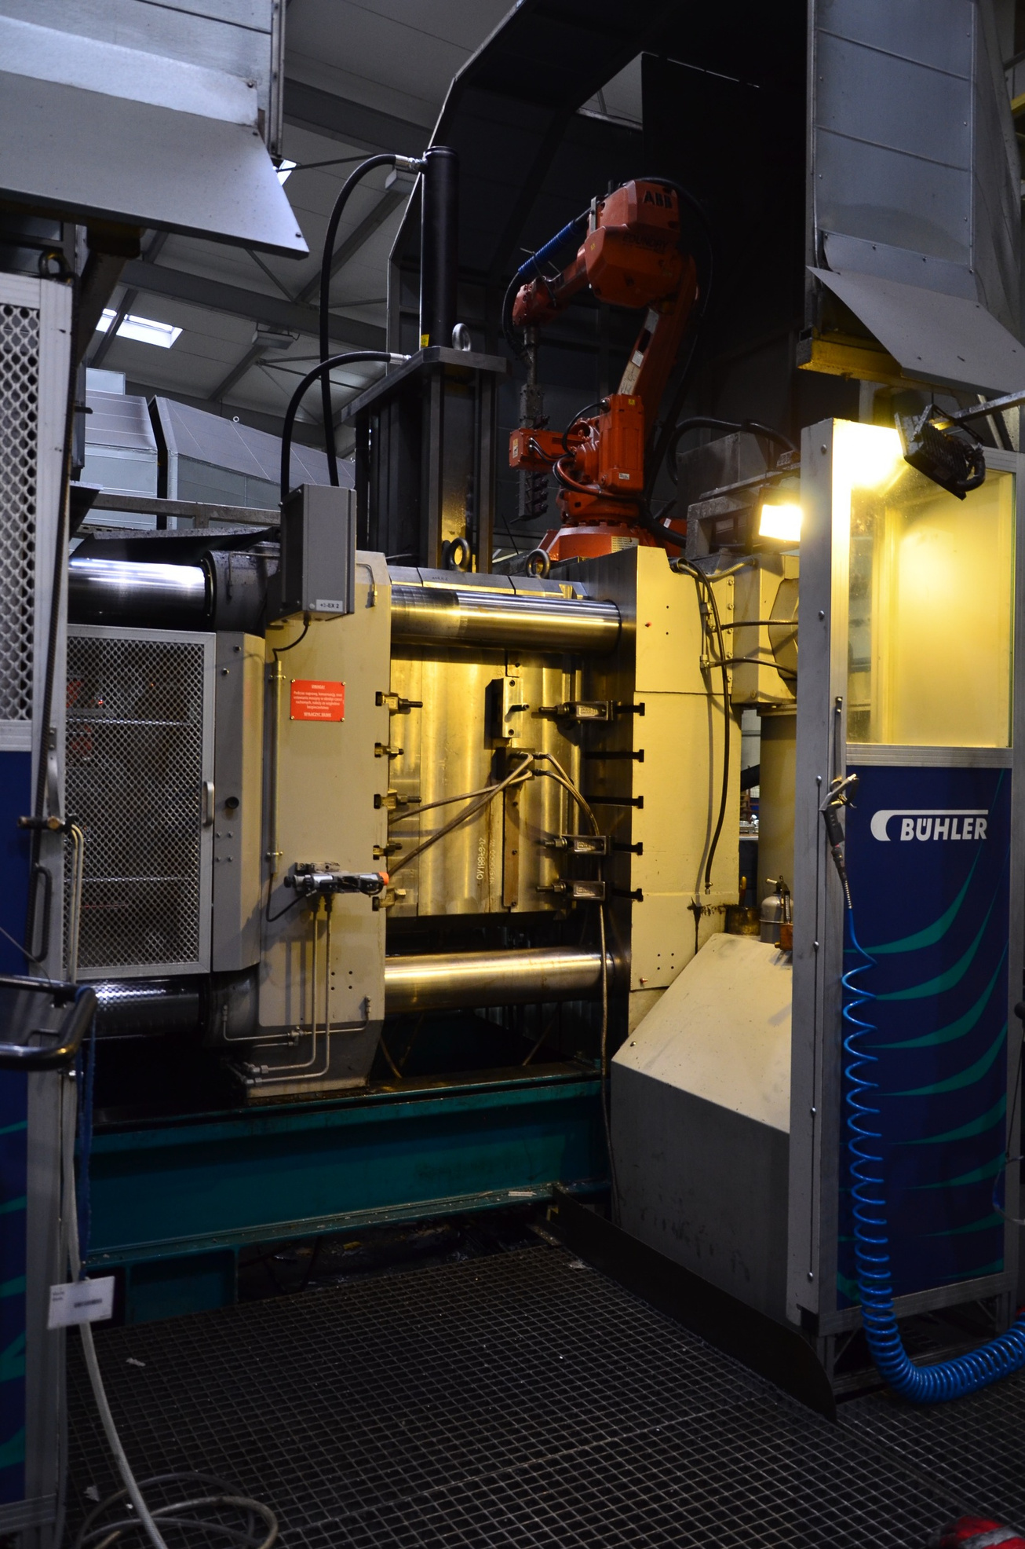
We are experts in
At our core, we are masters in a multitude of essential processes:
Die Casting
Shot-blasting
Vibro-abrasive
CNC Machining
Washing
Individual Packaging
Assembly
We also offer external surface protection options to enhance the durability and aesthetics of our products:
Passivation: Safeguarding against corrosion, ensuring longevity.
Impregnation: Enhancing structural integrity for long-lasting performance.
Anodizing: Elevating the appearance and resilience of our creations.
At Norlys Foundry, precision is our forte. We specialize in crafting intricate aluminum casts, including those for the demanding automotive industry. Our comprehensive approach covers everything from raw, rugged castings to meticulously pre-machined components and high end CNC machined parts, offering a complete spectrum of solutions. We're your go-to source for unparalleled craftsmanship and versatility in the world of aluminum casting.

Slide 4
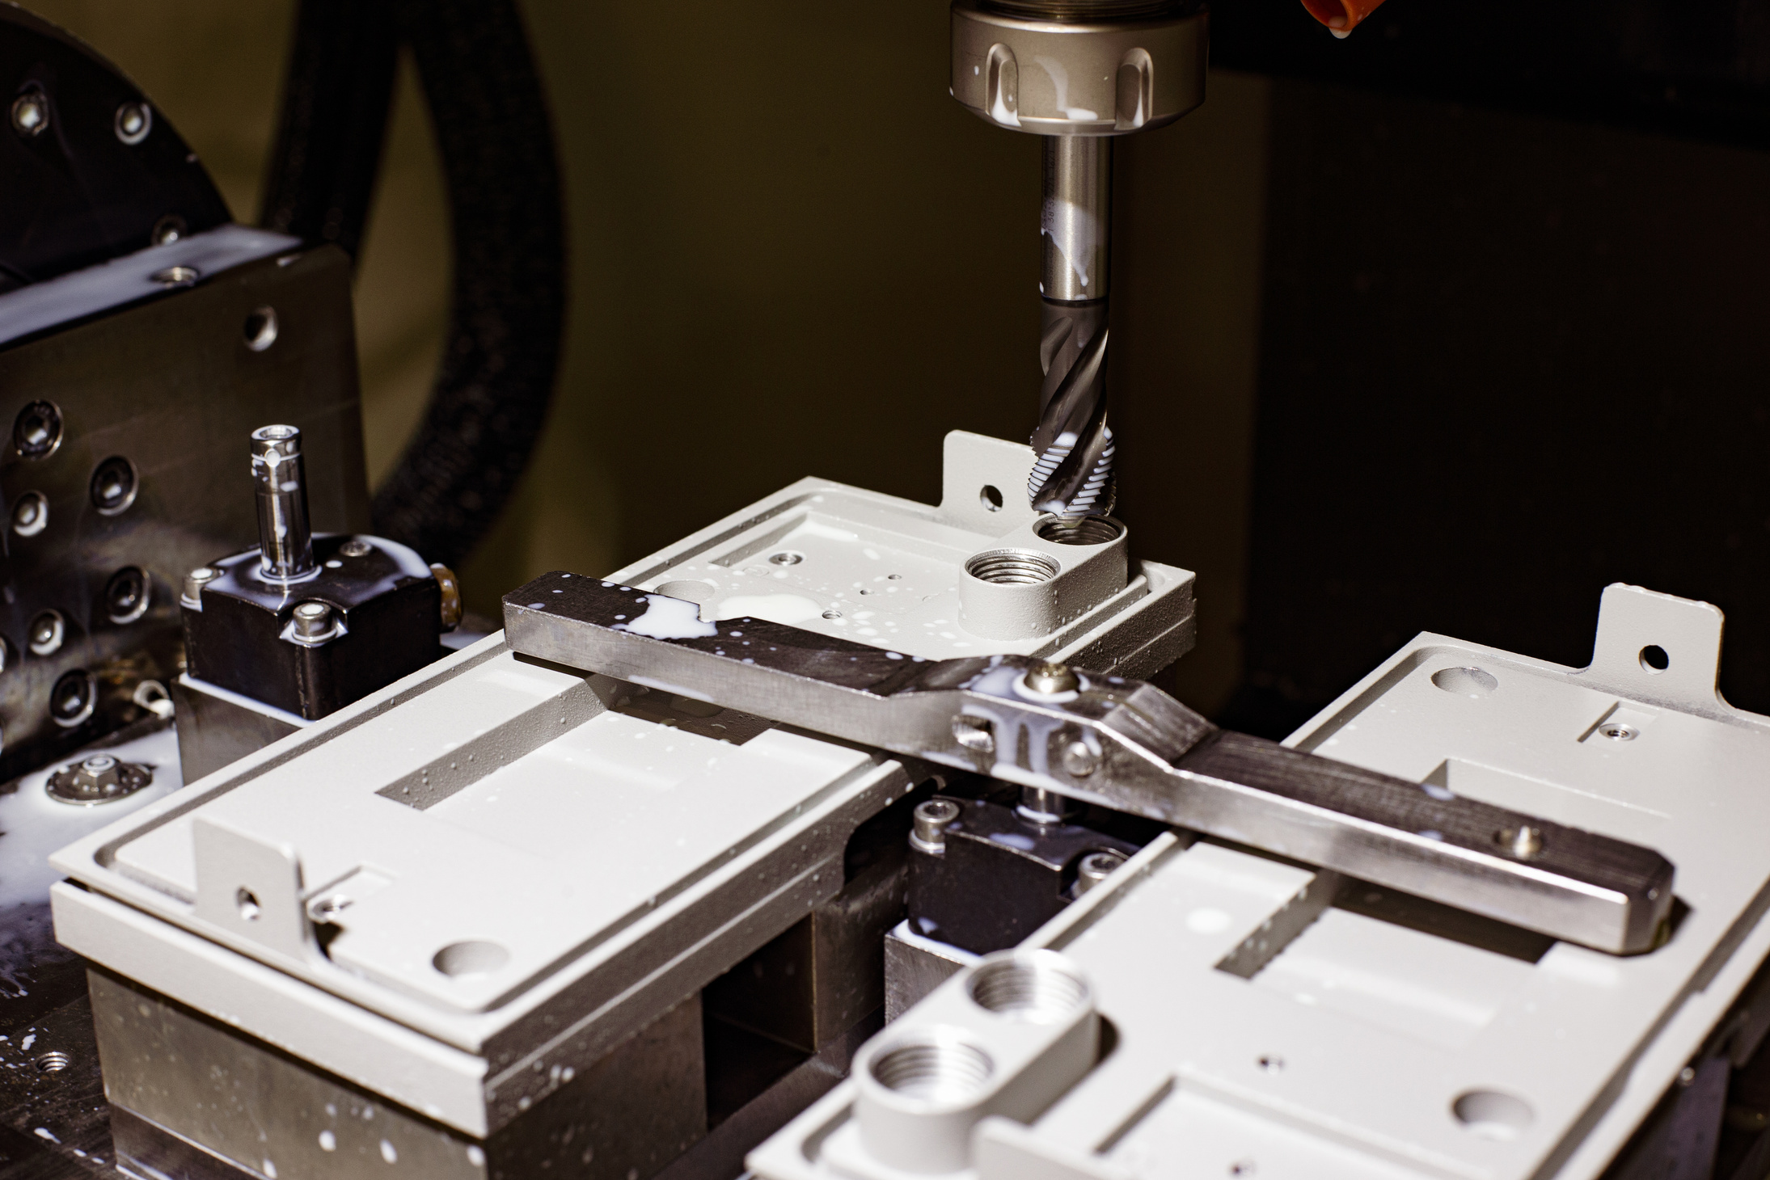
Equipment
Die Casting Machines: With capacities ranging from 300t to a whopping 840t, we handle various casting needs effortlessly.
Trimming Presses: We have three, ensuring precision in every detail.
Shot-Blasting Machine: For achieving a polished finish that shines.
Vibro-Abrasive Machine: Crafting seamless surfaces with finesse.
In our CNC Department, cutting-edge technology reigns supreme:
CNC Milling Centers: A total of eight, poised for precision and versatility.
CNC Lathe Machines: Three robust machines for turning excellence.
Washing Machines: Keeping our components pristine.
Within our Internal Laboratory, quality assurance takes center stage:
CMM Machine: For meticulous measurements and accuracy.
Contourmeter and Roughness Meter: Ensuring the finest surface finishes.
Optic Microscope: A closer look at perfection.
Density Index Measuring Equipment: Precise density assessments.
X-Ray: Uncovering the hidden details.
Hardness Tester: Measuring durability and strength.
Spectrometer: Ensuring material composition excellence.
We're equipped not just with machinery, but with the means to guarantee excellence at every step of the way.

Slide 5
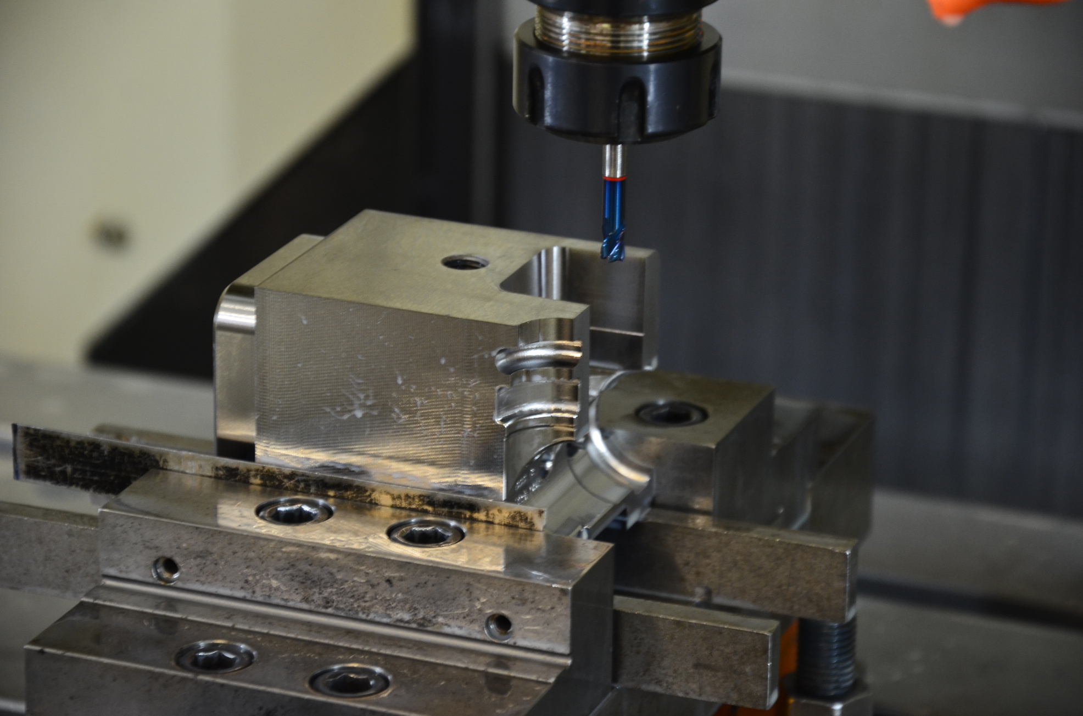
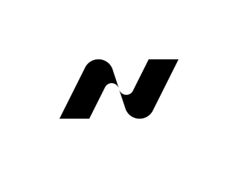
Machining and tooling
At Norlys Foundry, precision is our hallmark, and it's embodied in our state-of-the-art Tool Room Department. Here, we craft high-pressure molds, precision trimming dies, and customized clamping tools with cutting-edge technology. In our modern machining park, we wield a formidable arsenal of advanced equipment. With this formidable set of tools and our unwavering dedication to precision, we stand as your trusted partner for all your precision tooling and maintenance needs.
Our arsenal of cutting-edge equipment includes:
Three 4-Axis CNC Mills
Wire EDM Machine
Sinker EDM Machine
Horizontal Surface Grinding Machine
Universal Grinder
Die Spotting Press
Tempering Furnace and Quench Tank
Milling Machine
With this arsenal at our disposal, we're your trusted partner in precision tooling and maintenance.

Slide 6
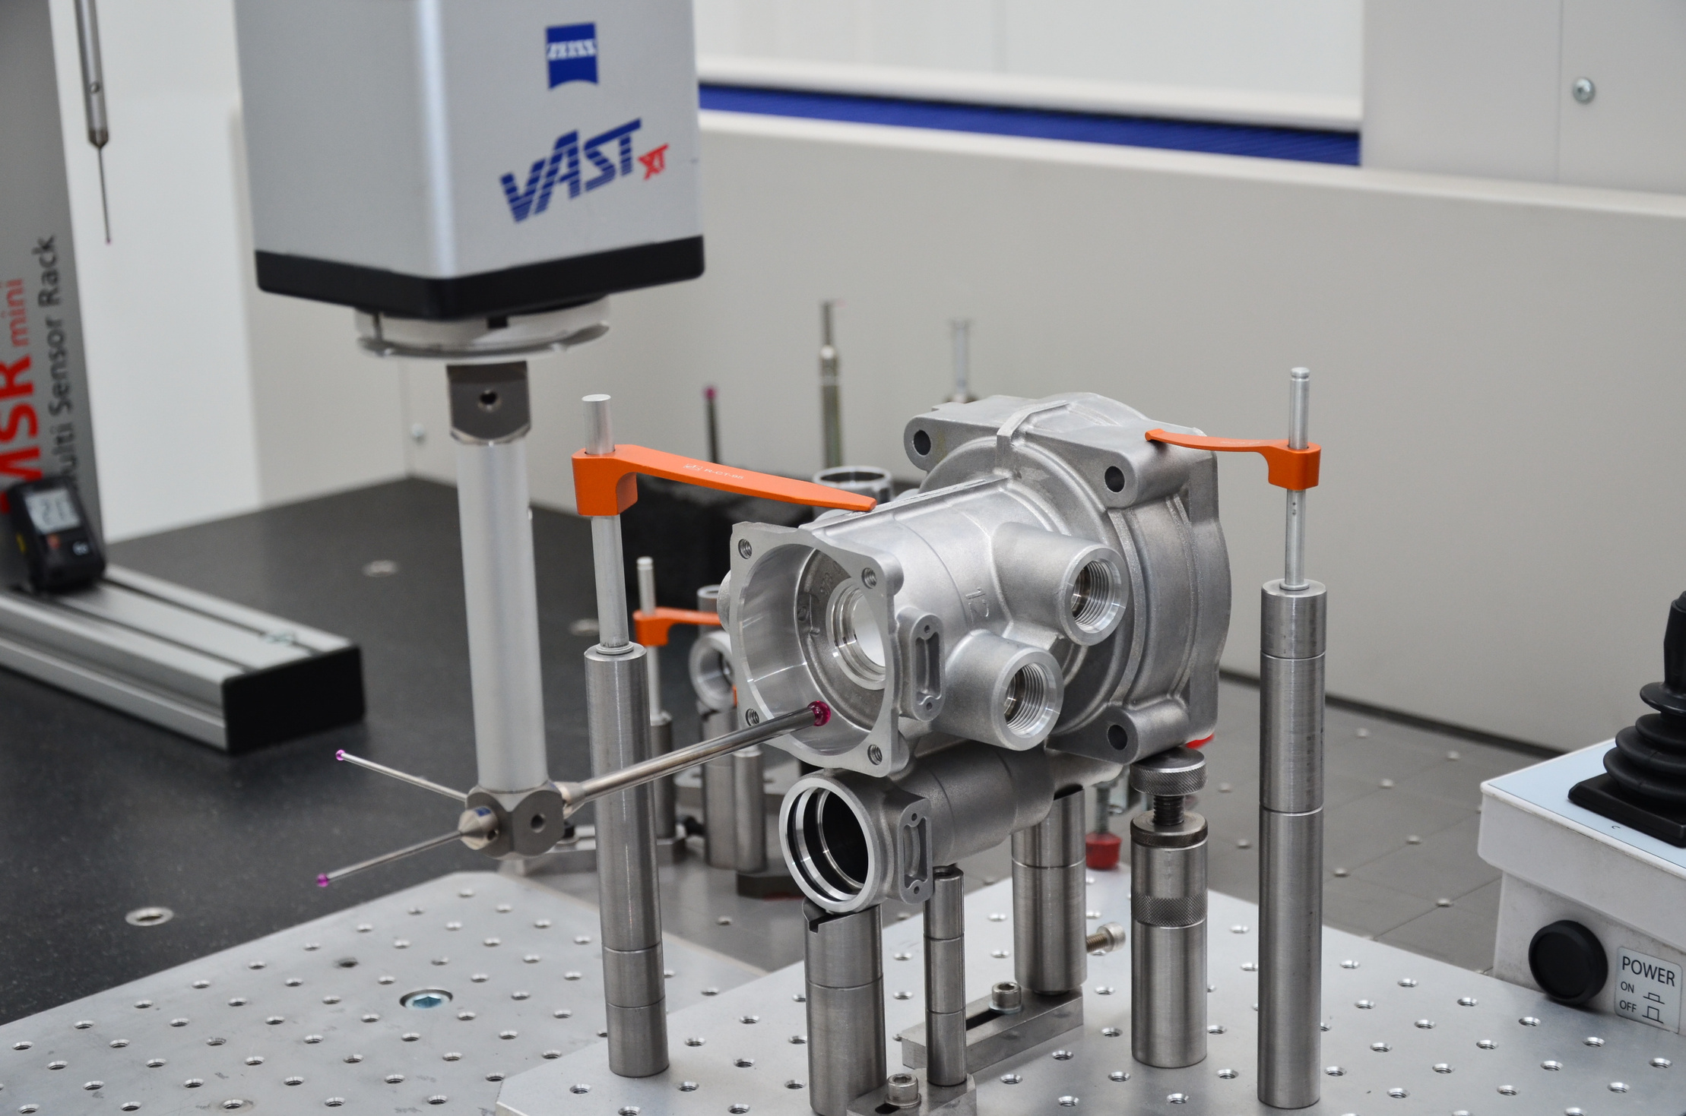
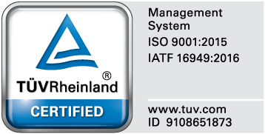

Quality certificates
We are proud to hold three quality system certificates - ISO 9001:2015, ISO 14001:2015, and IATF 16949:2016. These certifications demonstrate our unwavering commitment to maintaining the highest standards of quality, environmental management, and continual improvement across all aspects of our operations.

Slide 7
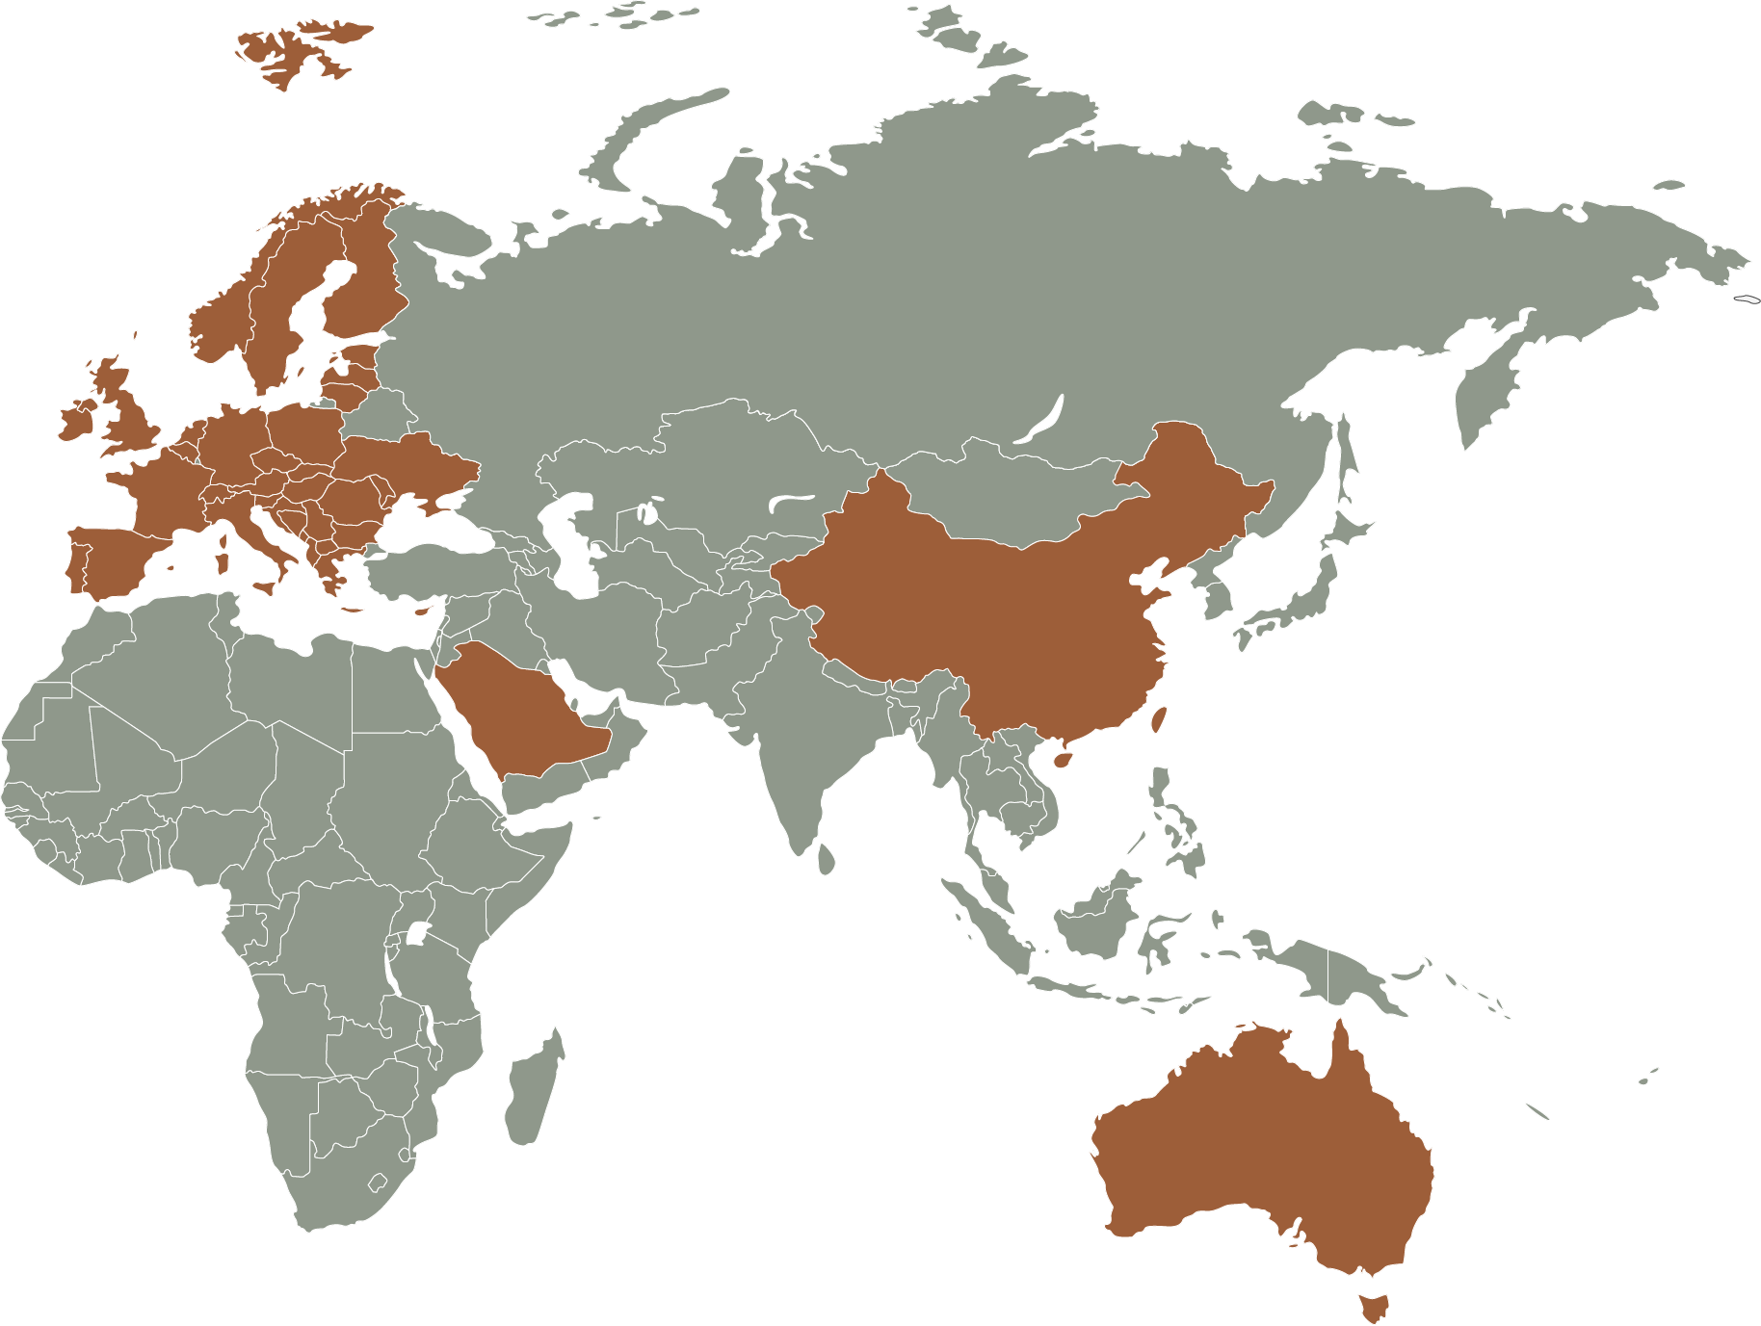
Main markets
Norlys Foundry's primary markets encompass two main sectors, catering to a broad global audience:
Lighting Fixtures Across Four Continents: We established a strong presence in the global lighting fixtures market, serving customers across four continents - Europe, Asia, Africa, and Australia. Our product range includes innovative and high-quality lighting solutions that illuminate homes, public spaces, and commercial establishments, meeting the lighting needs of diverse regions worldwide.
Automotive and European Customers: We supply components and solutions to the automotive industry and various other customers throughout Europe. Germany, in particular, hosts some of our most significant automotive clients, such as the renowned ZF Group. These partnerships underscore our reputation for excellence and its strategic focus on serving the German automotive market.
Our commitment to quality and their extensive presence in both the lighting and automotive industries position us as a dependable and versatile partner for customers across the globe.

Slide 8
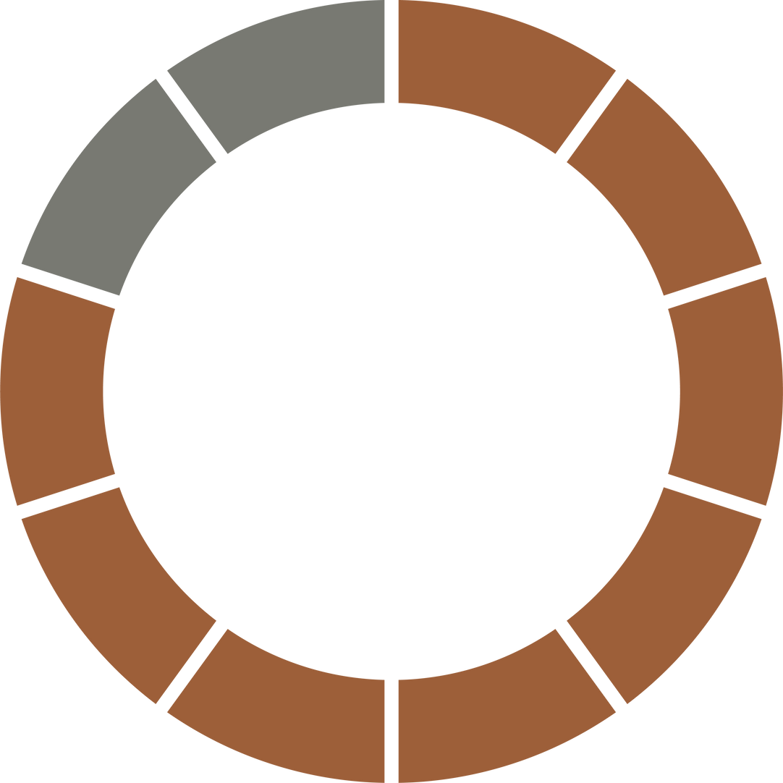
Turnover
Norlys Foundry's financial composition reflects a balance between two key segments:
Foundry Operations: Accounting for 20% of the company's overall turnover, the foundry division plays a pivotal role in Norlys Foundry's revenue generation.
Outdoor Luminaire Clients: This segment, representing the lion's share at 80% of the annual turnover, showcases the company's strong foothold in the outdoor luminaire market.
The company's annual turnover stands at an impressive €13 million, underscoring its financial stability and market presence.
We are committed to growth and innovation, as evidenced by annual investments exceeding €300,000. These investments reflect the company's dedication to enhancing its products and services, ensuring that they remain at the forefront of their respective industries.
An interesting facet of Norlys Foundry is its ownership of land and buildings, which are held privately. This aspect not only demonstrates the company's commitment to long-term sustainability but also provides a solid foundation for their operations.
20% foundry clients
80% outdoor luminaires clients

Slide 9
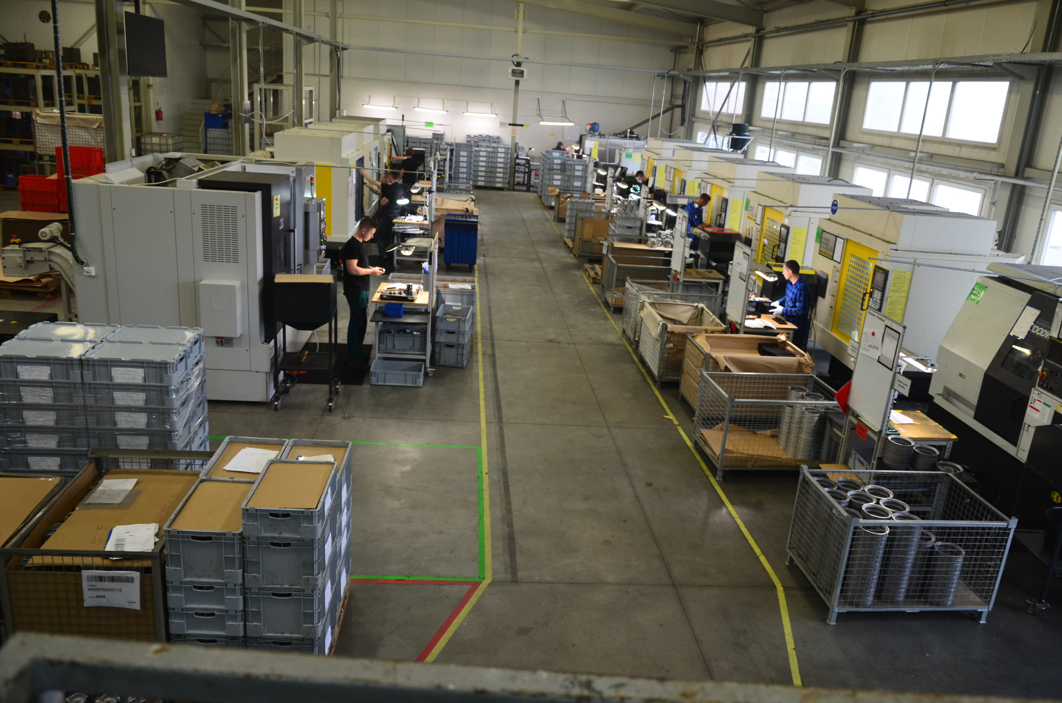
Our goals
At Norlys Foundry, our main objectives encompass several key areas:
Sustainable Development and Earth-Friendly Produc:tion A core pillar of our mission is to lead in sustainable development and prioritize production methods that are in harmony with the environment. Our commitment to eco-conscious practices ensures that every step of our operations is guided by a deep sense of responsibility toward our planet.
Market Expansion: We aim to increase our market share, both domestically and internationally. To achieve this, we seek to establish meaningful partnerships with esteemed companies across various industries. These collaborations not only help us grow our presence but also allow us to disseminate our sustainability ethos on a global scale.
Single-Digit PPM (Parts Per Million) Achievement: Our stringent quality control and production processes are geared towards achieving a single-digit PPM level. This commitment to excellence ensures that our products meet the highest standards of quality and reliability, serving as a testament to our dedication to customer satisfaction and product performance.

Slide 10
Thank You

Slide 11
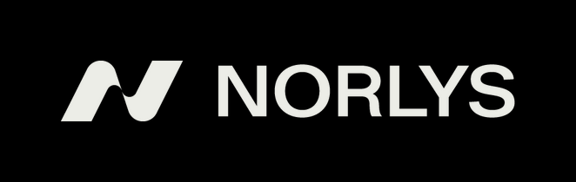

Contact
Ul. Zawiszy Czarnego 7
33-300 Nowy Sącz / POLAND
foundry.norlys.com
+48 18 449 57 01
+48 18/ 449 57 00
odlewnia@norlys.pl

