Slide 1
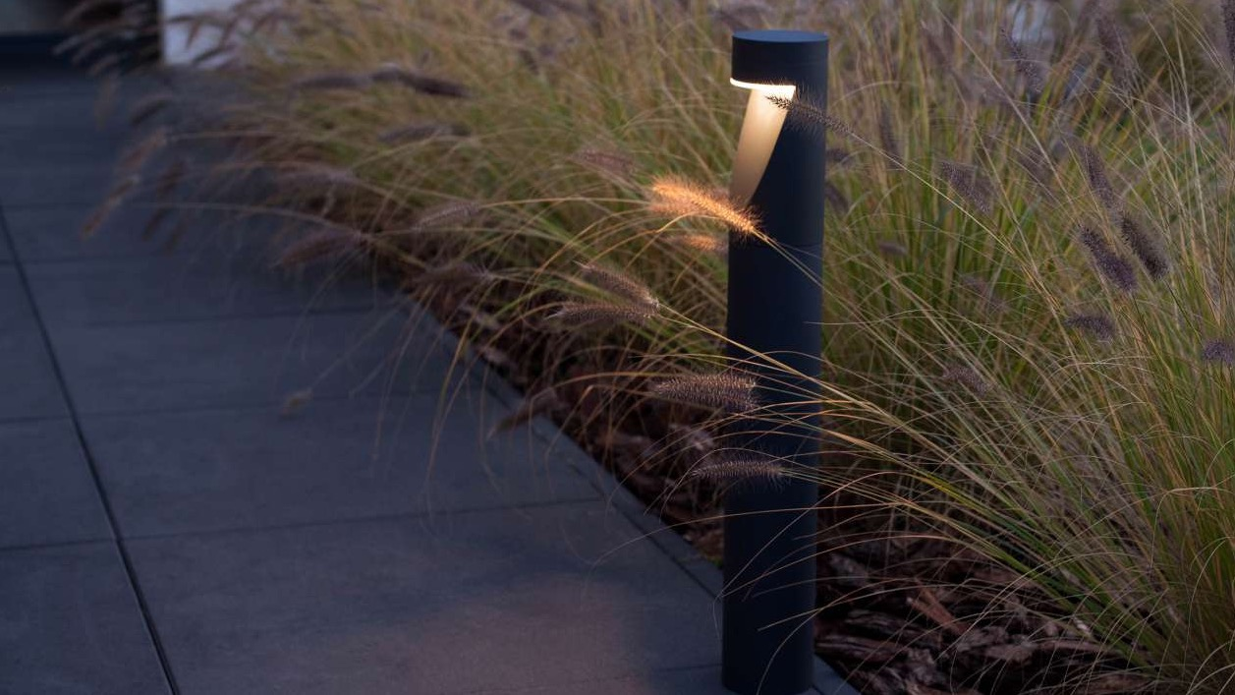



Slide 2
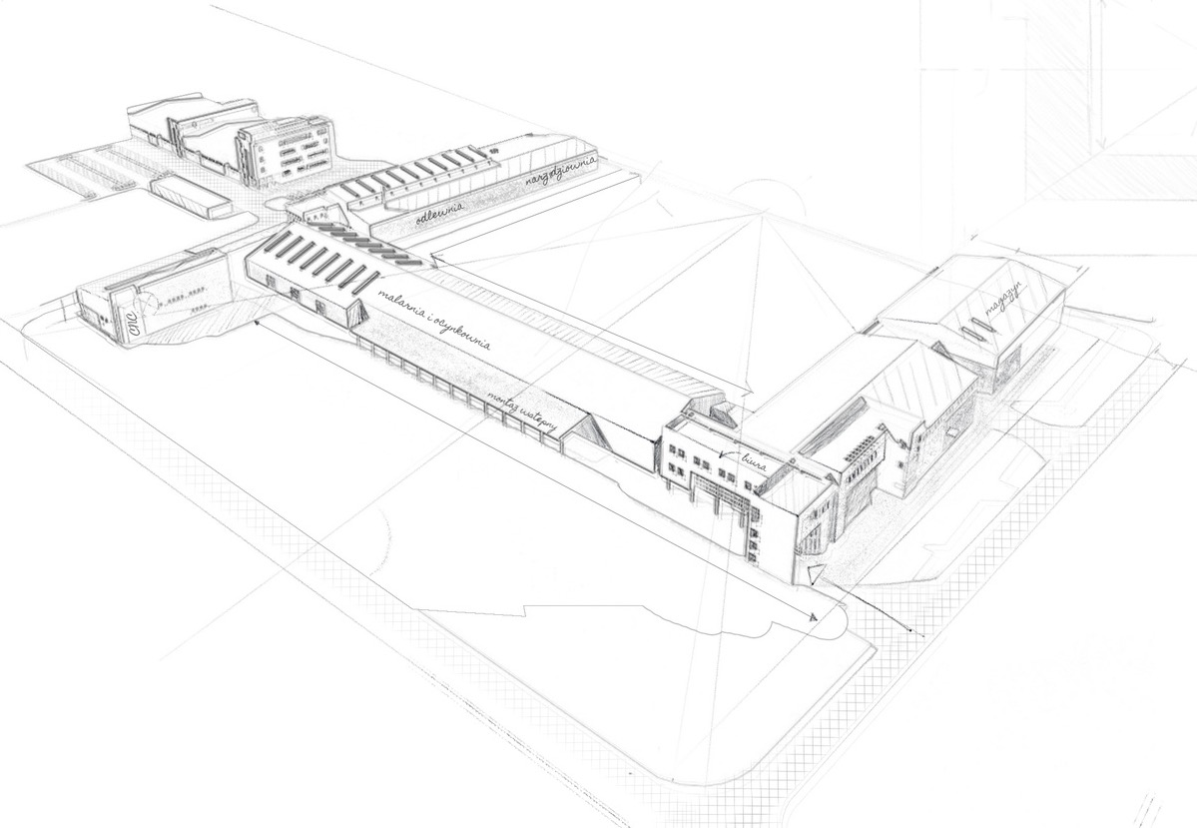

Brightening your life
with our passion for light
Norlys is the embodiment of the Scandinavian spirit. It was born in the frosty North, reflecting its simplicity, resilience, and natural essence. However, it has a second face—an offering of a strong and invigorating handshake. Norlys is the answer to long polar nights, the rawness of nature, and the need for security. That's why we have been illuminating spaces for 30 years. It is our passion and mission.
What works in Norway works worldwide. As we design for the future, we conserve resources, think about future generations, and respect the nature we draw inspiration from. We provide long-lasting quality because caring for the environment is caring for our customers. By offering a diverse range of outdoor lighting products, we cater to both residential and commercial customers, including municipalities, architects, landscape designers, and homeowners. Our efficient and attractive lighting solutions contribute to the safety, ambiance, and overall aesthetic of outdoor spaces.
Our history, tradition, and experience are a source of pride for us, but also a commitment to better understanding the needs of people. The values we won't compromise on and wholeheartedly believe in present us with new challenges and form the foundation of our mission: to co-create a beautiful, better world with you and for you. We help you feel at home in this world.

Slide 3



Our values
For People
Passion of Light
Responsibility
We are experts in our field, but we are
also eager to share our knowledge.
Our aspiration is to develop and maintain lasting relationships with our customers, who are the driving force behind everything we do at norlys.
We believe in shaping the world in our own way. Gently and harmoniously, but with passion, showcasing it in the best possible light. We know it deserves nothing less.
We look to the future, think long-term, and know that future generations will follow in our footsteps. Honesty in our approach to sustainable development requires us to adhere to the most rigorous standards of production quality and environmental responsibility.

Slide 4

norlys in numbers
30+
300+
24
5mln
years on the market
team members
countries
unit sold

Slide 5
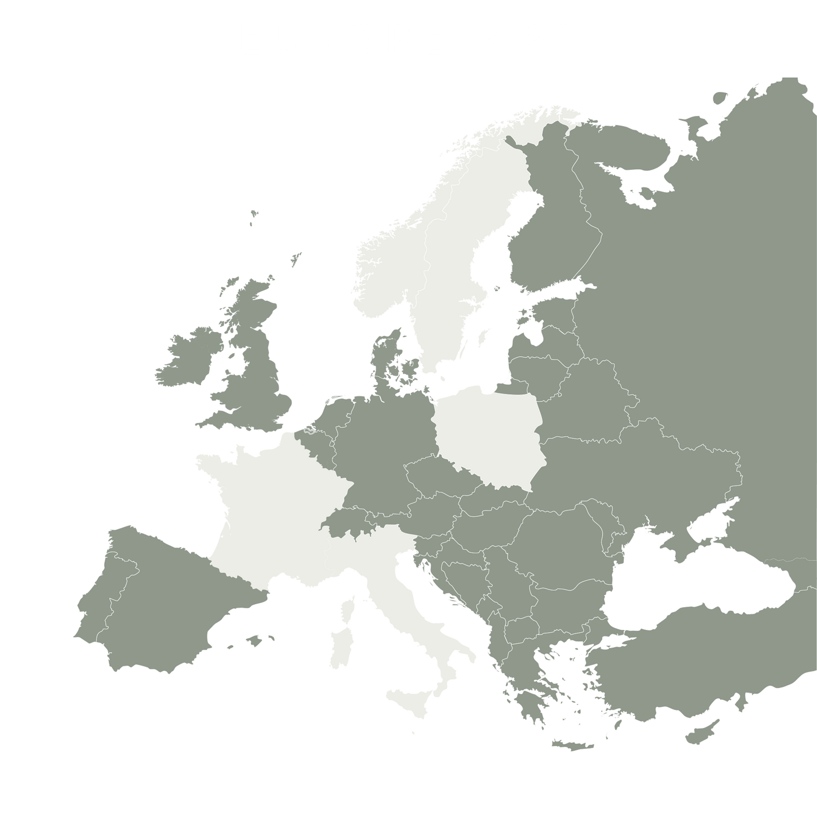
Norlys around the world
We have built a strong and reliable presence in Europe (except Russia and Belarus), MENA, and Australia with our branches located in Norway, Sweden, France and Poland accompanied by our extensive sales network of professional distributors.
With our expansive reach and local presence, we understand the unique preferences and requirements of each region. Our team of experts is well-versed in navigating the intricacies of different markets, enabling us to tailor our offerings to match the specific demands of the target audience.
Our dedication to customer satisfaction drives us to provide optimized logistics solutions, streamlining the process and ensuring timely delivery of the products.

Slide 6
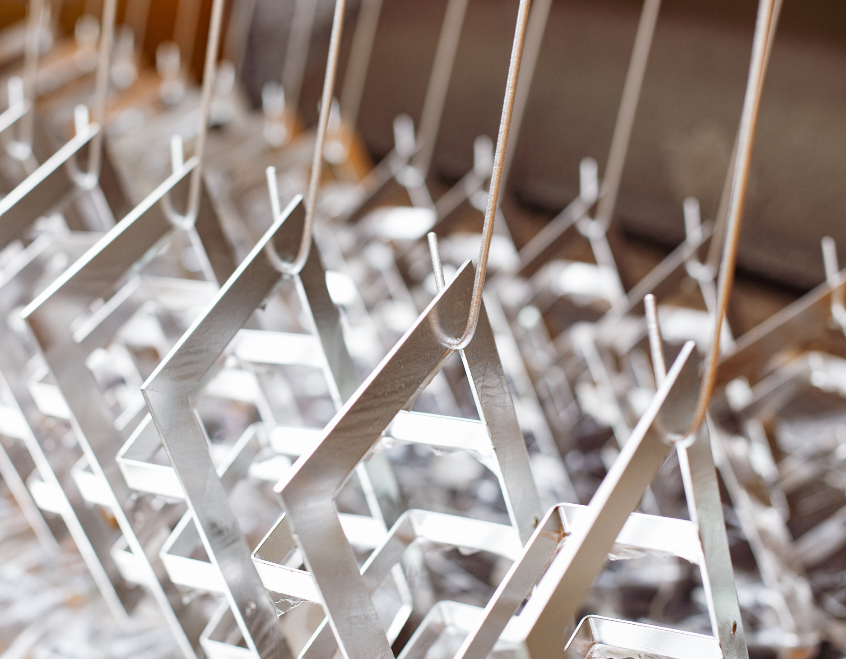
The highest quality at every stage
of production
Our state-of-the-art facilities are the heart of our operations, equipped with cutting-edge technology and manned by a skilled team of experts. We take pride in our vertically integrated production process.
Within our facilities, we house an aluminum foundry, a press department, dedicated hot-dip galvanizing department, machining department employing CNC machining techniques and a powder paint shop.
To ensure the highest quality standards, we have invested in a dedicated Research Laboratory equipped with top-class specialized equipment. This enables us to conduct rigorous testing on our lighting fixtures, ensuring they meet the stringent requirements specific to ENEC (European Norms Electrical Certification), in accordance with the ISO 17025 standard.

Slide 7
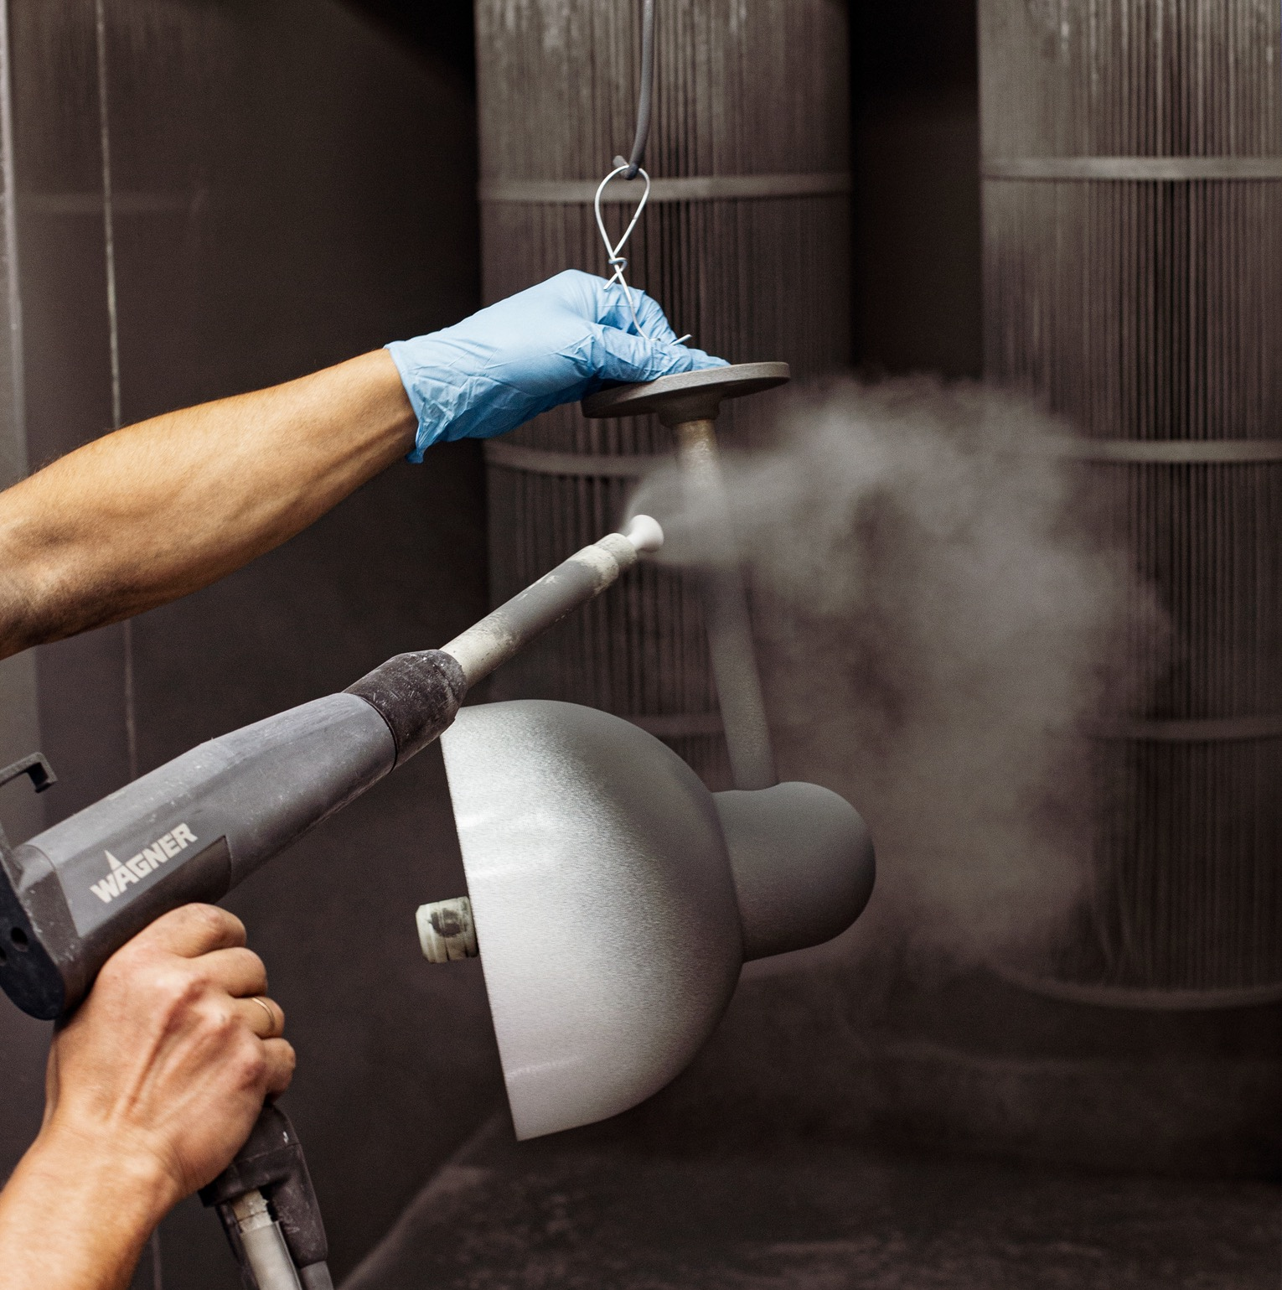
Durability of our product
At norlys, we have a steadfast belief in the power of quality. It is the foundation upon which our reputation is built and the driving force behind our success.
Our unwavering commitment to quality means that we source materials known for their durability and reliability. Whether it's aluminum or stainless steel, we ensure that our luminaires are crafted from the best available materials, setting a strong foundation for exceptional performance.
To protect and enhance the appearance of our luminaires, we employ meticulous finishing techniques. Our products undergo a powder varnish coating or hot-dip zinc treatment, providing a robust shield against corrosion and mechanical damage. This means that our lighting fixtures not only maintain their impeccable appearance but also withstand the test of time.
Our rigorous quality control processes ensure that every luminaire leaving our facility adheres to the highest industry standard

Slide 8
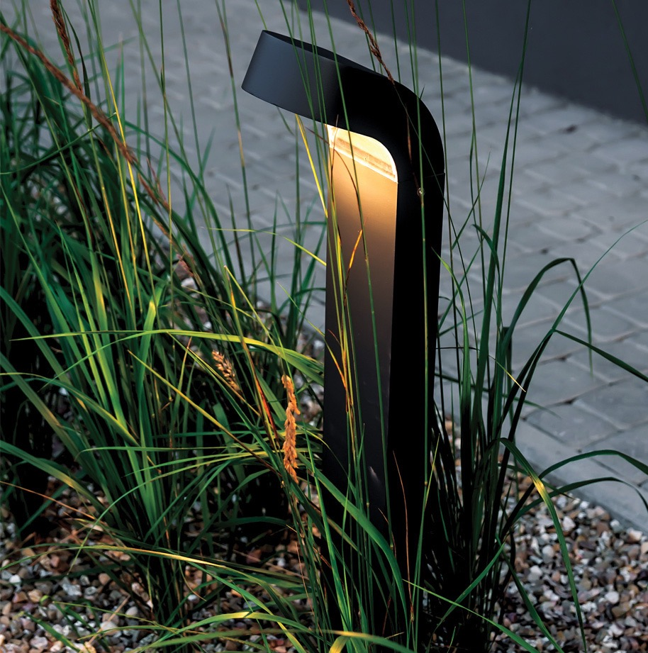

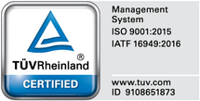

Sustainable development and environmental responsibility
Our commitment to the natural environment and sustainability is at the core of everything we do. As an eco-friendly company, we prioritize reducing our carbon footprint and implementing practices that align with our environmental values.
In our production halls, we have integrated heat recovery modules, allowing us to efficiently harness and utilize waste heat, reducing our overall energy consumption. Furthermore, we operate our own sewage treatment plant, ensuring that our processes are environmentally responsible.
We are proud to hold three quality system certificates - ISO 9001:2015, ISO 14001:2015, and IATF 16949:2016. These certifications demonstrate our unwavering commitment to maintaining the highest standards of quality, environmental management, and continual improvement across all aspects of our operations.
In addition to our quality management systems, we have also implemented the ISO 17025 series. This accreditation is an assurance of our commitment to quality testing and validation.

Slide 9
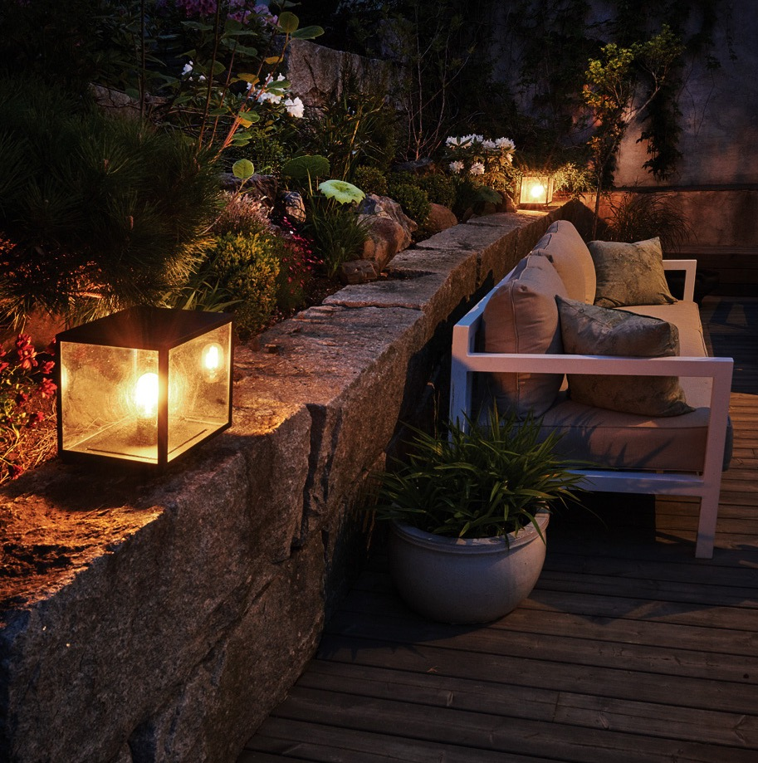
Illuminate your
home&garden
Our exquisite luminaires are designed with exceptional durability and distinctive aesthetics, and not only provide the necessary illumination but also elevate the visual appeal of a garden.
Crafted with meticulous attention to detail, our products are built to withstand the harshest weather conditions, ensuring their longevity and performance in any outdoor setting.
The clients may experience the perfect balance between functionality and style as our lighting fixtures illuminate a garden with optimal light output. Whether it is needed to brighten up a pathway for safety, accentuate a captivating landscape feature, or create a cozy ambiance on your patio, our luminaires are the ideal choice.
Our wide range of designs and styles ensures that you'll find the perfect product to suit your unique taste and match the aesthetic of any outdoor space. From sleek and modern fixtures to timeless and elegant designs, norlys luminaires create a captivating and inviting atmosphere in any garden.

Slide 10
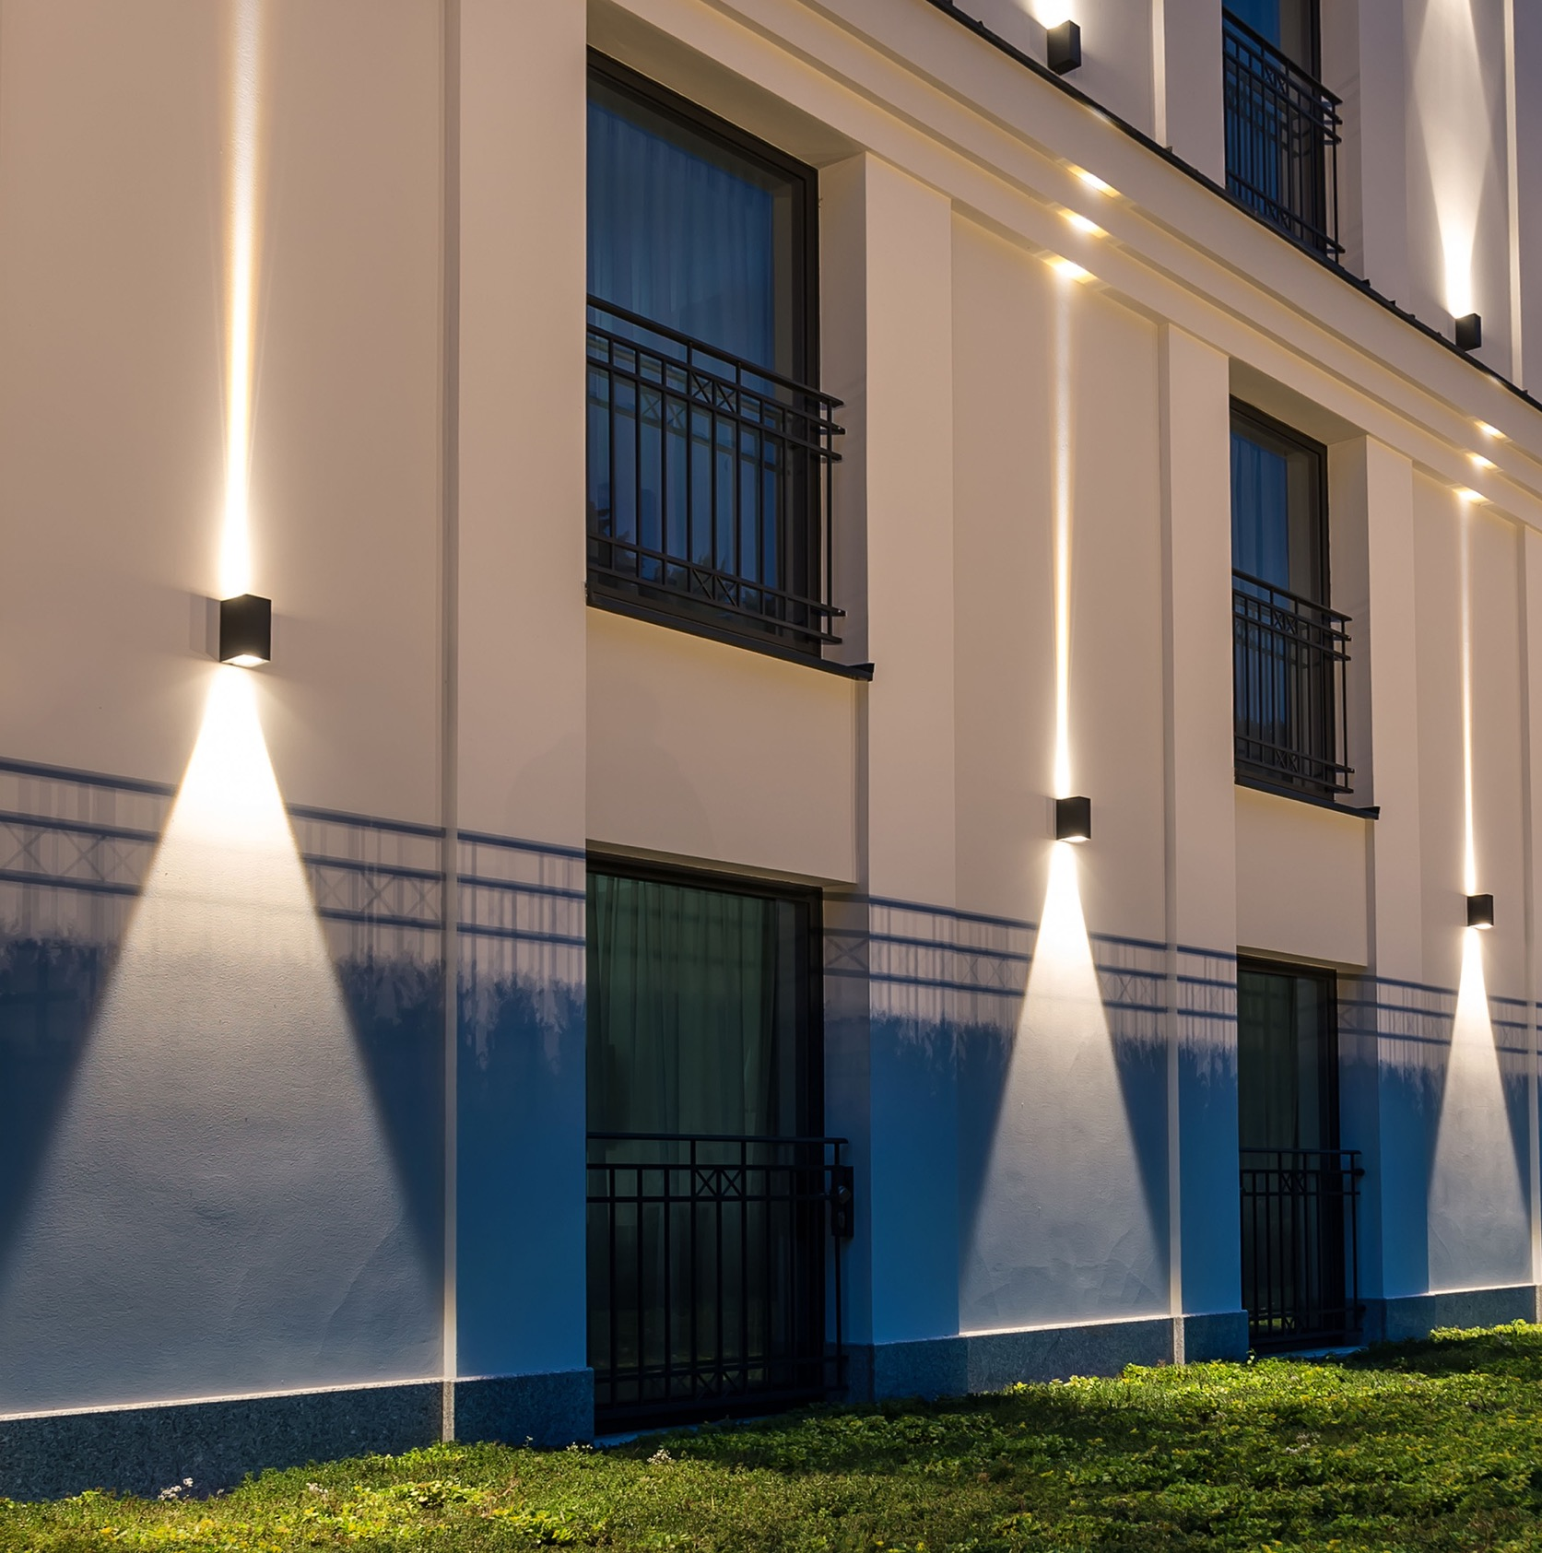
Modern luminaires
Step into the world of modern lighting with our exceptional range of luminaires. Designed to captivate and inspire, our Asker, Glode, Narvik, Lillehammer, Borg, and other models embody the essence of contemporary aesthetics. With their sleek and minimalist design, our luminaires effortlessly blend into any environment, creating a seamless integration with a modern decor.
Illuminate surroundings with confidence as our luminaires are equipped with bright and energy-efficient LEDs. These cutting-edge light sources provide optimal illumination while minimizing energy consumption, making them a sustainable and cost-effective lighting solution.
To perfectly complement a personal style and interior design, we offer a wide range of colors and finishes. Whether a bold and eye-catching hue is needed or a subtle and understated tone, our selection allows to customize lighting fixtures to create the desired ambiance.

Slide 11
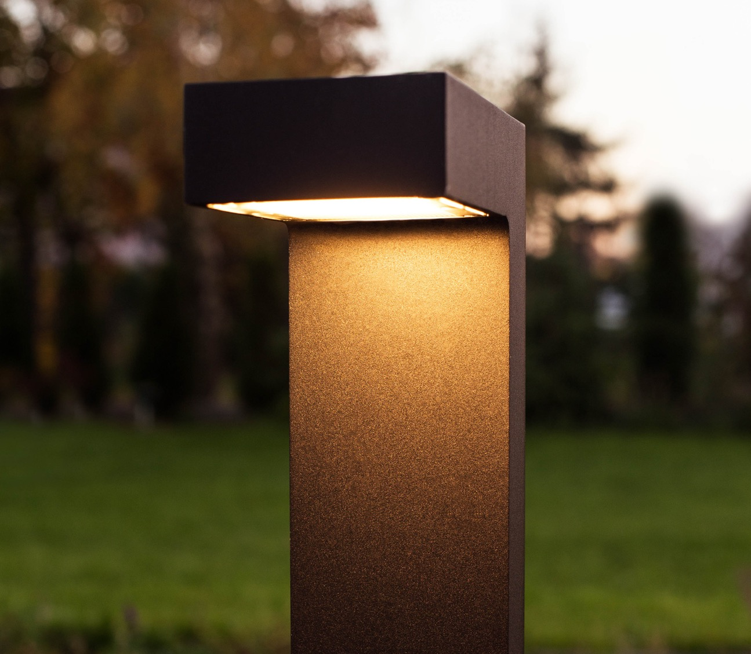
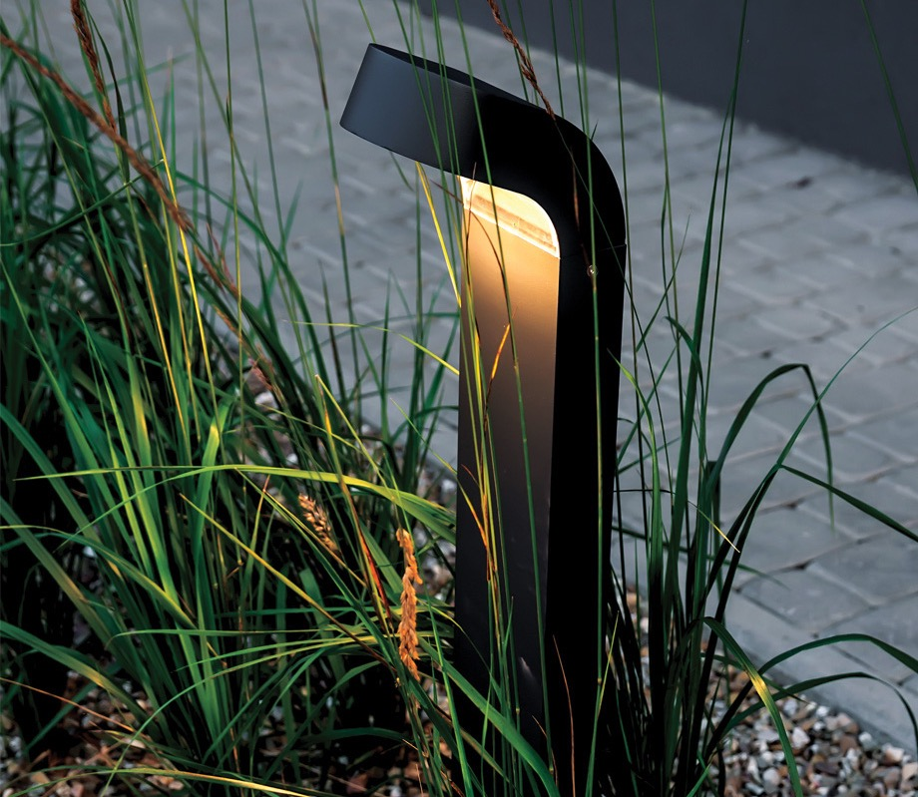
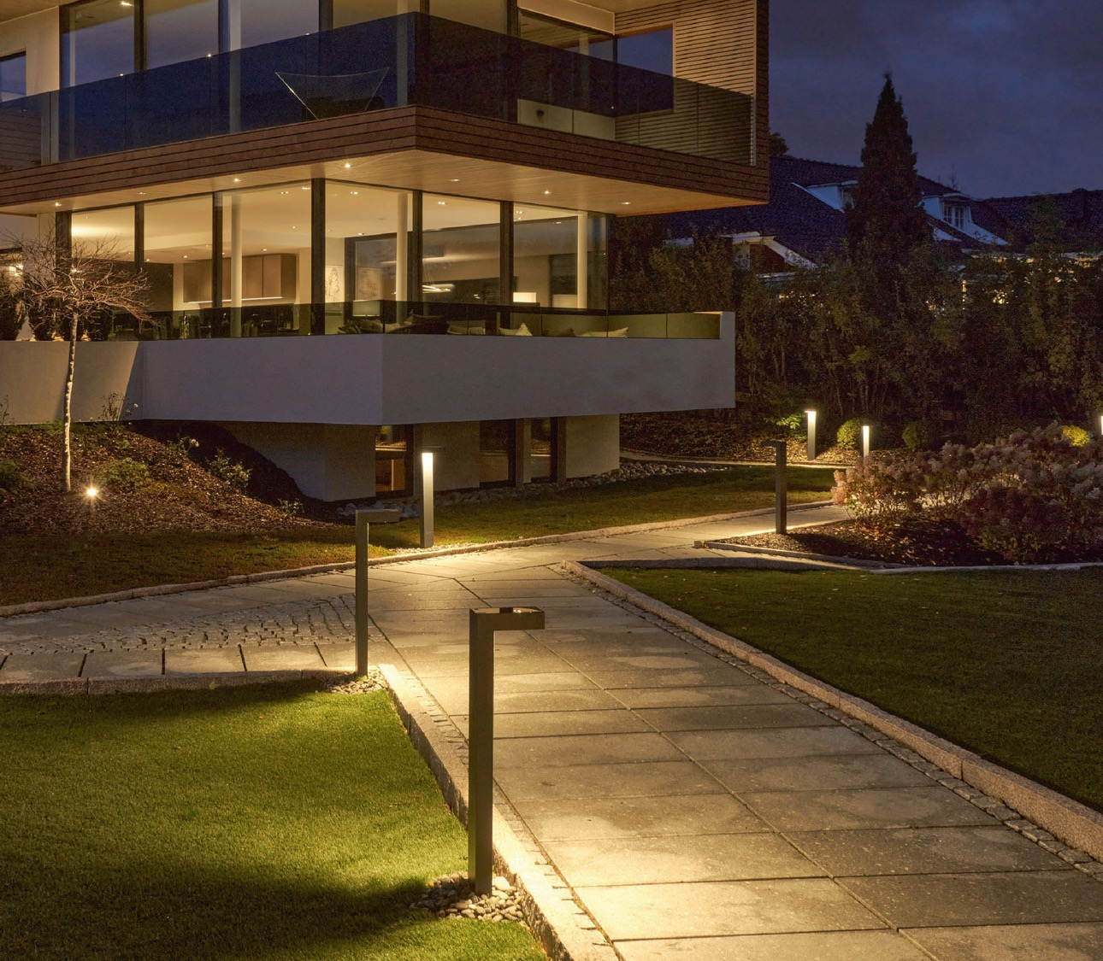
Asker
Molde

Slide 12
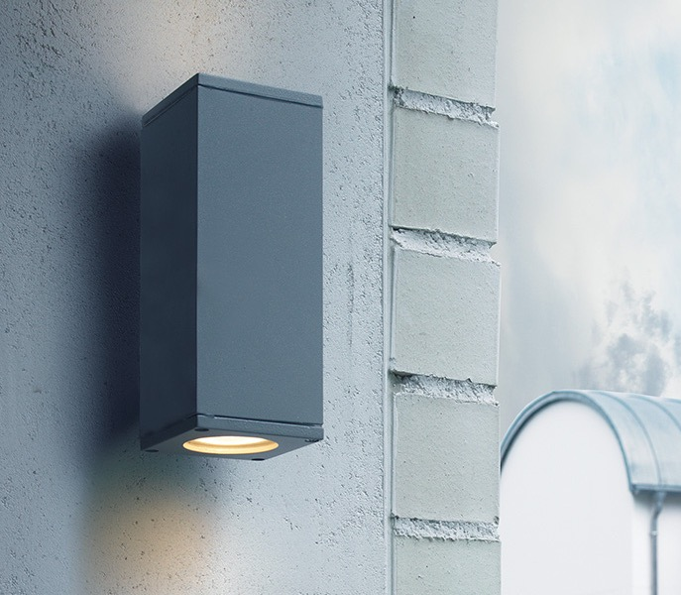
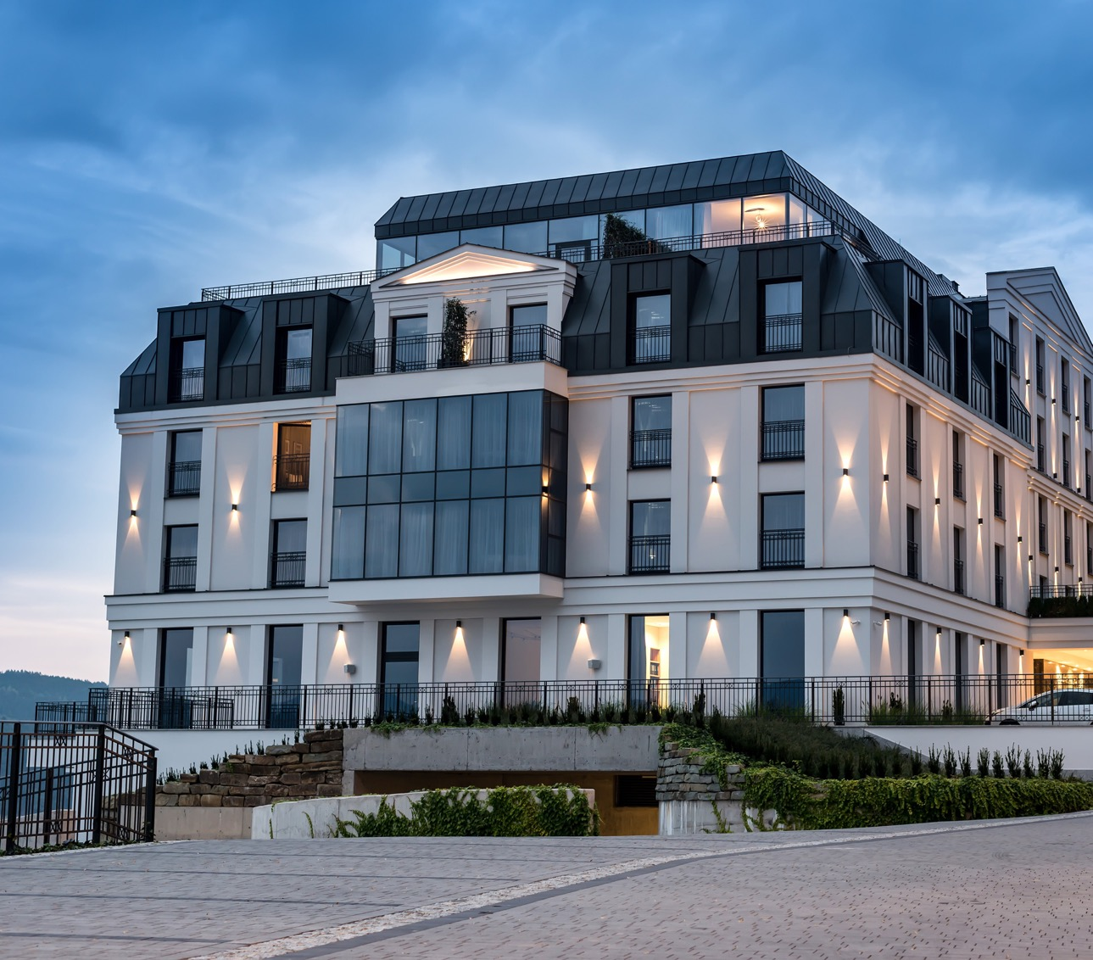
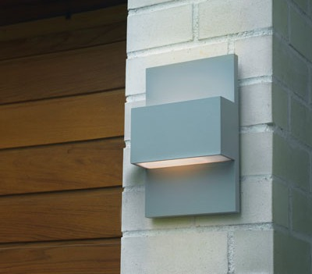
Sandvik
Geneve

Slide 13
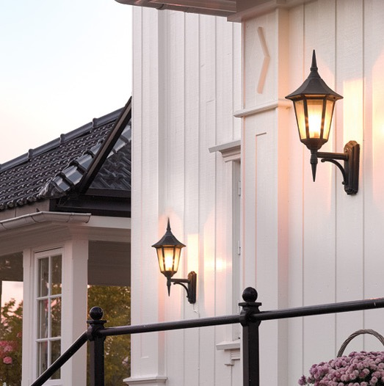
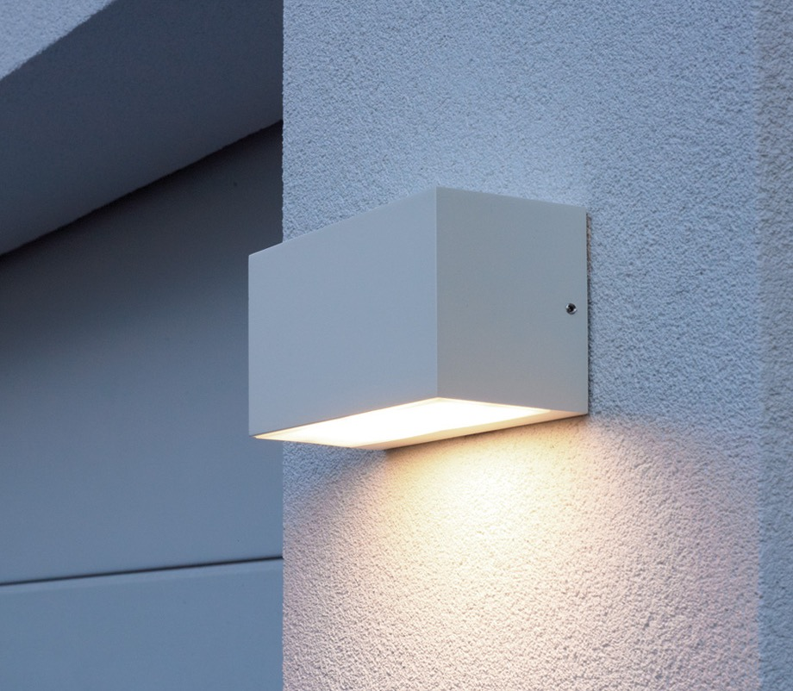
Classic luminaires
Elevate the elegance of an outdoor space with our collection of classic luminaires. Designed with a timeless charm, these luminaires exude sophistication and add a touch of refinement to any area. Their classic design style ensures they never go out of fashion, allowing to enjoy their beauty for years to come.
Whether it's a garden, pathway, or patio, these luminaires become focal points that exude a sense of charm and grace. They create an inviting ambiance that leaves a lasting impression on all who experience them.
While our classic luminaires boast a traditional design, we continuously strive to enhance their functionality. Through ongoing improvements and innovations, we ensure that these luminaires meet the highest standards of performance.

Slide 14
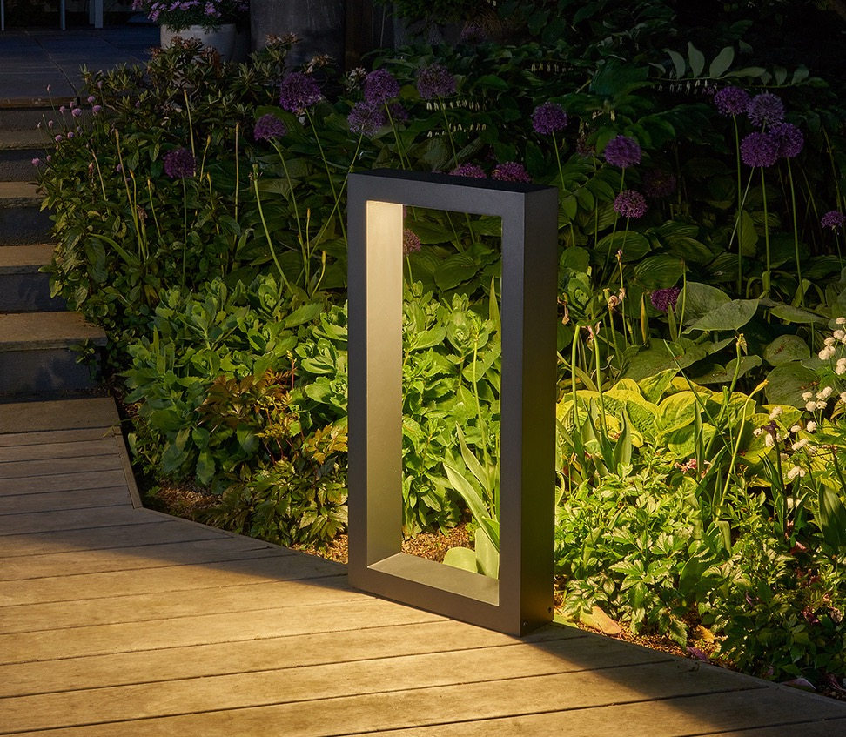
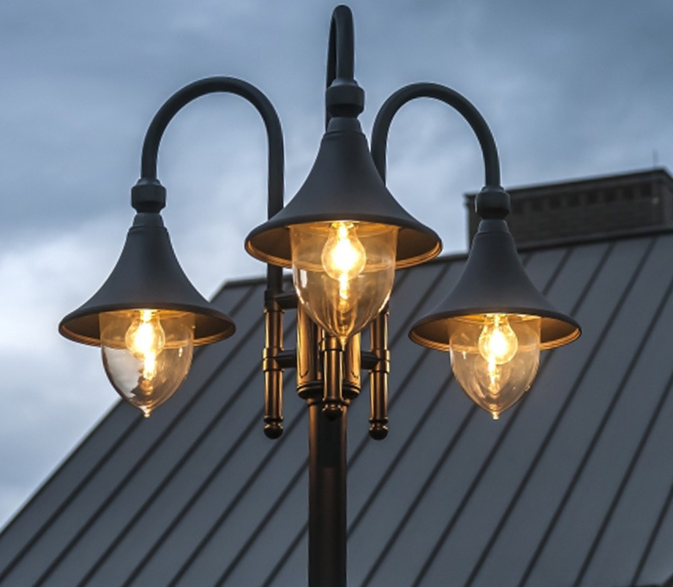
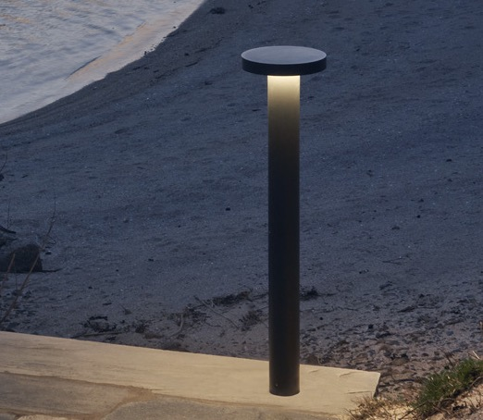
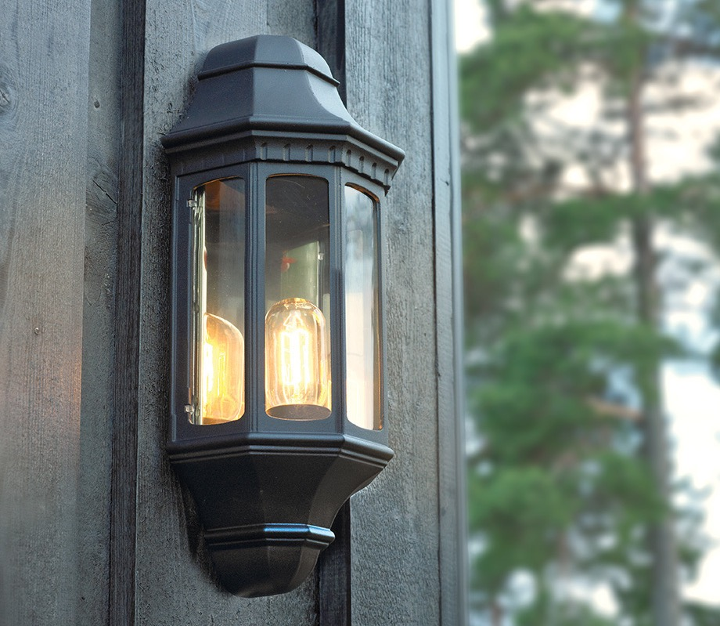
Firenze
Genova

Slide 15
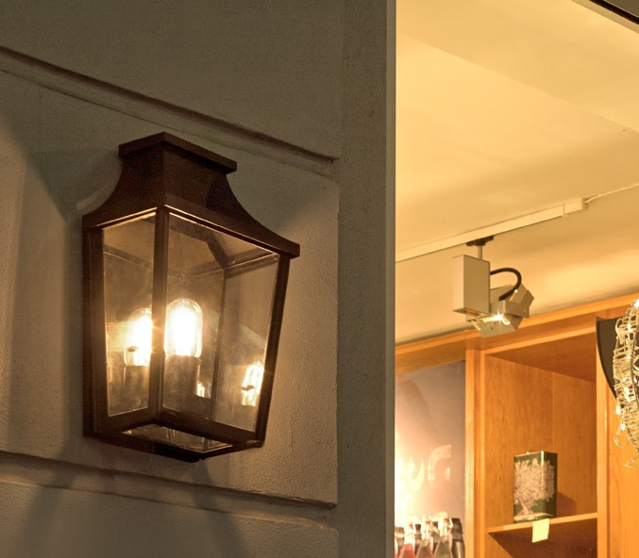
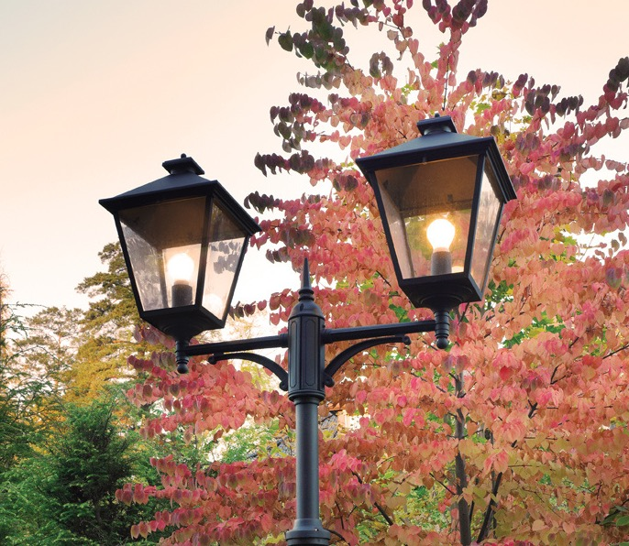
London

Slide 16
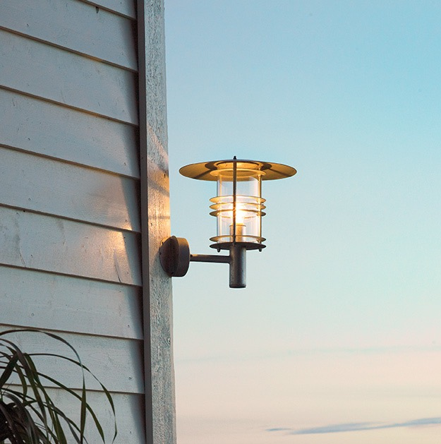
Loft luminaires
Designed to serve elegance and functionality for modern outdoor spaces. Crafted with attention to detail, our luminaires are designed to seamlessly blend with contemporary and minimalist aesthetics.
With their sleek and stylish appearance, Loft Luminaires add a touch of sophistication to any outdoor setting, be it a cozy patio, a trendy rooftop terrace, or a sprawling garden. Their clean lines and minimalist form create a visually stunning statement, instantly elevating the ambiance of any space.
Our cutting-edge technology ensures ample illumination with an emphasis on energy efficiency.
Crafted from high-quality, waterproof materials, they are built to withstand the harshest elements nature throws their way. Rain, snow, or shine, our luminaires remain unyielding, maintaining their flawless appearance and superior performance year after year.

Slide 17
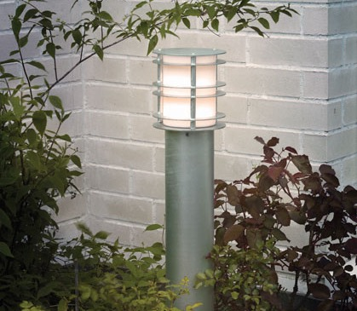
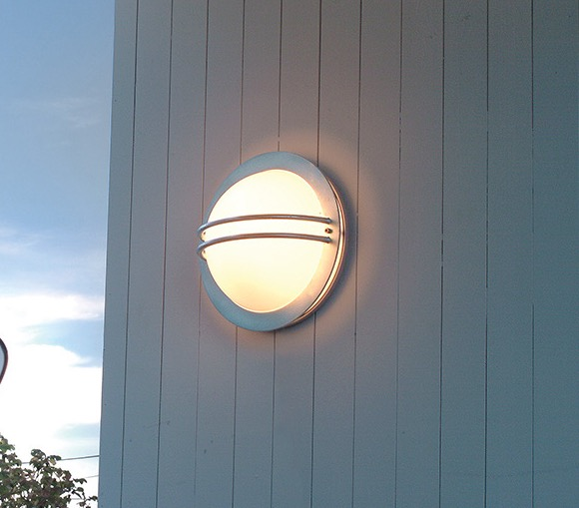
Stockholm
Bremen

Slide 18
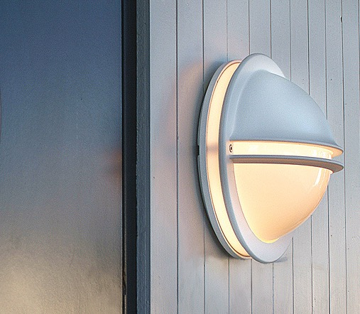
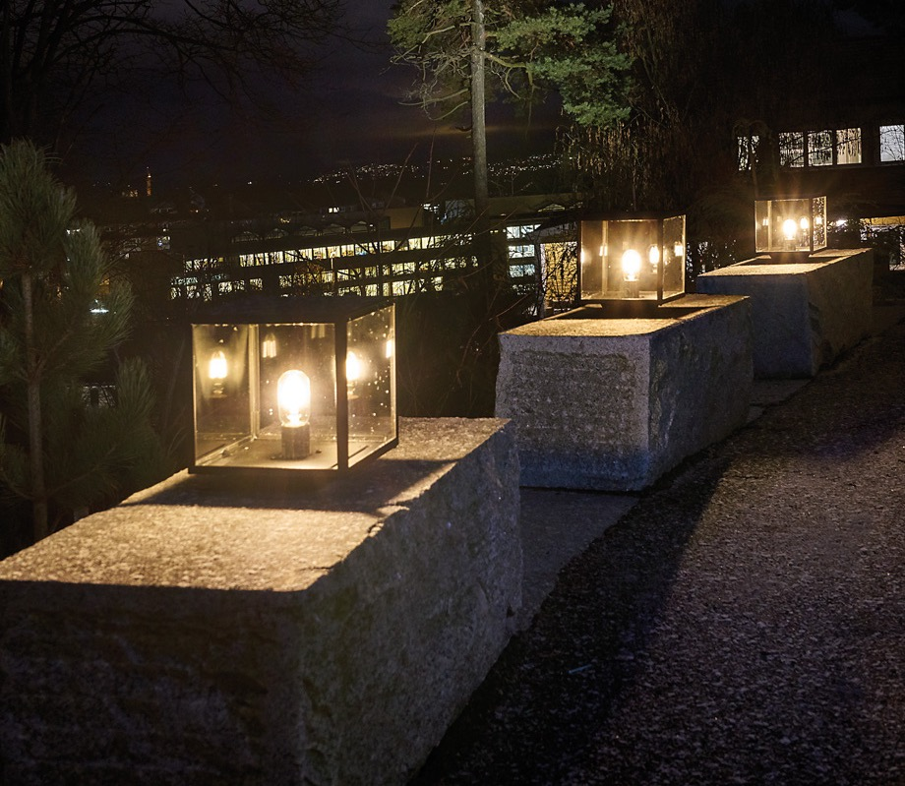
Berlin
Lofoten

Slide 19
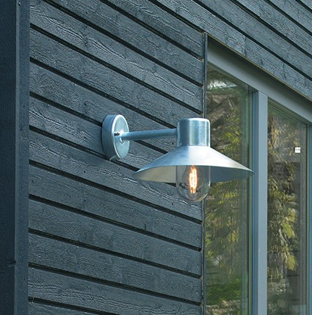
Industrial luminaires
Discover the allure of our industrial luminaires - the epitome of style, durability, and functionality for outdoor lighting requirements, that embody the perfect fusion of contemporary design and rugged resilience.
The industrial products are carefully crafted to exude an air of chic minimalism, making a bold statement in any outdoor space. With their clean lines, robust construction, and industrial finishes, they add a touch of urban charm that resonates with the discerning tastes of today's design-conscious individuals.
Designed with functionality in mind, these lighting fixtures provide exceptional illumination. Their powerful light output ensures optimal visibility, promoting safety and security in any outdoor setting.
Industrial lighting solutions are built to withstand the toughest environmental conditions. From extreme temperatures to heavy rains, they are engineered to endure while maintaining their impeccable appearance and superior performance for years to come.

Slide 20
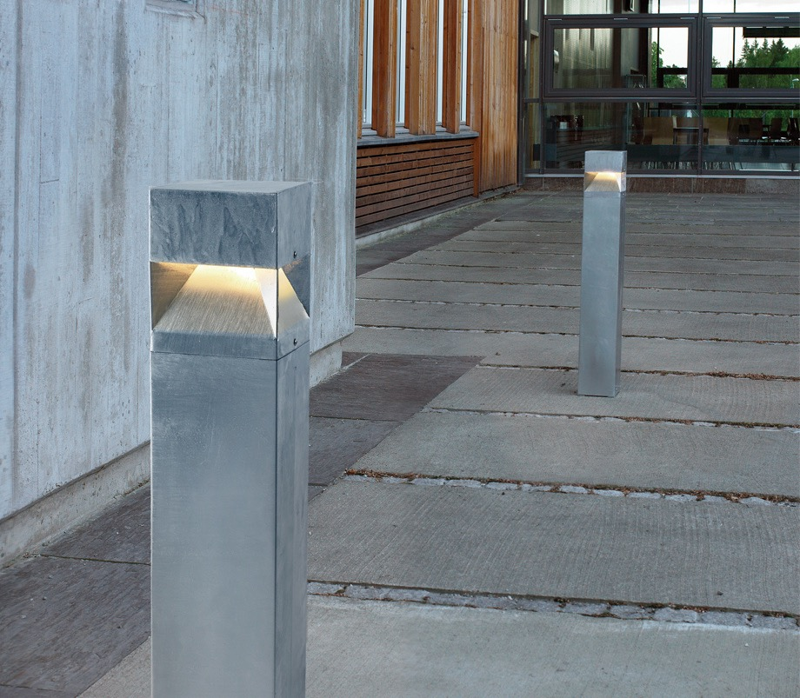
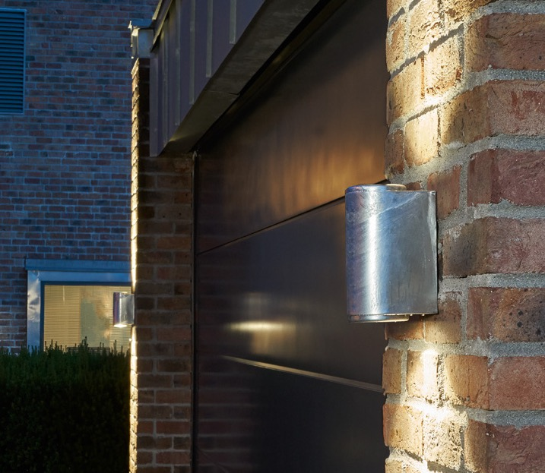
Arvika
Mandal

Slide 21
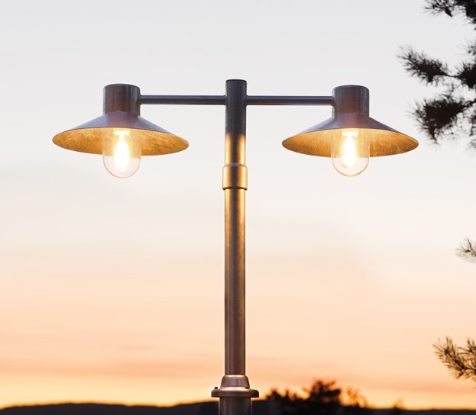
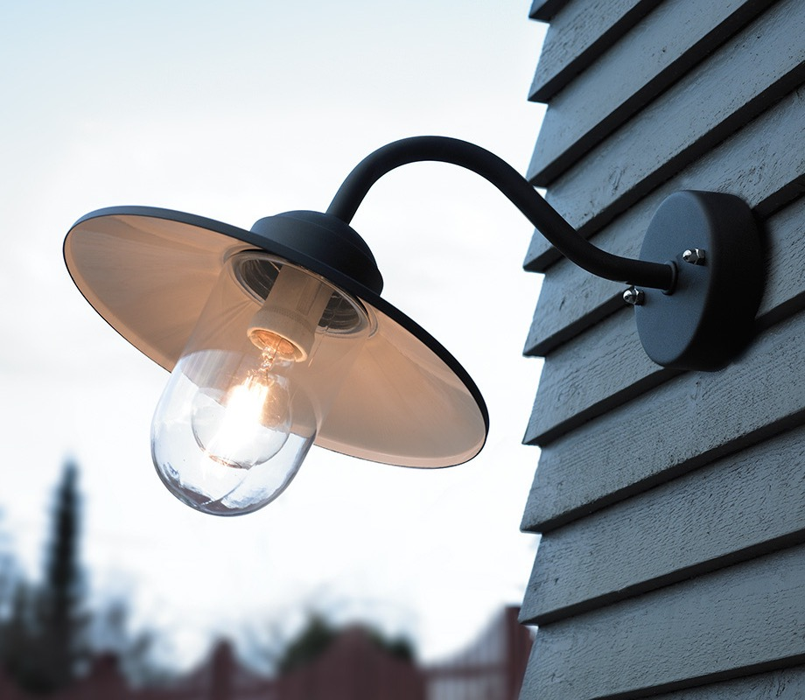
Lund
Karlstad

Slide 22
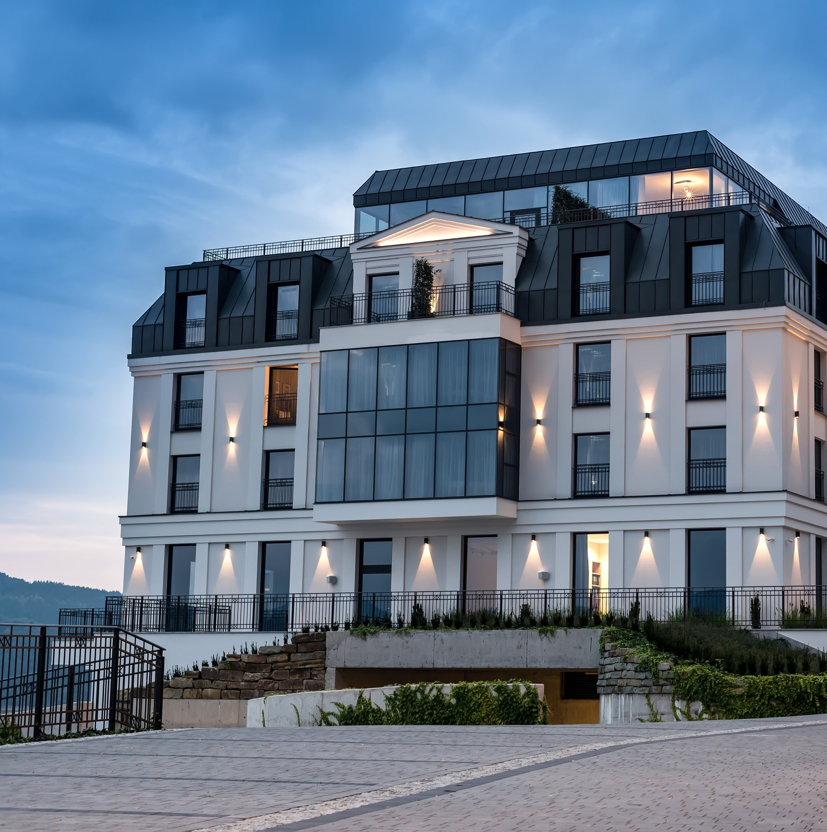
Best solution for your
investment project
When it comes to your investment project, we offer the best solution that combines functionality, aesthetics, and reliability. Our extensive range of lighting options provides architects with a diverse selection to choose from, ensuring that the projects stand out with the perfect lighting solution.
With a wide variety of heights, colors, light temperatures, and design options, our luminaires offer endless possibilities to suit your project's unique requirements. Modern designs or timeless and elegant styles, norlys provides the best lighting solutions that elevate any investment project to new heights.

Slide 23
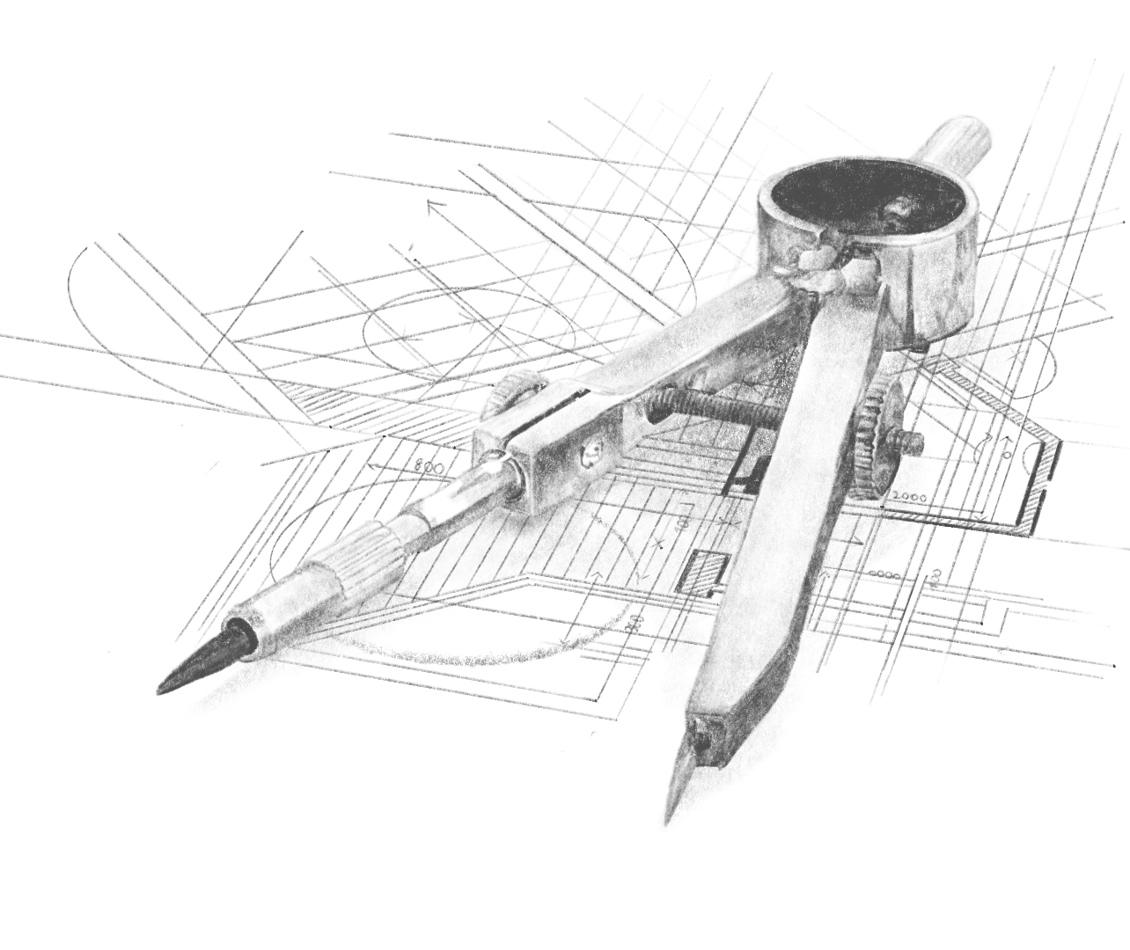
For architects
We understand the importance of collaboration and work closely with architects throughout the entire investment. From initial consultation to project completion, we provide architects with the necessary tools, resources, and files to streamline the integration of our lighting solutions into the designs. Our dedicated team is readily available to address any questions or concerns that may arise, ensuring a smooth and successful partnership.
With our commitment to delivering excellence, our lighting solutions will not only enhance the aesthetics of any project but also provide reliable and long-lasting performance. We prioritize the highest standards of quality and craftsmanship, ensuring that our luminaires become a part of your investment project vision.

Slide 24
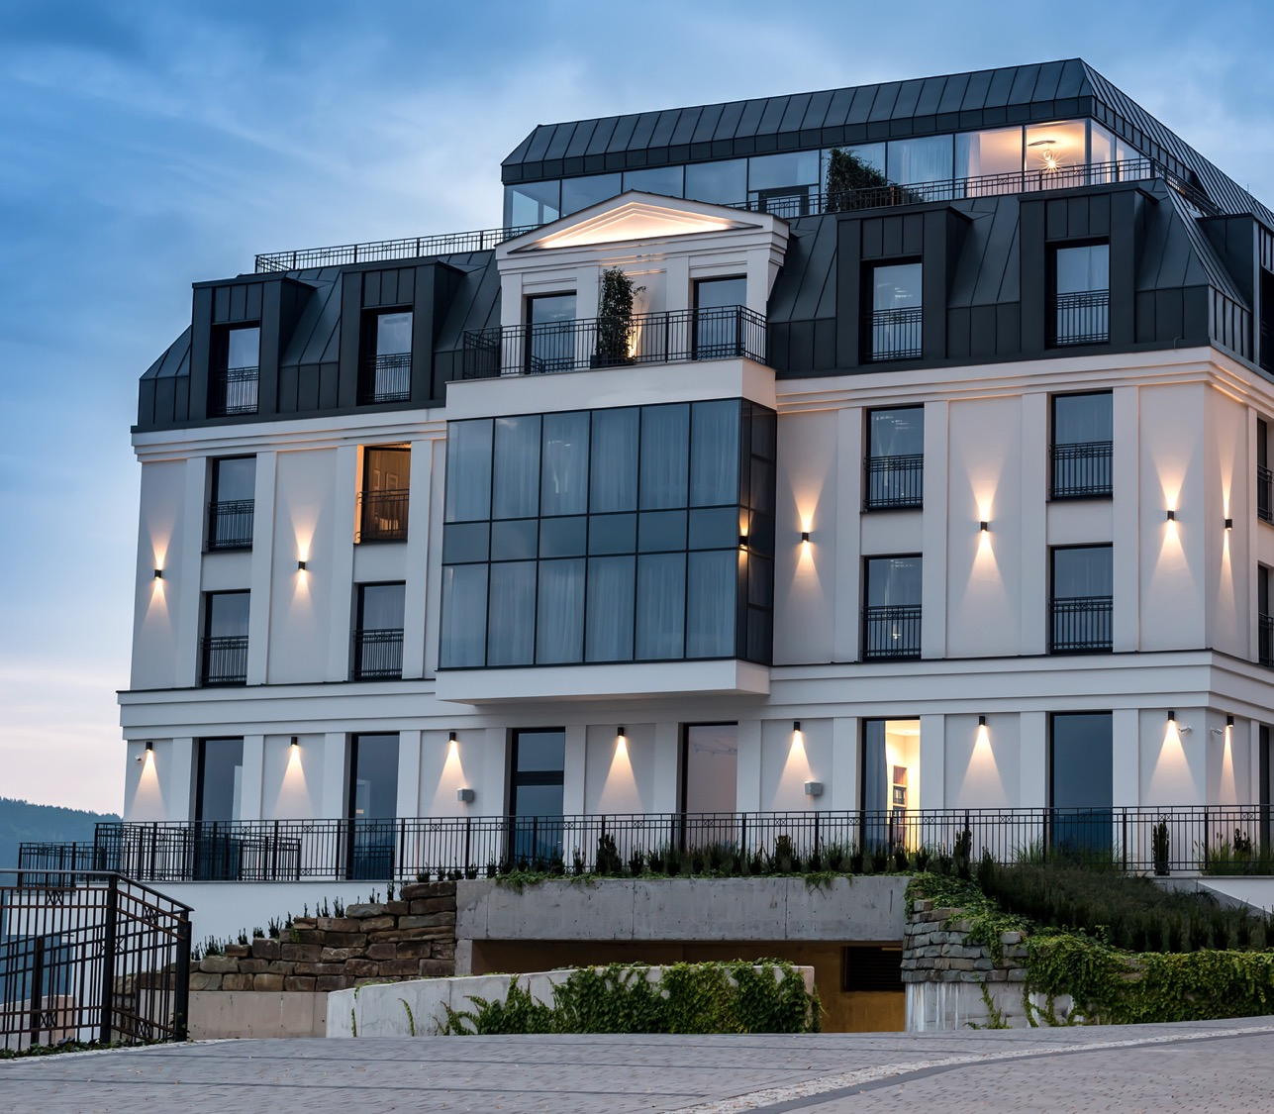
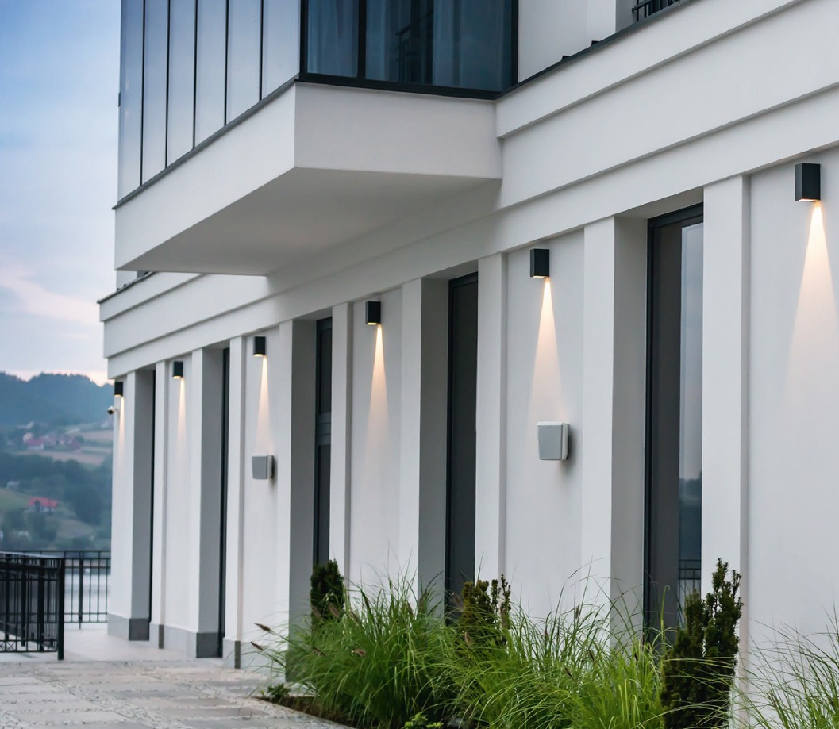
Lillehammer

Slide 25
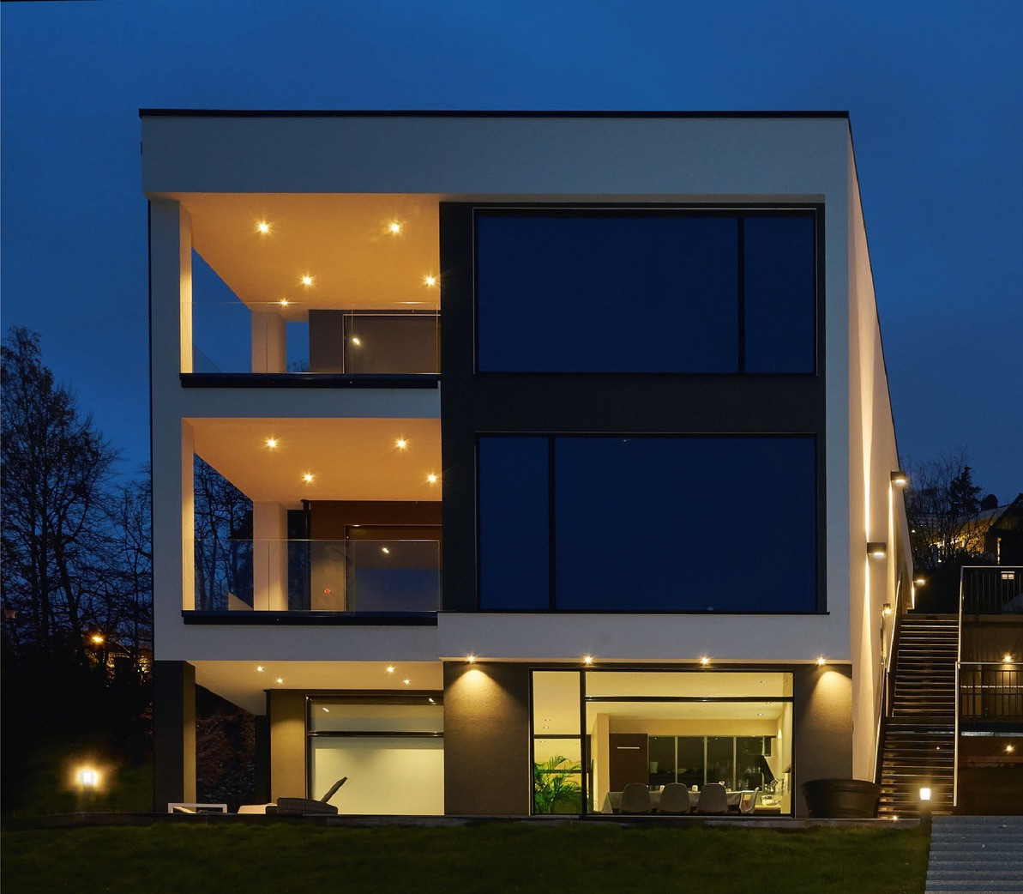
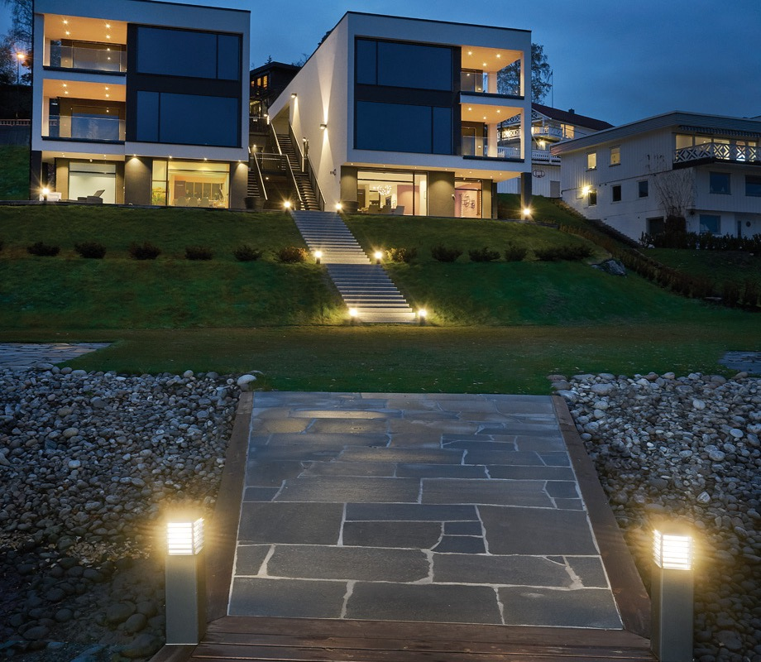
Voss
Halmstad

Slide 26
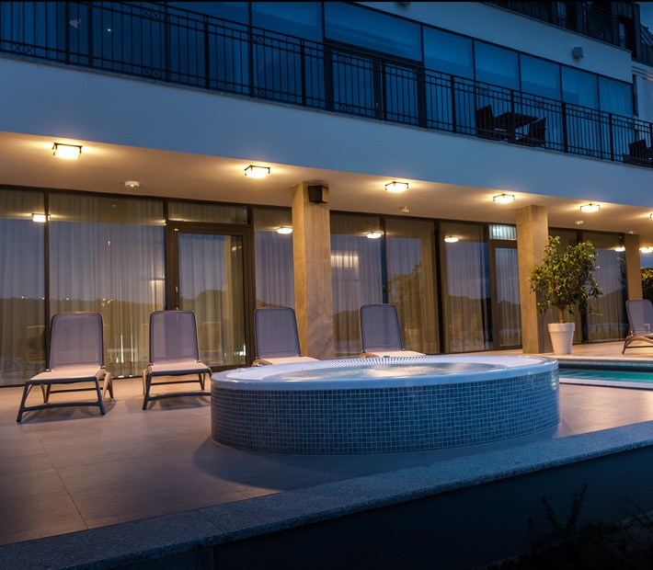
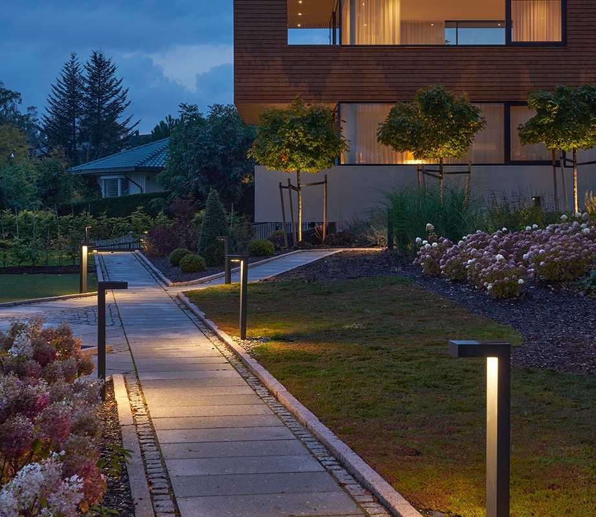
Nordland
Asker

Slide 27
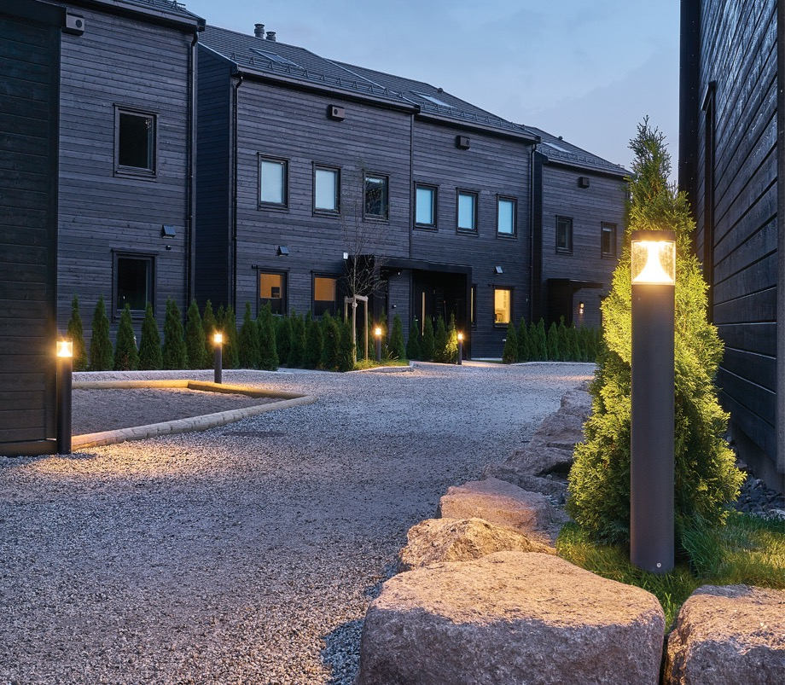
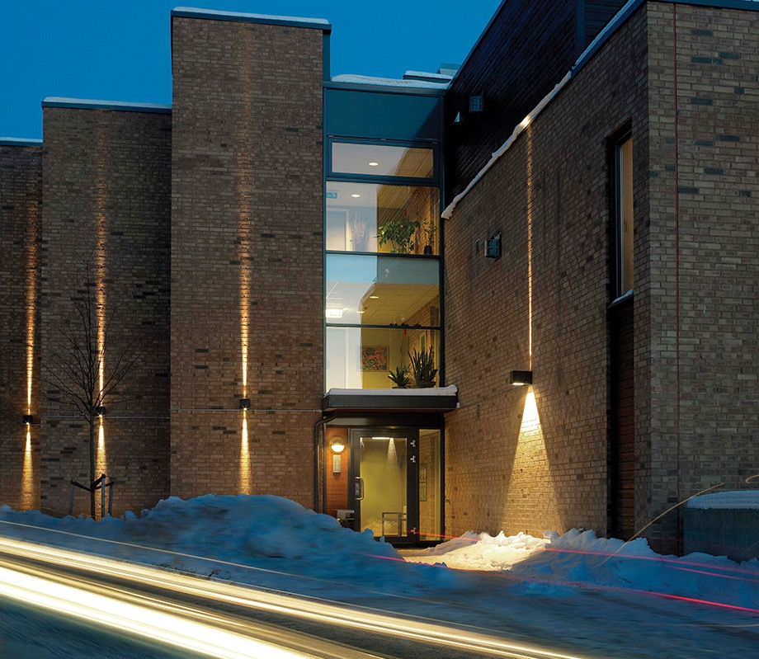
Egersund Mini
Voss

Slide 28
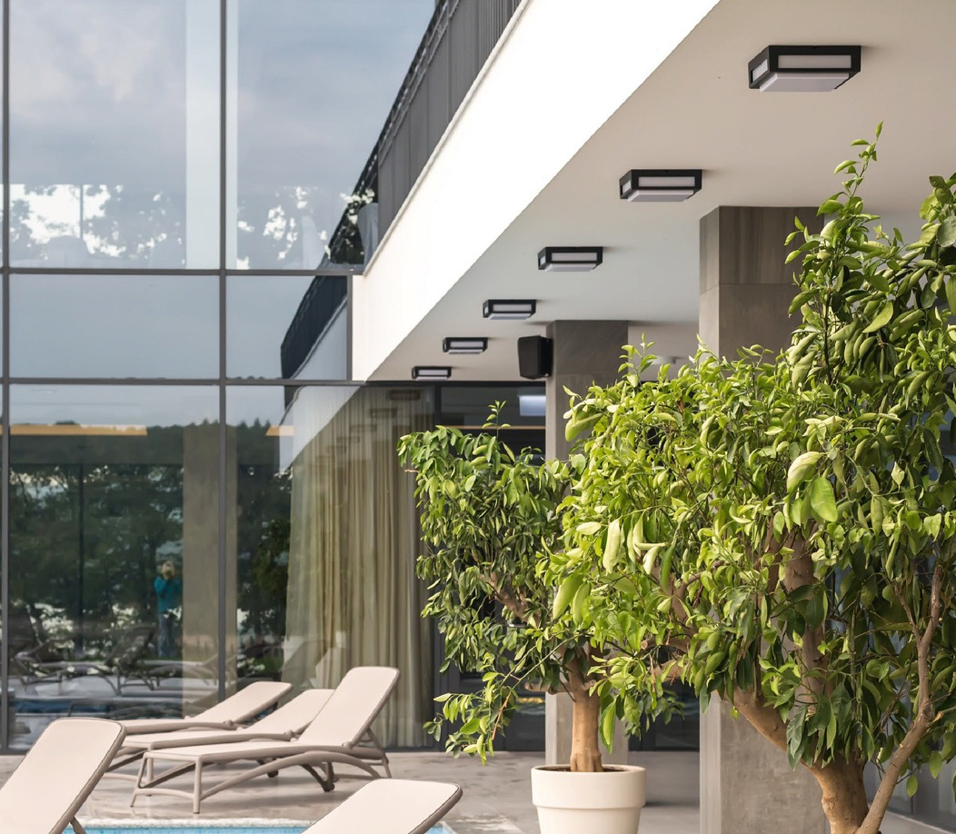
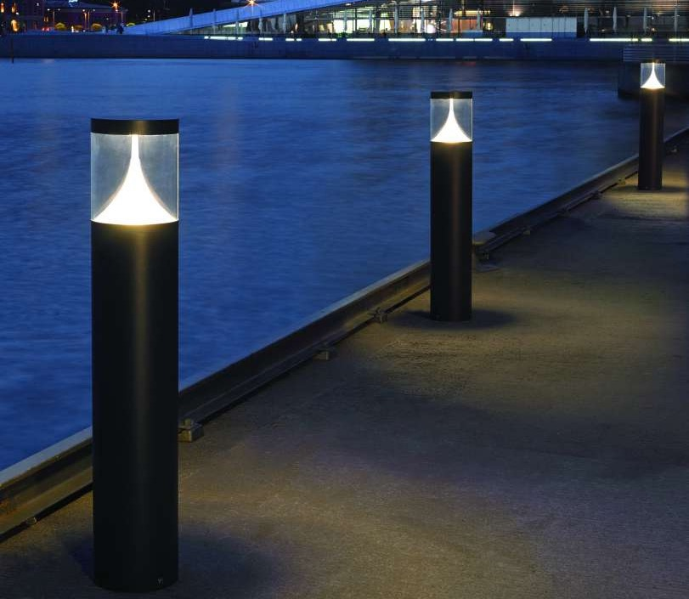
Nordland
Egersund

Slide 29
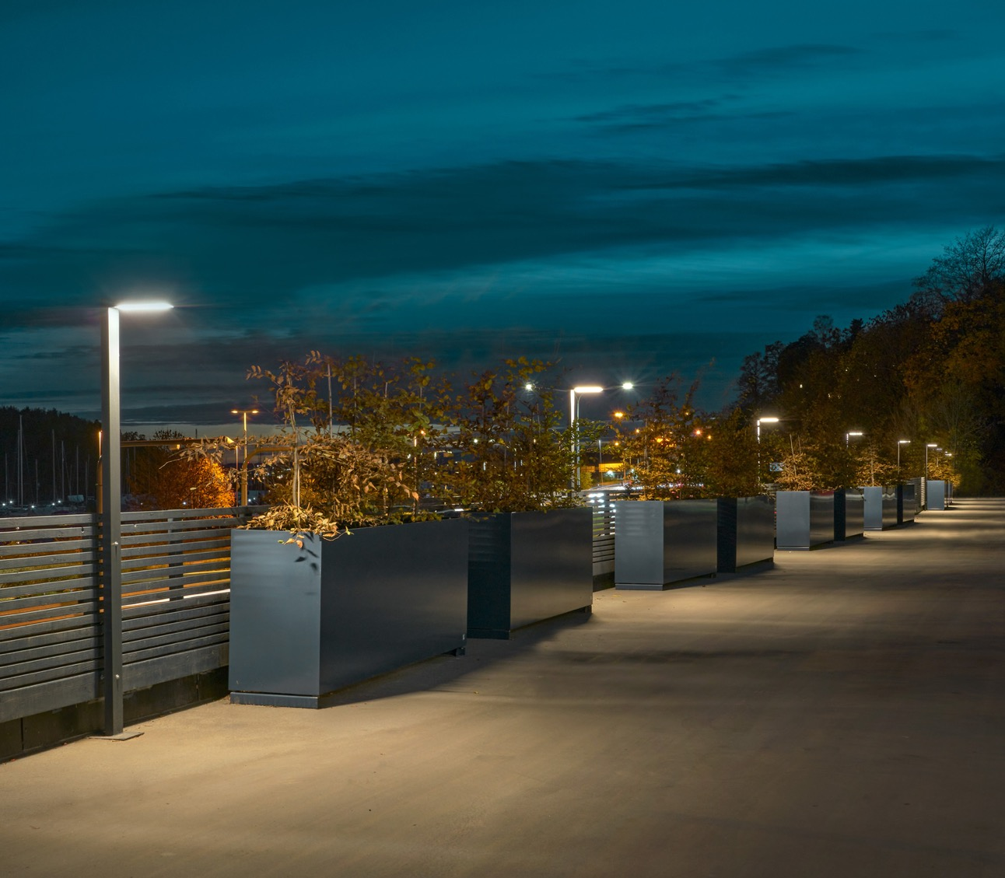
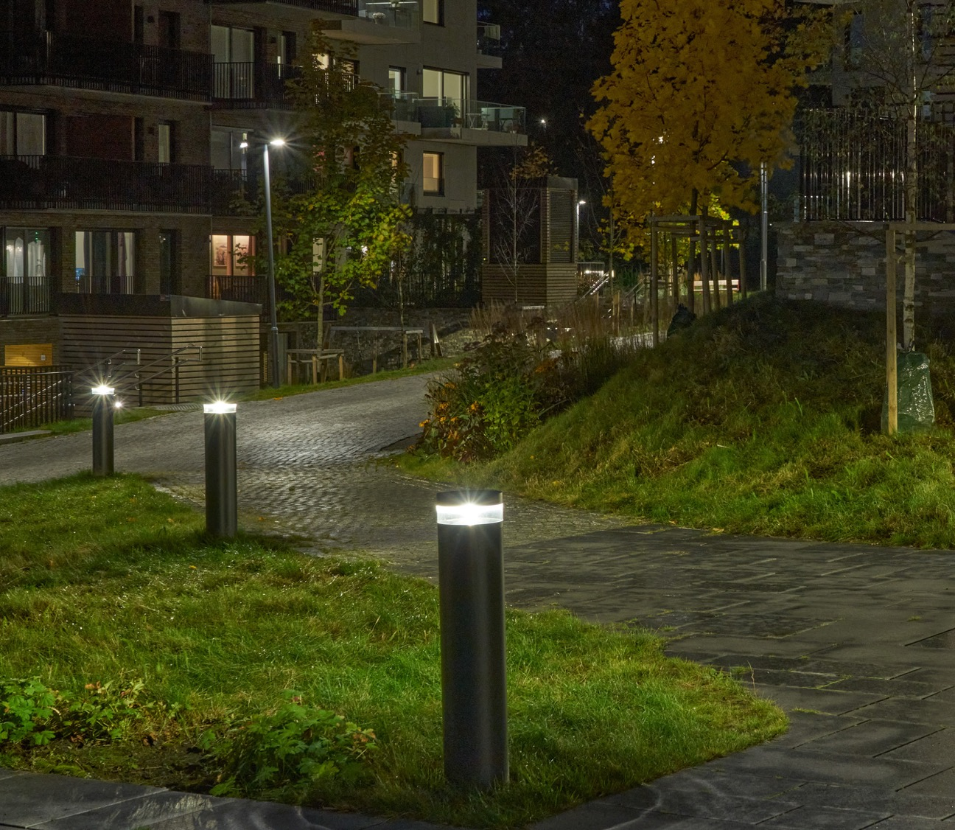
Asker Pole
Stavanger

Slide 30


Contact
Norlys AS
Hovfaret 4B, NO-0275 Oslo
P.B 1014 Hoff, NO-0218 Oslo - Norway
info@norlys.com

