Slide 1
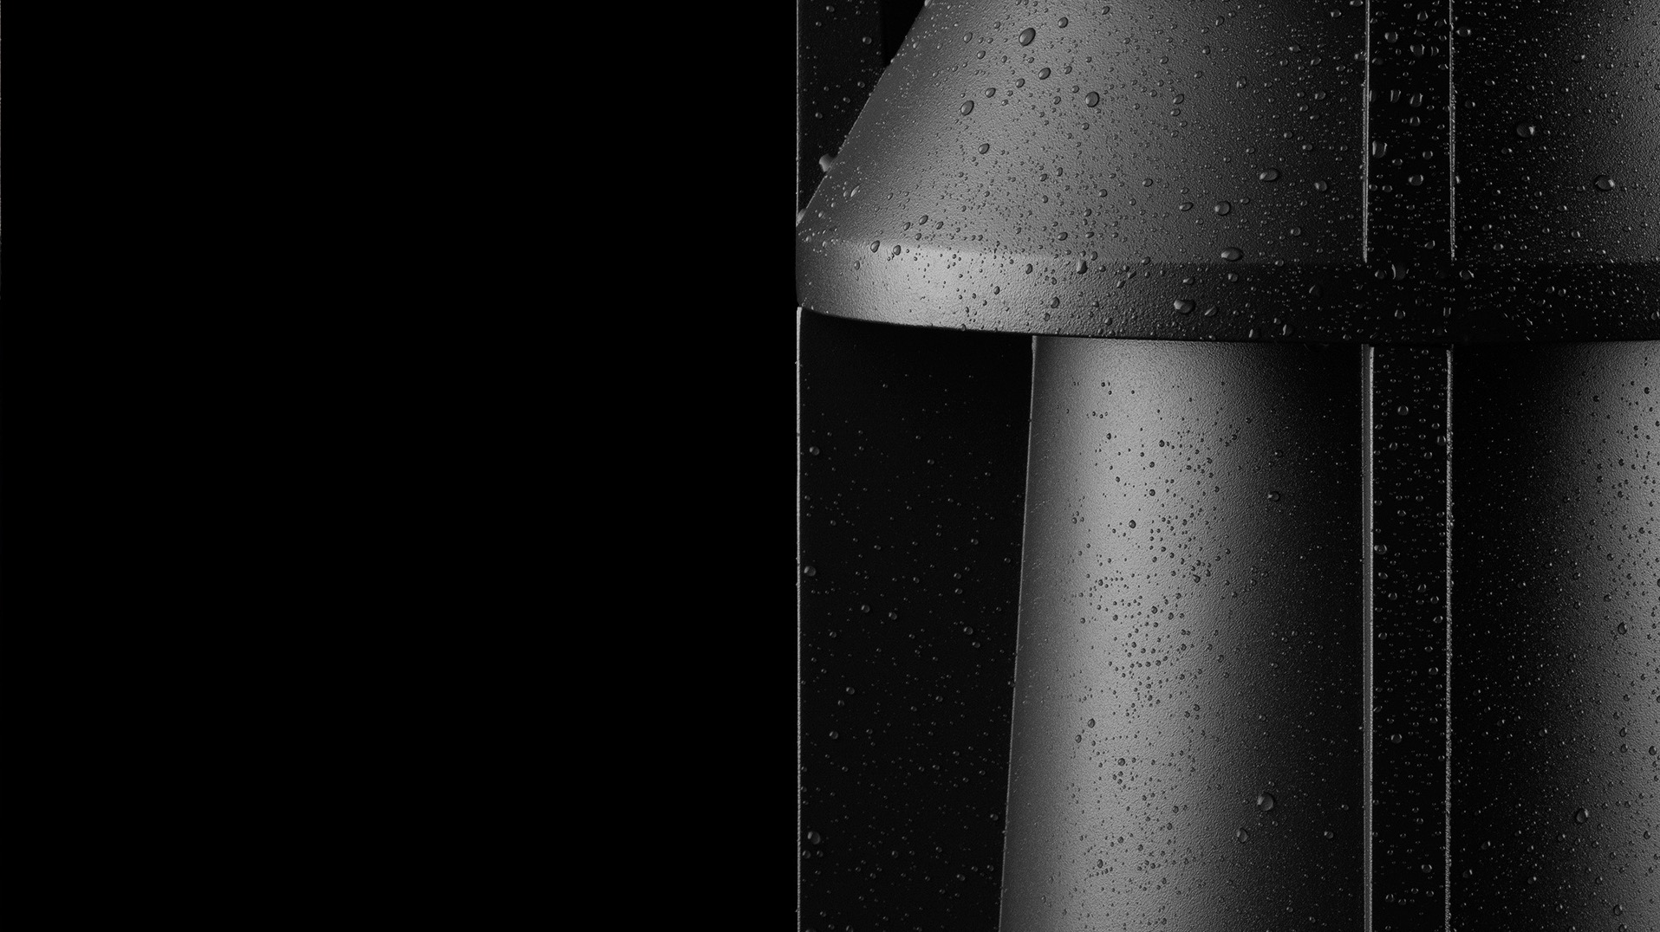

MATERIALS USED IN PRODUCTION
SURFACE PROTECTION
(AGAINST CORROSION)

Slide 2
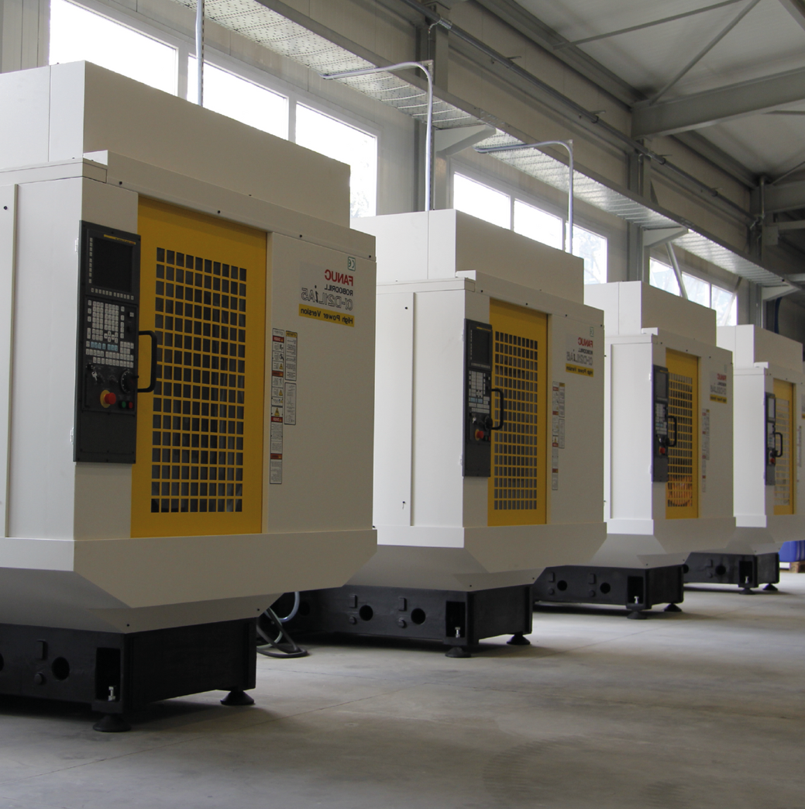
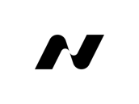
SURFACE PROTECTION
Norlys uses solid and long proven technology processes to assure best possible anti-corrosion properties for its product surfaces.
We possess laboratory base, which enables performing various tests (material composition, density, thickness of chemical pretreatment, zinc and polymer paint layers) along with the final ageing and salt chamber tests of performance of applied material and technology.

Slide 3
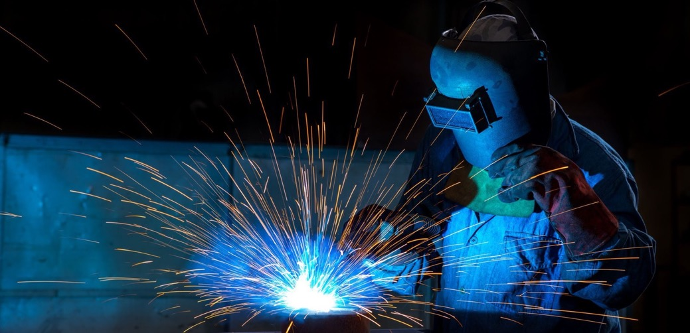
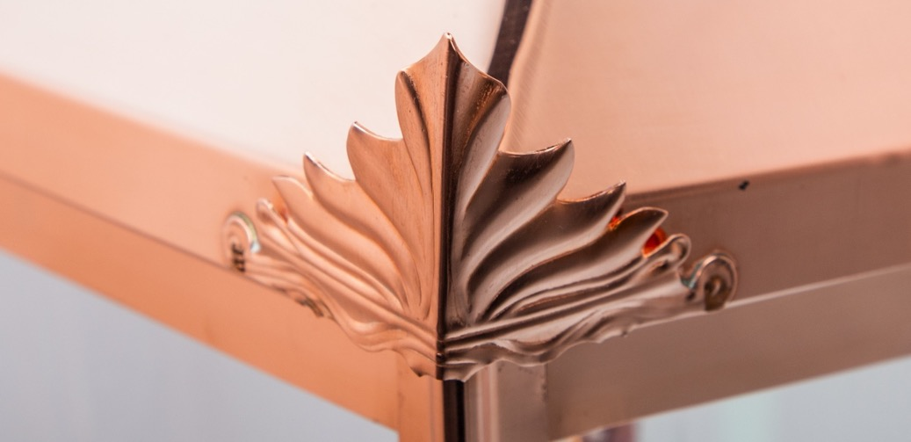
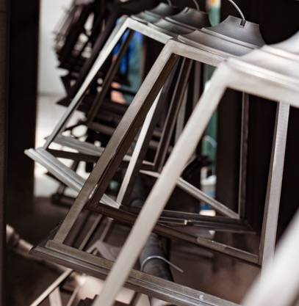
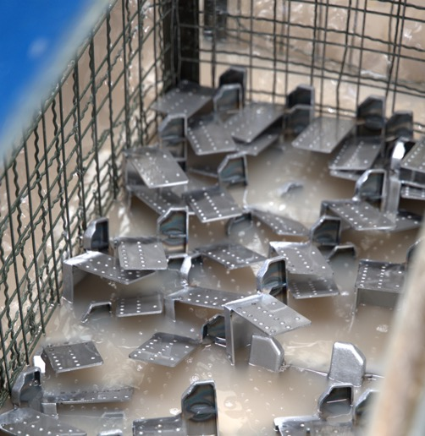
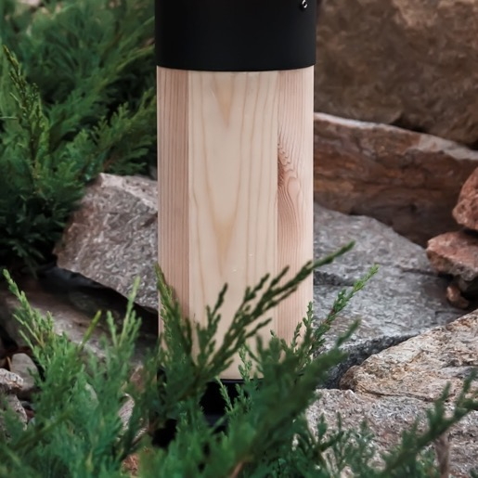
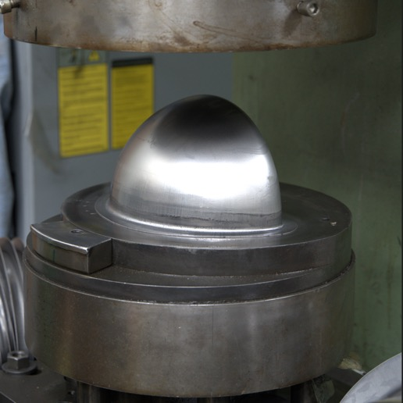
LIST OF MATERIALS
ALUMINIUM - alloys, extruded, plates
STEEL- plates, pipes – either painted or galvanized
STAINLESS STEEL - plates, screws, extras
COPPER - plates, screws, extras
WOOD - Scandinavian pine

Slide 4
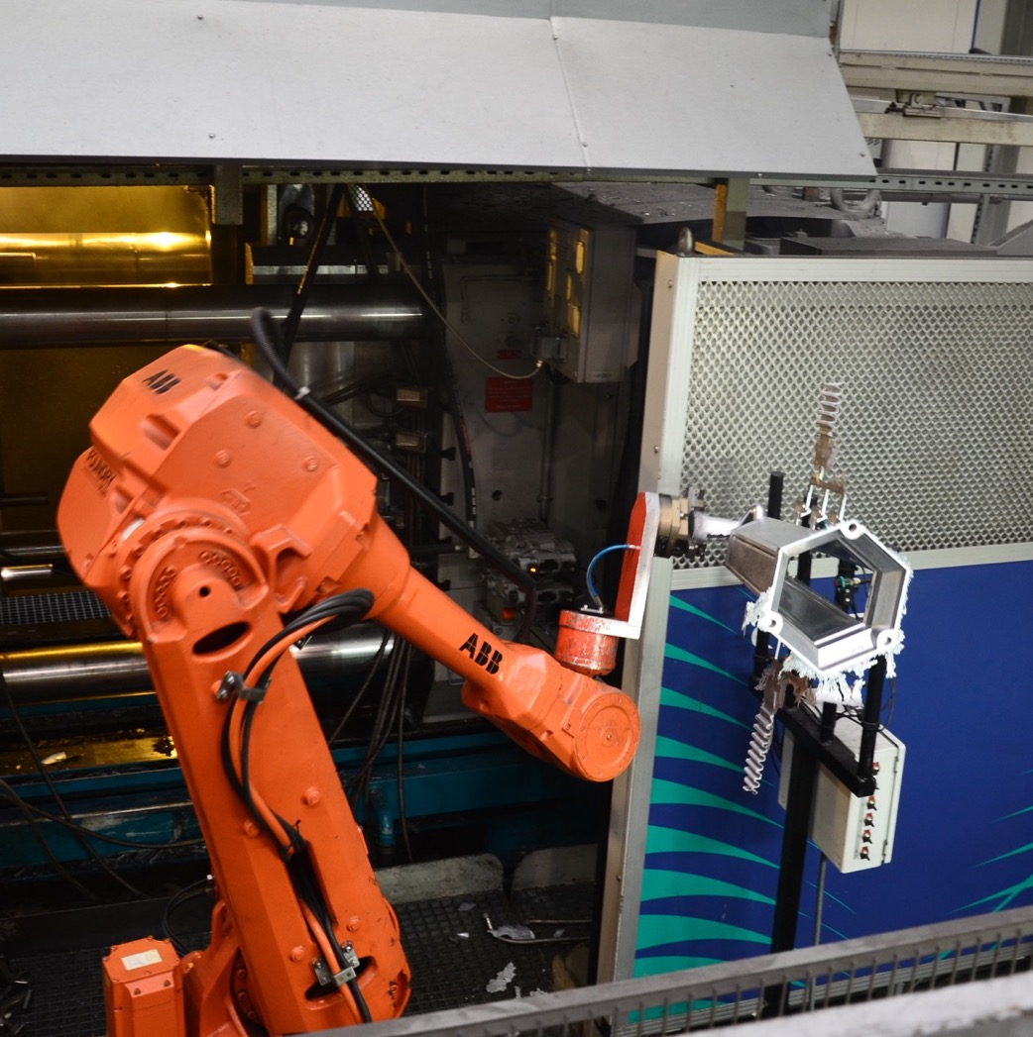

ALUMINIUM
NORYLS possess its own tooling shop which is used for production and constant maintenance of high precision moulds for aluminium. In our own die cast foundry we are able to keep full control over whole die casting process.
We use mainly three types of aluminium in our products:
aluminium alloy DIN 231, with lowered copper content, which provides automotive grade anti-corrosion properties.
aluminium alloy DIN 230, which provide excellent anti-corrosion properties and is used for critical elements.
for aluminium pipes and profiles – PA38 and PA11, which provides excellent anti-corrosion properties.

Slide 5
STEEL
Norlys uses, European sourced, basic steel plates, pipes and profiles in its production process.
Apart from regular steel plates, we use highest quality deep-drawn steel plates for some of our products.
In order to assure long lasting anti-corrosion protection for steel, Norlys performs a multi stage physical and chemical surface treatment process, before finally painting it into a desired finish.
For some of the steel elements, Norlys uses another method of surface treatment - hot dip galvanizing.

Slide 6
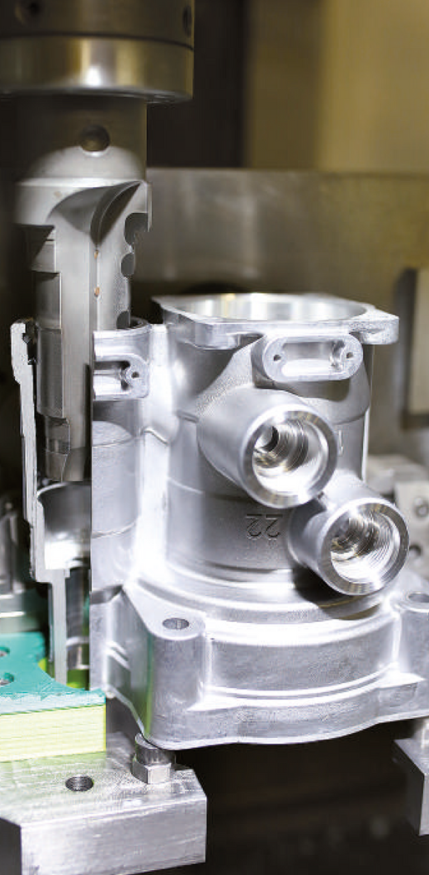
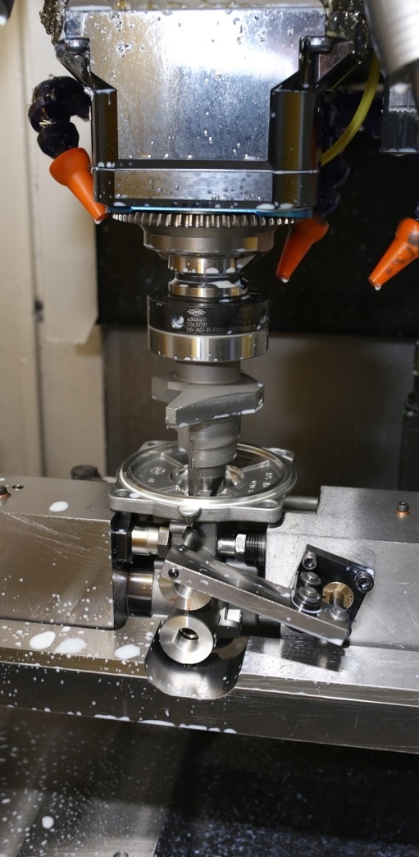
WHY WE USE ALUMINIUM AND STEEL
A centuries - old tradition of processing steel, which is an extremely durable yet formable material. Well-known technology and methods of surface protection.
The introduction of aluminium castings has provided the opportunity to produce lightweight and highly durable luminaire structures of virtually any shape.
Both steel and aluminium provide very good heat transmission from electronic components, which plastics (synthetic materials) will not provide.

Slide 7
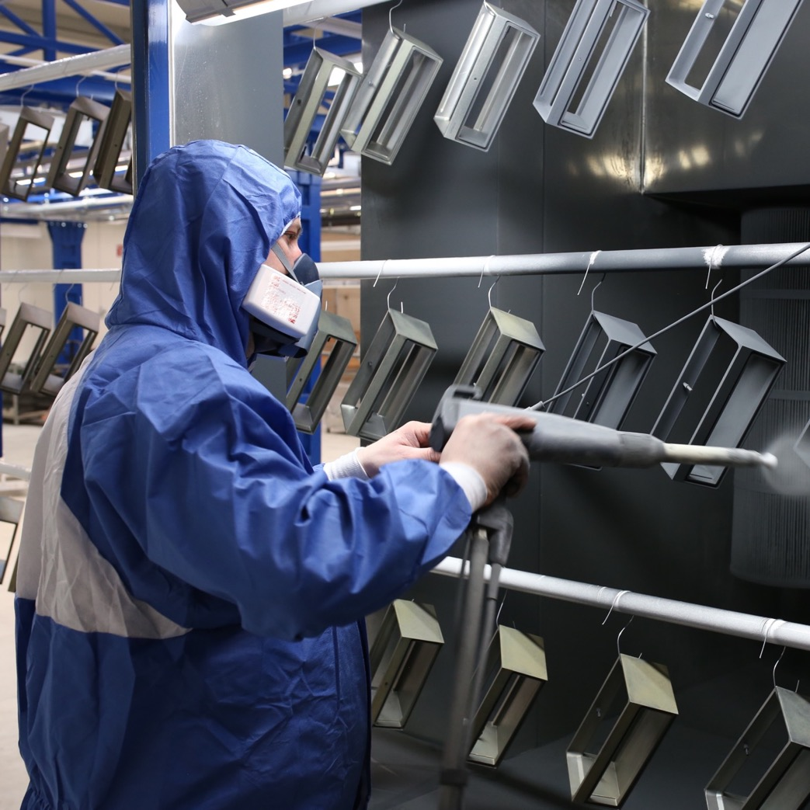
PAINT SHOP
Majority of steel and aluminium elements are painted in order to assure long lasting corrosion protection.
Our paint workshop uses powder paints applied by TRIBO method.
Right after applying the powder, elements undergo polymerization process in specialized ovens.

Slide 8
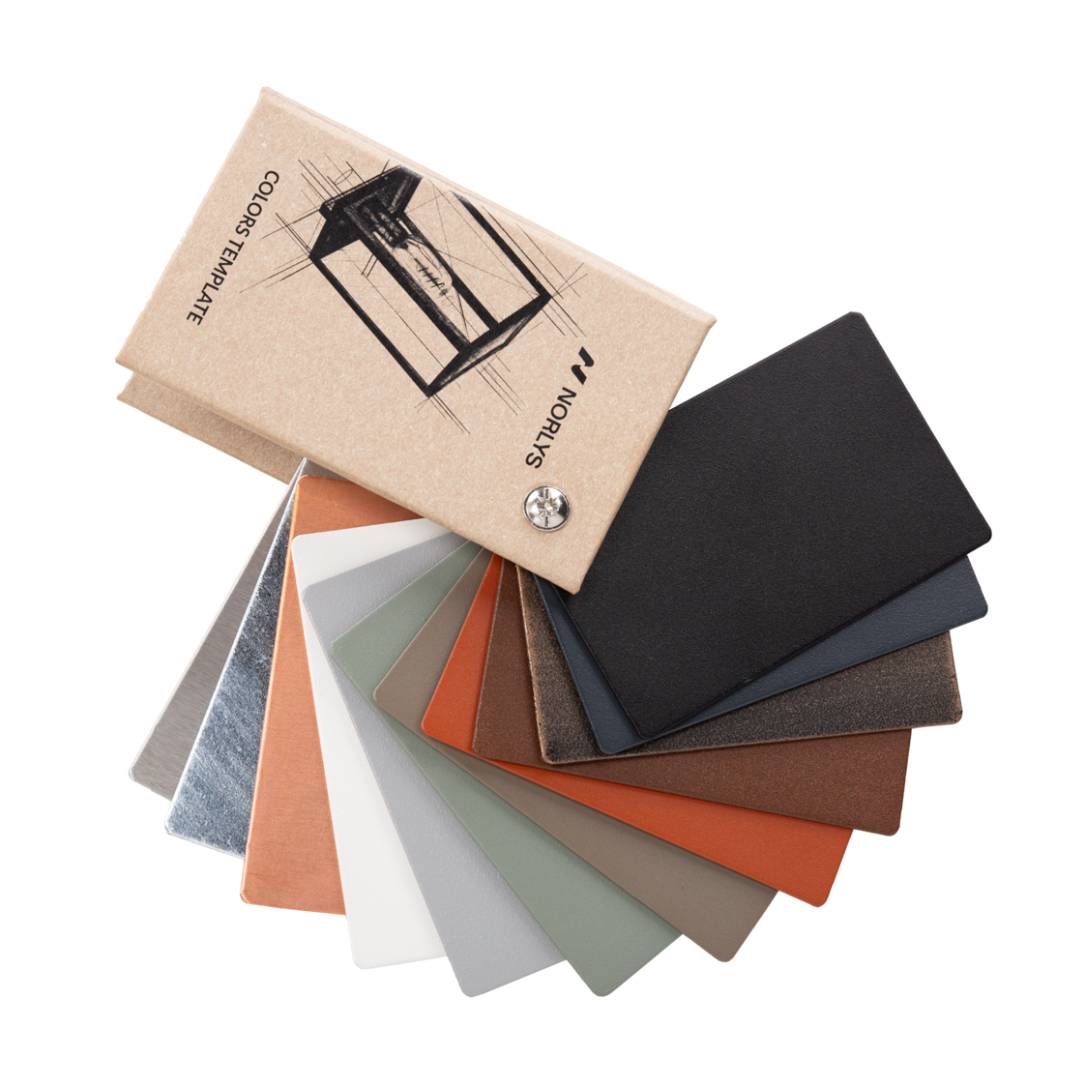
COLOUR PALETTE
Current palette consists:
BLACK RAL9005
GRAPHITE RAL7016
ALUMINIUM RAL9006
WHITE RAL9003
CORTEN STEEL (CLOSE TO RAL8011)
COPPER BROWN RAL8004
CEMENT GREY RAL7033
BEIGE GREY RAL 7006
There is a possibility of painting in RAL colour selected by client.

Slide 9
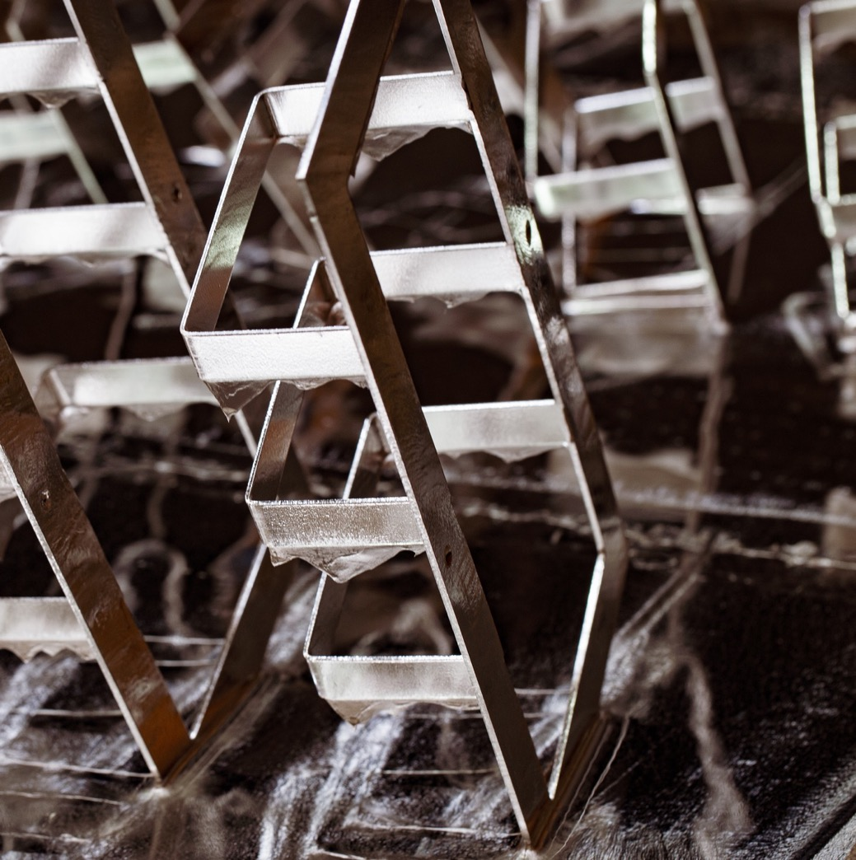
HOT DIP GALVANIZED STEEL
One of the best ways of providing very long lasting anti-corrosion protection for steel made elements, is using the hot dip galvanizing process of surface protection. It can be applied either as the final step of surface treatment, or as a one of the steps before final powder painting.
The process is performed 'in house’, using one of the smallest hot dip bath of molten zinc, which enables us precise tuning and controlling surface quality of individual products.
In harsh North sea (Atlantic) coast environment, hot dip galvanized lanterns can survive 20+ years with no visible rust.

Slide 10
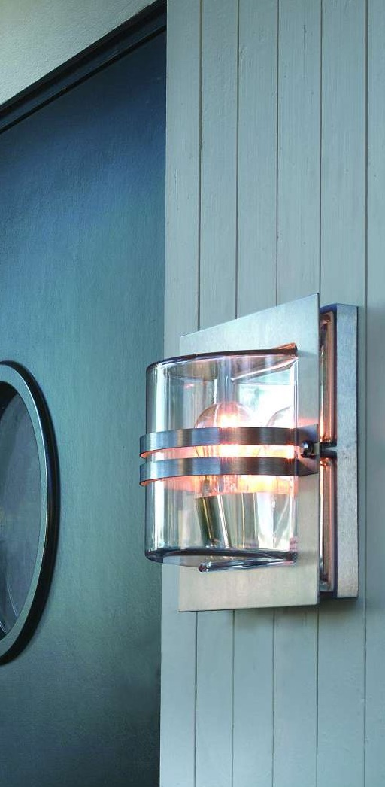
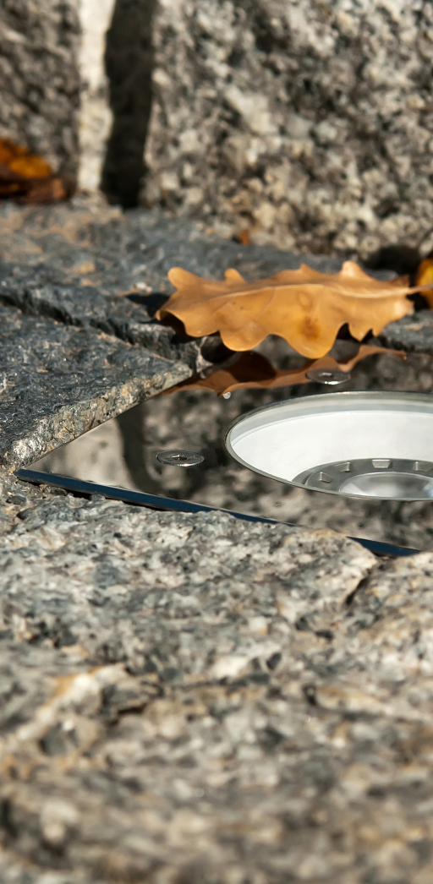
STAINLESS STEEL
Very good, natural corrosion resistance, if maintained regularly.
Limited, but visually appealing usage
BASEL
RENA
MOSS
BERN

Slide 11
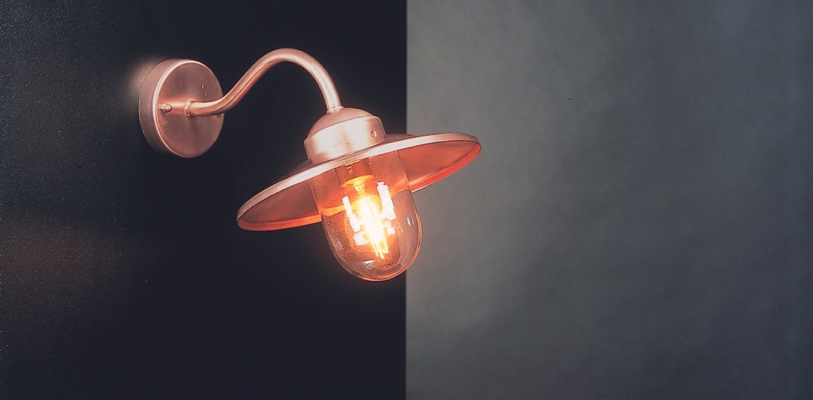
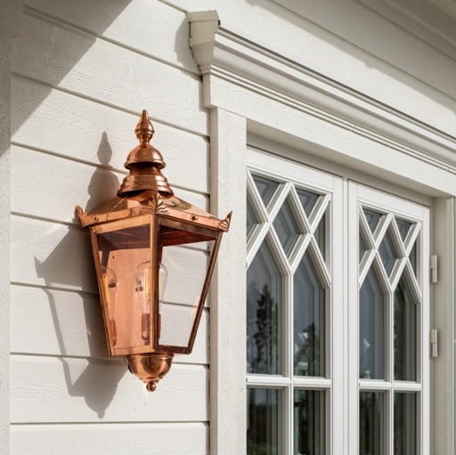
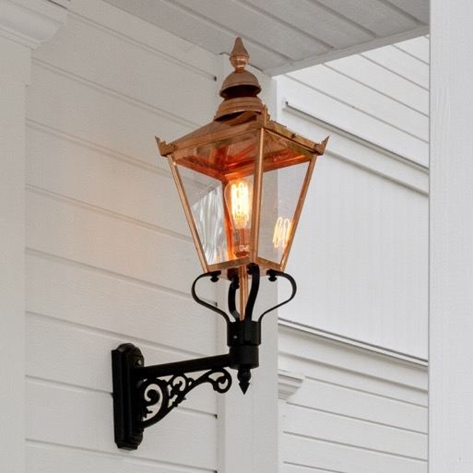
COPPER
Norlys uses copper in several families of products as on optional finish.
BERN
BASEL
PARIS
KARLSTAD
VANSBRO
WHOLE CHELSEA RANGE

Slide 12
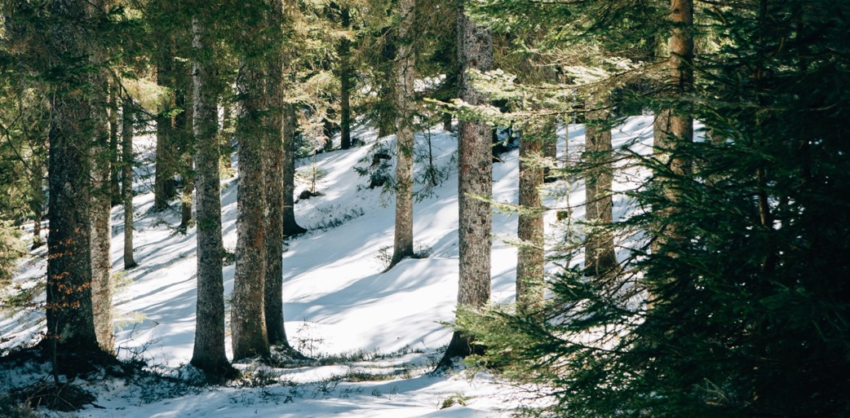
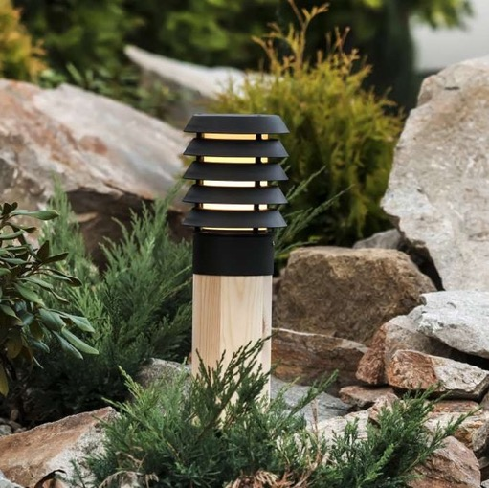
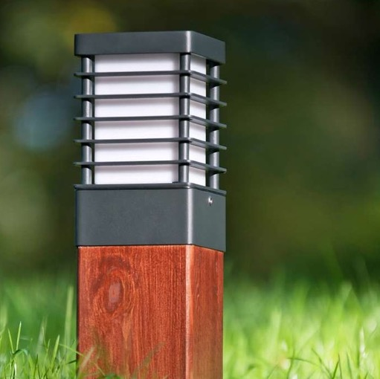
(SCANDINAVIAN) WOOD
Norlys uses natural wood in many families of its bollards.
We buy wooden lantern elements only from one Swedish supplier, who selects for us the best Scandinavian pine, sourced from North Europe forests.
As a standard, we provide two types of wood surface finish:
initially protected, transparent wood finish, which turns grey in time,
fully protected, distinctive brown lacquer finish, which can last years, if maintained regularly.
For larger project, we are able to provide bespoke wood finish - either colour or used technology wise.

Slide 13

Thank You

Slide 14

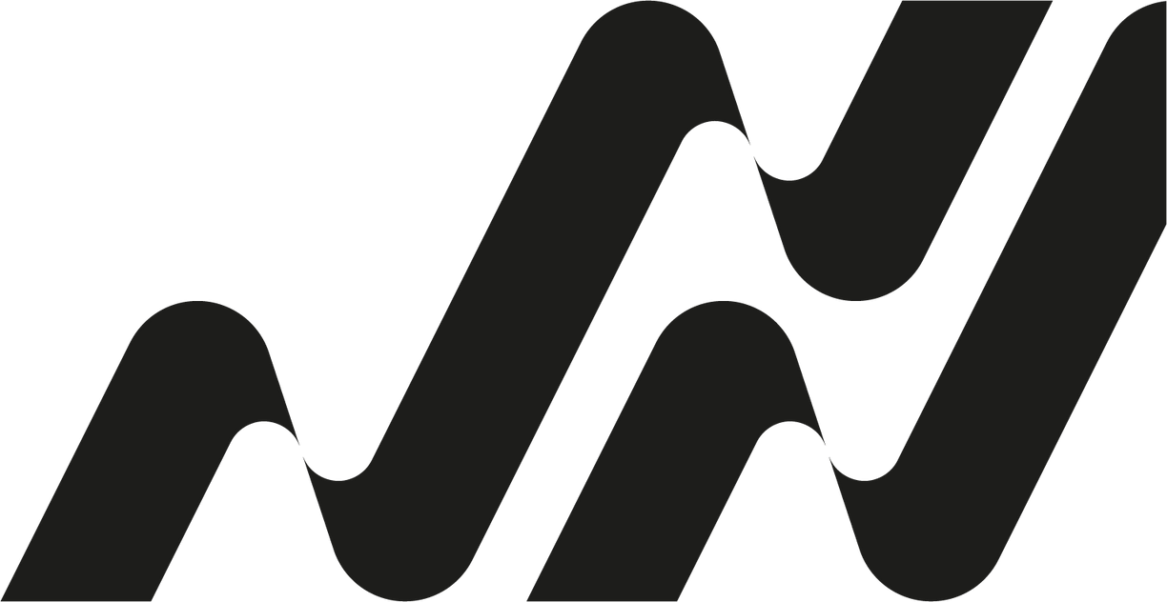
Contact
Norlys AS
Hovfaret 4B, NO-0275 Oslo
P.B 1014 Hoff, NO-0218 Oslo – Norway
info@norlys.com

