Slide 1

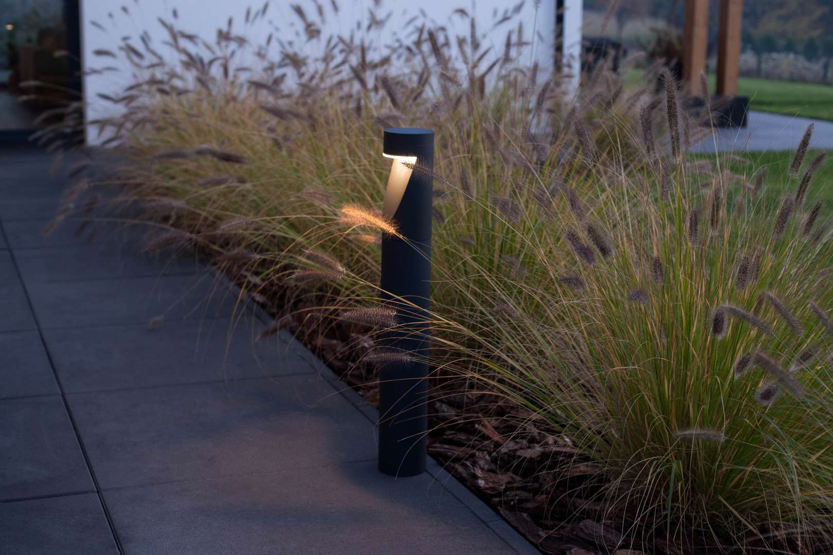

SELECTED PROJECT LANTERNS

Slide 2
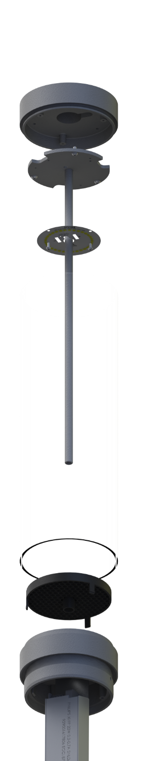
Project lantern
efficient radiator
(desired features)
- high IP
- high IK
- high corrosion an UV resistance
- availability of various mount options
- availability of various finishes
- availability of service/spare parts
- available as „families”
proper LED light source
durable diffuser
- efficiency over 90lm/W
- availability of various colour temp.
- availability of various lens types
- modern steering option (DALI, Zhaga)
- high Ta (for selected locations)
- L70B50 >100 000h
- driver durability and longevity
flexible mount system
ULOR inhibitor

Slide 3
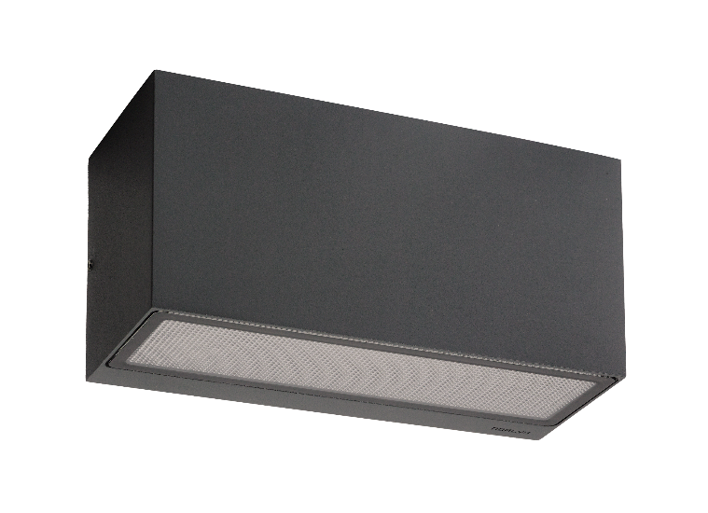
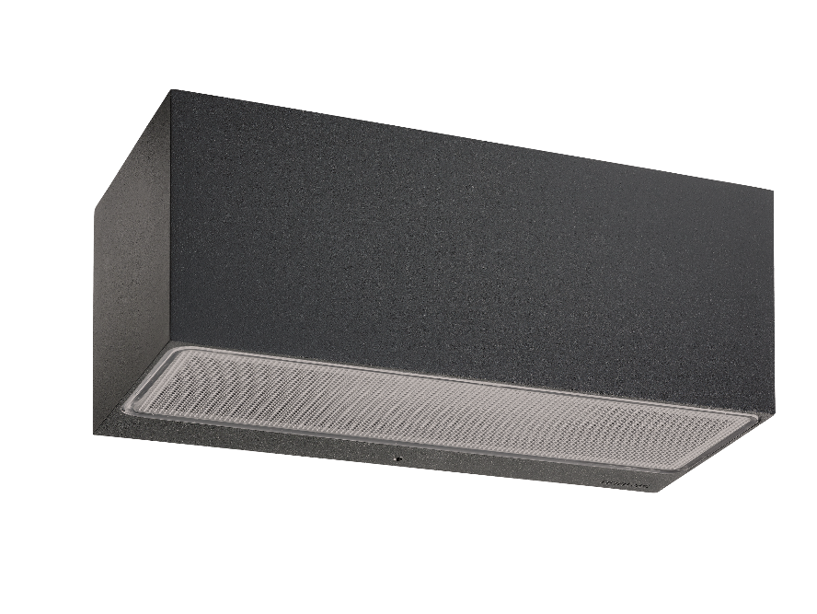
standard version up/down:
- luminous power 8,8W
- luminous flux 312lm
Asker and Asker Big
- available in many up-down light output configurations
- high power light output DALI versions
available
- galvanized steel version available
LED colour temp. 3000K/4000K
(other colour options on request)
standard version up/down:
- luminous power 8,3W
- luminous flux 547lm

Slide 4




Slide 5
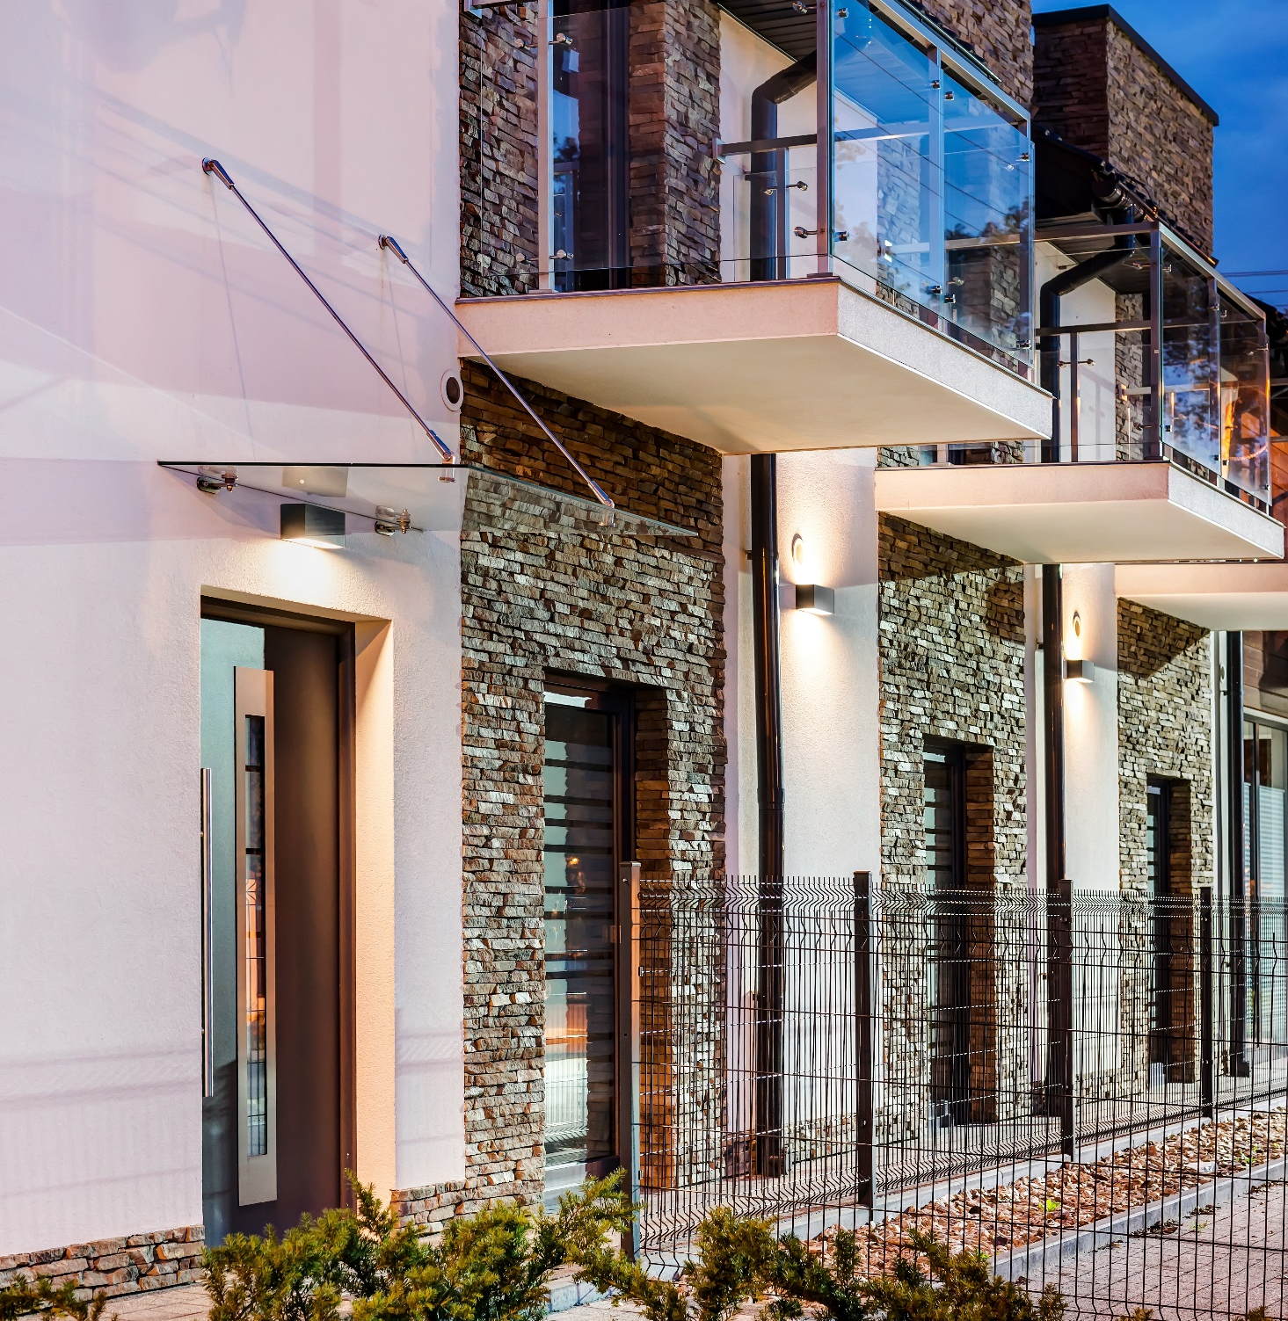
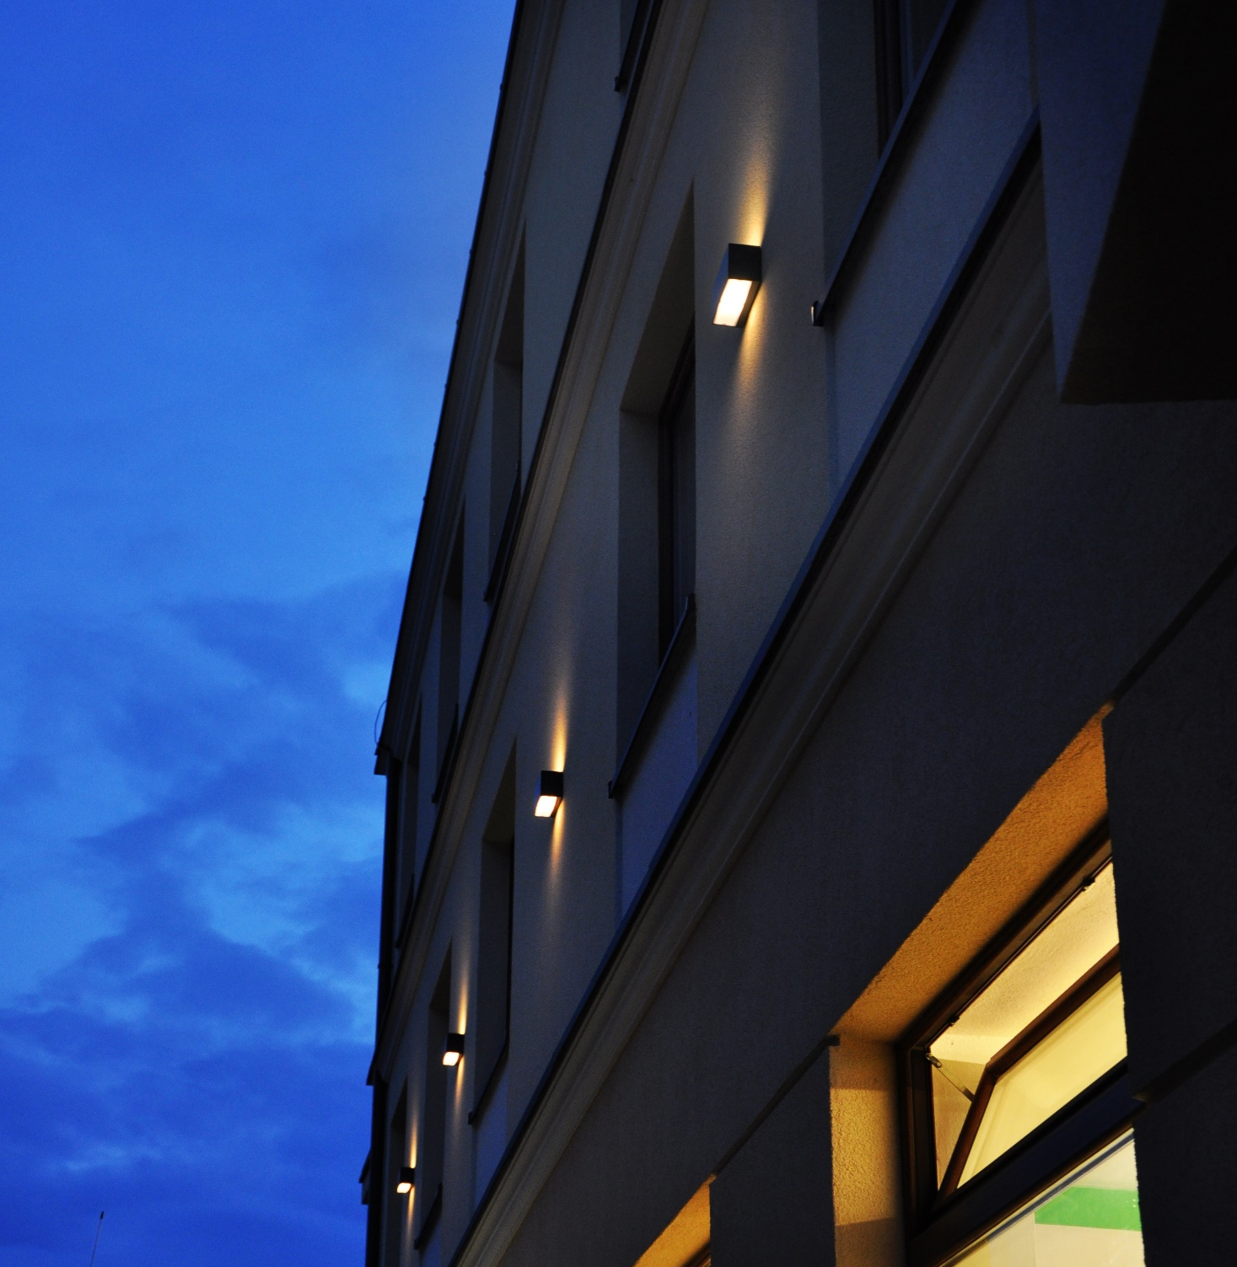
Notes:
Następny slajd (Lilehammer) działa z opóźnienie, trzeba poczekać sekundę.

Slide 6
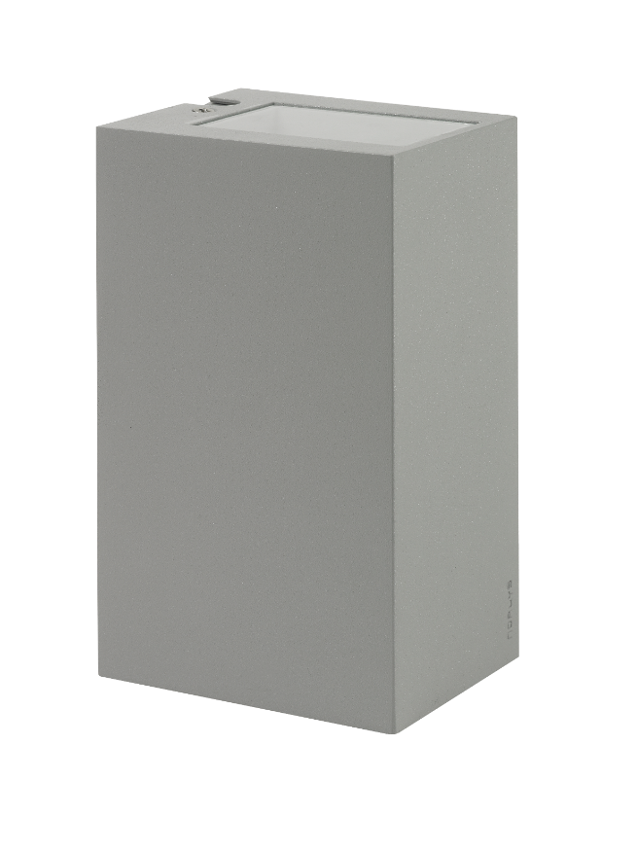
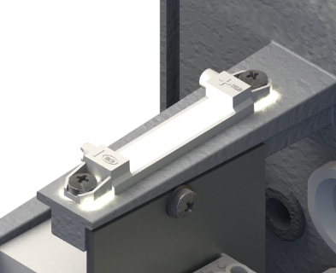
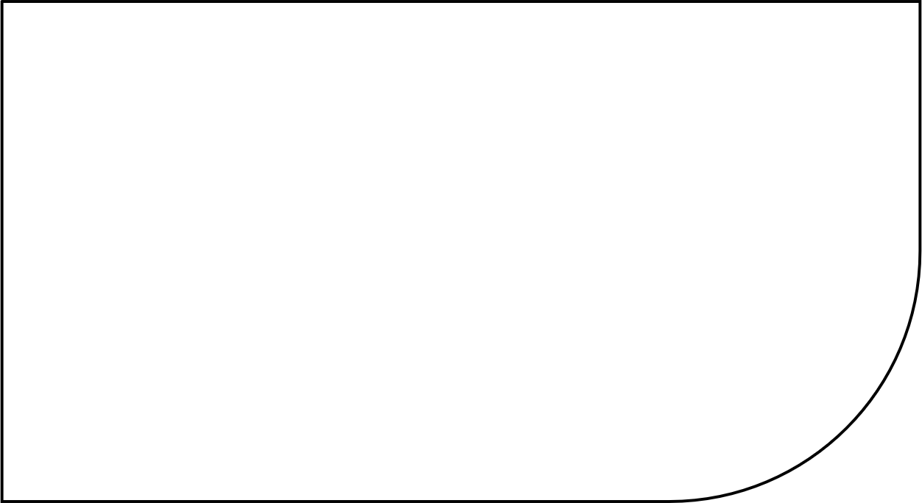
Lillehammer
- IP65
- IK08
- 4W and 7,3W options
- LED colour temp. 3000K/4000K
equipped with efficient
LED light sources
available in many up-down narrow-wide light output configurations modified by using a set of lens, shutters and covers.
Notes:
Działa z opóźnieniem, trzeba poczekać sekundę (nie wiem czemu)

Slide 7
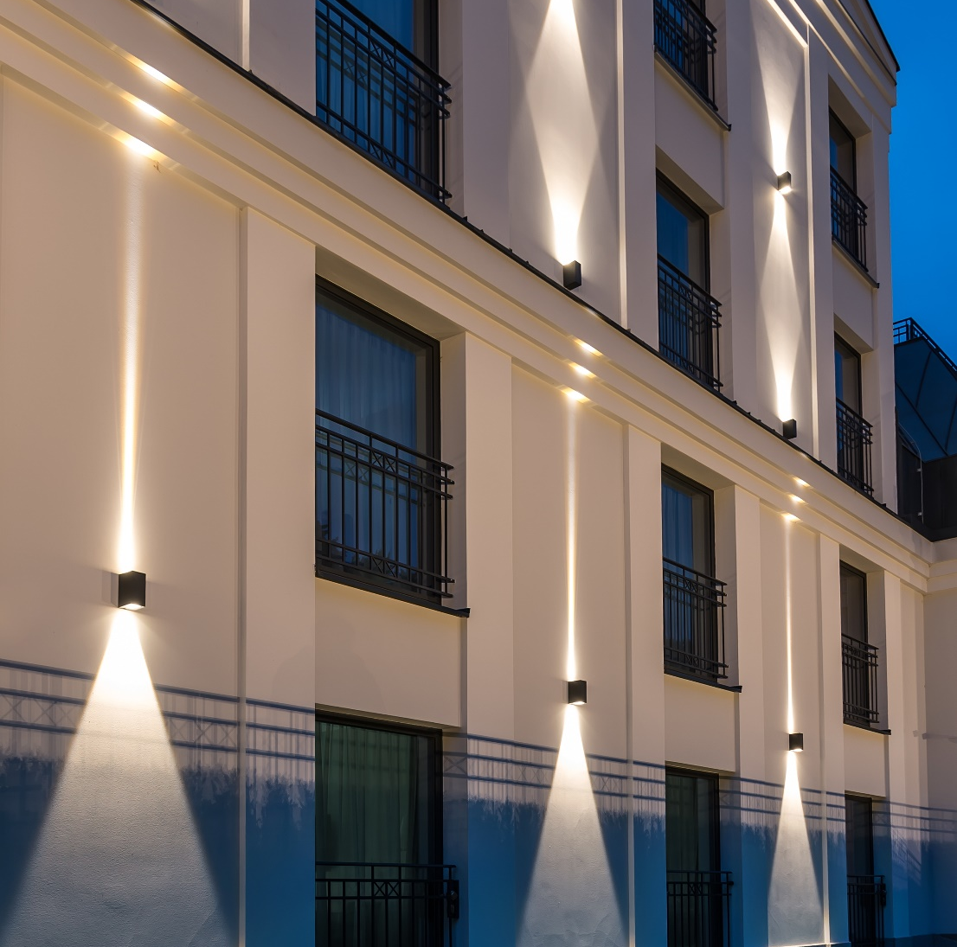

Slide 8


Notes:
Click – ON; click - OFF

Slide 9
2 LED modules up-down
Lysfjord
- IP65
- IK08
- driver durability 100 000h
- L70B50 >70 000h
- DALI
wattage 14.6W (per side)
luminous flux 68,5lm (per side)
Art. 6403
Art. 6408

Slide 10
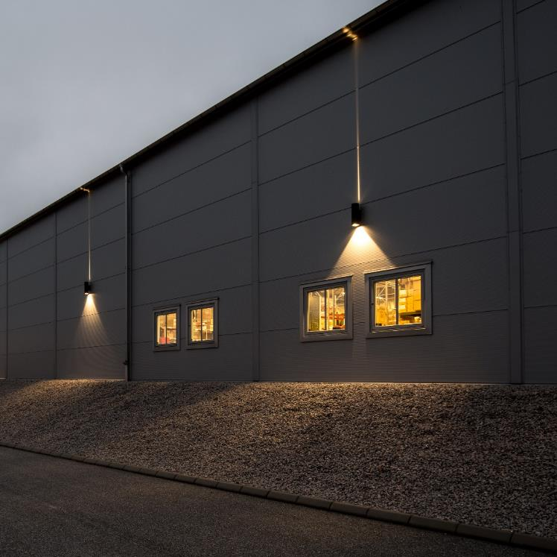

Slide 11
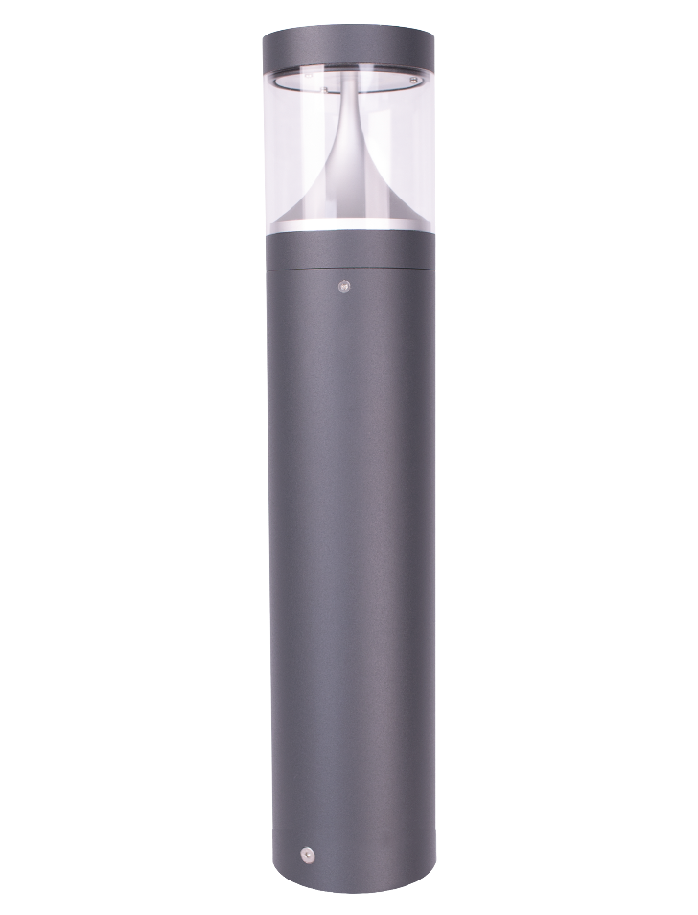
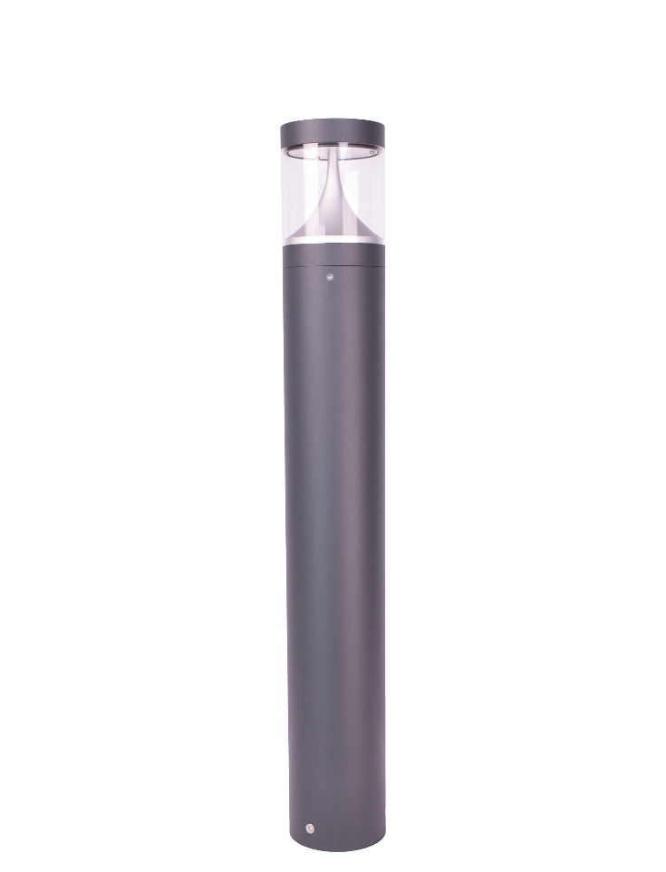
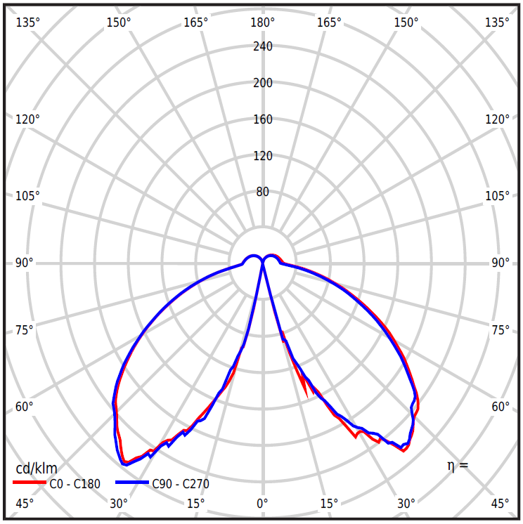
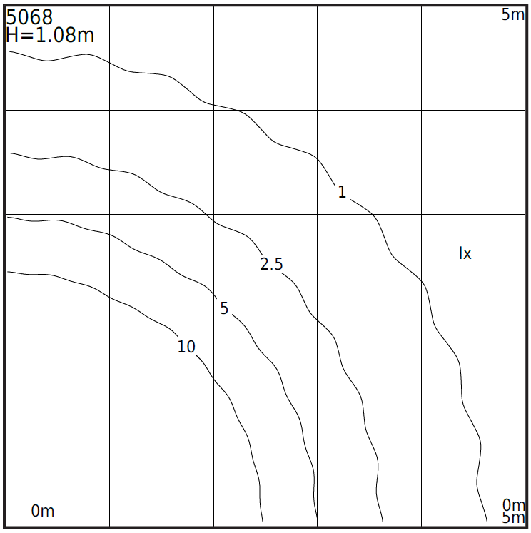
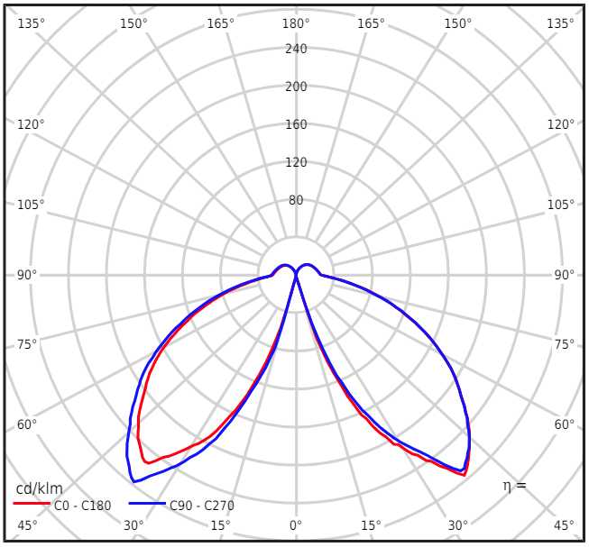
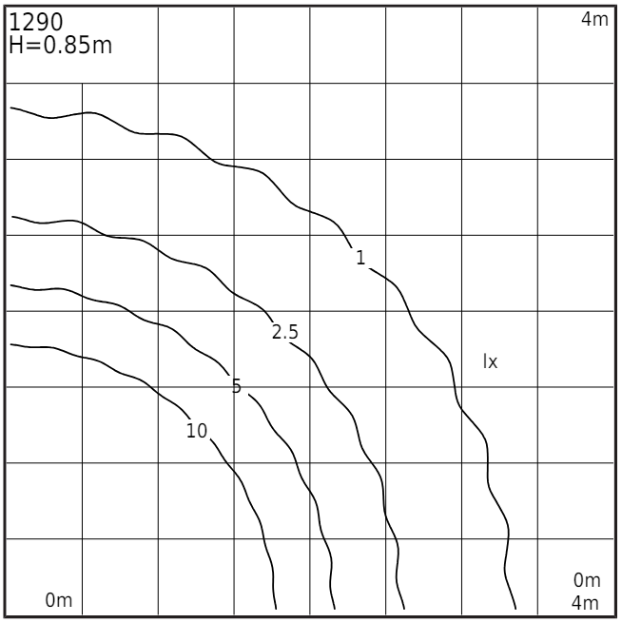
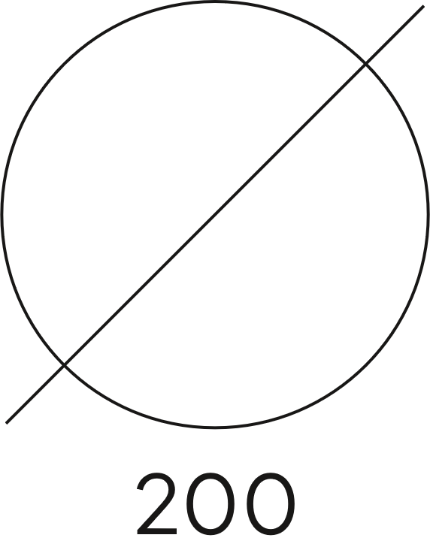
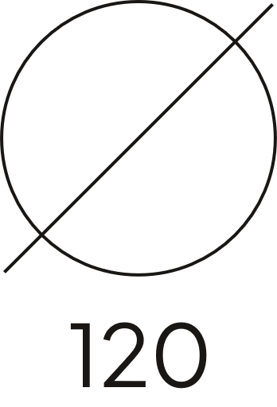
Egersund
wattage 21,9W
luminous flux 1681lm
efficiency 76.8lm/W
- IP65
- IK08
- transparent PMMA lens
- colour temp. 3000K/4000K
- DIM/DALI versions avaliable
wattage 9.1W
luminous flux 864lm
efficiency 94.9lm/W
several heights
Art. 5068
Art. 1290

Slide 12
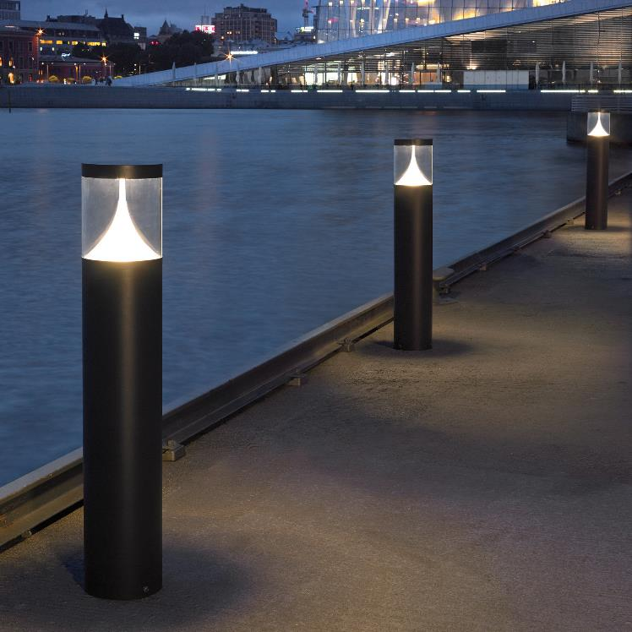

Slide 13
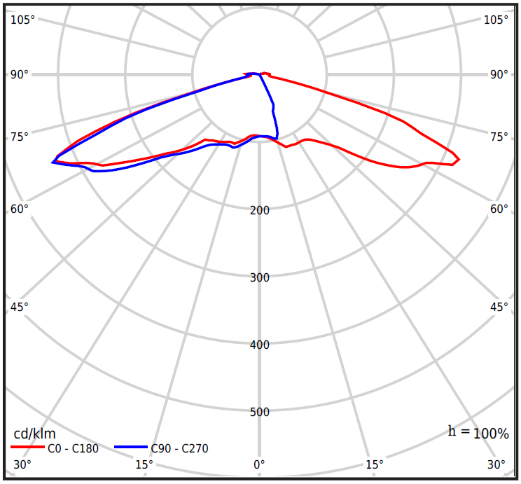
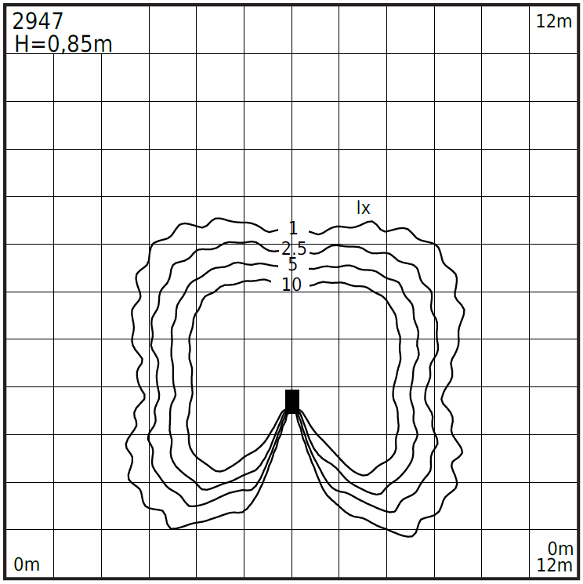
equipped with
LED lens type V
(other lens versions avail.)
Skara 2947
equipped with electric socket E (Uni)
(other socket versions possible)
- IP65
- IK08
- colour temp. 3000K or 4000K
- luminous flux 604lm
- driver durability 50 000h
- L70B50 over 260 000h
aluminium body
Art. 2935
Art. 2947

Slide 14
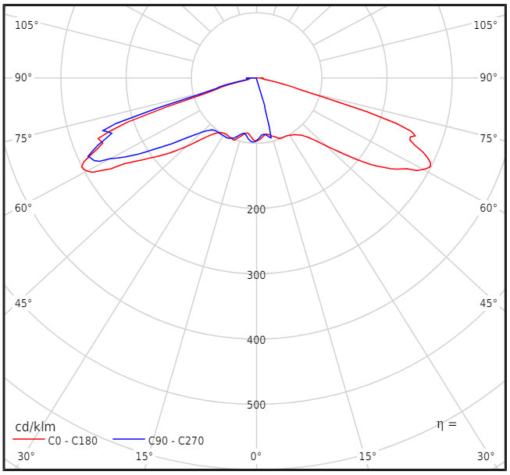
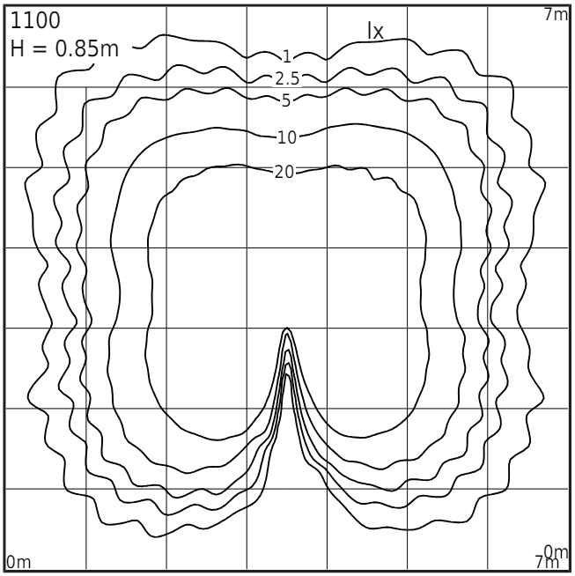
Trysil 1100
equipped with
LED lens type V
(other lens versions avail.)
- IP65
- IK08
- wattage 7.4W
- luminous flux 703lm
- efficiency 95lm/W
- L70B50 >109 000h
aluminium body
durable mount system

Slide 15
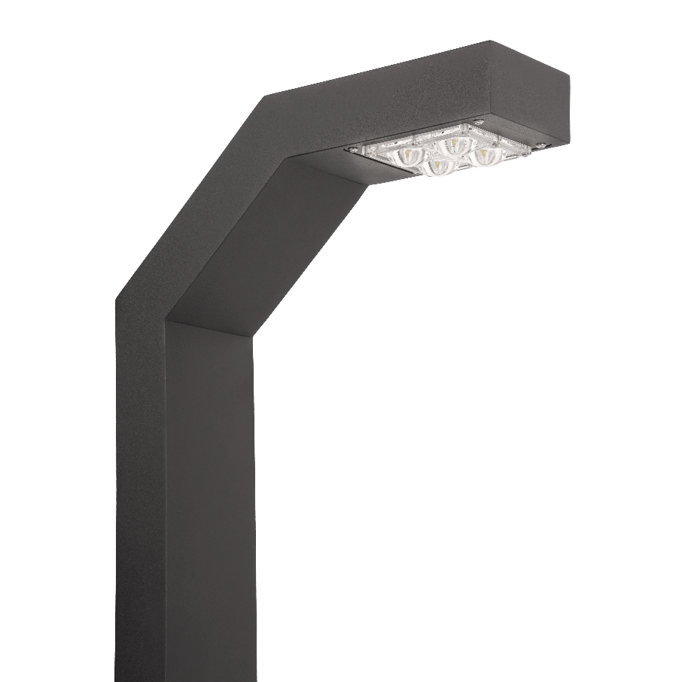
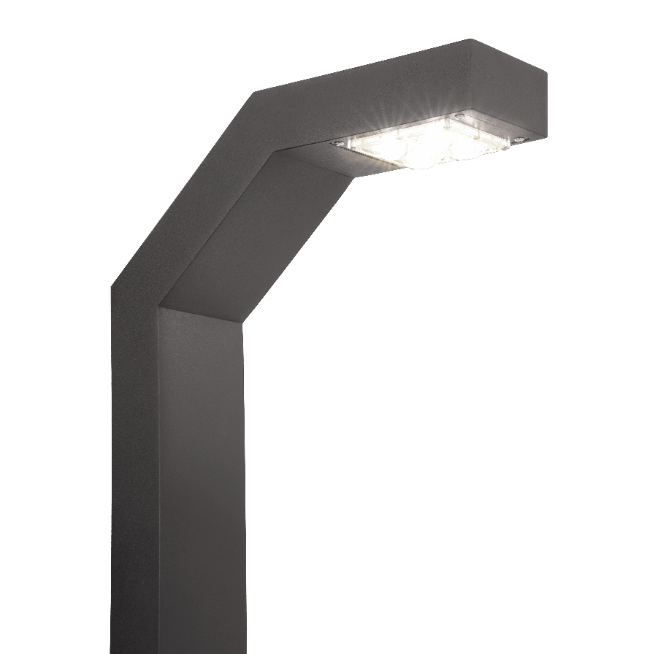
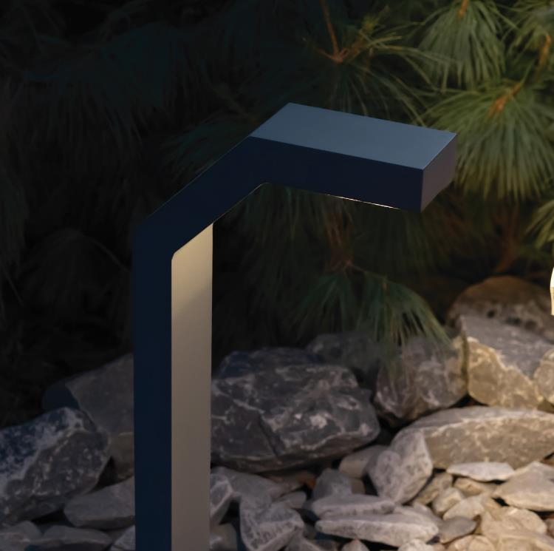
Notes:
Day/Night – on click.

Slide 16
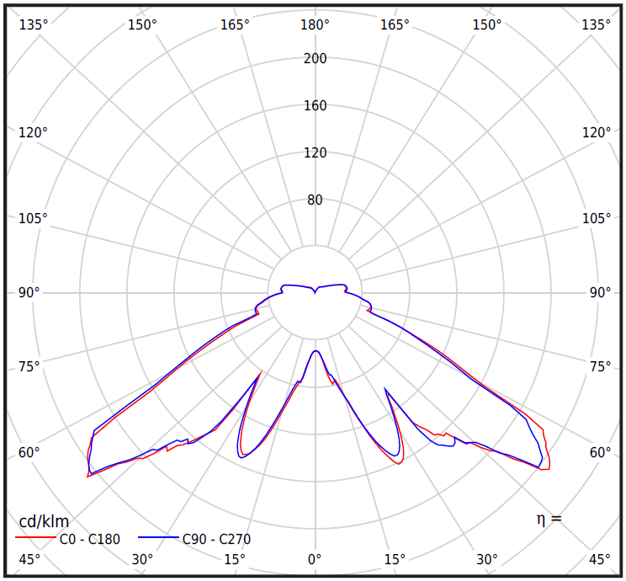
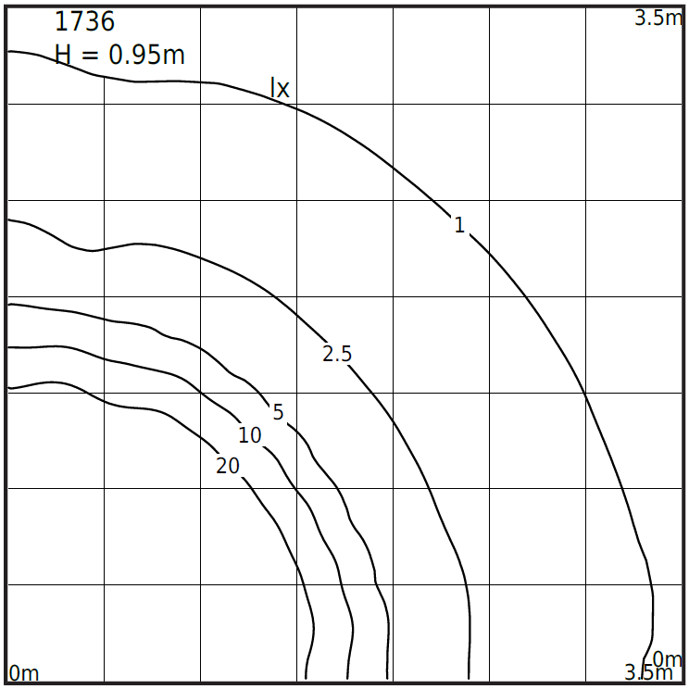
improved luminous flux 1416lm
(in comparison with classic versions)
Narvik 1736
- IP65
- IK10 (excellent durability )
- wattage 22.2W
- colour temp. 3000K/4000K
- L70B50 72 000h
- driver durability 100 000h
- power factor PF 0.95
transparent PMMA
diffuser
service door
for easy access

Slide 17
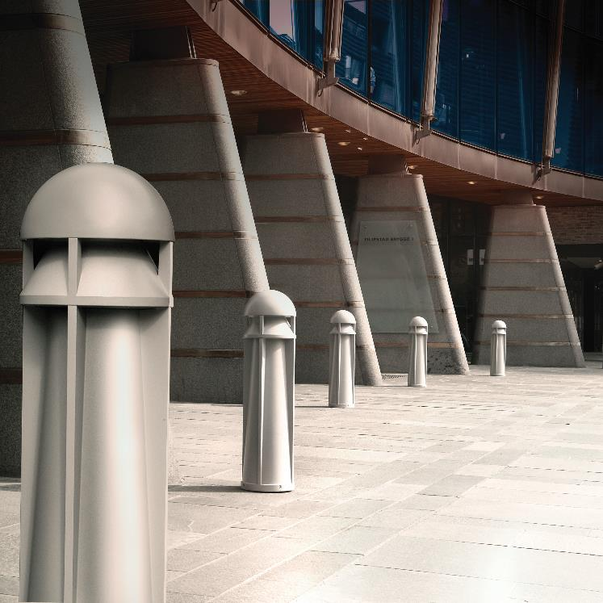

Slide 18
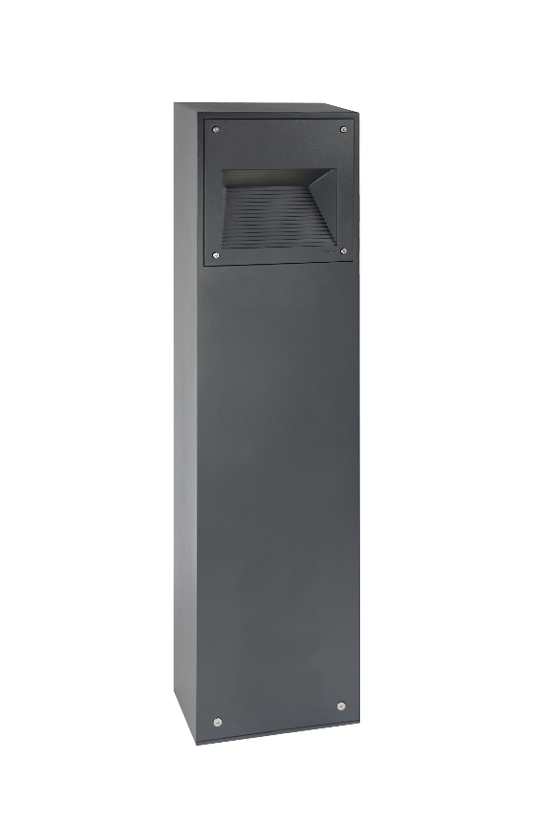
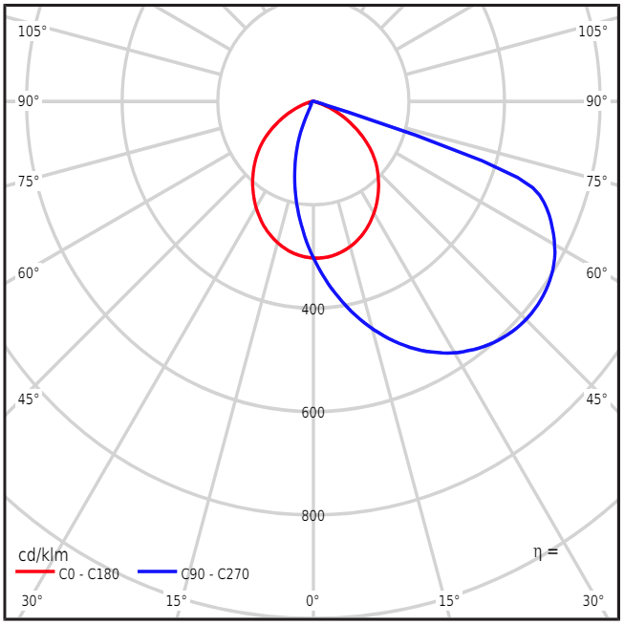
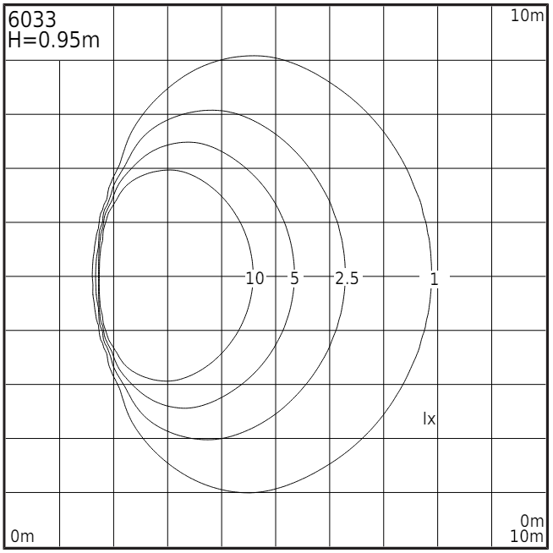
Namsos 6033
safety satin glass
DALI
- IP65
- IK07
- wattage 13.8W
- luminous flux 904lm
- efficiency 65.5lm/W
- power factor PF 0,98
- L70/B50 >102 000h
aluminium body
robust mount system

Slide 19
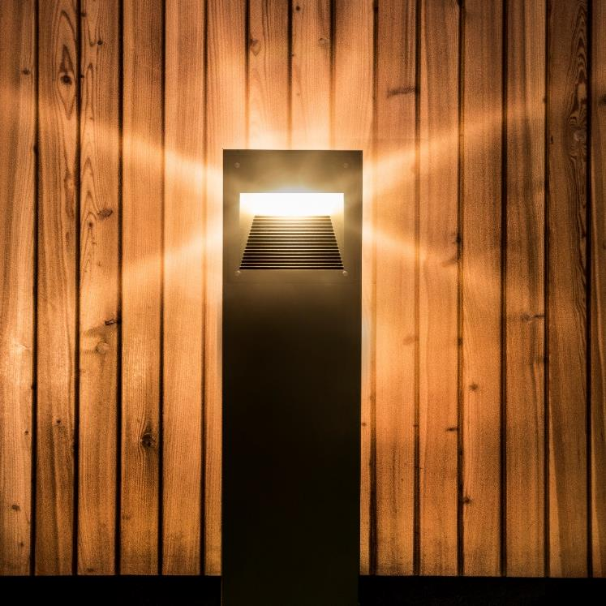

Slide 20
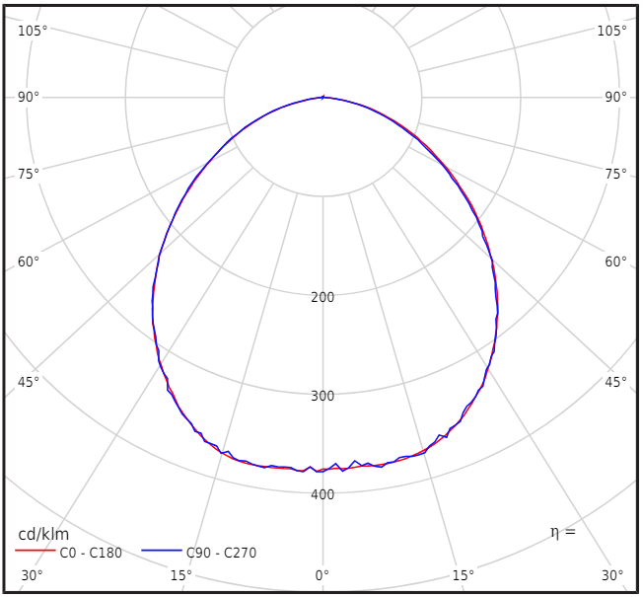
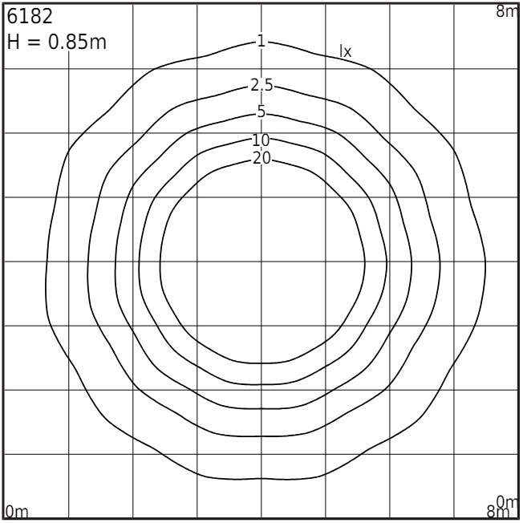
Borg Bollard
luminous flux 1396lm
4 heights as standard
(35; 55; 85 and 110cm)
- IP65
- IK08
- efficiency 87.8lm/W
- power factor PF 0,99
- driver durability 100 000h
- L70/B50 >72 000h
DALI
aluminium body
Art. 6193
Art. 6183
Art. 6172
Art. 6122

Slide 21
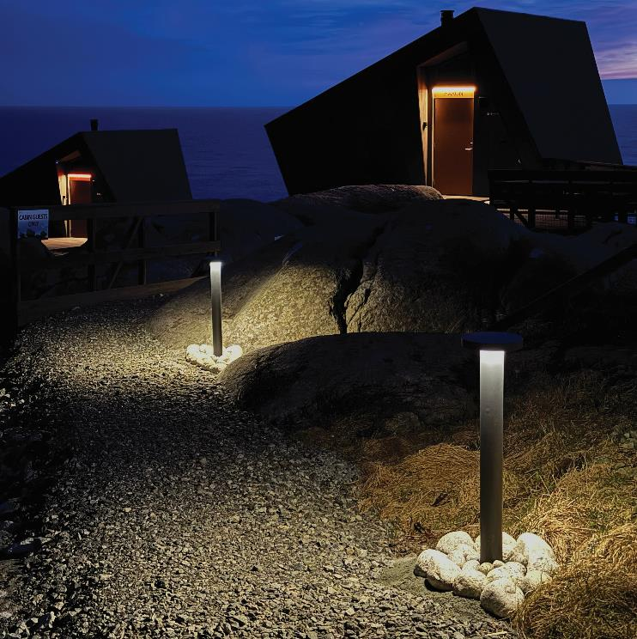

Slide 22
equipped with
LED lens type V (CHECK)
(other lens versions available)
Hellvik
- IP65
- wattage 11,9W
- luminous flux 1537lm
- efficiency 129,2lm/W
- L70/B50 > 100 000h
DALI
durable mount system
Art. 2416
Art. 2406

Slide 23
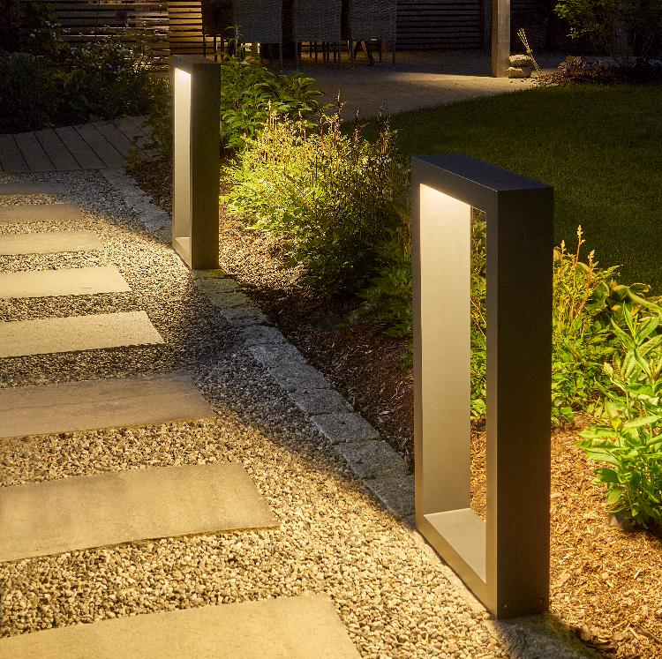
Art. 2416
Art. 2406

Slide 24
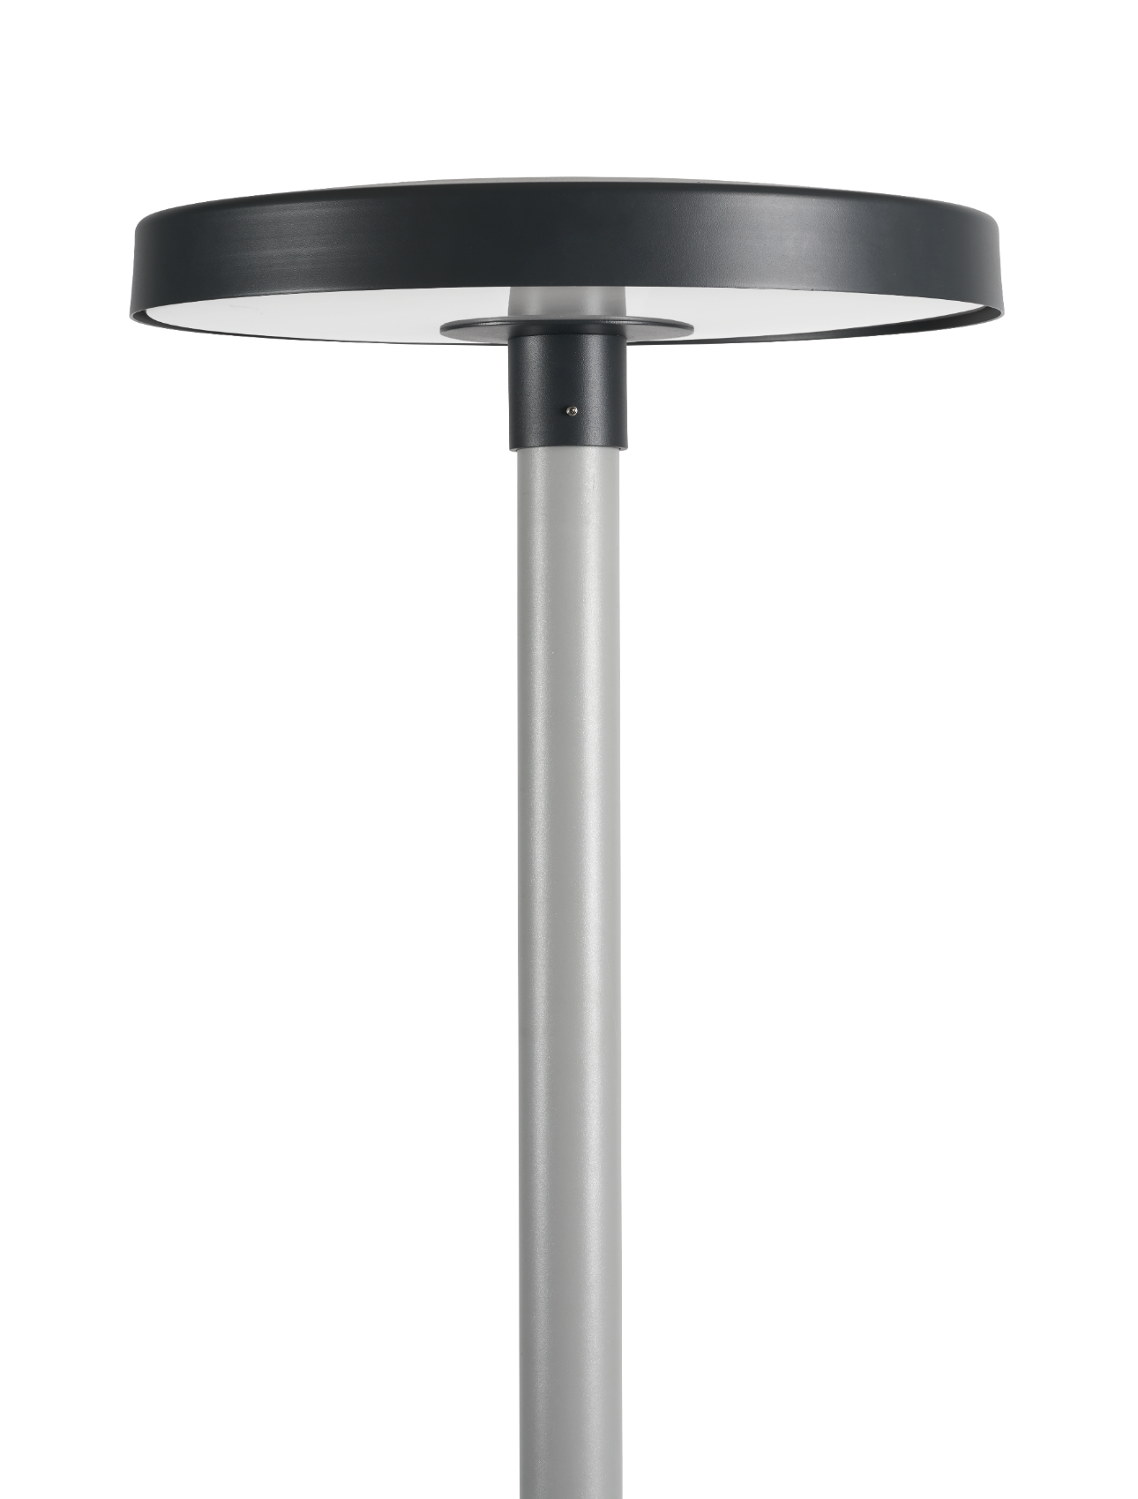
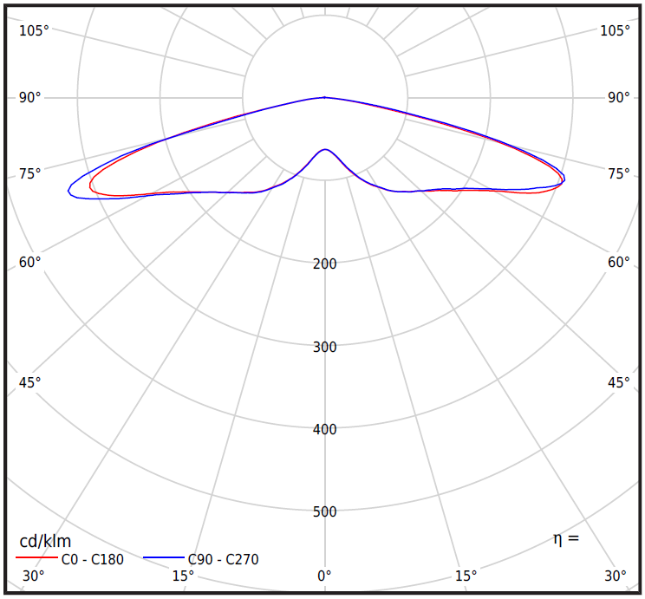
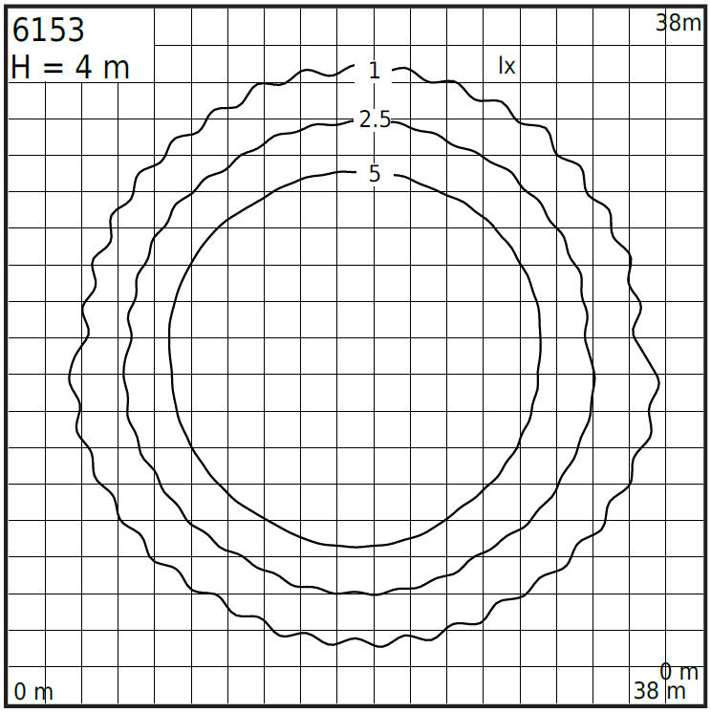
DALI2 and Zhaga-D4i Sensor Ready
Borg 6153
- IP65
- IK08
- efficiency 127lm/W
- power factor PF 0,98
- ULOR 0%
- colour temp. 3000K/4000K
transparent or satin
diffuser
ULOR 0%
power 53W
luminous flux 6730lm

Slide 25
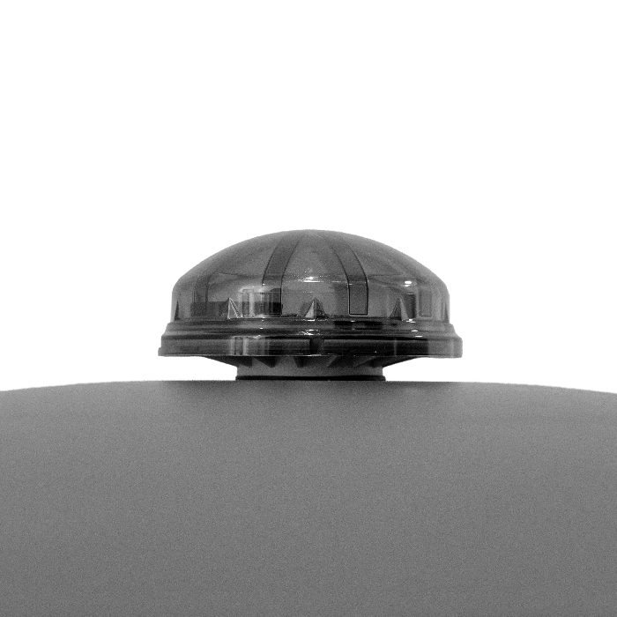
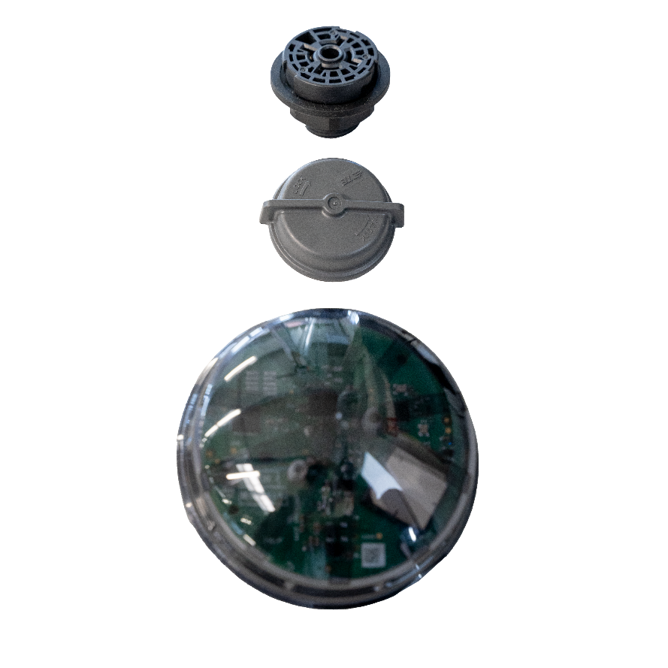
Ø60mm standard mount
Zhaga-D4i Sensor Ready

Slide 26
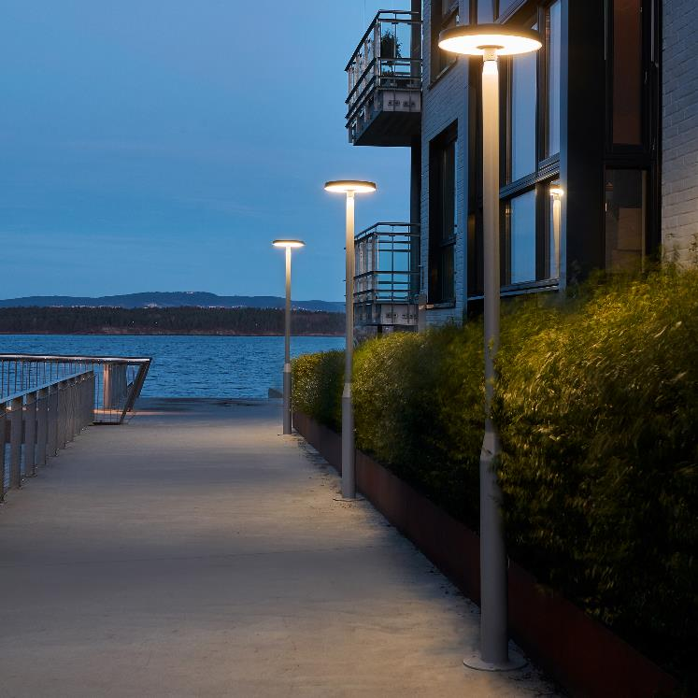

Slide 27
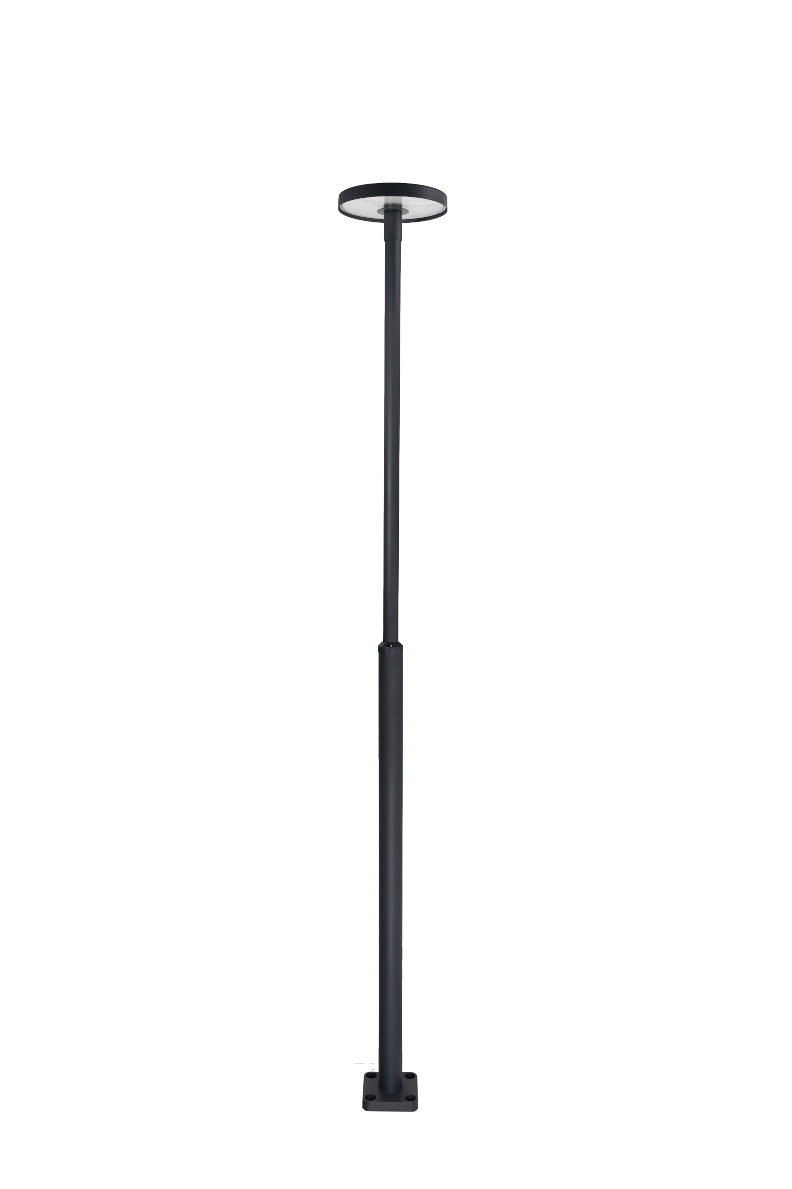
mounted on 3004 pole

Slide 28
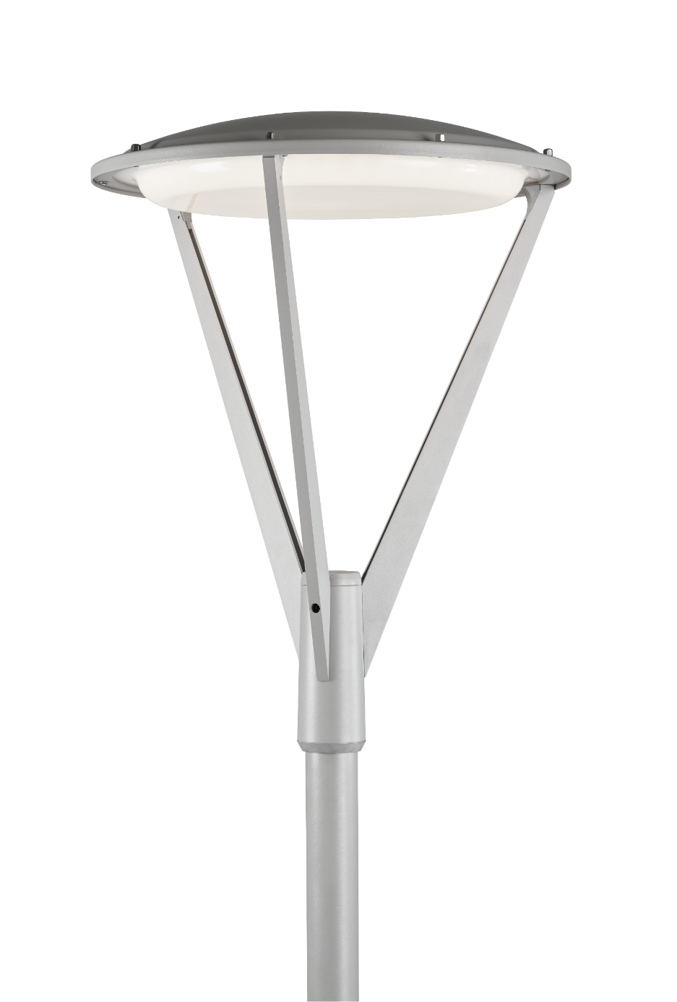
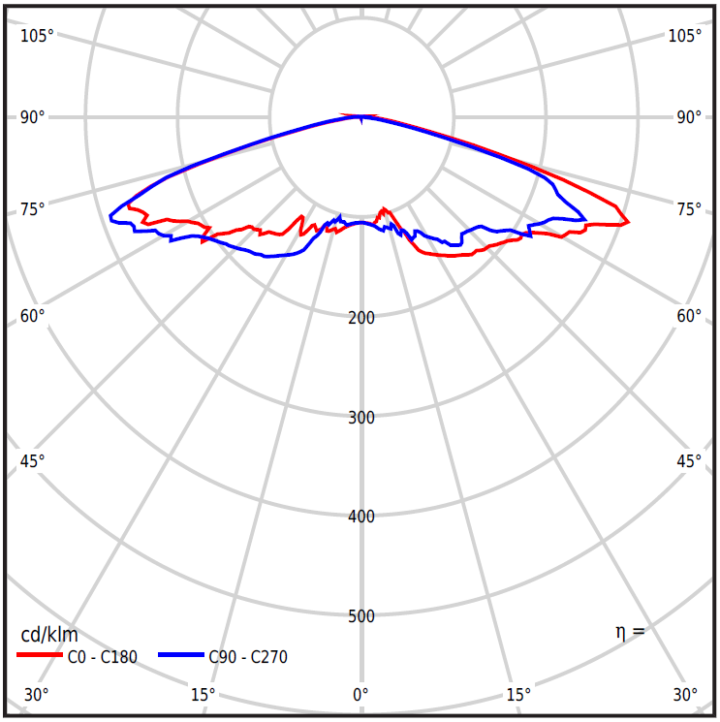
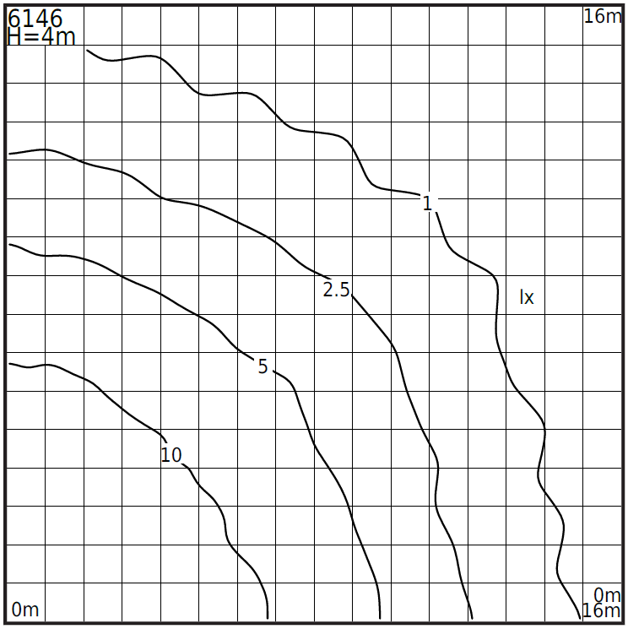
Hammerfest 6146
- IP65
- IK07
- efficiency 123lm/W
- driver durability 100 000h
- ULOR 1%
transparent
or opal
diffuser
ULOR 1%
DALI2 and
Zhaga-D4i Sensor Ready
Ø60mm standard mount

Slide 29
Zhaga-D4i Sensor Ready

Slide 30
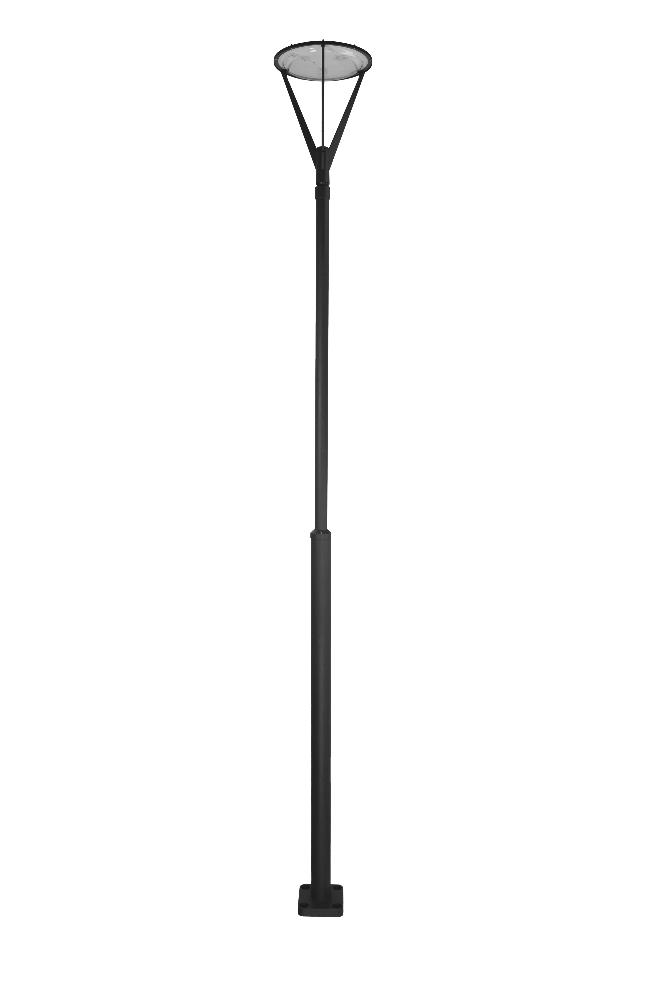
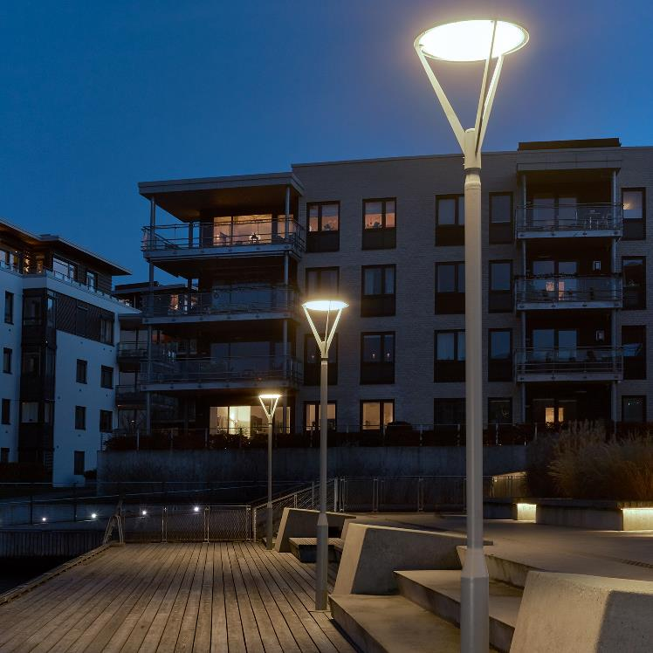
mounted on 3004 pole
Notes:
Zamocowane na słupie 300X

Slide 31



colour temp. 3000K/4000K
Egersund Park 6113
- IP65
- wattage 23.7W
- luminous flux 2239lm
- efficiency 94.5lm/W
- power factor PF>0,99
- L70B50 >72 000h
- ULOR 1%
PMMA diffuser
Ø120mm aluminium body

Slide 32


Slide 33





equipped with LED lens type V
(other lens versions available)
Trysil Pole
- IP65
- IK10
- wattage 12.2W
- luminous flux 1705lm
- efficiency 139.8lm/W
- colour temp. 3000K/4000K
aluminium body
durable mount
Art. 1091
Art. 1046

Slide 34


equipped with LED lens type II/III
(other lens versions available)
Asker Head 4332
- IP65
- efficiency 137lm/W
- power factor PF 0,97
- L70/B50 100 000h
- colour temp. 3000K/4000K
Ø60mm mount
DALI2/Night Dim
wattage 39,8W
luminous flux 5457lm

Slide 35

Asker Head 4332
- Ø60mm standard mount
(other mount diameters possible)
- adjustable head position angles

Slide 36


Ø60mm mount
(other mount options possible)
Mora 6460
- IP65
- IK08
- wattage 17.6W
- luminous flux 1626lm
- efficiency 92.4 lm/W
- power factor PF 0,93
- L70B50 >110 000h
colour temp. 3000K/4000K
aluminium reflector
safety glass

Slide 37
Ø60mm mount
(other mount options possible)
Mora 6467
- IP65
- IK08
- wattage 33.5W
- luminous flux 3437lm
- efficiency 102.6 lm/W
- power factor PF 0,99
- L70B50 >110 000h
colour temp. 3000K/4000K
aluminium reflector
safety glass
DALI2/NightDim

Slide 38
dimmable (TRIAC)
Art. 2122
Art. 2120
Nidaros
- IP65
- wattage 7.8W
- luminous flux 765lm
- efficiency 98,1 lm/W
- power factor PF 0,90
- L70/B50 >110 000h
Art. 2121
safety glass
aluminium reflector
3 sizes (9, 18 and 23cm)

Slide 39
Sol 4056
transparent PC diffuser for IK10
(glass version possible, lower IK)
- IP65
- IK10
- wattage 19,1W
- luminous flux 2421lm
- efficiency 126,8lm/W
- L70/B50 >100 000h
- power factor PF 0,96
light control DALI
colour temp. 3000K/4000K
aluminium reflector

Slide 40



Bespoke projects
(and modifications)
- own tooling shop
- own die cast foundry
- own hot dip galvanizing facility
- own paint shop
- own metal workshop (classic one)
- own CNC mill departments
- own welding department
custom made die cast moulds
custom made press tools
custom made/modified steel and aluminium lantern elements
colour/finish customization
properties customization (IP, IK…)

Slide 41


Bespoke projects
(and modifications)
- own tooling shop
- own die cast foundry
- own hot dip galvanizing facility
- own paint shop
- own metal workshop (classic one)
- own CNC mill departments
- own welding department
custom made die cast moulds
custom made press tools
custom made/modified steel and aluminium lantern elements
colour/finish customization
properties customization (IP, IK…)

Slide 42

Thank You

