Slide 2
Initial capital Norwegian 100%
Shares in company holding:
About Norlys
Notes:
Company was established in 1953 in Norway, nowadays shares in company holding are… and the company is representated by chairman of the board mr Kordek

Slide 3
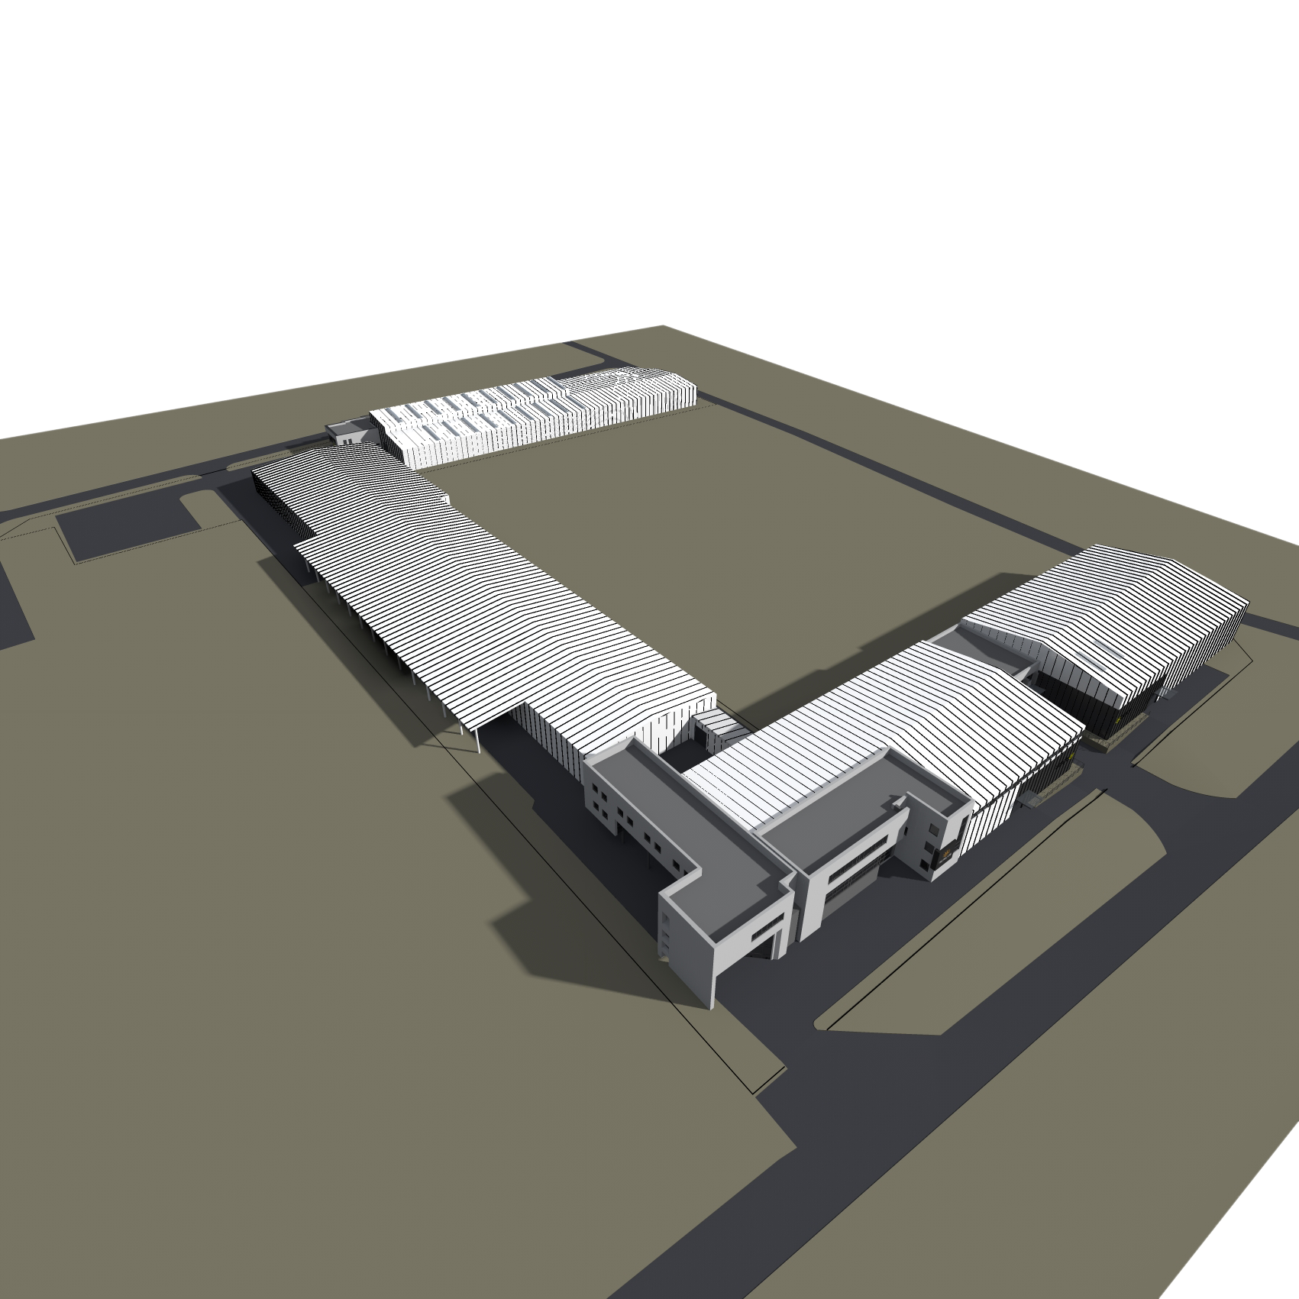
NORLYS w Polsce
15 500 m² usable area
20 500 m² buisness area
280 employees
55 administrative stuff
21 departments
18 engineers
Notes:
Thirteen thousant
Fifteen thuosant fivehundred
Twenty th five hundret

Slide 4
Turnover of money and investement

Slide 5
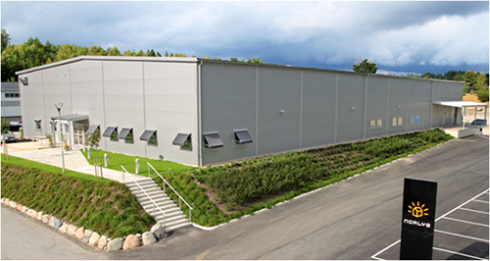
Distribution Network
Branch of NORLYS
Norway
Sweden
Poland
France
Italy
Great Britain
Exclusive distribution
Finland
Russia
Lithuania
Ukraine
Hungary
Austria
Switzerland
Belgium
Netherlands
Denmark
Spain
Greece
Portugal
Irleland
Island
Cyprus
Turkey
Selective distribution
Germany
Czech Republic
Slovakia
Romania
Bulgaria
Latvia
Estonia
Lack of representation

Slide 6
Sales by country

Slide 7
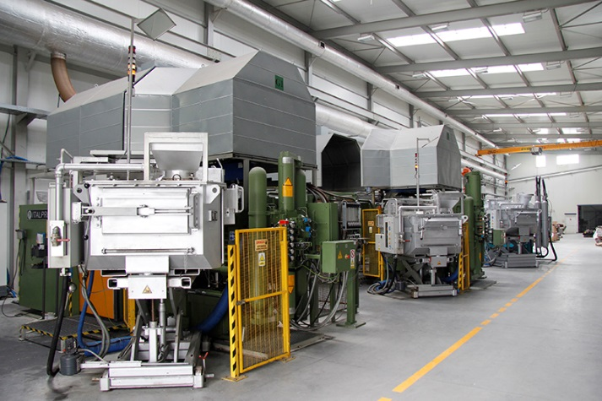
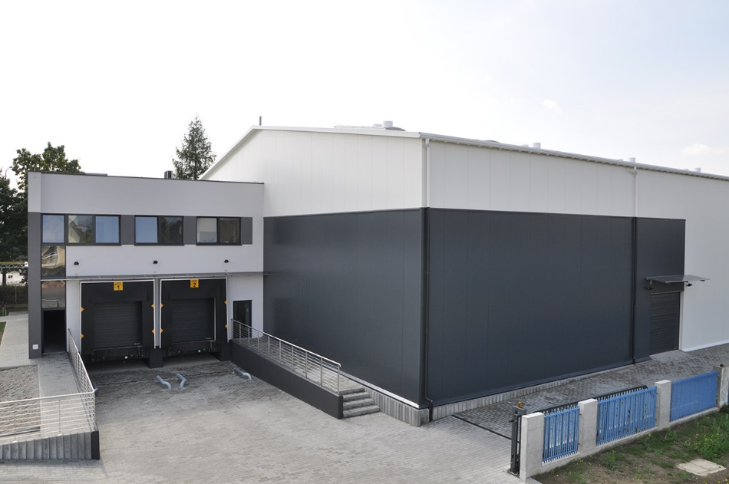
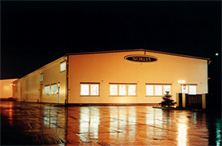
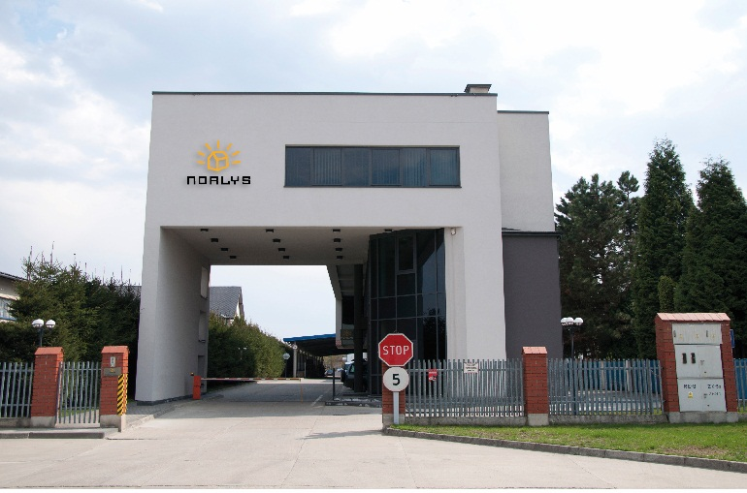
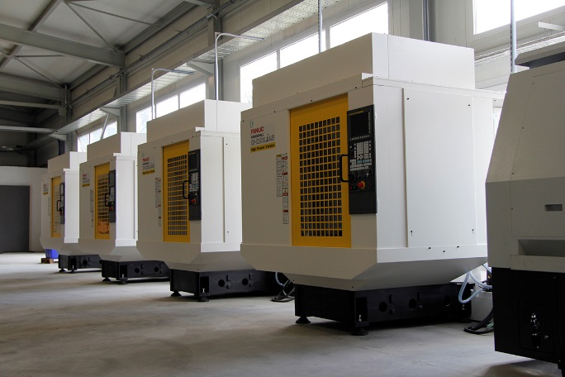
NORLYS over the years
Ocynkownia ogniowa
Galvanizing department
2004
1998
2004
1998
2002
2002
Foundry department
2011
Year Established
Year Established
1953
1953
Warehouse
Warehouse
2006
2006
Tools Department
Warehouse
2013
Year Established Polish Dep.
Year Established Polish Dep.
1993
New Office
1993
New Office
2009
2009
Powder Paint Shop
Powder Paint Shop
Production Hall
Production Hall
2014
CNC
Year established
1953
Year Established Polish Dep.
1993
2014

Slide 8
Foundry, Tool Department and Machining Department

Slide 9
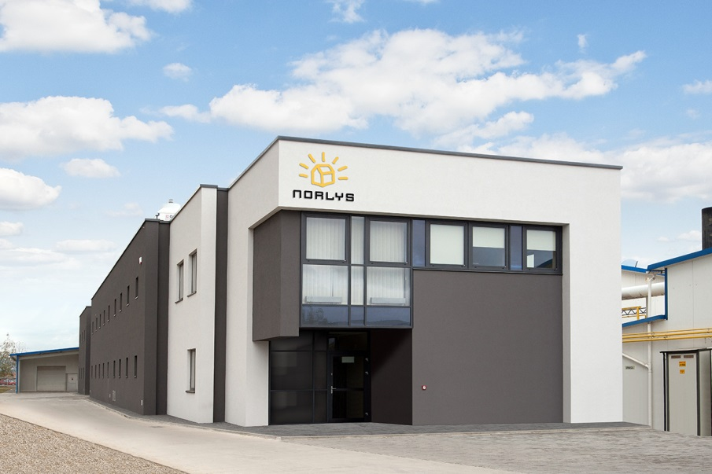

Foundry
Office
Four high pressure die casting machines

Slide 10
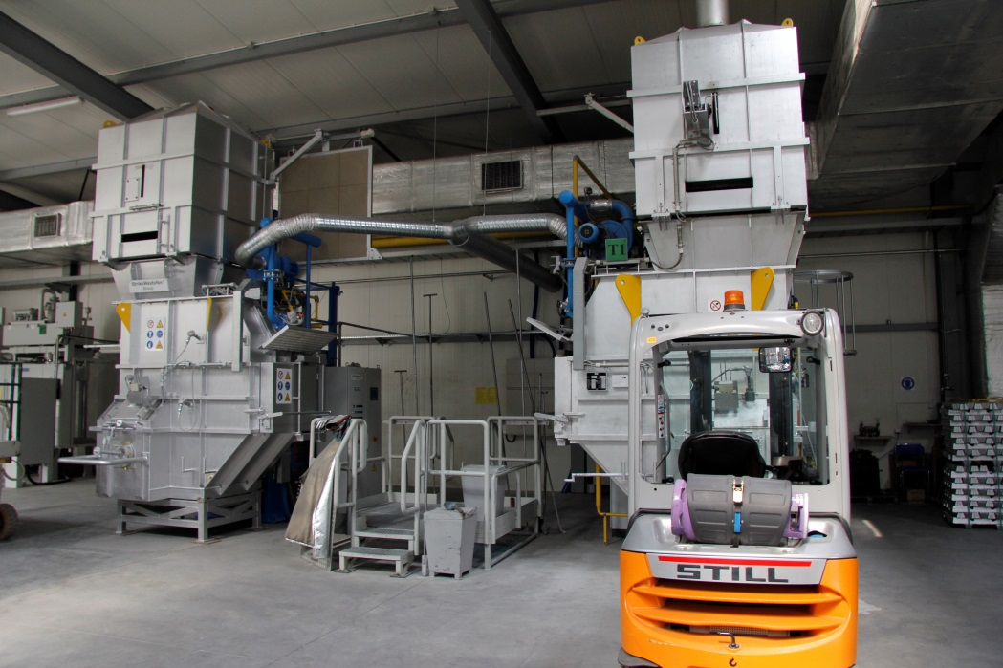
Foundry
Melting furnances

Slide 11
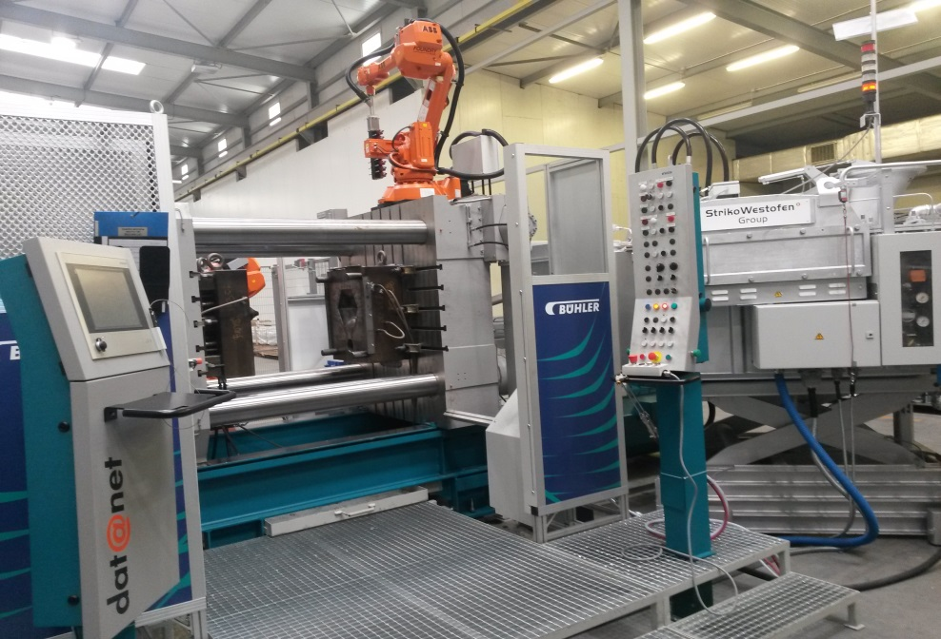
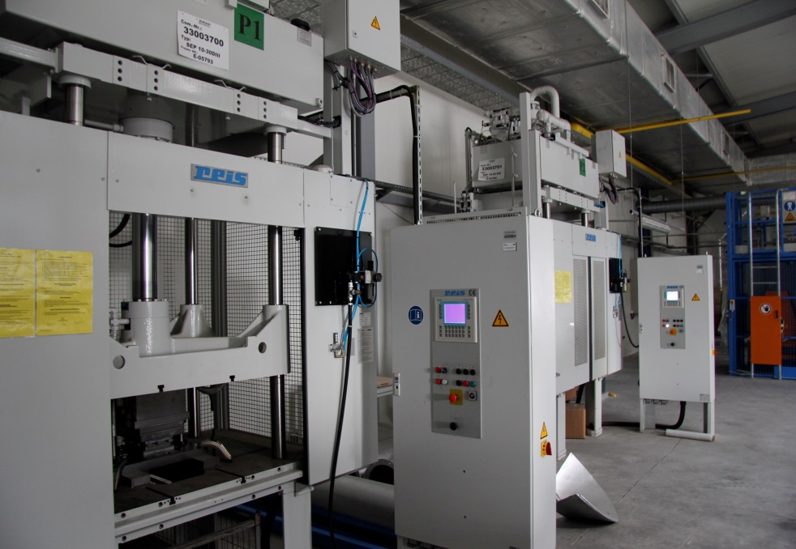
Foundry
High pressure die casting machine with robots and vacuum casting process
Trimming presses

Slide 12
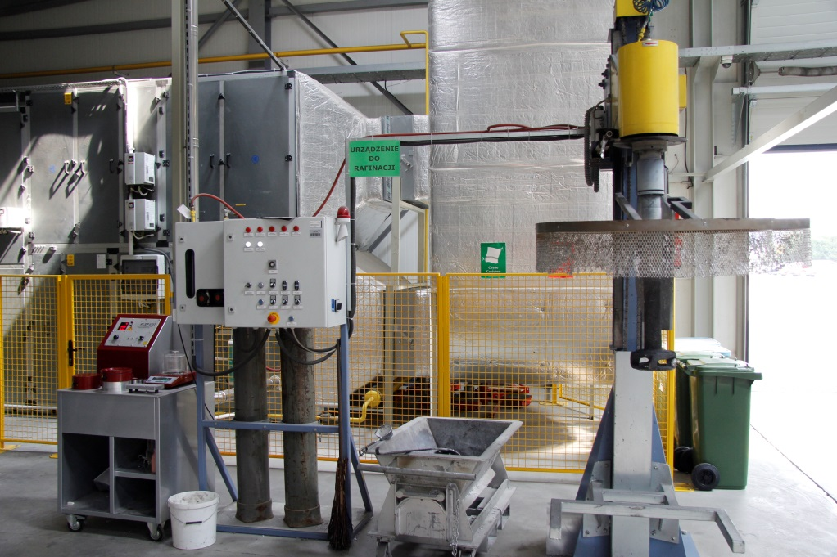
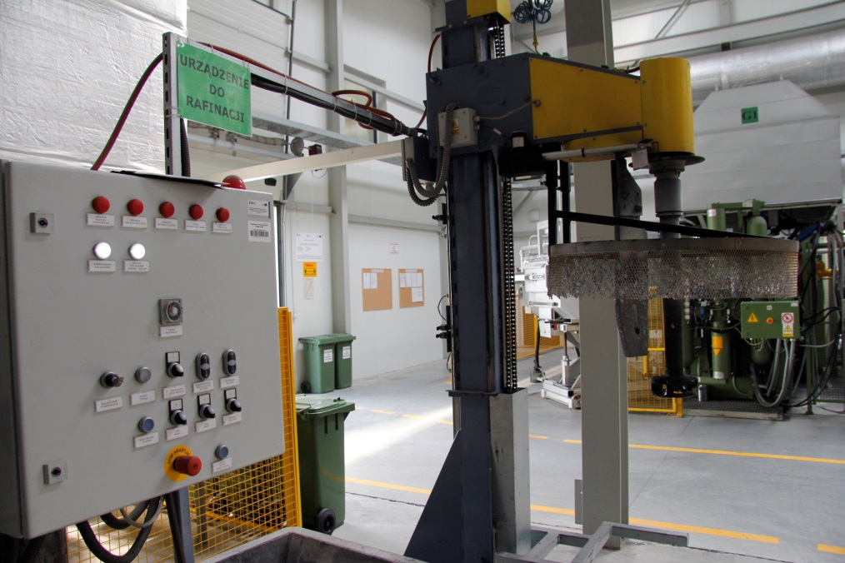
Foundry
Degassing equipment
Vacuum density testing machine

Slide 13
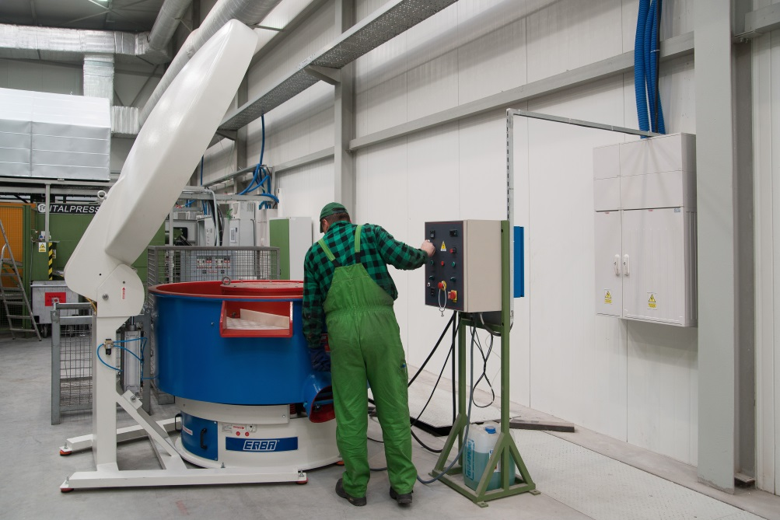
Foundry
Vibratory surface finishing machine

Slide 14
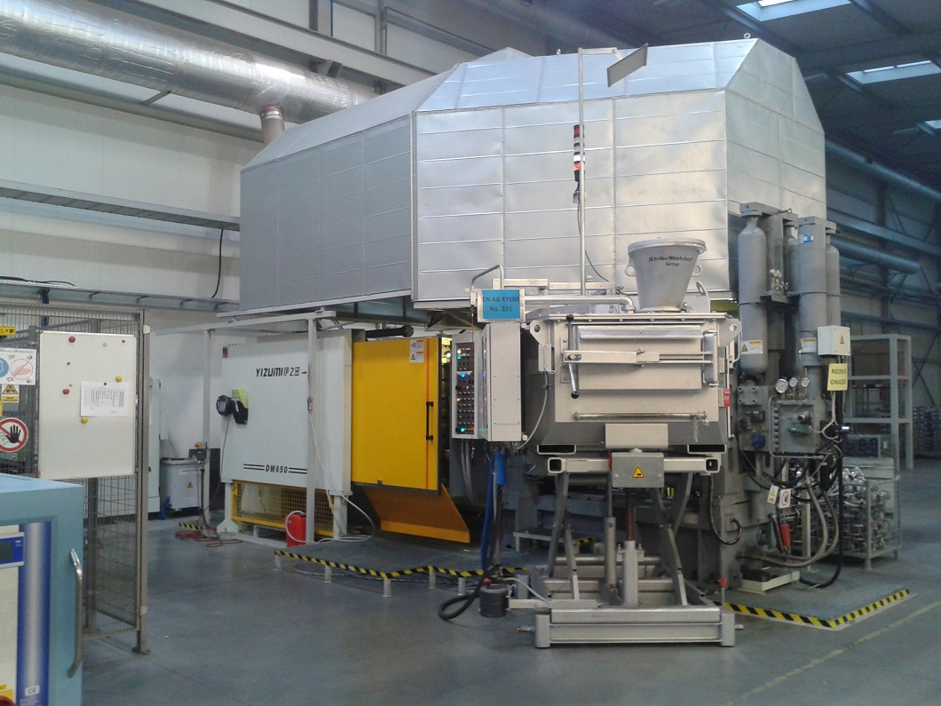
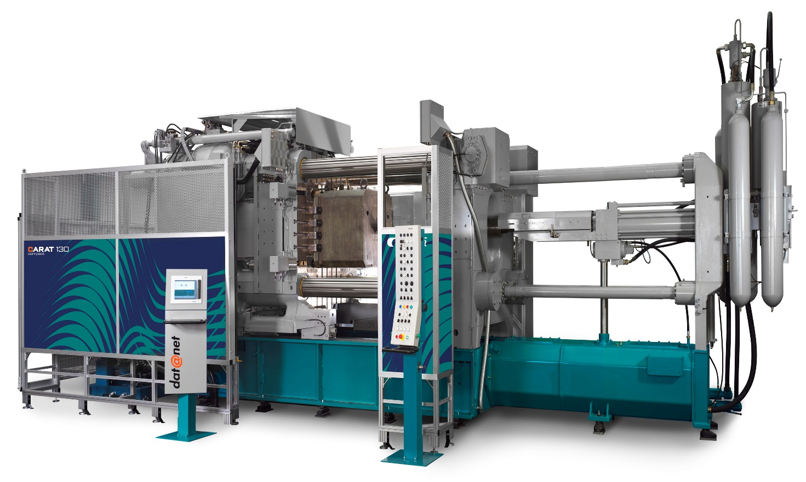
Foundry in next few months
Two new die casting machines 660 (5th) and 300 (6th)

Slide 15
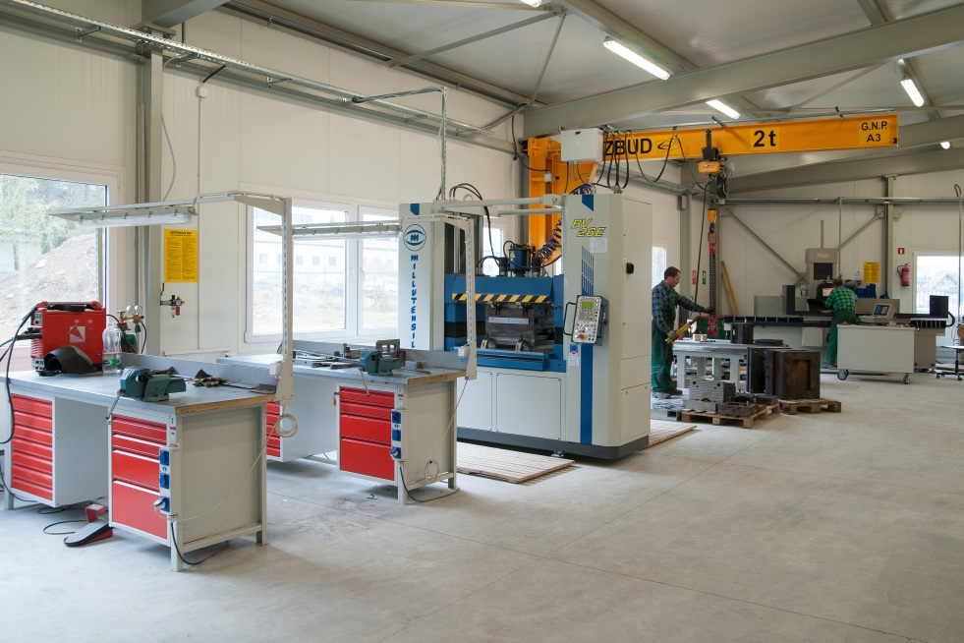
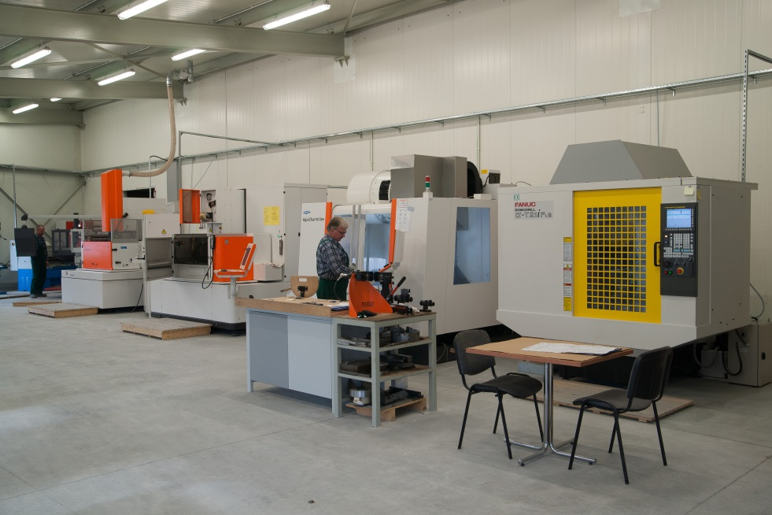
Tool Department
General overview

Slide 16
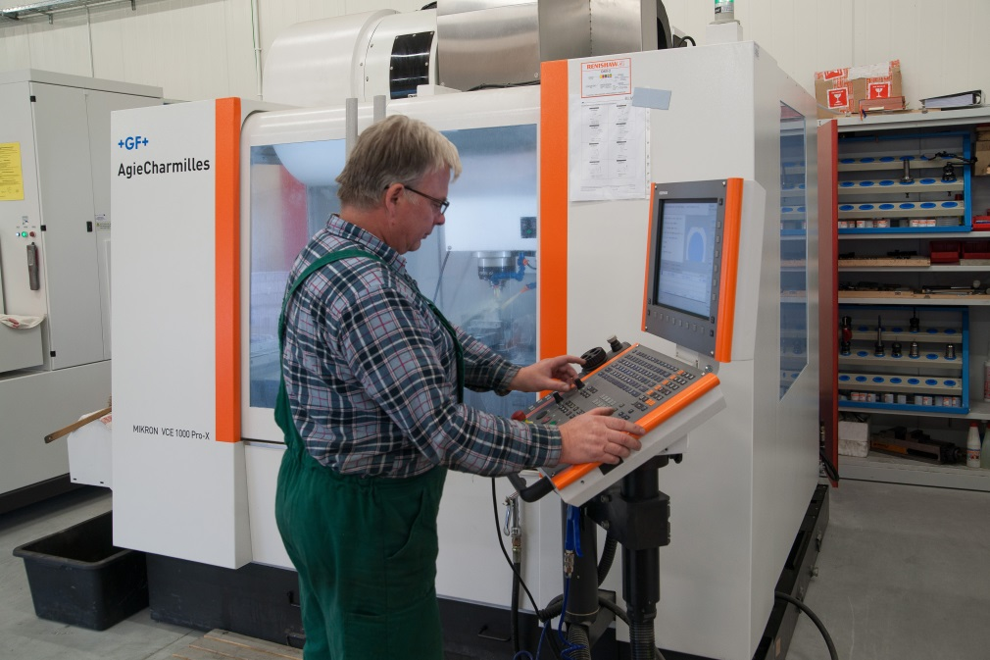
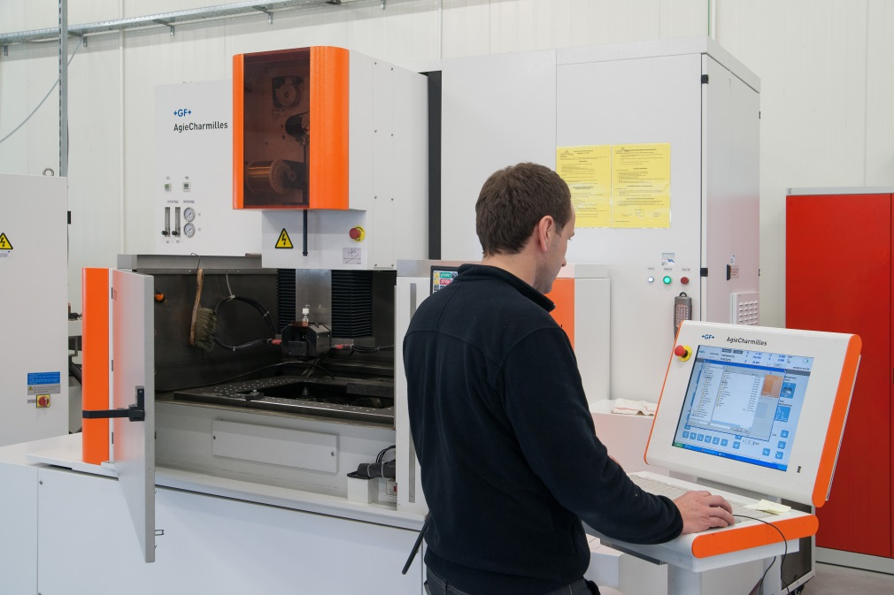
Tool Department
High-precision cutting machine (CNC)
Wire cutting machine (CNC)

Slide 17
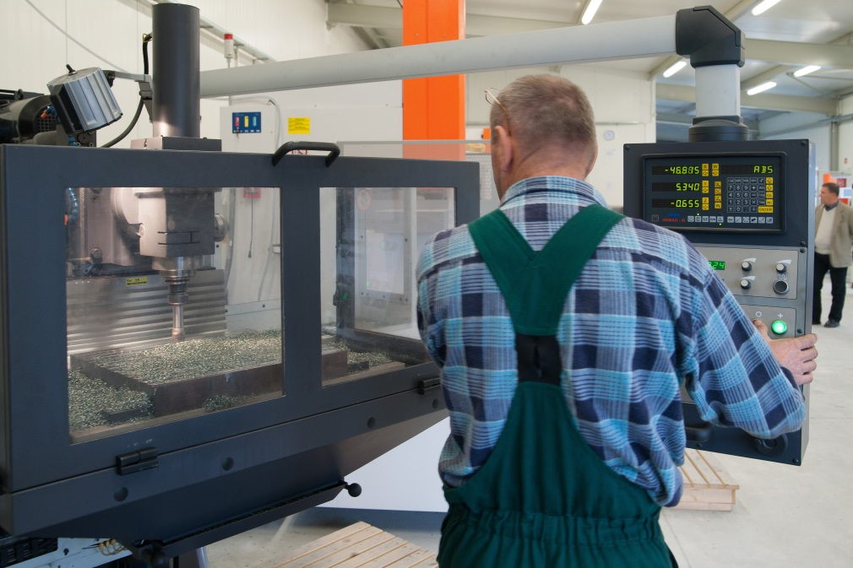
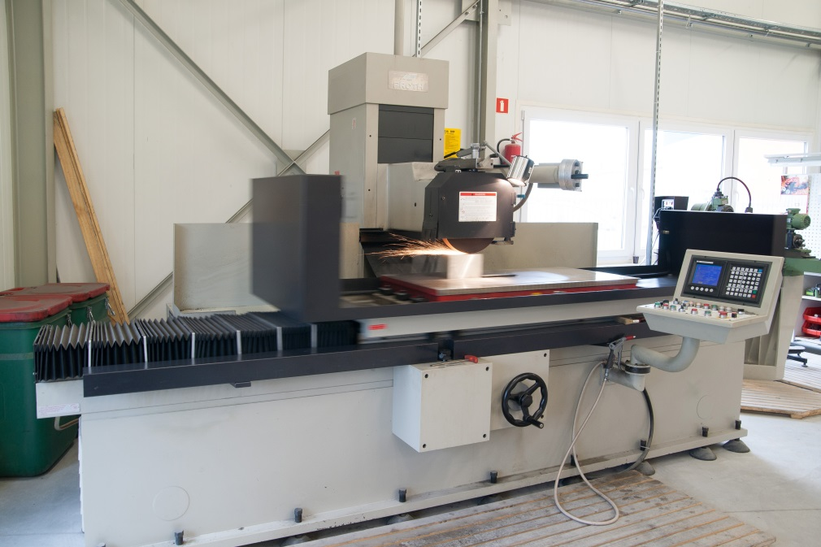
Tool Department
Cutting machine
Precision surface grinder

Slide 18
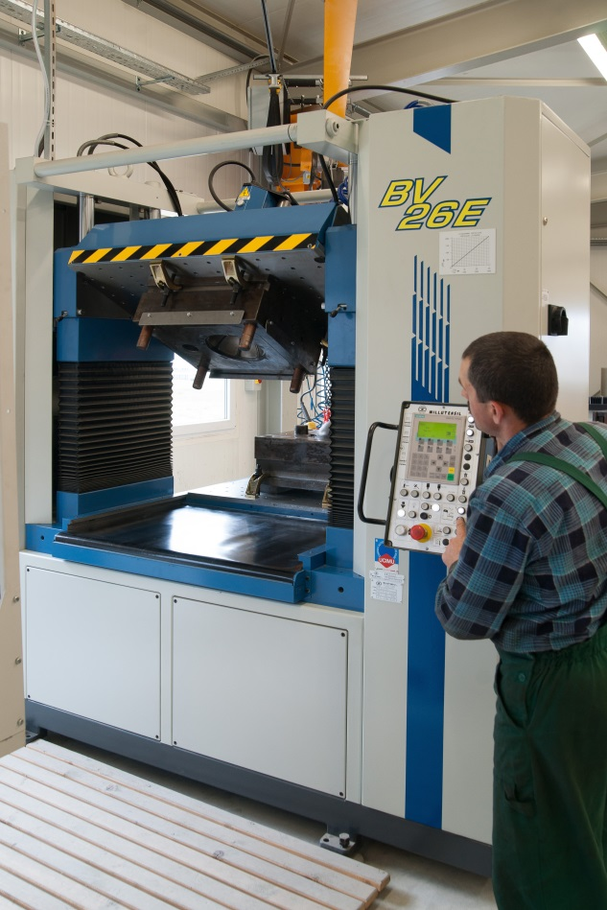
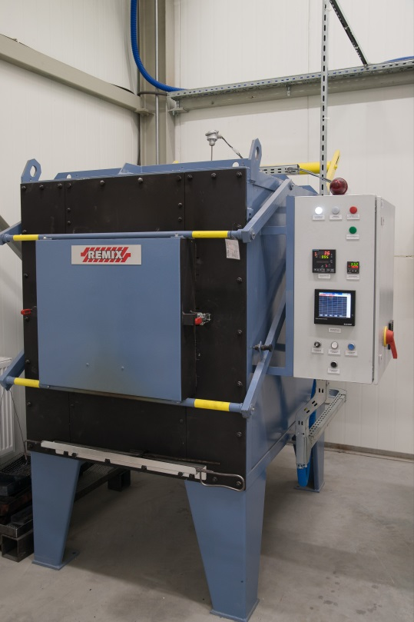
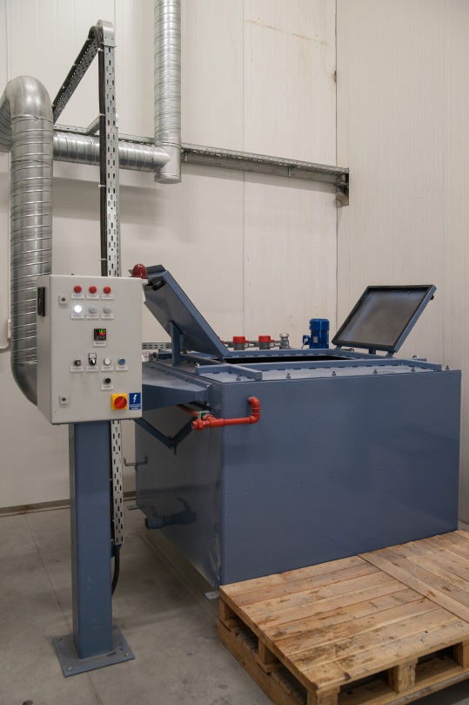
Tool Department
Equipment for heat treatment
Spotting press

Slide 19
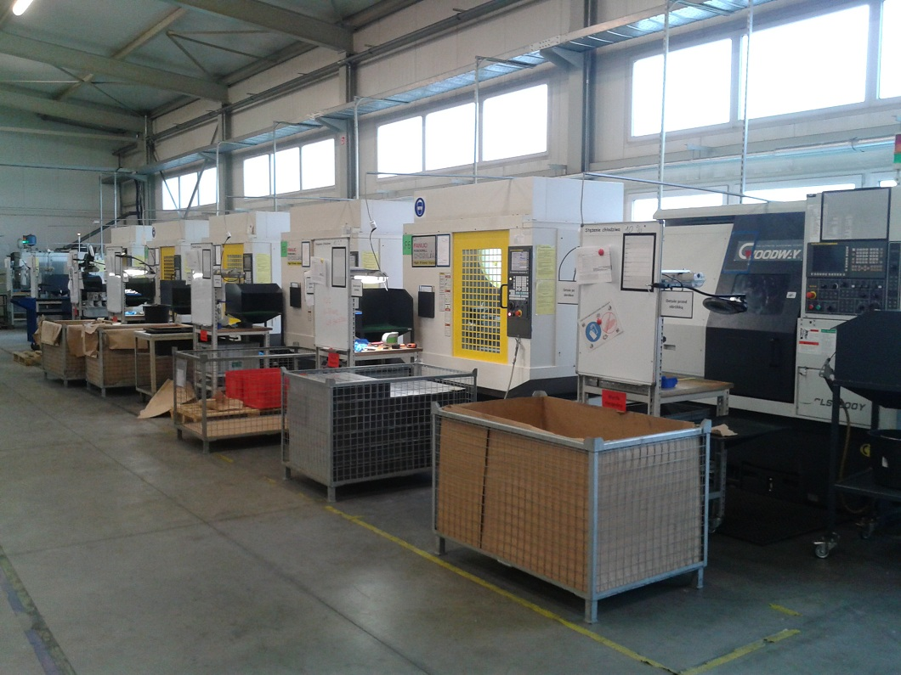
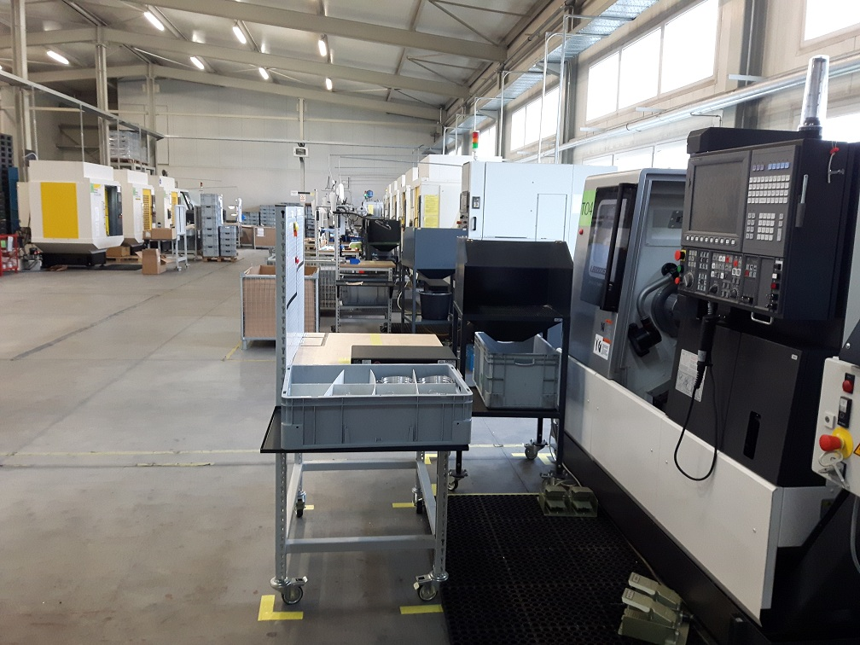
Machining Department
4 Lathe,10 Milling and 1 washing machine
Notes:
Milling Fanuc Robodrill

Slide 20
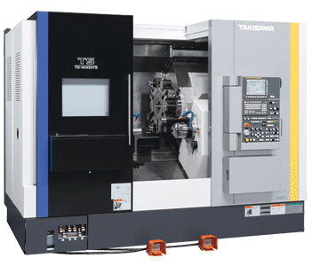
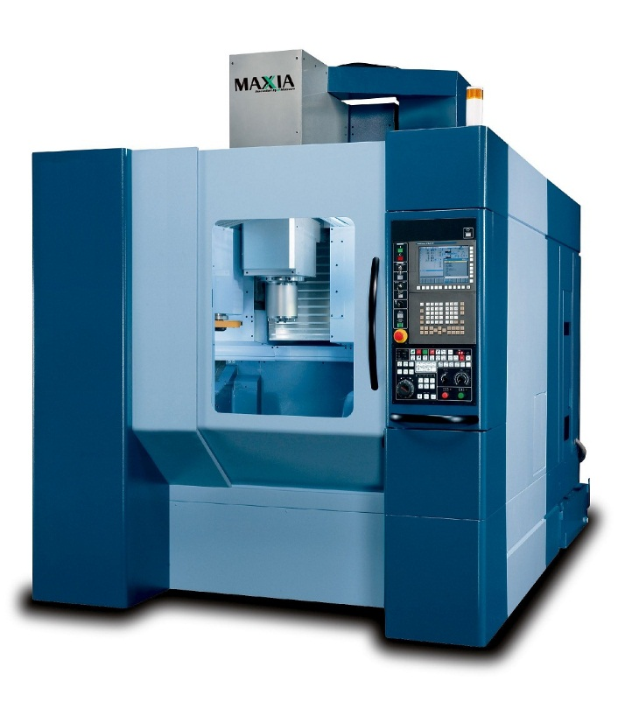
Machining Department in next few months
Anothet Lathe and Milling machines
Notes:
Milling Fanuc Robodrill

Slide 21
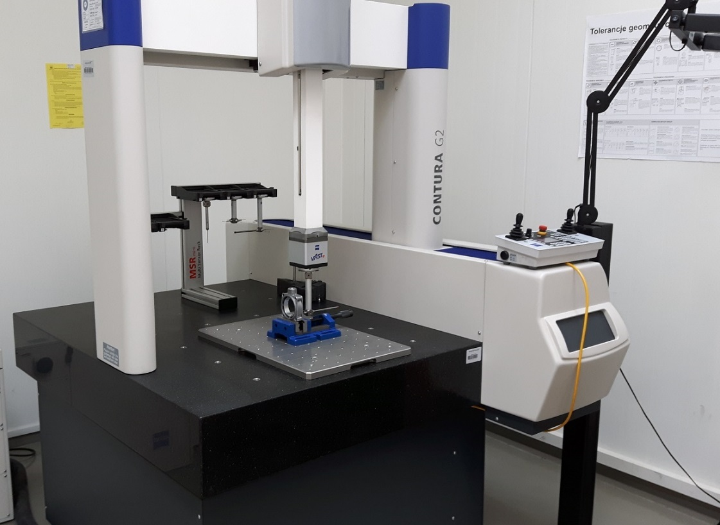
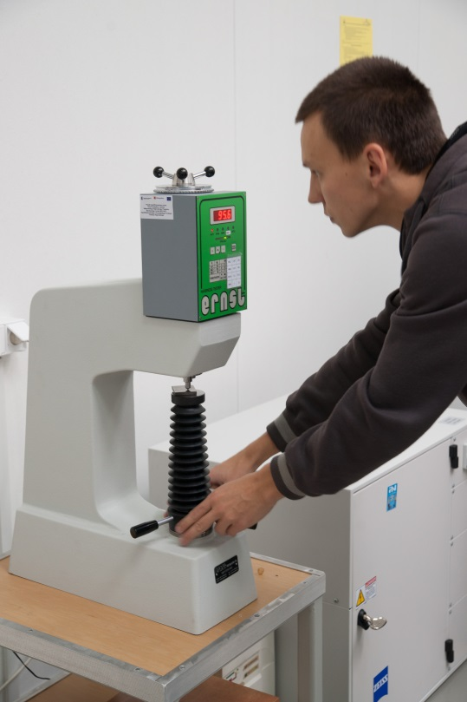
Measuring Laboratory
Coordinate measuring machine (CNC)
Hardness tester

Slide 22
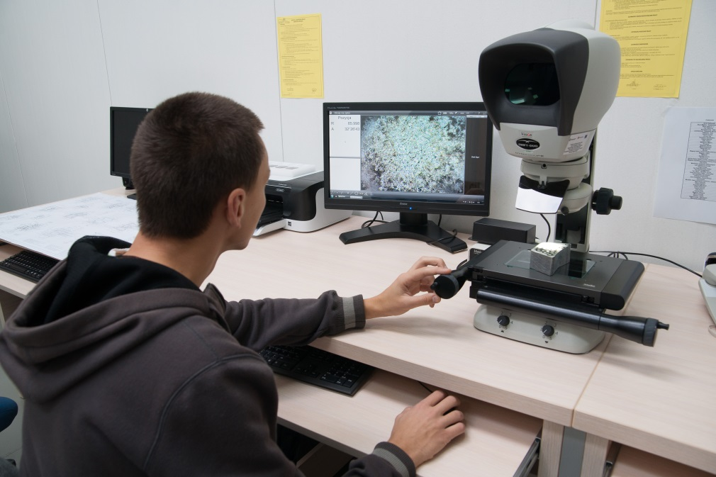
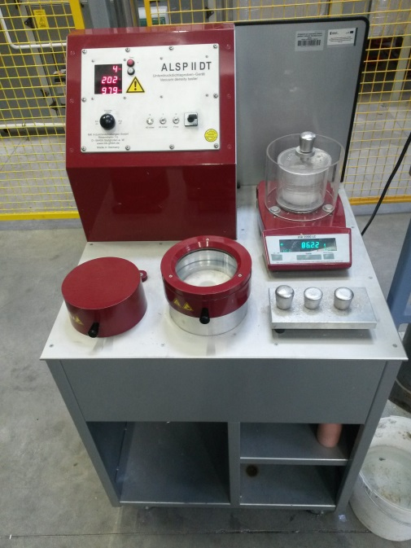
Measuring Laboratory
Measuring microscope
Vacuum
density-testing equipment

Slide 23
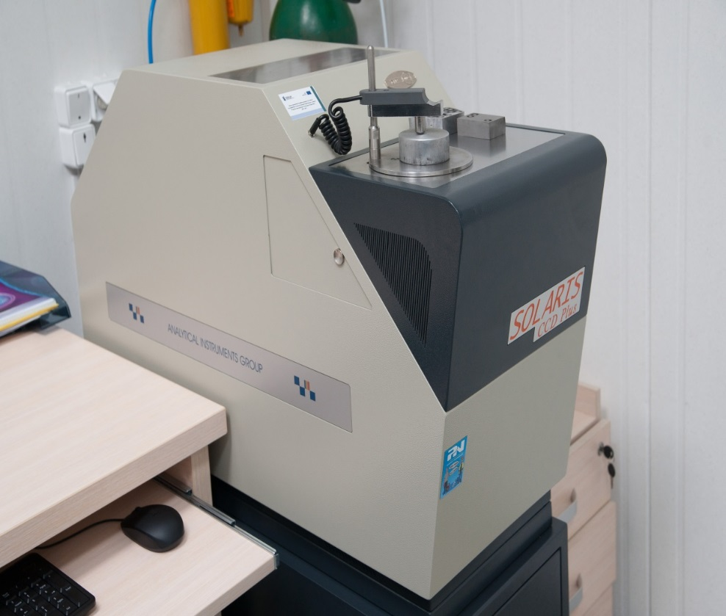
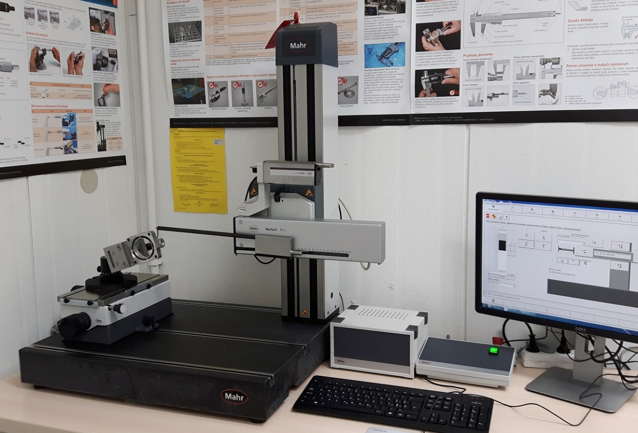
Measuring Laboratory
Spectrometer
Machine for measuring contour and roughness

Slide 24
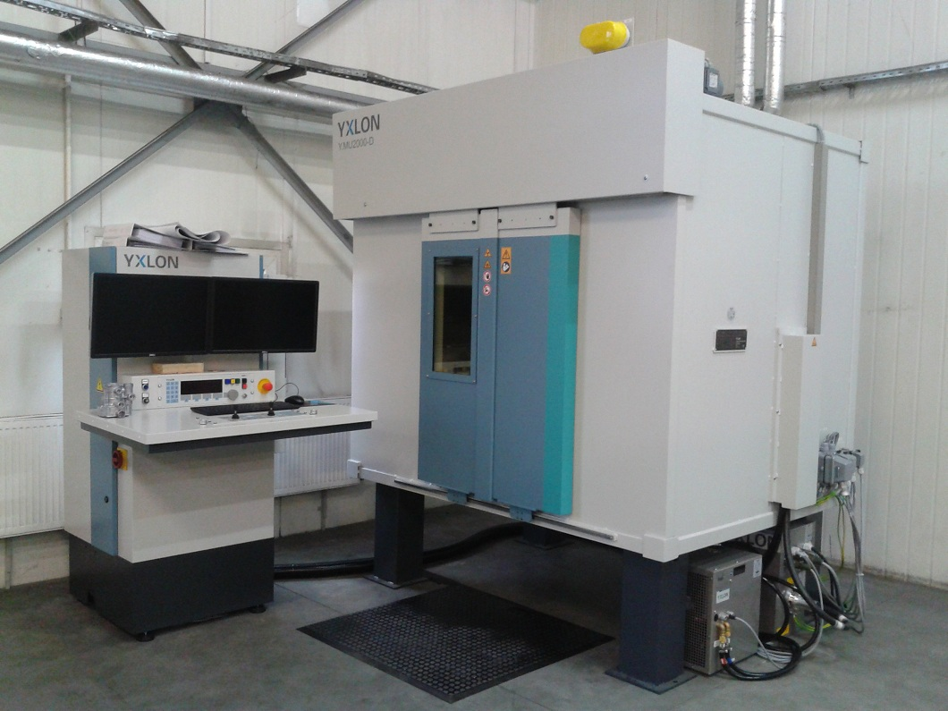
Measuring Laboratory
Xray Machine

Slide 25
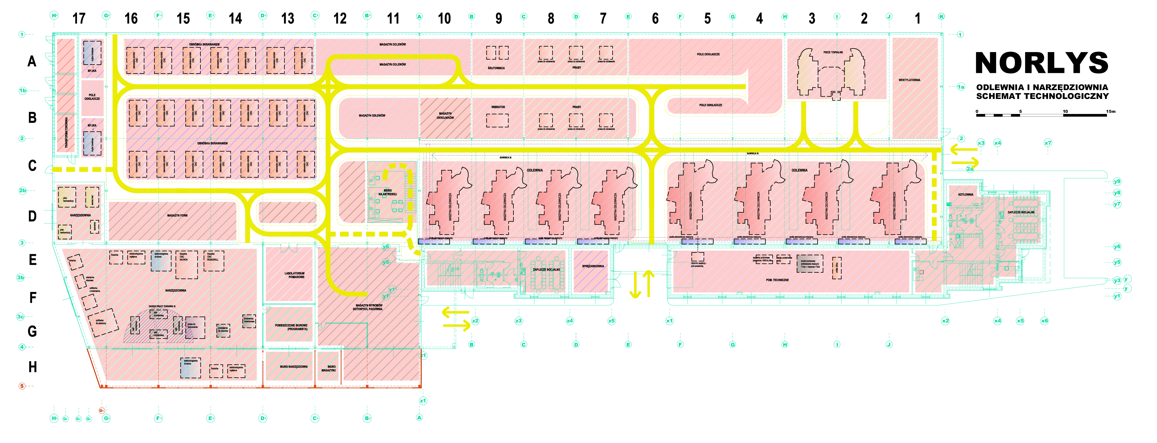
At present – April 2017
Expect to deliver 2017
Planned 2018-2020
4 casting machines
10 CNC Milling Centers
4 CNC Lathe Machines
1 X-Ray Machine
1 Washing machine
2 casting machines
2 CNC machines
2 casting machines
7 CNC machine

