Slide 1
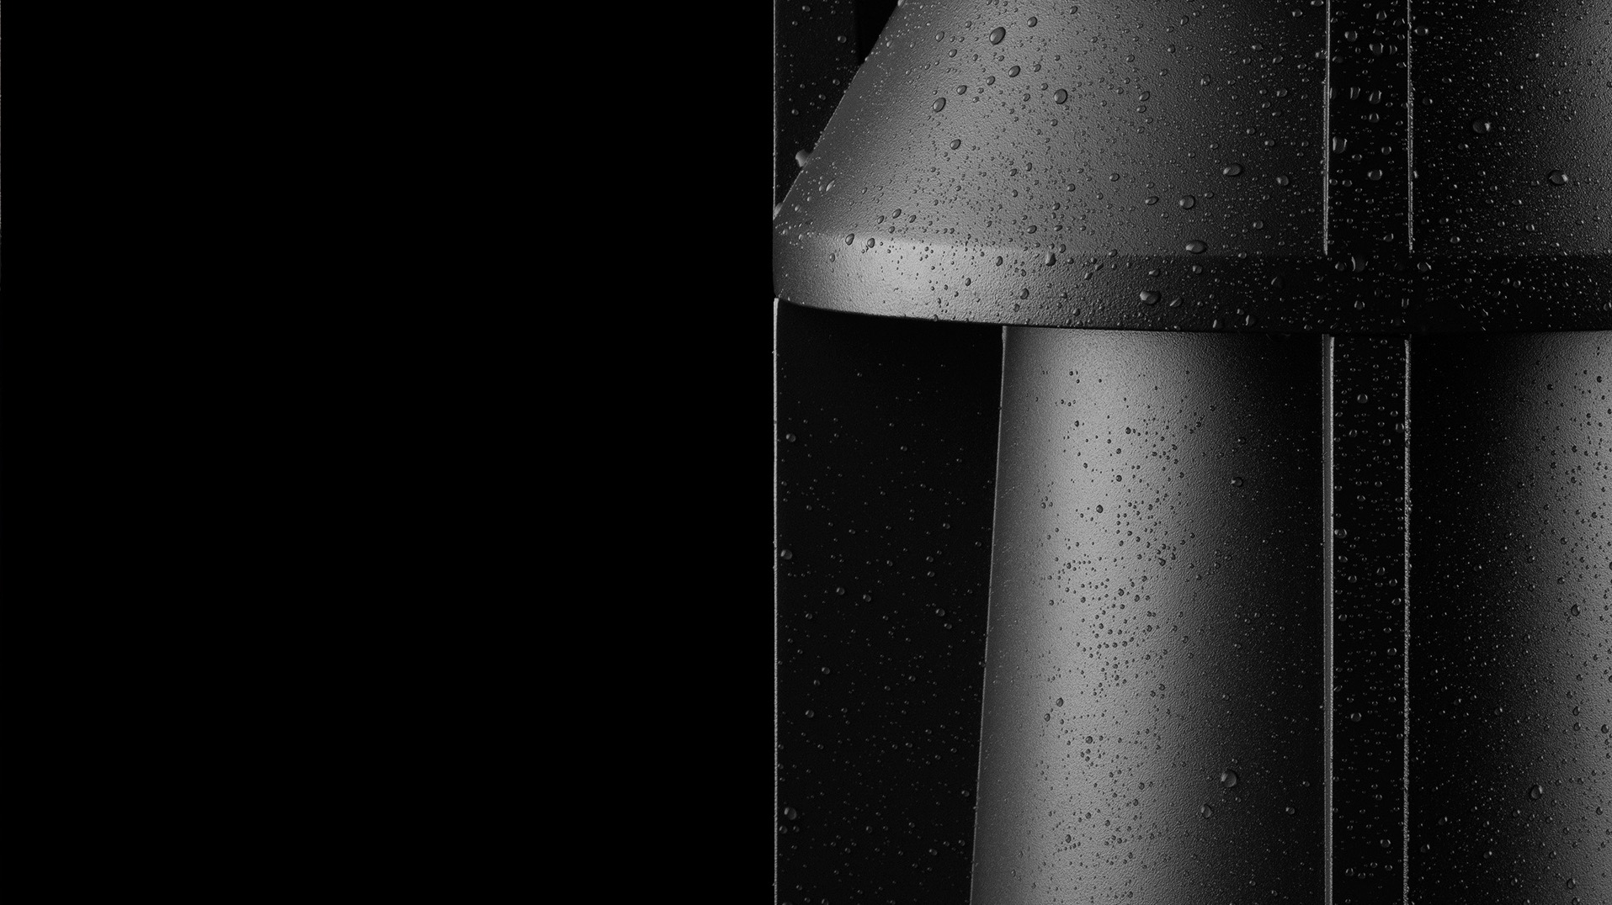

sales points

Slide 2
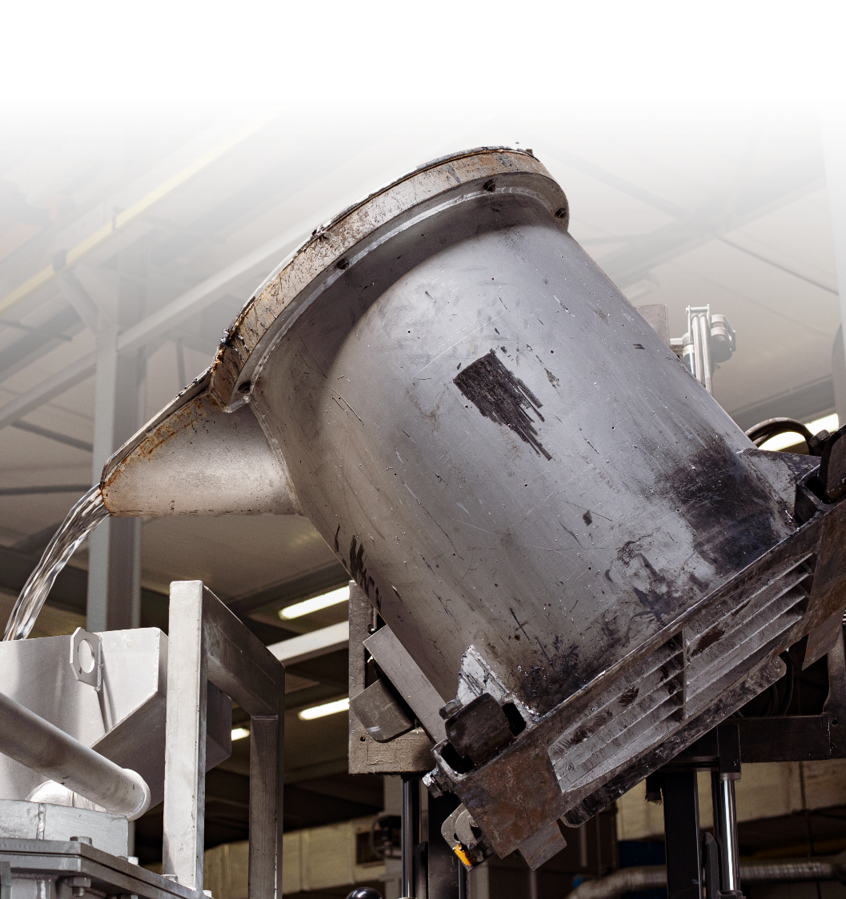


Production facilities
Norlys owns aluminium die casting foundry, along with a tool shop and two laboratories. It also owns departments used for forming and processing steel and copper components. There is a paint shop, hot dip galvanizing facility, CNC mills and of course assembly department, fully integrated with QC.
Die casting operation works under automotive regime - IATF 16949.
The rest of production - ISO 9001.
We are a full production facility –
– not only an assembly department.

Slide 3
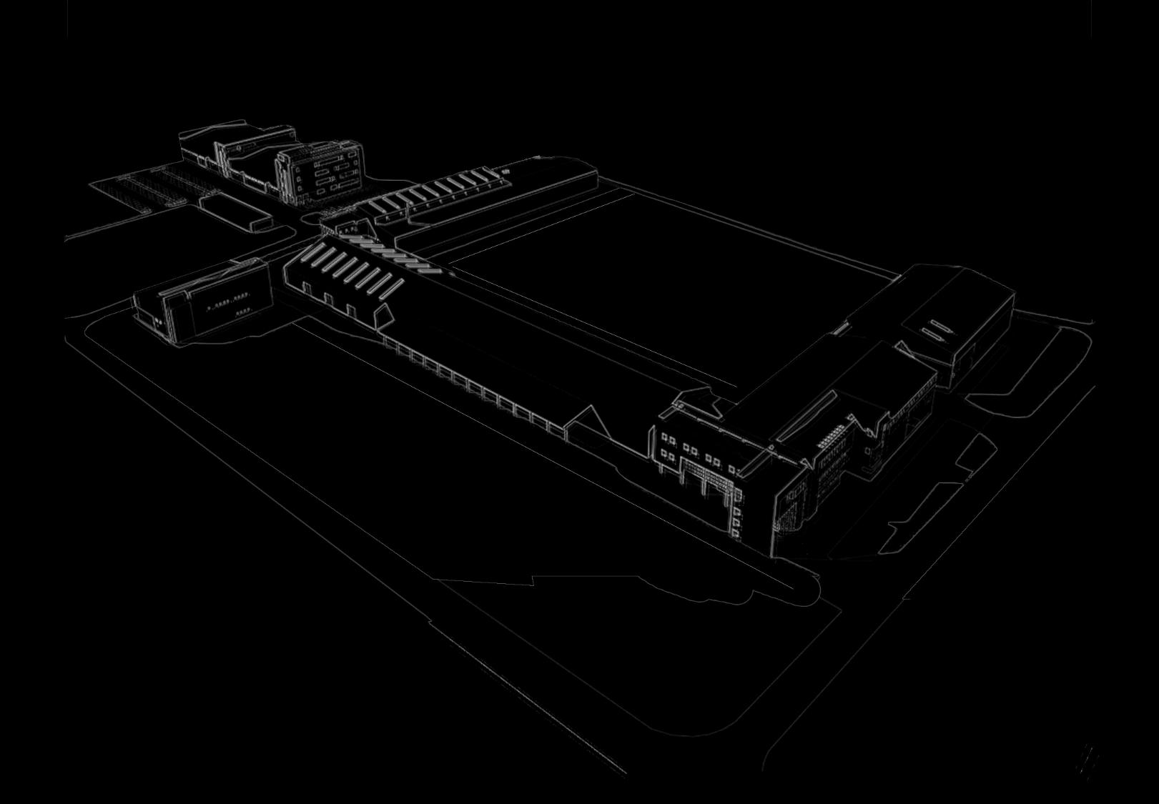
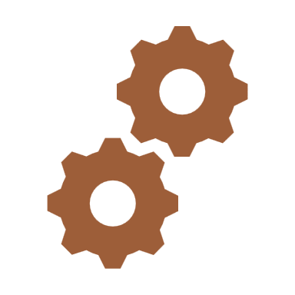
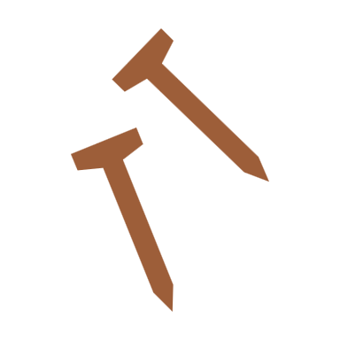

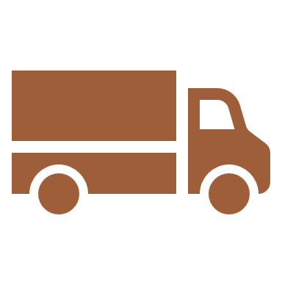



We are a producer
Product
customisation
Spare parts
avaliability
Short
lead times
High quality
components
We are able to modify existing products and make bespoke products reg. clients’ needs.
An end user may expect availability of spare and service parts for a very long time.
Stock products are ready to be despatched within 48 hrs. Other products – up to 4 weeks.
High quality electronic and electrical components used. (preferably made in EU)

Slide 4



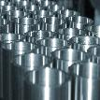



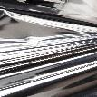

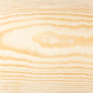

European sourced aluminium, steel, wood and copper raw components.
steel
copper
aluminium
wood

Slide 5
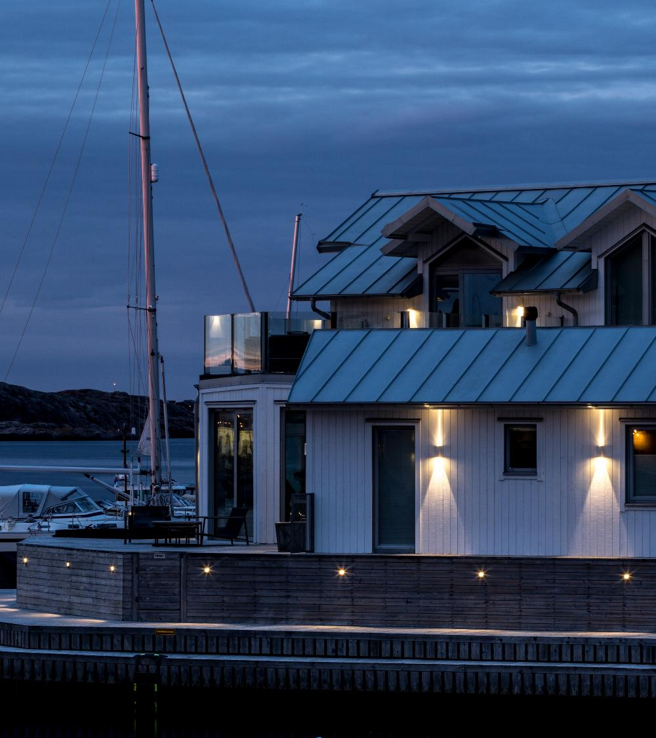


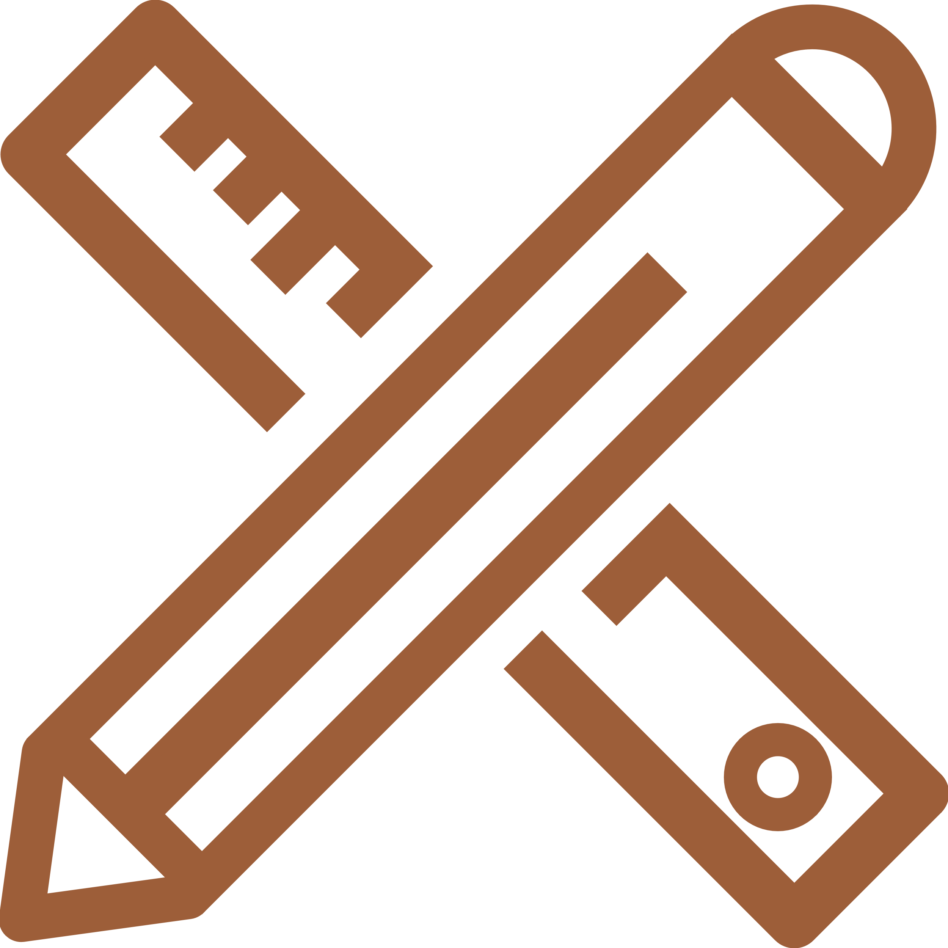
Scandinavian setup
Production and product life cycle with ecology in mind
Simple installation and easy servicing of products
Corrosion resistance proven in harsh conditions of north sea shore for years
Scandinavian design

Slide 6
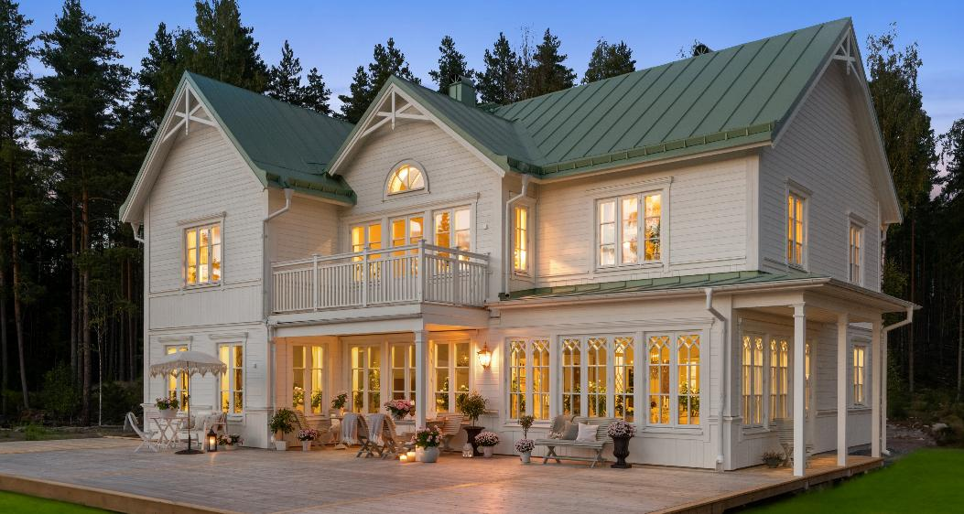
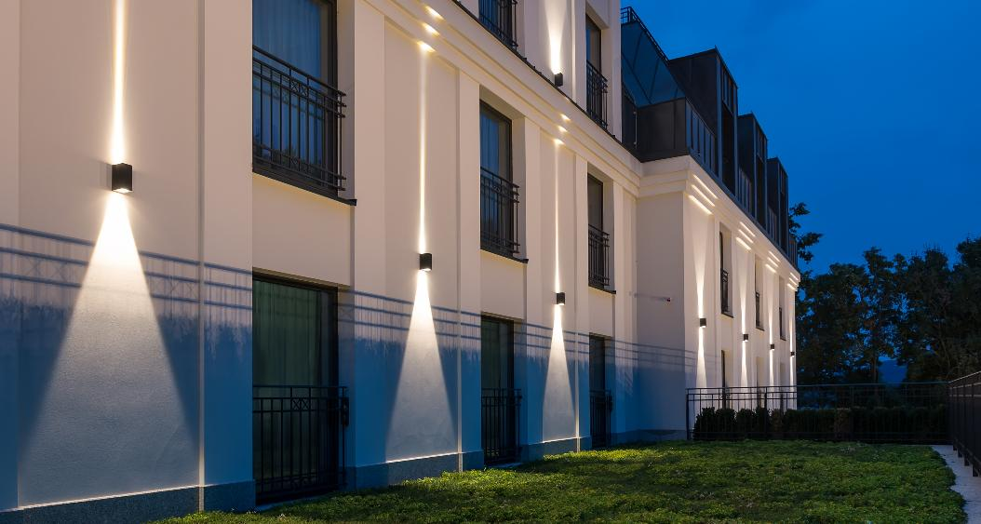
Two main markets
Dividing portfolio into two main (overlapping) groups – 'home and garden' and 'specification/project market’.
For 'specification/project market' we deliver extra tools. BIM objects, 3D objects, photometricale data, etc.
‘Lighting professionals’ are able to find Norlys products within ‘DIALux software’.

Slide 7

Thank You

