Slide 1
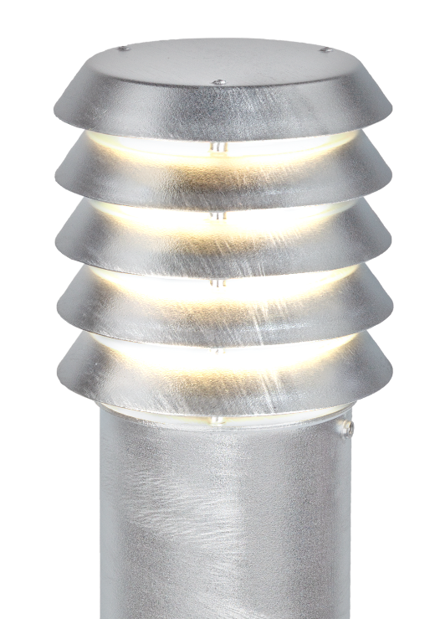

COASTAL ZONE products.
/surface protection/

Slide 2


COASTAL ZONE
Norlys possess a vast, distinctive selection of products, which is perfectly suitable for costal zone territory, regarding their resistance against corrosion.
From our own experience we know, that in harsh North sea (Atlantic) coast environment, hot dip galvanized lanterns can survive dozens of years with no visible rust.
That’s why we are totally convinced, that providing 25 years ‚no corrosion’ warranty, we help our client to make a right choice.

Slide 3
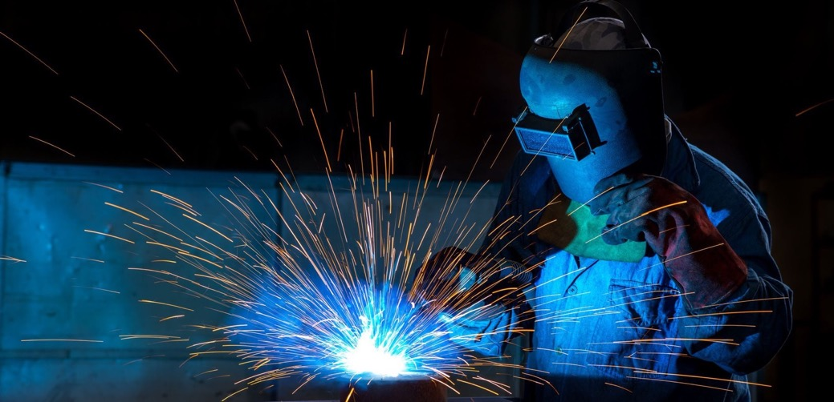
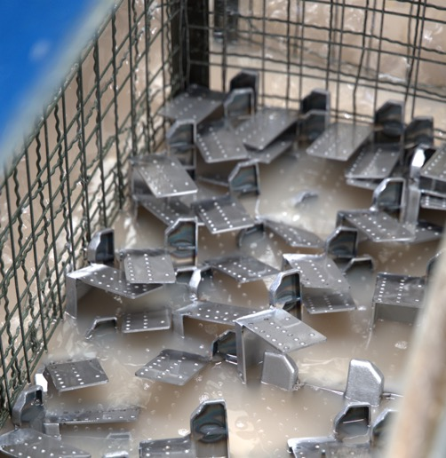
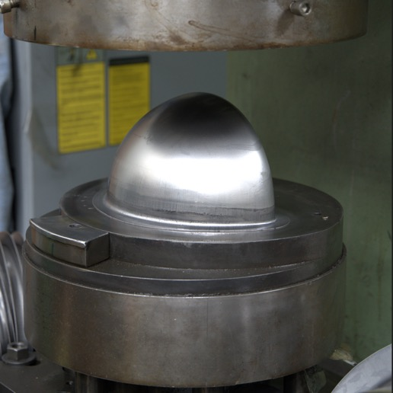
STEEL – why we’ve chosen it?
A centuries - old tradition of processing steel, which is an extremely durable yet formable material. Well-known technology and methods of surface protection.
Norlys uses, European sourced, basic steel plates, pipes and profiles in its production process.
In order to assure long lasting anti-corrosion protection, Norlys performs
a multi stage physical and chemical surface treatment process, before finally painting it into a desired finish.
For some of the steel elements, Norlys uses another, yet excellent, method of surface treatment - hot dip galvanizing.

Slide 4
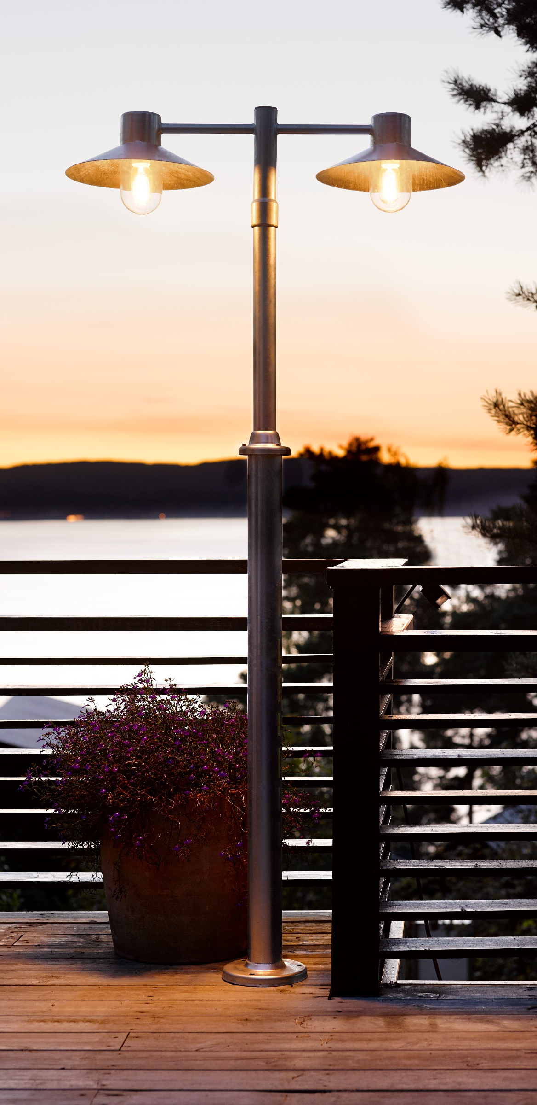
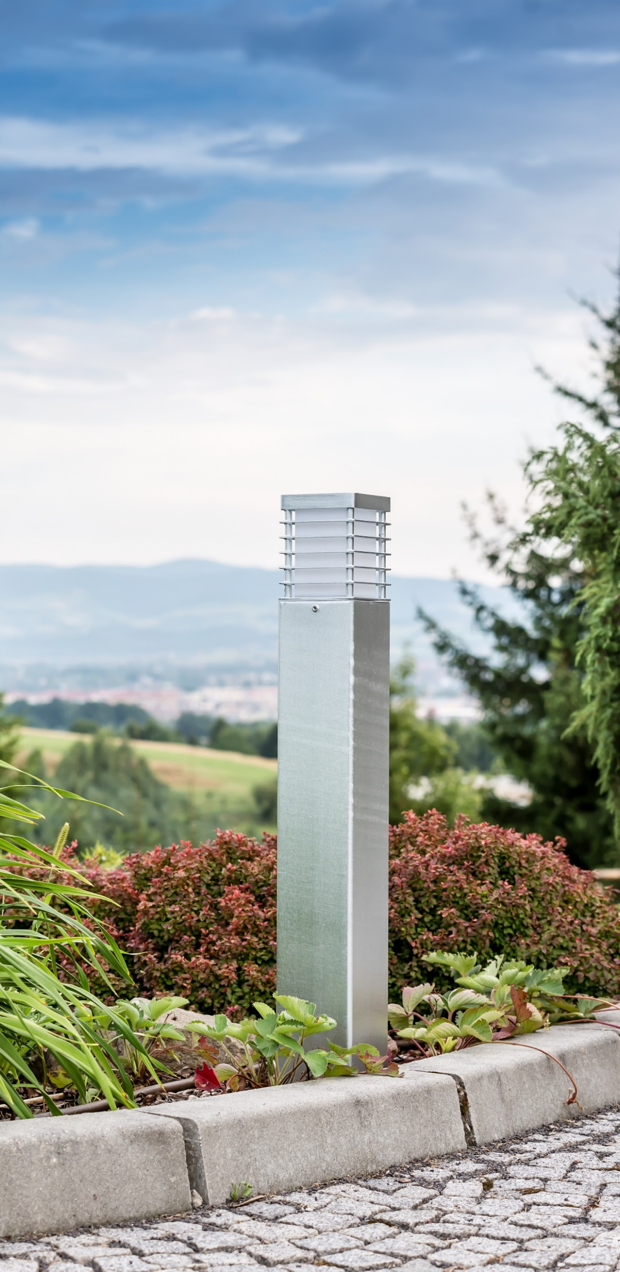
HOT DIP GALVANIZED STEEL
One of the best ways of providing very long lasting anti-corrosion protection for steel made elements, is using the hot dip galvanizing process of surface protection. It can be applied either as the final step of surface treatment, or as a one of the steps before final powder painting.
The process is performed 'inhouse’, using one of the smallest hot dip bath of molten zinc, which enables us precise tuning and controlling surface quality of individual products.
The process of galvanization has been divided in to four main technological stages, with their own parameters’ regime.

Slide 5
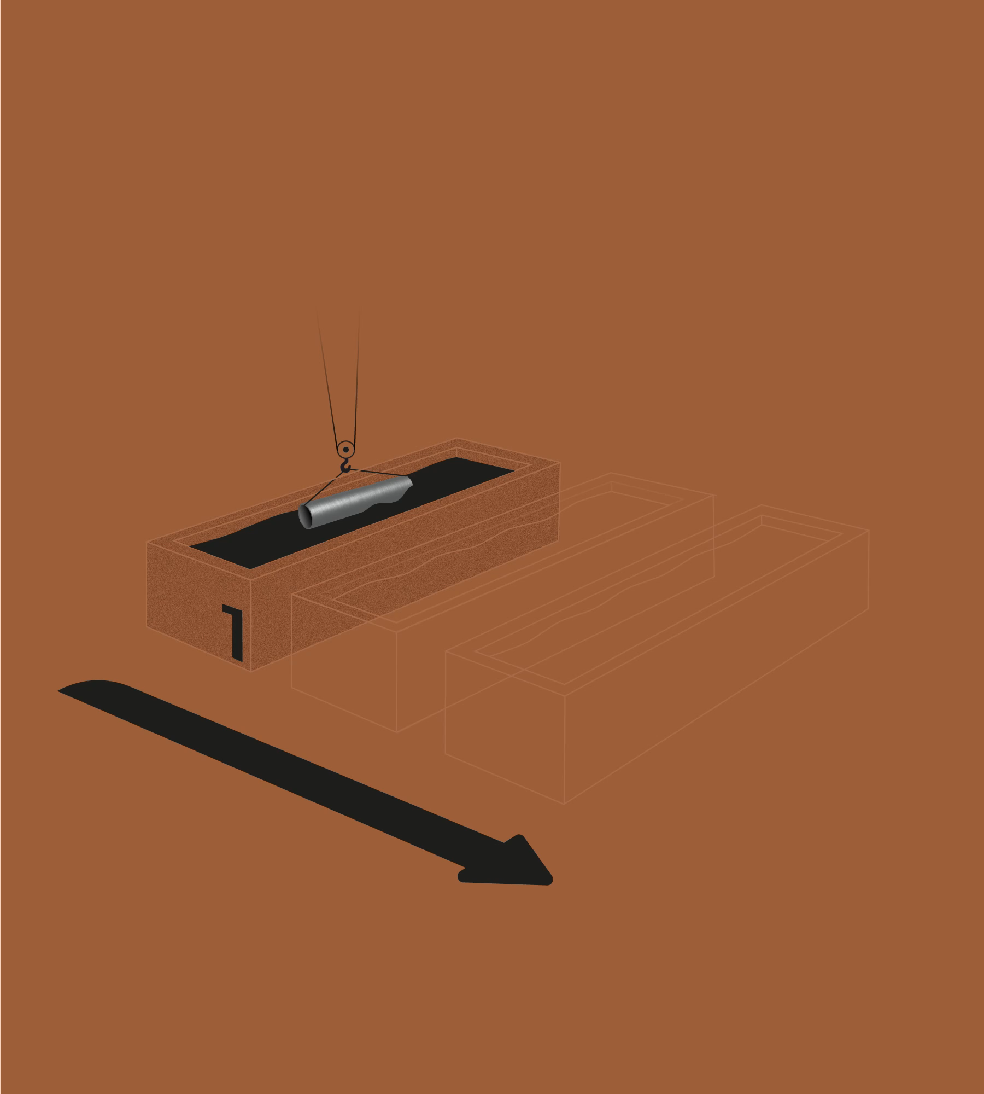
HOT DIP GALVANIZATION
PROCESS – initial stages.
Surface cleaning
Performed in baths of surface agents solution, with precisely controlled composition and temperature. During that stage, protective oils and impurities applied during production process, are completely removed from steel surface.
Rust removal and surface activation
Salt acid bath with precisely controlled time and agent concentration, has to be applied, in order to remove any possible rust traces from processed elements.
Applying ‚chemical glue’
Literally seconds after finishing the previous stage, the final bath has to be arranged, in order to prevent microscopic grains of corrosion from formation on steel surface. This stage is crucial for excellent adhesion of hot zinc layer applied during the next step.

Slide 6
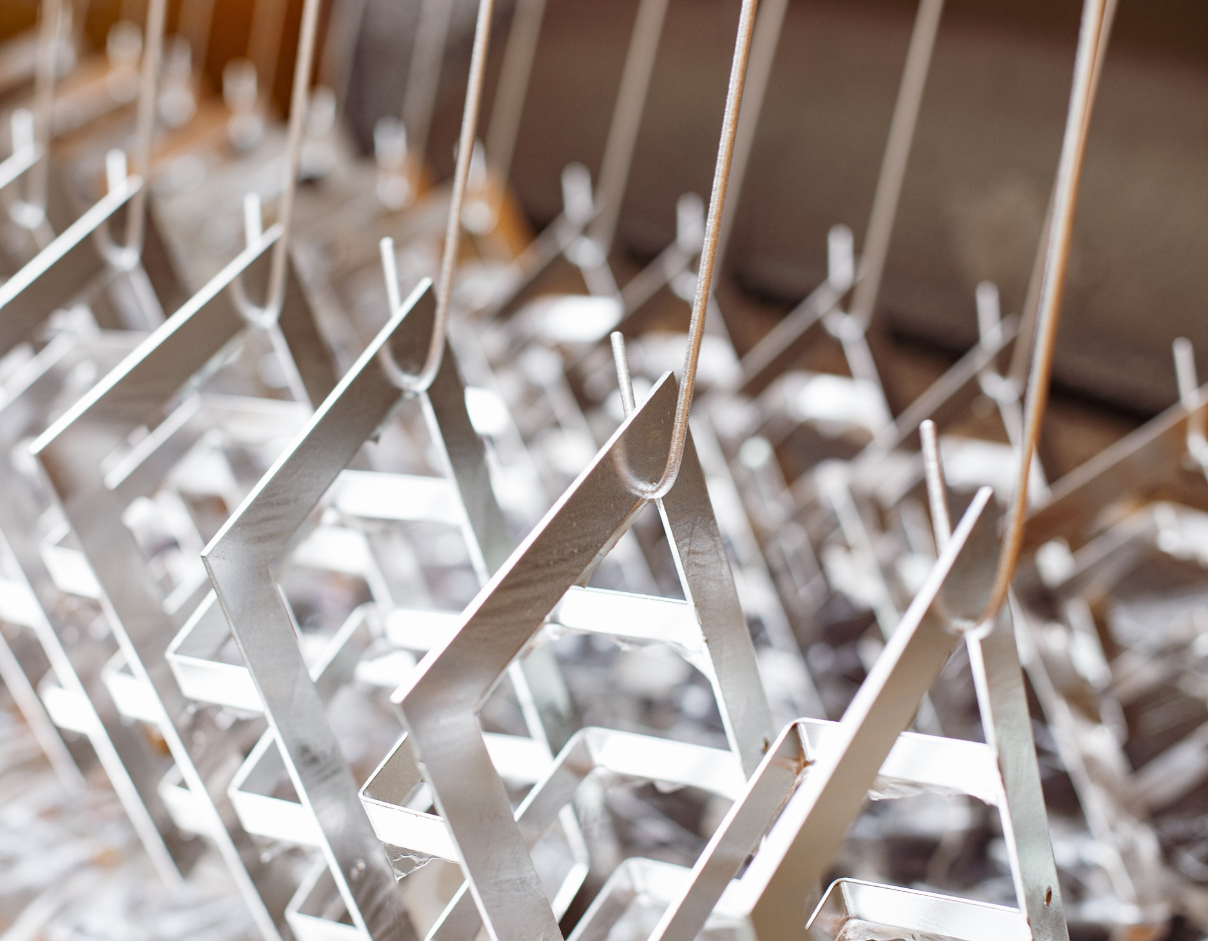
HOT DIP GALVANIZATION
PROCESS – the final stage.
Final hot dip galvanization
Once a set of elements are completely dry after the previous stage, they have to be dipped into a bath of melted zinc, which during next minutes, completely covers a surface of processed steel elements. This process effectively locks down sensitive steel surface, providing physical and chemical shield against corrosion.

Slide 7



DIALux package
Norlys as a silver partner, is now available in the online catalogue of the DIALux software. Our products can now be easily found and integrated into projects, making the process of planning and implementing modern lighting solutions much easier.
We invite you to discover our range in the catalogue and work with us to create exceptional projects.

Slide 8

Let me provide you some inspirations:

Slide 9
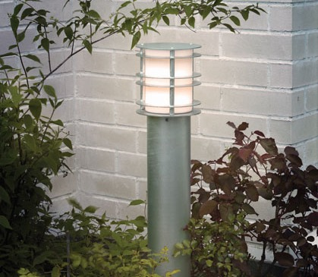

Stockholm

Slide 10
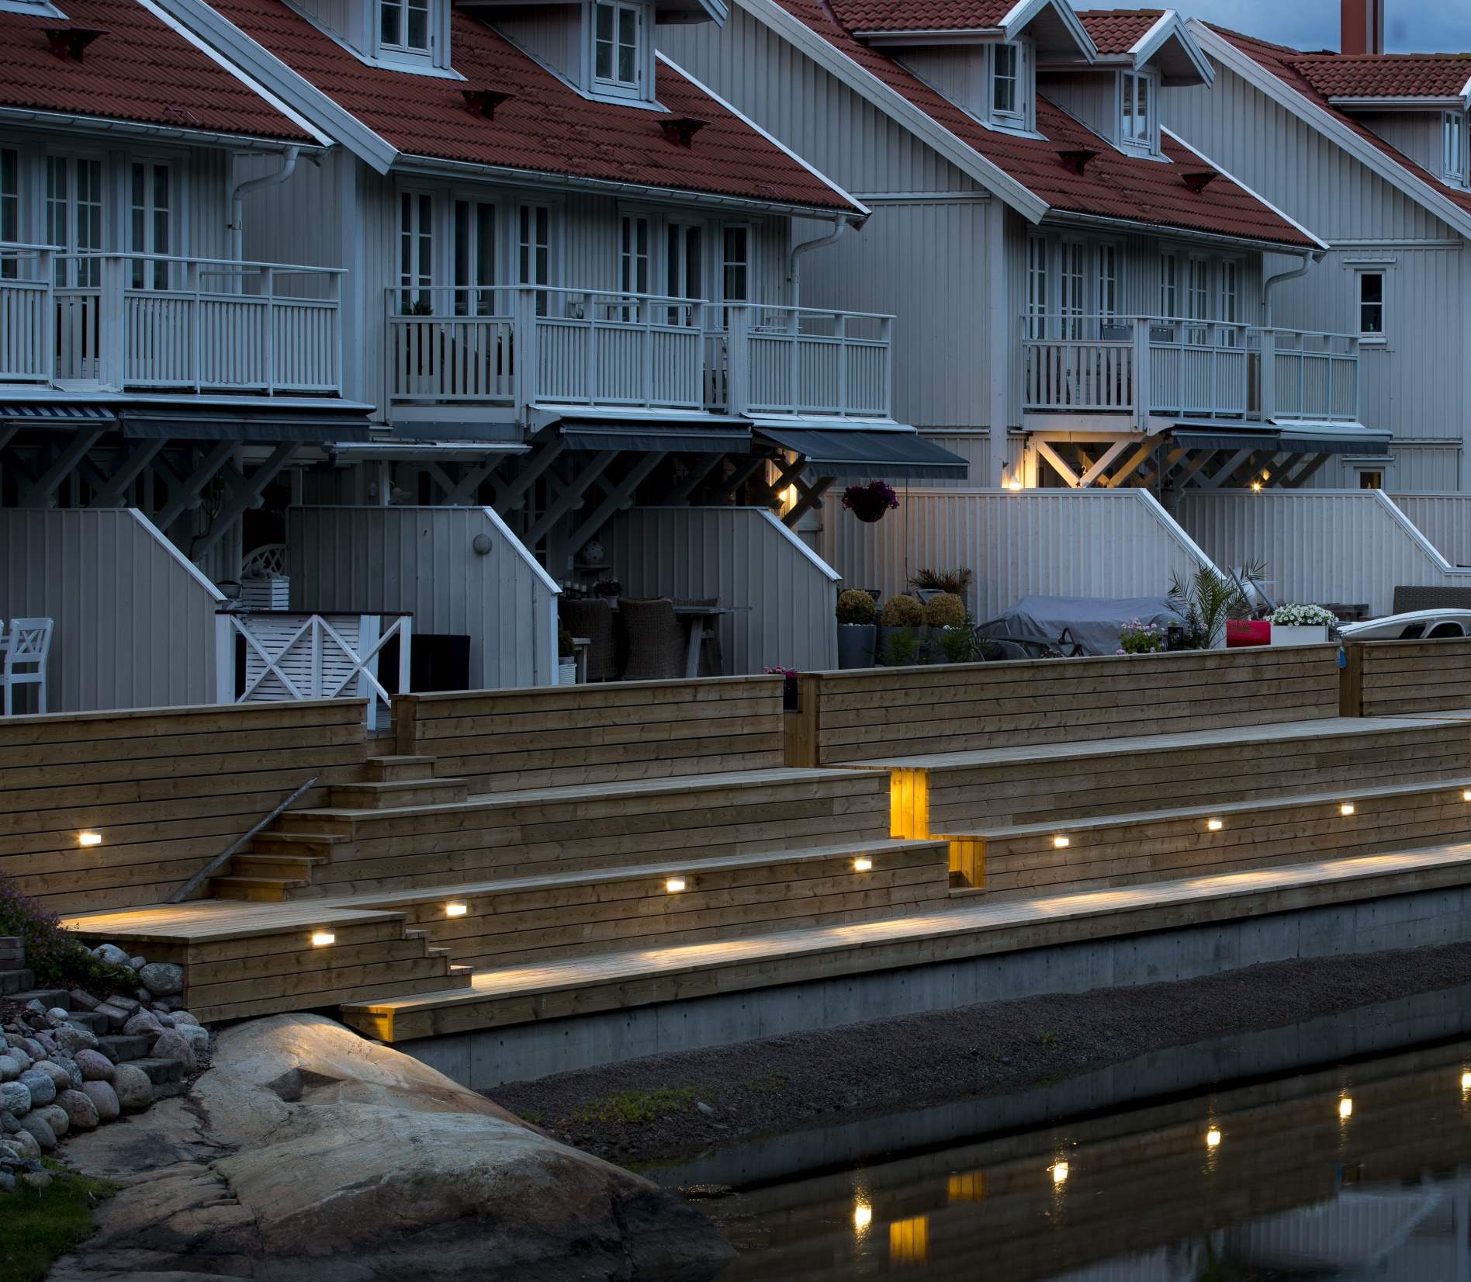
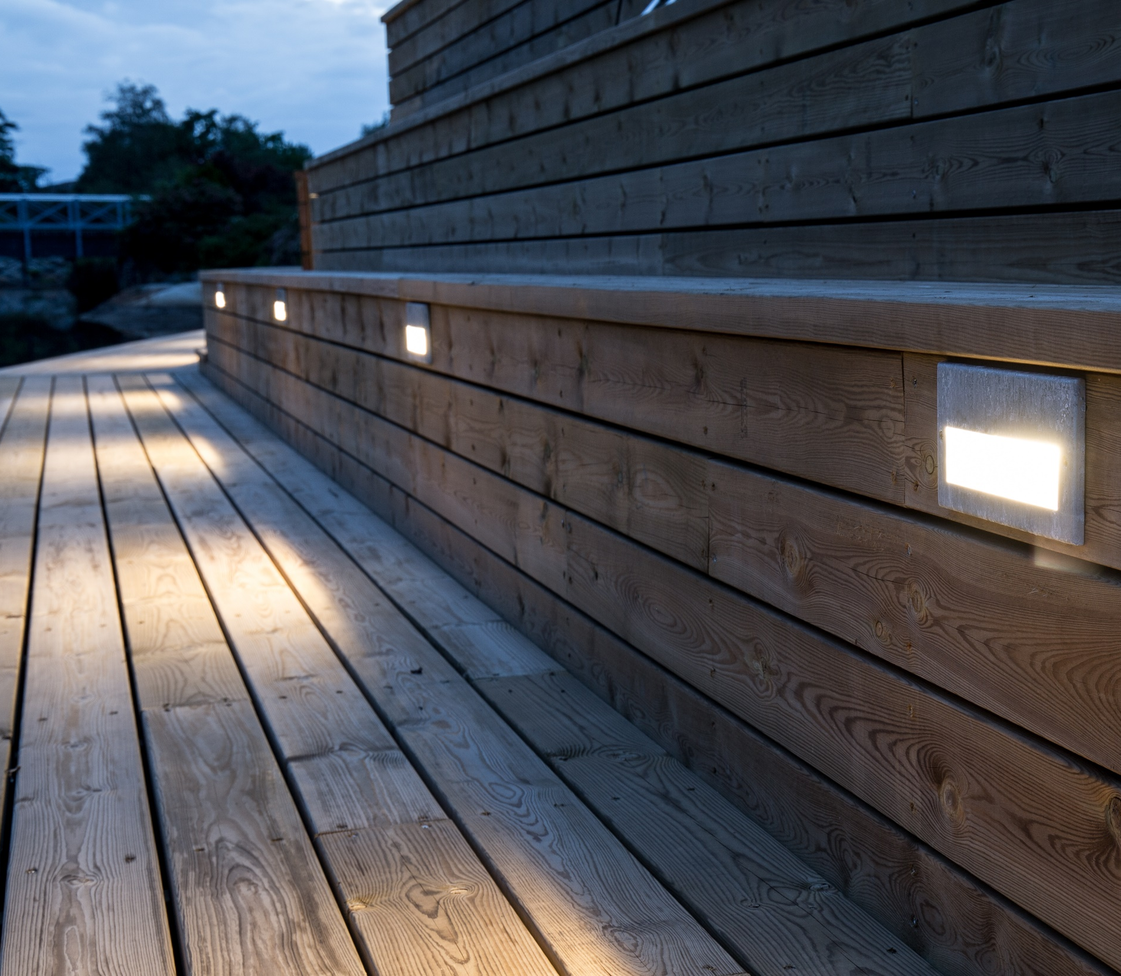
Namsos

Slide 11
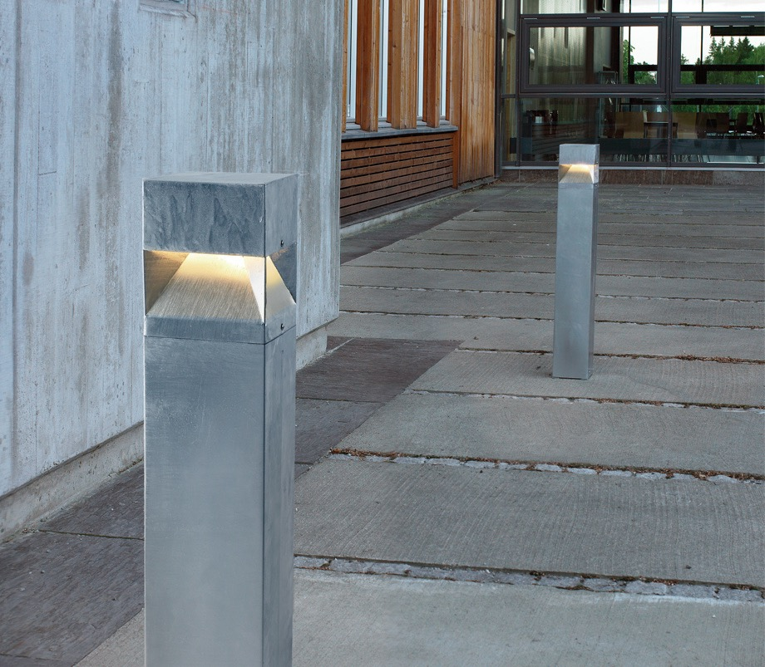
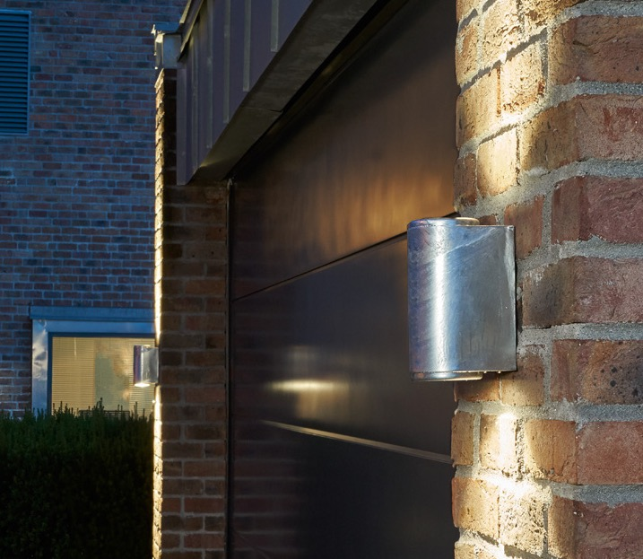
Arvika
Mandal

Slide 12

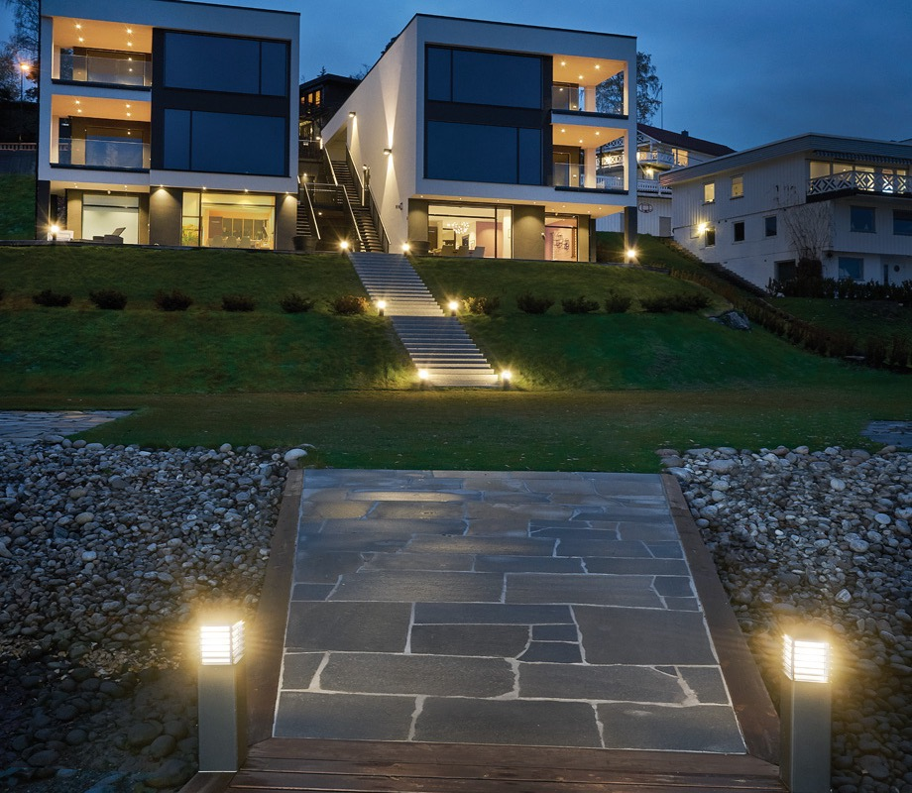
Lund
Halmstad

Slide 13
Thank You

Slide 14


Contact
Norlys AS
Hovfaret 4B, NO-0275 Oslo
P.B 1014 Hoff, NO-0218 Oslo – Norway
info@norlys.com

Slide 15
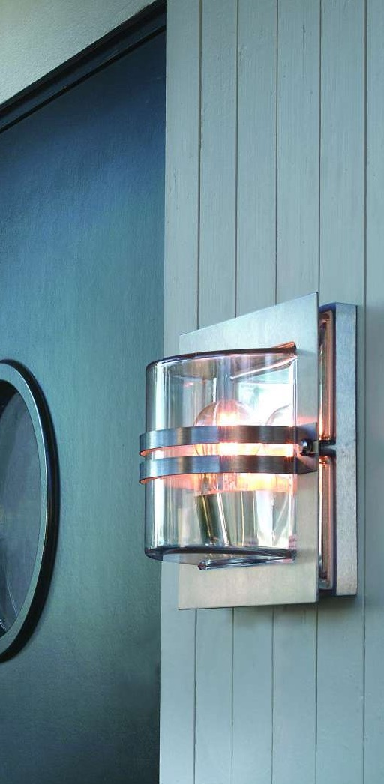
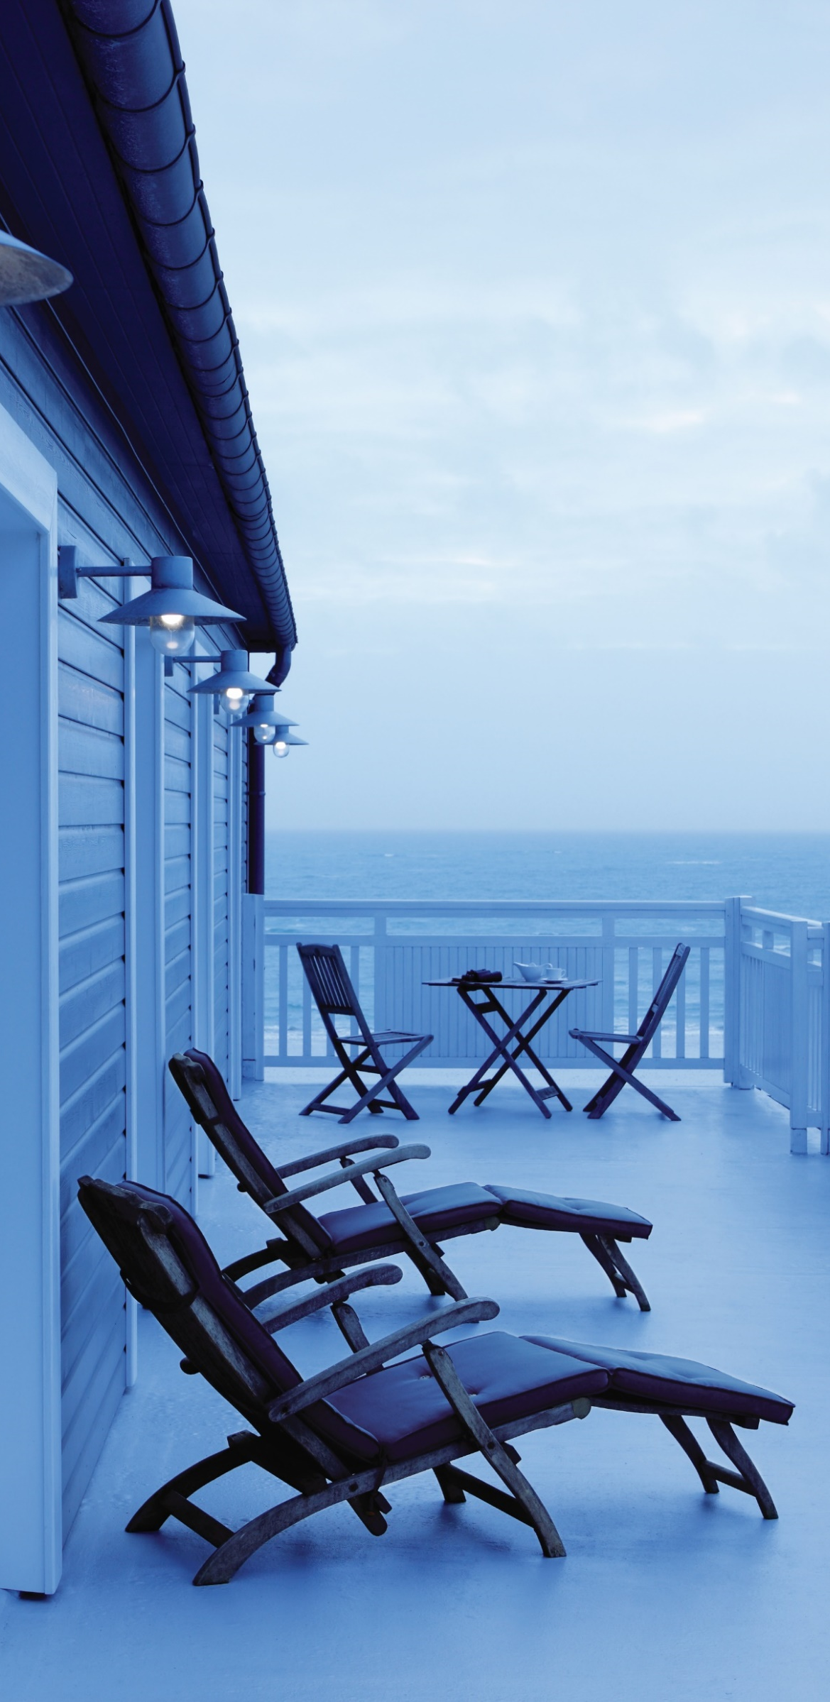
HOT DIP GALVANIZATION
PROCESS – initial stages.
Surface cleaning
Rust removal and surface activation
Applying ‚chemical glue’

Slide 16
HOT DIP GALVANIZATION
PROCESS – the final stage.
Final hot dip galvanization
Once a set of elements are completely dry after the previous stage, they have to be dipped into a bath of melted zinc, which during next minutes, completely covers a surface of processed steel elements. This process effectively locks down sensitive steel surface, providing physical and chemical shield against corrosion.

Slide 17
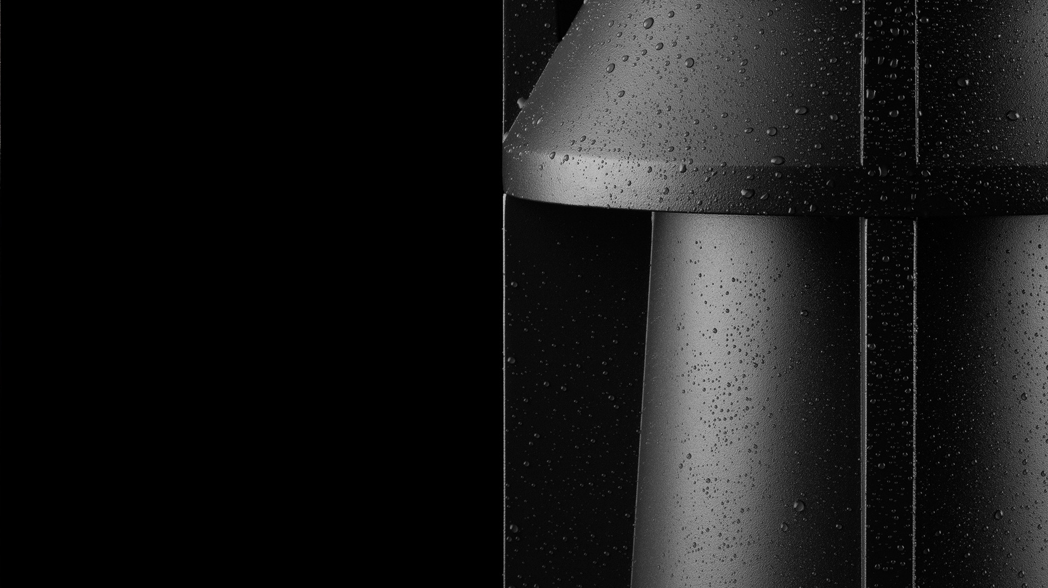

COASTAL ZONE products.
/surface protection/

